Slide 1
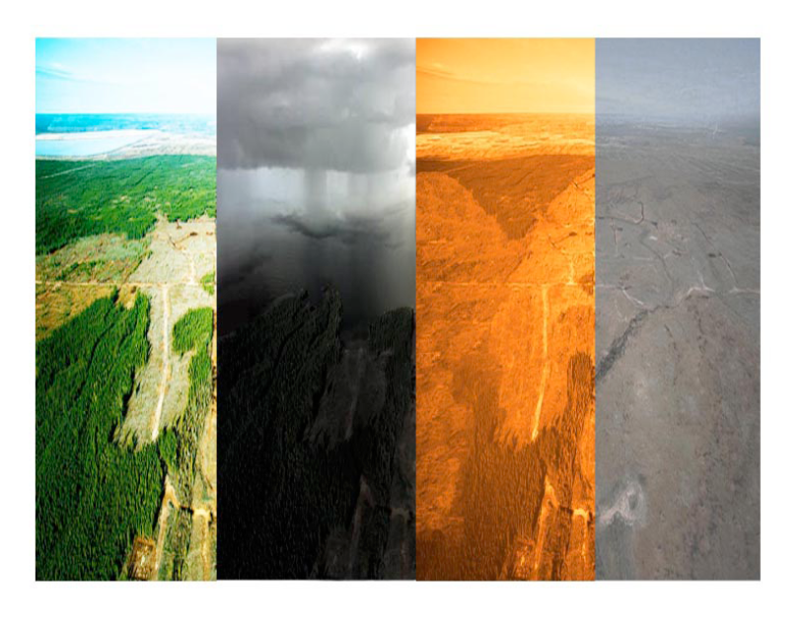
Oluwakemi Izomo

Slide 2
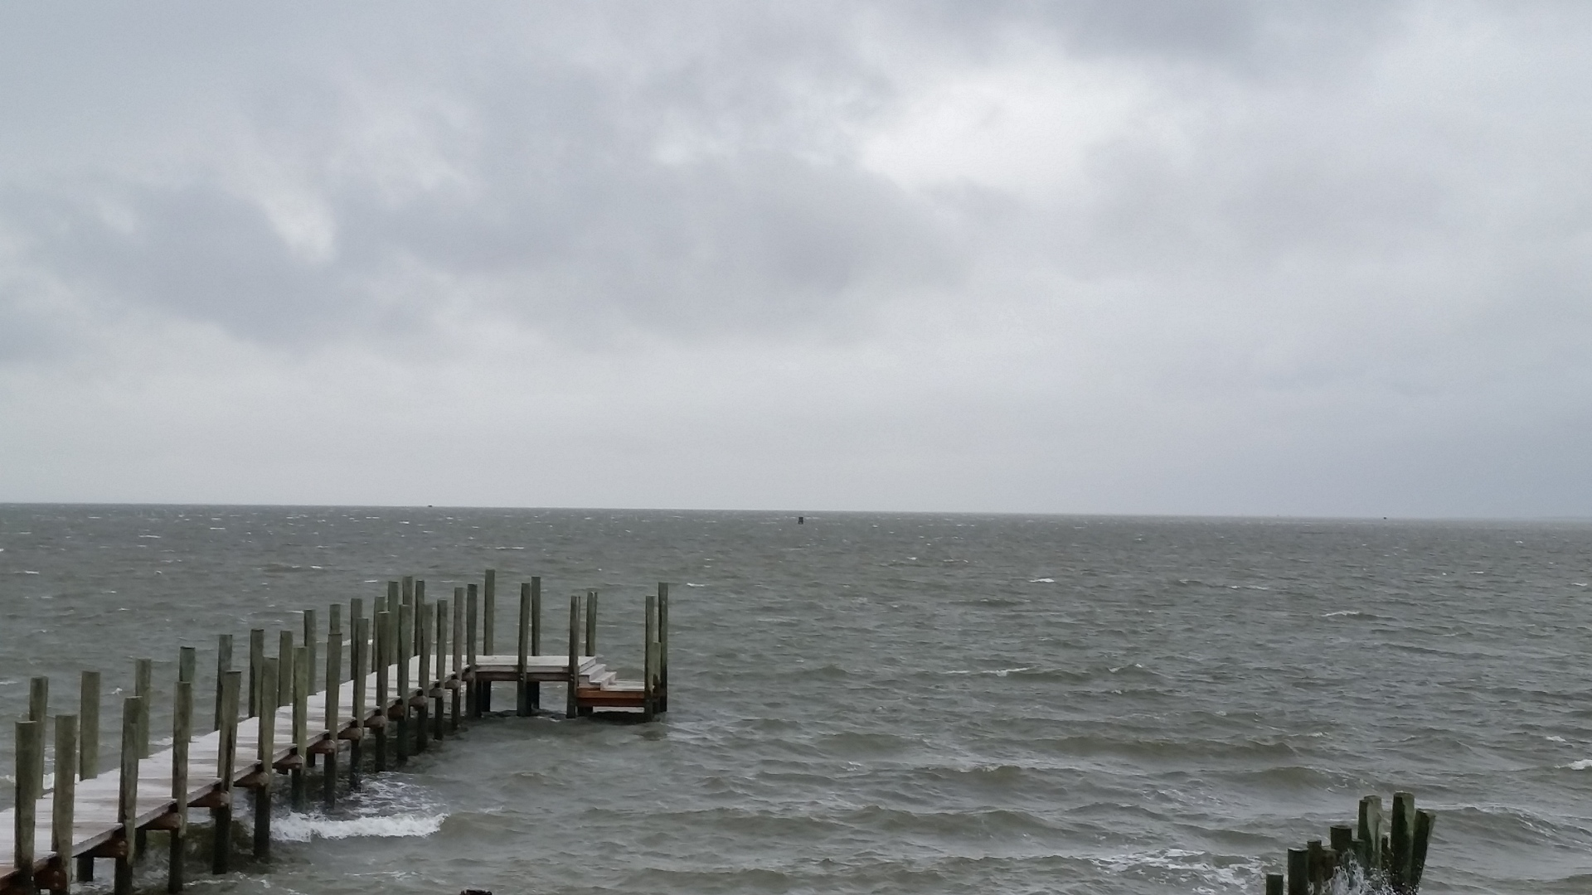
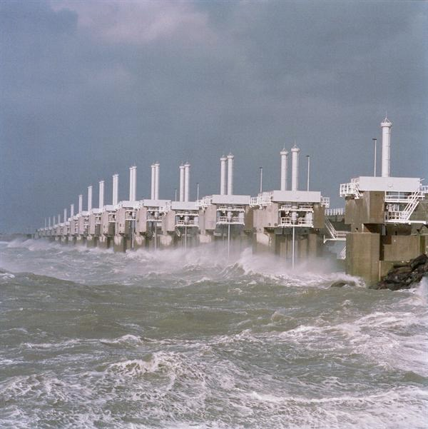
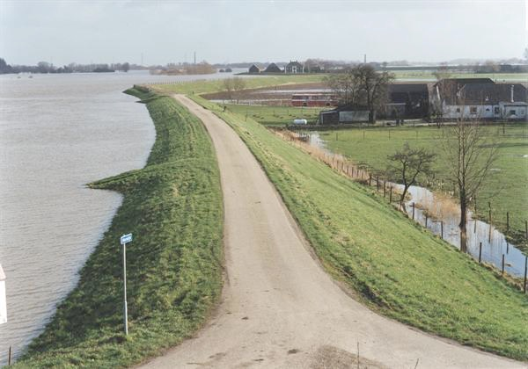
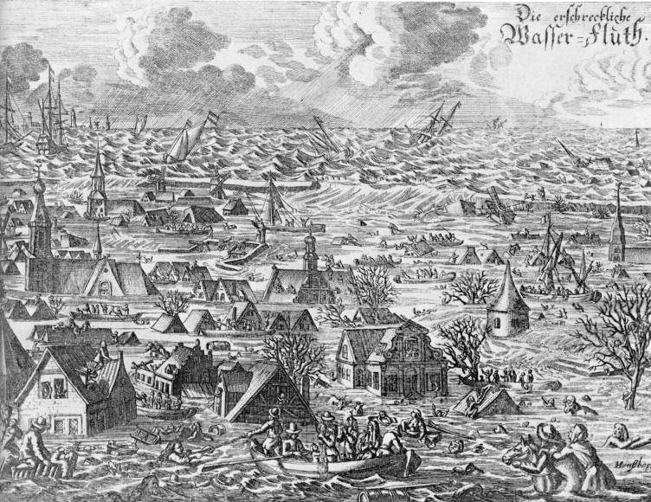
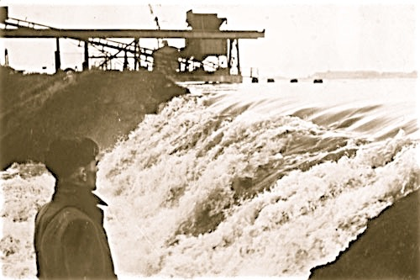
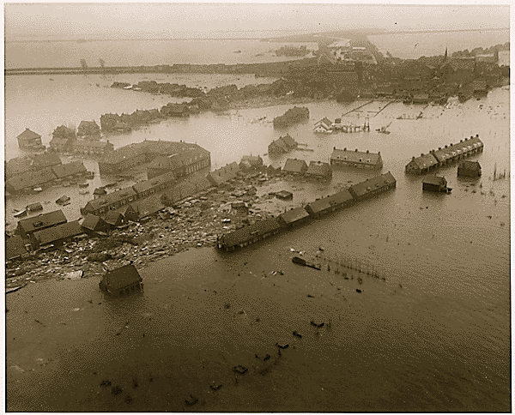
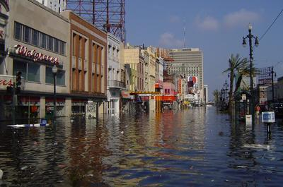
1 or 2 meters of sea level rise …
5, 10, 20, ... meters …
The Baseline: Past Climate and Sea Level Changes
The Syndrome: Recent Climate and Global Changes
The Diagnosis: Leaving the “safe operating space”
The Prognosis: Anticipating Surprises
The Therapy: “Lifestyle” changes
Hans-Peter Plag
April 7, 2015

Slide 3
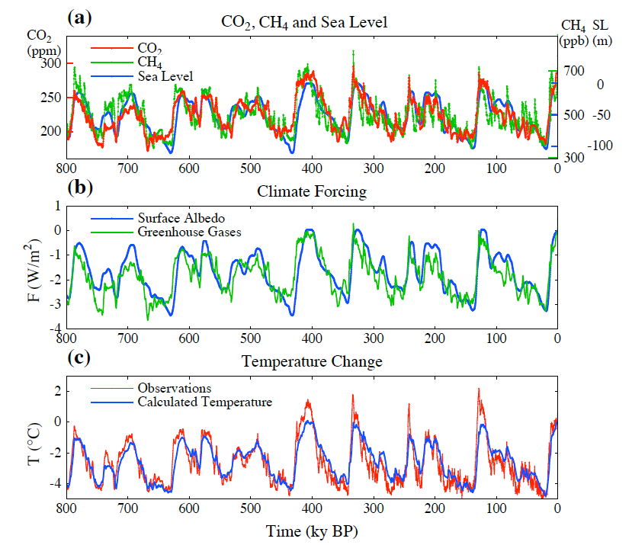
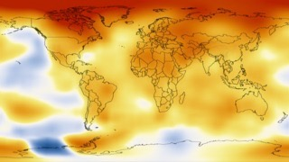
Climate Change is a long-term shift in the statistics of weather - averages, frequency and magnitude of extremes.
Climate is determined by:
incoming radiation (sun)
reflected radiation (albedo)
retained heat (Greenhouse gases)
The Baseline: Past Climate and Sea Level Changes
Temperature anomaly 2008-2012 compared to 1900
Climate can change from local to global scales.
Climate can change a lot over time.

Slide 4
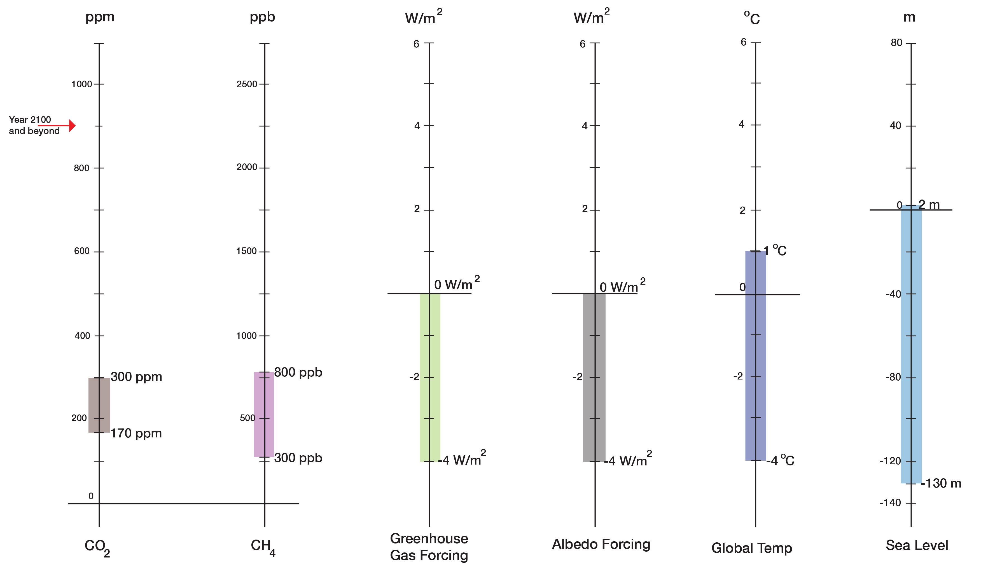
Long-term (centuries to millennia) correlations:
130 ppm CO2 <=> 5ºC
130 ppm CO2 <=> 130 m in sea level
Normal Range up to 1900

Slide 5
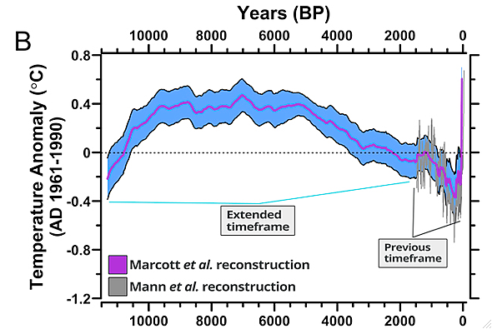
The “Safe Operating Space”
<------------Holocene------------->
11,700
today
Marcott et al., 2013

Slide 6
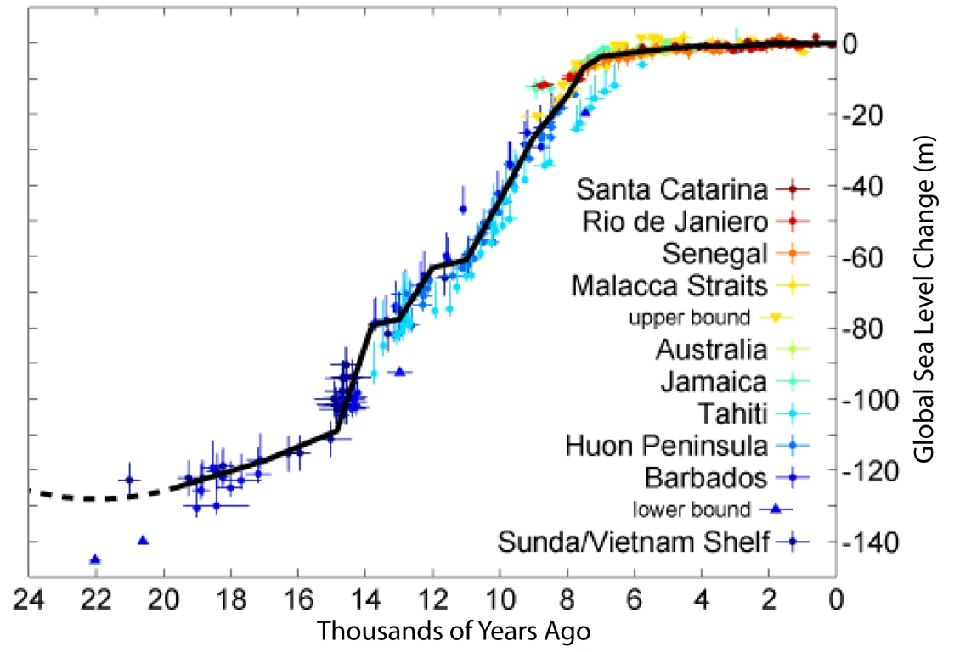
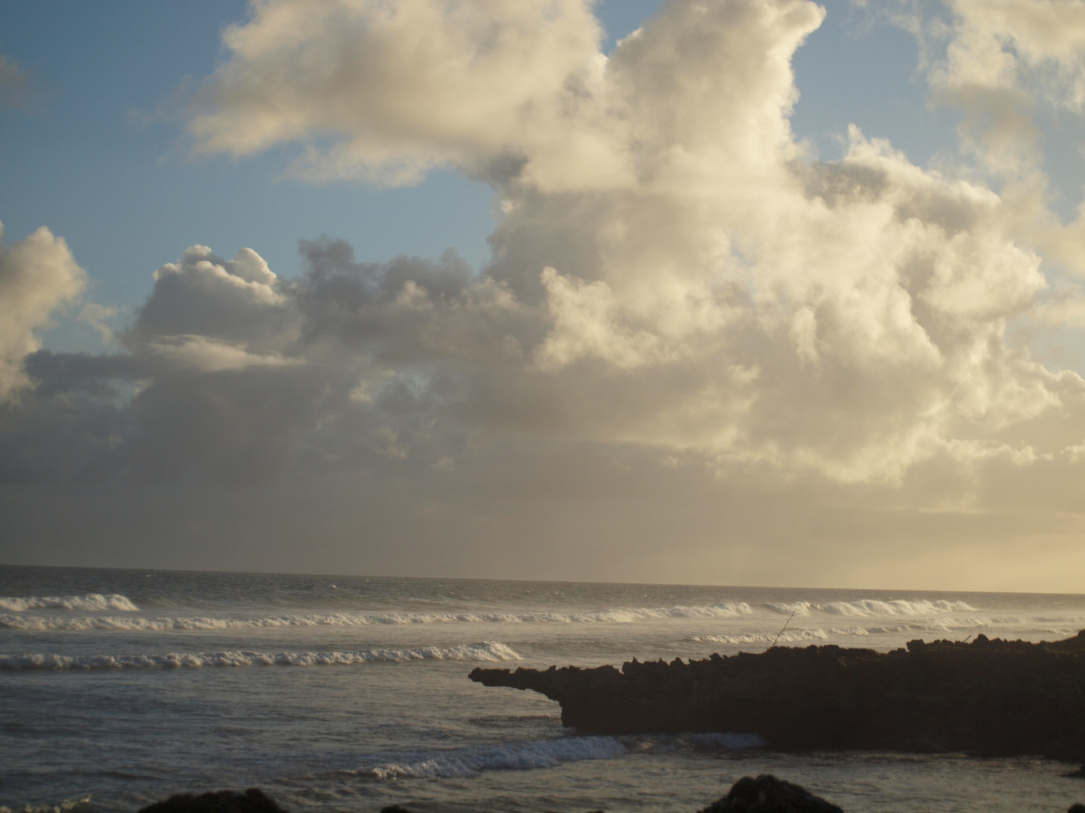
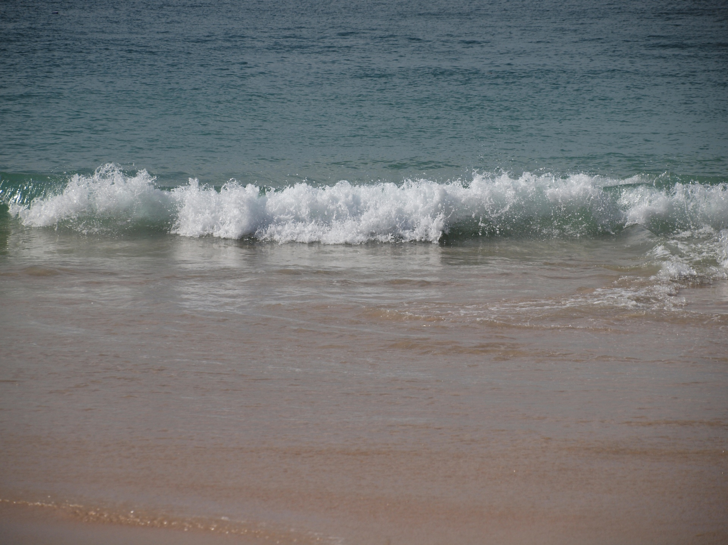
Global and Local Sea Level Changes
20,000 years ago, sea level in Northern America and Scandinavia was up to 600 m higher than today, and in some other location 200 m lower
<---Holocene-->
Local Sea Level changes can be much larger than the global average changes.
During the last 7,000 years, global (and local) sea level was exceptionally stable
Sea Level changes can be much larger than what we know from our history.

Slide 7
The Holocene had unusually stable climate and sea levels; a perfect condition for the development of civilizations.

Slide 8
Global Temperature Changes
Global Sea Level Changes
<--Holocene-->
<------------Holocene------------>
The Baseline for Civilization:
During the Holocene, climate, global temperature, and sea level were exceptionally stable; a perfect condition for the development of civilization.
The Holocene was a “safe operating space for humanity”
Marcott et al., 2013

Slide 9
During the Holocene, climate and sea level were exceptionally stable
The Holocene was a “safe operating space for humanity”

Slide 10
The Syndrome: Recent Climate (and Global) Changes
Temperature 2008-2012 compared to 1900

Slide 11
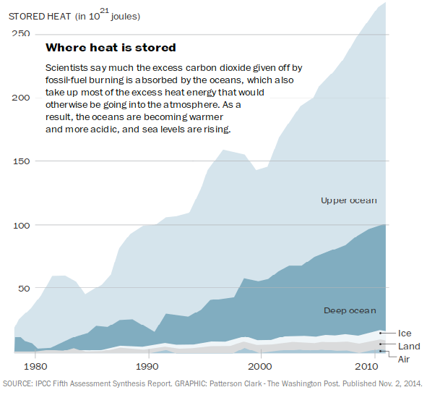
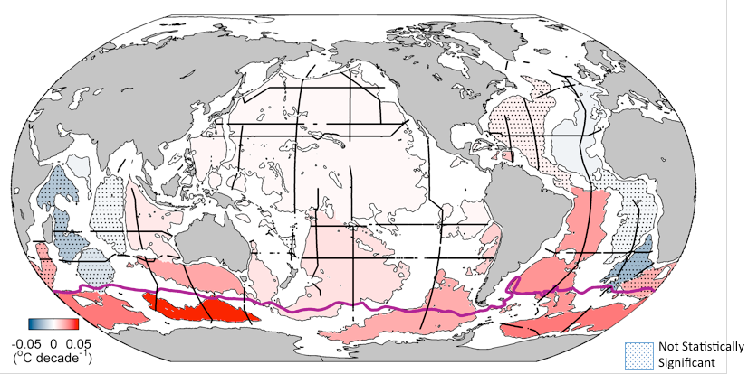
Heat storage:
Air

Slide 12
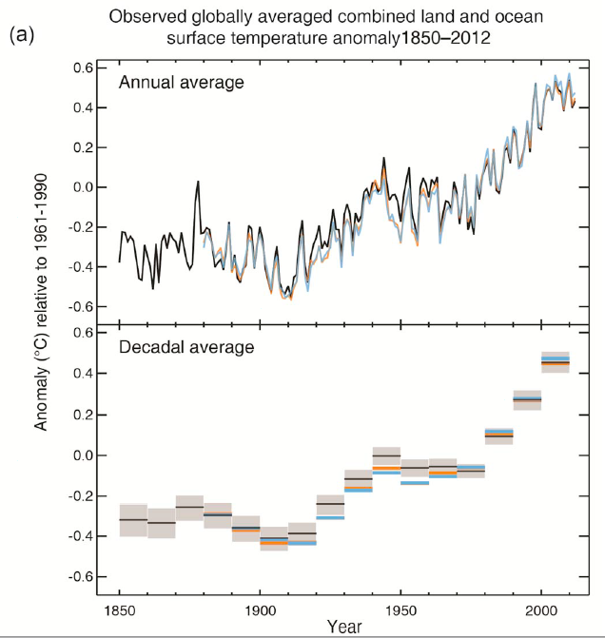
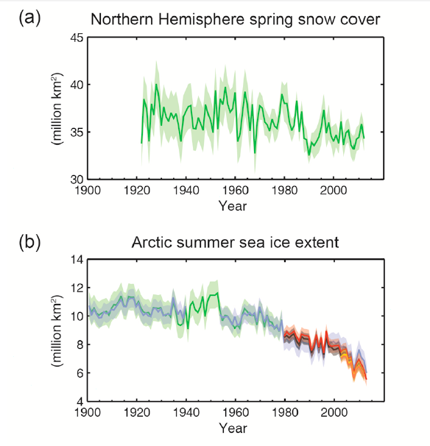
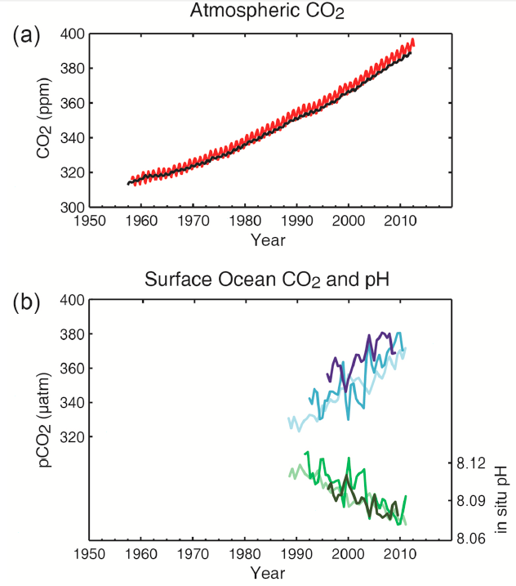
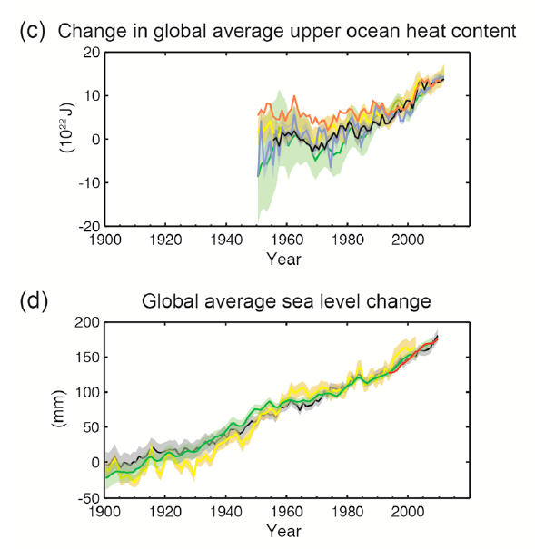
Snow Cover
Temperature
Sea Ice
Upper Ocean Heat
Sea Level
IPCC, 2013

Slide 13
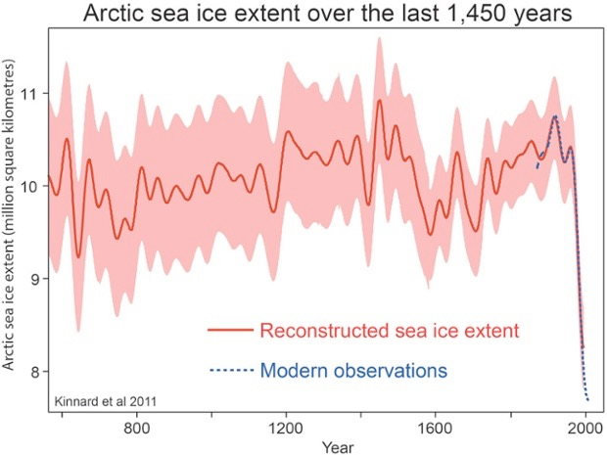
Marcott et al., 2013
Kinnart et al., 2011

Slide 14
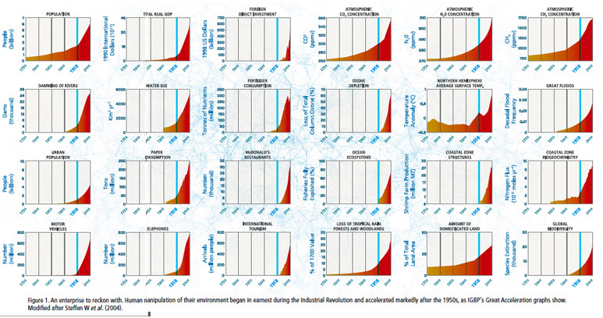
Population
GDP
CO2
CH4
1750
2000
Temperature
Floods
We are Reengineering the Planet ...
McDonald’s
Cars
Deforestation
Extinction

Slide 15
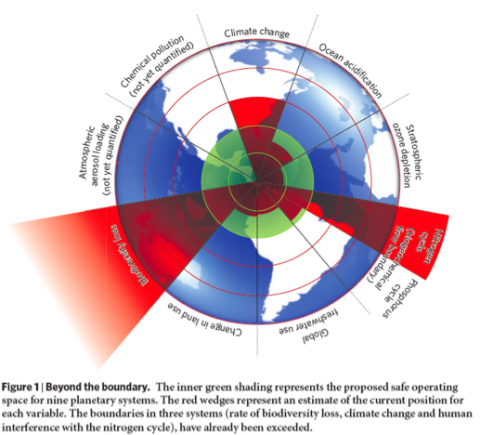
We are moving out of the Holocene and the “safe operating space for humanity” (Rockstroem et al., 2009):
Climate Change (***)
Ocean acidification (**)
Stratospheric ozone depletion (*)
Nitrogen (******) and Phosphorous cycles (**)
Global freshwater (*)
Change in land use (*)
Biodiversity loss (*******)
Atmospheric aerosols (?)
Chemical pollution (?)
Climate change and sea level rise are symptoms, not the cause,
the “sickness.”

Slide 16
Humanity is in the “Emergency Room”
Best news from the Emergency Room?
“The patient is stable”
Holocene
The Syndrome: Recent Climate (and Global) Changes
20th and 21st Century
Future

Slide 17
“What would you like to tell your 20 year old self?”
If you are 20 years old today, and if you die prematurely, the most like cause of this is one or another impact of climate/global change.

Slide 18
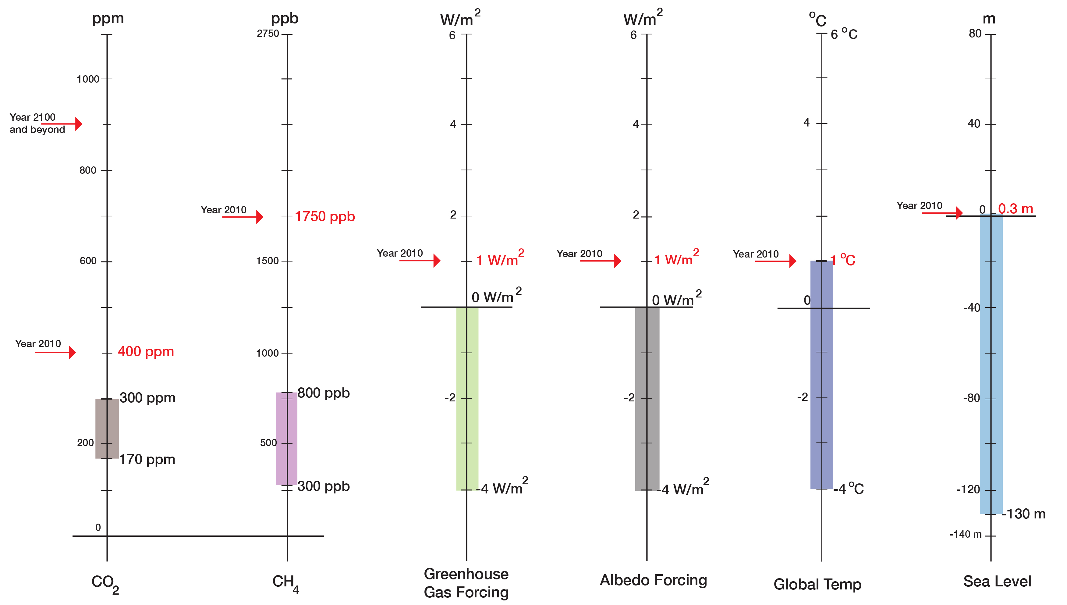
“Current State”
“Normal Range”
(800,000 years)

Slide 19
During the Holocene, climate and sea level were exceptionally stable
The Holocene was a “safe operating space for humanity”
During the last hundred years, we have introduced rapid and large changes
The system is already now outside the “normal range” and in the transition to the Post-Holocene

Slide 20
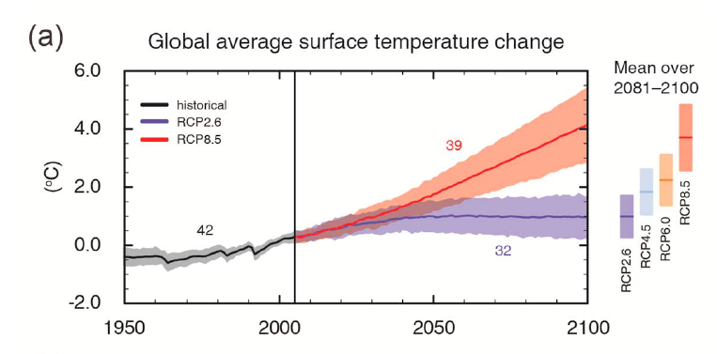
The Prognosis: Anticipating Surprises
IPCC, 2013

Slide 21
}
4
<--Post-Holocene
3
IPCC Assessment:
Very Likely by 2100
2
o
1 C
<--Holocene--->
Marcott et al., 2013

Slide 22
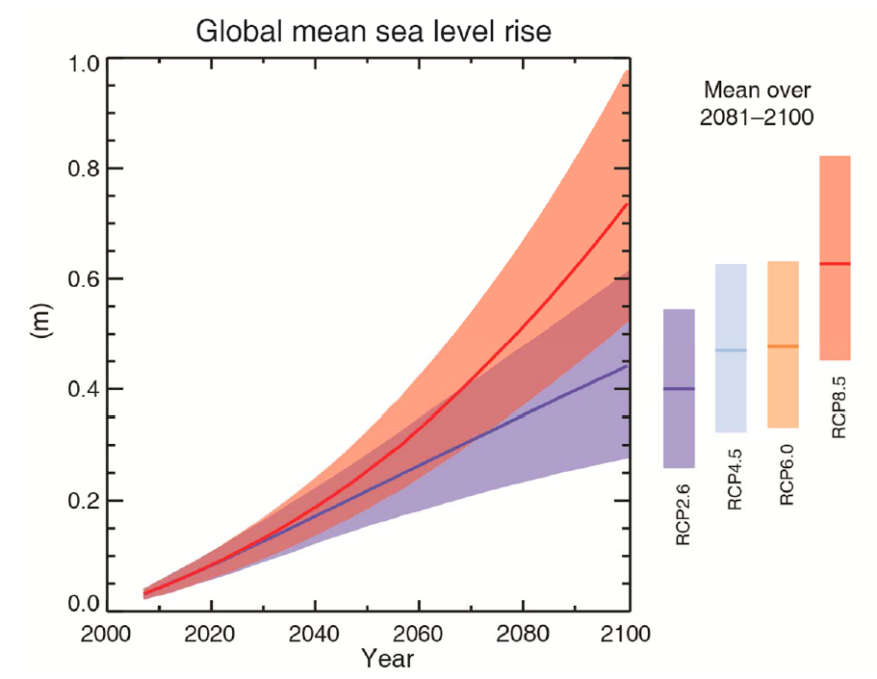
Note: No accelerated contribution from Greenland and Antarctic ice sheets consider
IPCC, 2013
Modified from Church et al. (2010)

Slide 23
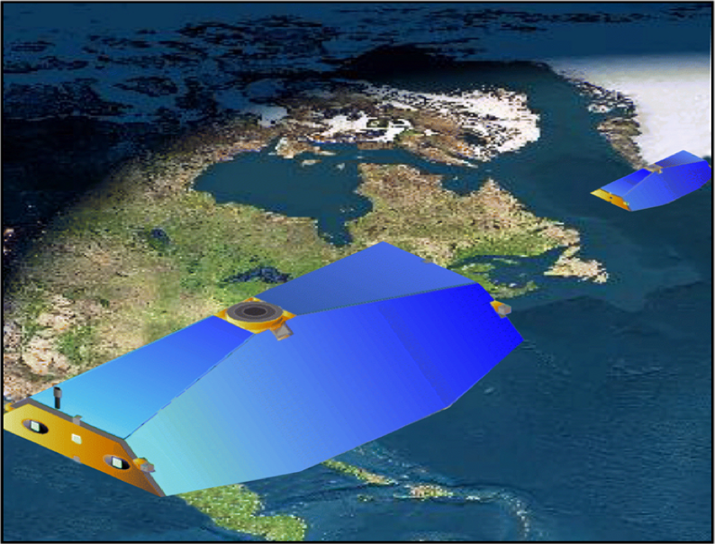
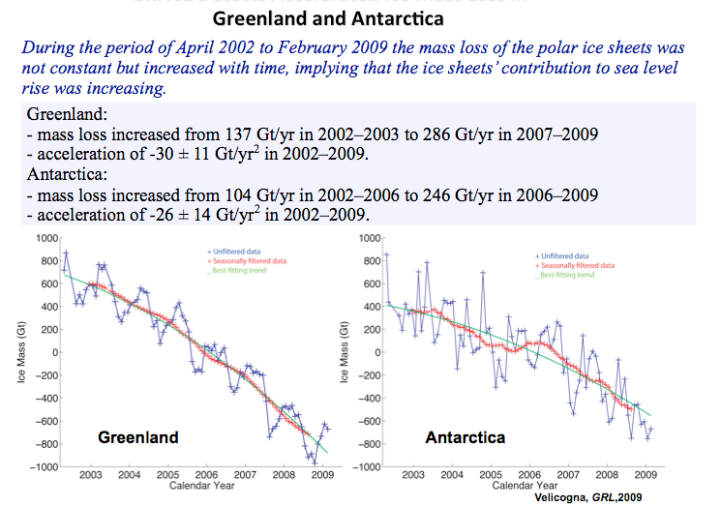
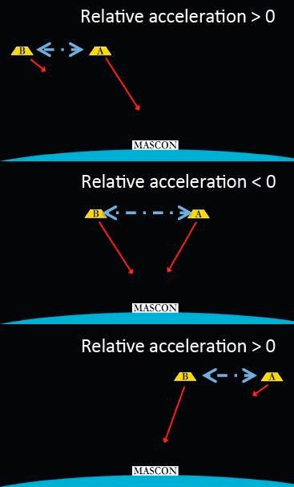
Example: Greenland and Antarctic Ice Sheets
Accepted knowledge in 2000:
Greenland: no significant contribution to sea level rise
Antarctica: minor contribution
Main contribution: steric changes
Gravity Recovery and Climate Experiment (GRACE)

Slide 24
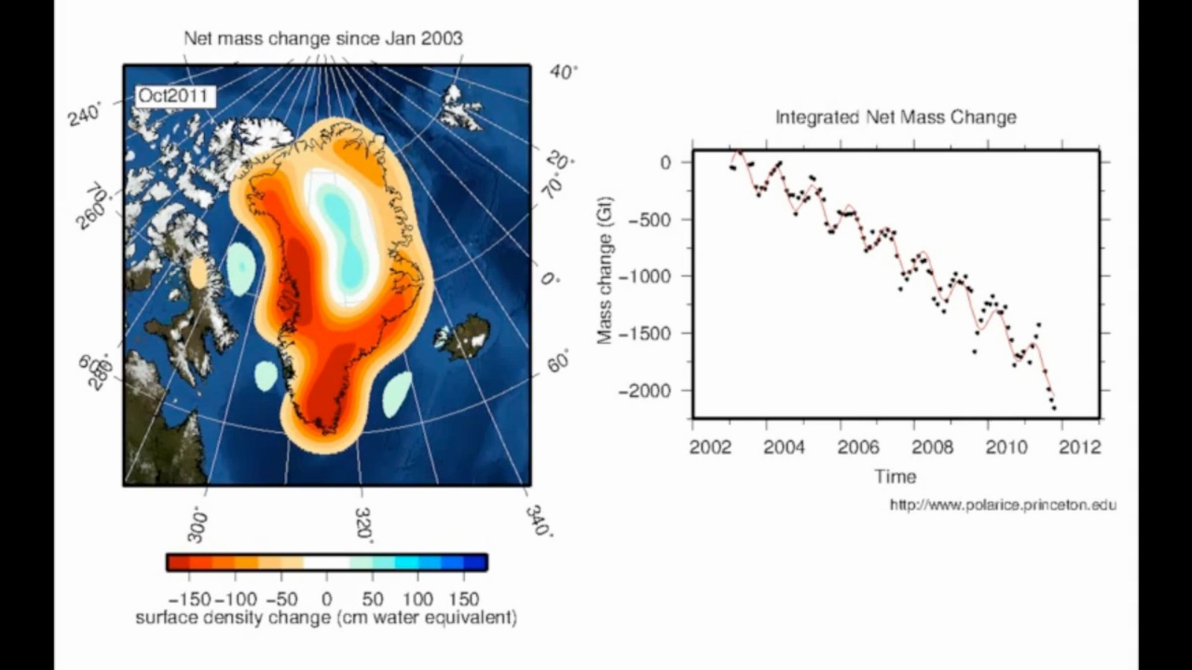
The last 12 years of observing the ice sheets have revealed many surprises ...

Slide 25
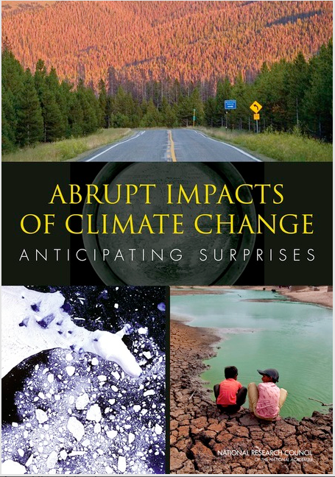
National Research Council in 2013:
There is the potential for surprises and new extremes ...
Already happening: Disappearance of late-summer Arctic sea ice
Elliott, 2015

Slide 26
National Research Council in 2013:
There is the potential for surprises and new extremes ...
Already happening: Disappearance of late-summer Arctic sea ice
Already happening: Increases in extinction threats
Rossman&Marash (2014)

Slide 27
National Research Council in 2013:
There is the potential for surprises and new extremes ...
Already happening: Disappearance of late-summer Arctic sea ice
Already happening: Increases in extinction threats
Disruption of Atlantic Meridional Overturning Circulation: unlikely in the 21st century; but gradual chance could have severe consequences
Greenland ice sheet: abrupt changes very unlikely in the 21st century
West Antarctic Ice Sheet: up to 4.8 m sea level rise; abrupt changes unlikely in the 21st century
Most likely (low-probability) rapid impact: ocean acidification

Slide 28
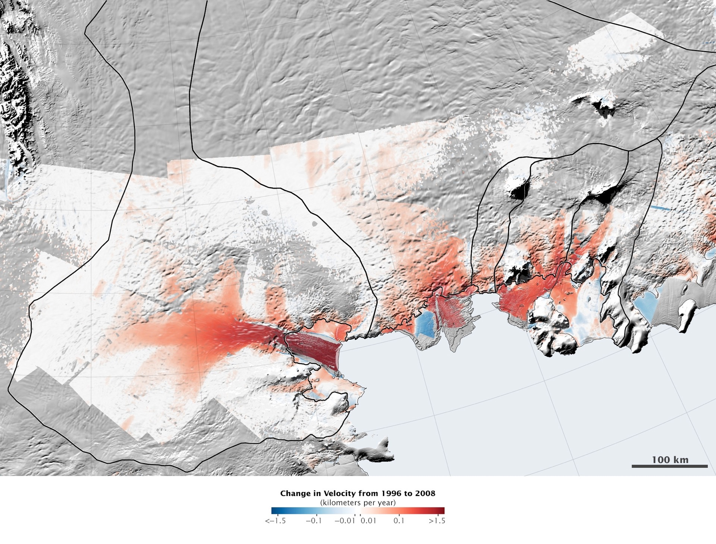
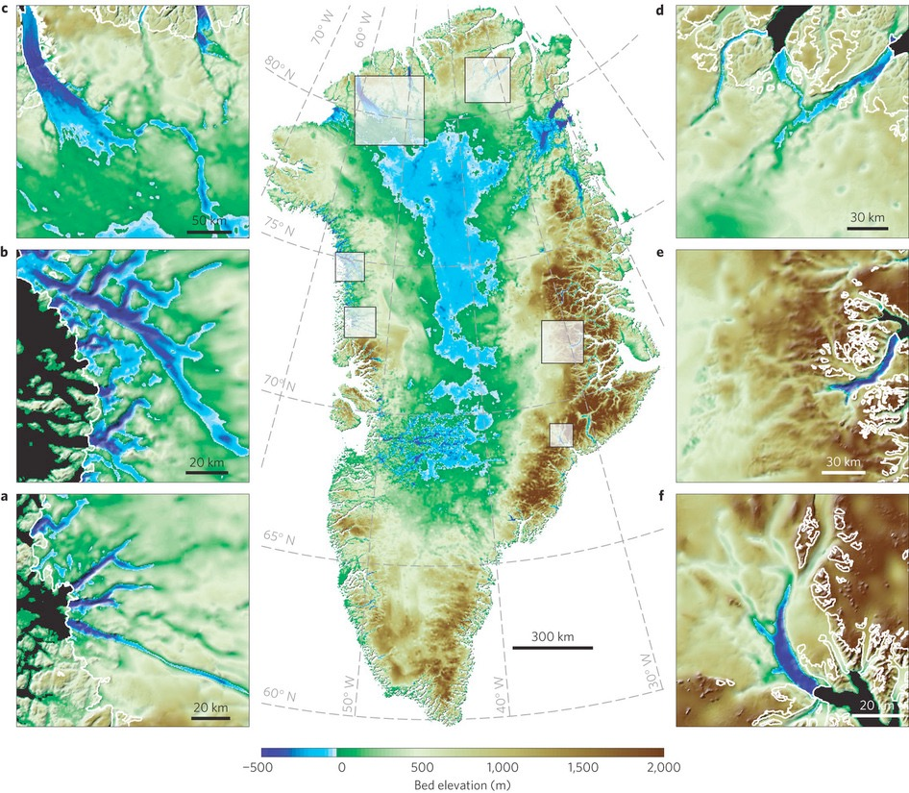
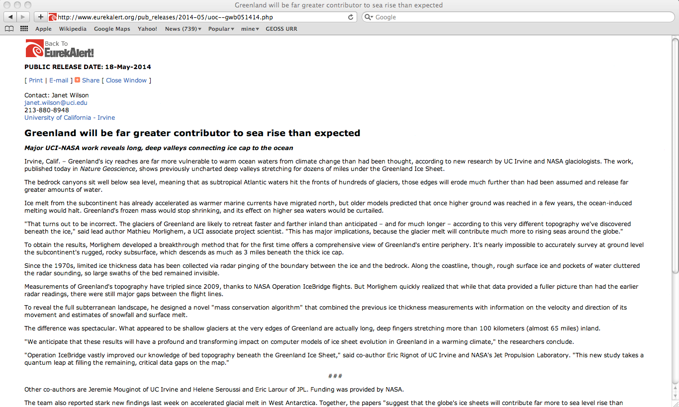
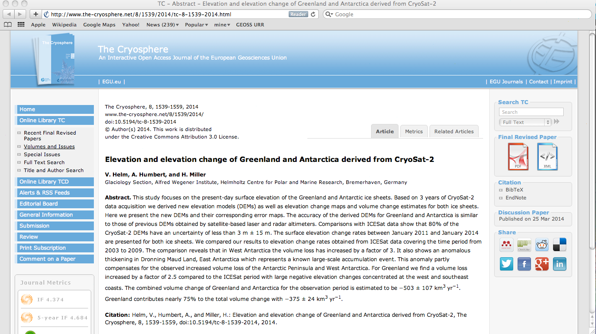
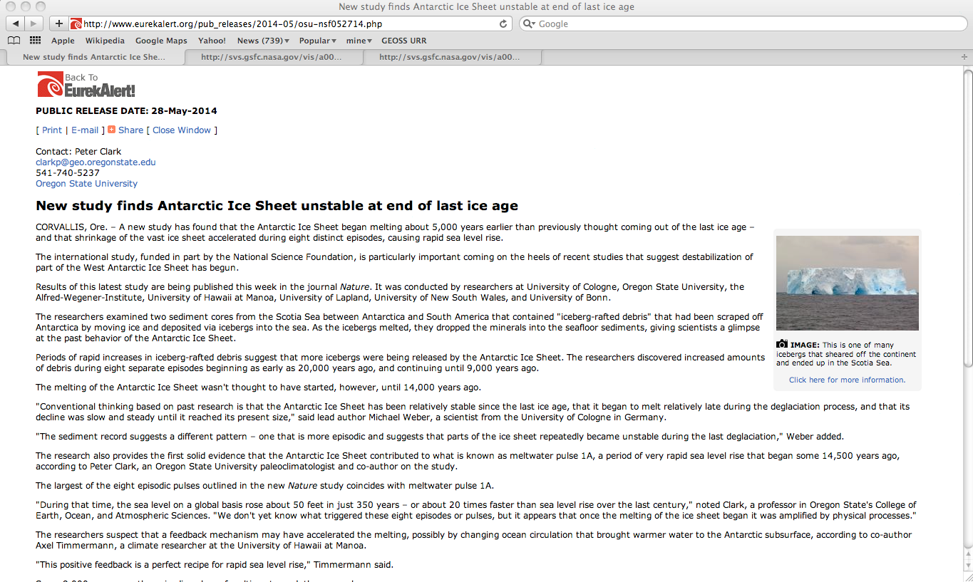
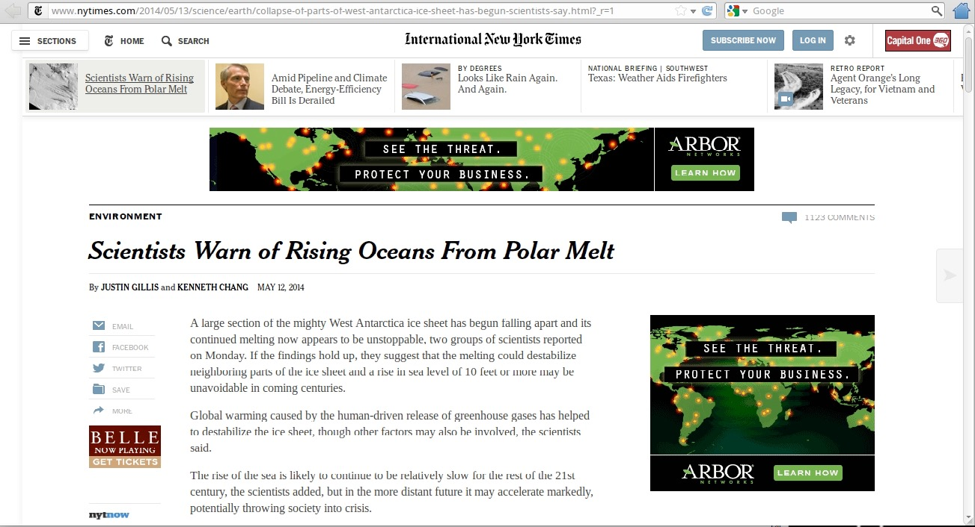
May 12, 2014: A large section of the mighty West Antarctic ice sheet has begun falling apart ... That’s enough ice to raise global sea level by more than 15 ft. (4.6 m)
National Research Council in 2013:
There is the potential for surprises and new extremes ...
May 18, 2014: The glaciers of Greenland are likely to retreat faster and further inland than anticipated ....
September, 2014: The combined volume change of Greenland and Antarctica for the observation period is estimated to be −503 ± 107 km³ yr⁻¹. Greenland contributes nearly 75% to the total volume change with −375 ± 24 km³ yr⁻¹
May 28, 2014: During that time, the sea level on a global basis rose about 50 feet in just 350 years

Slide 29
WAIS Contribution to Global Sea Level
Accepted knowledge in 2000:
Greenland: no significant contribution to sea level rise
Antarctica: minor contribution
Main contribution: steric changes
4.5 m
Knowledge in 2014:
Greenland: is contributing, is accelerating, potentially a large contribution to sea level rise
Antarctica: West Antarctic ice sheet (WAIS) will contribute 4.5 m
800 Years?
100 Years?
How worried should we be?

Slide 30
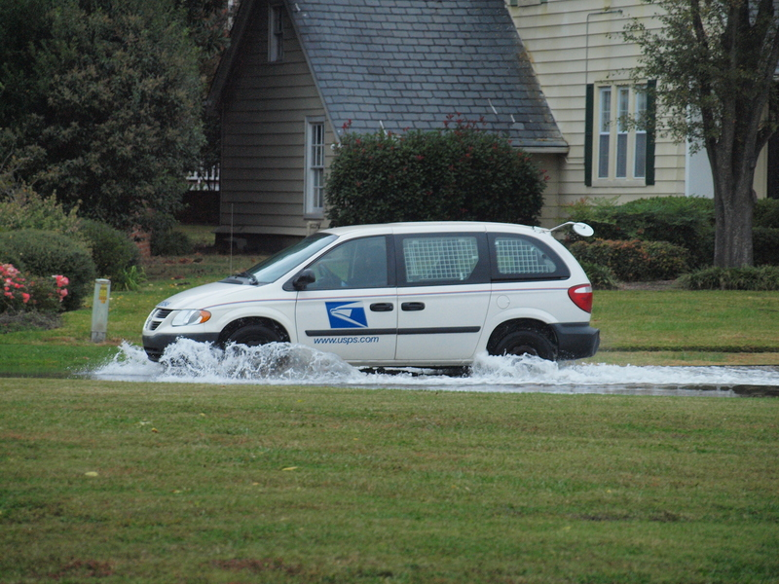
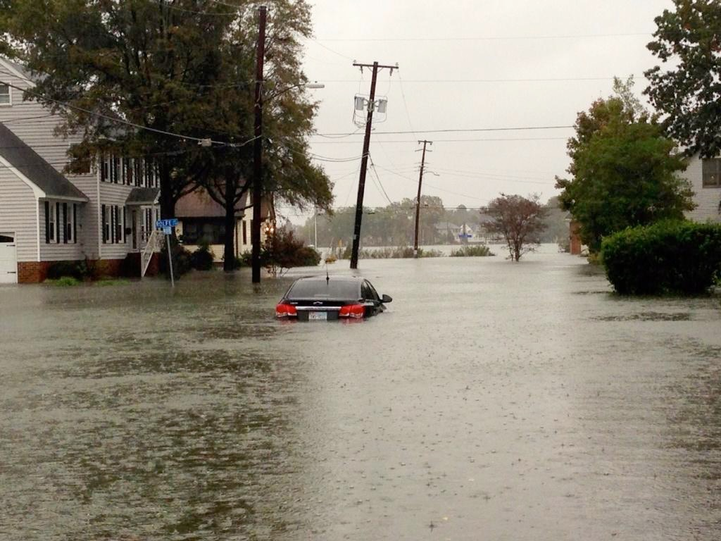
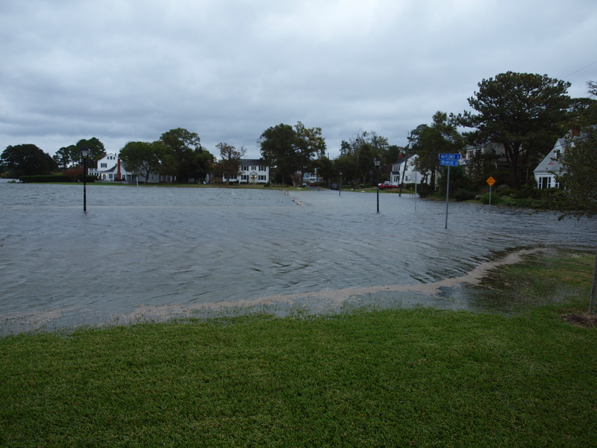
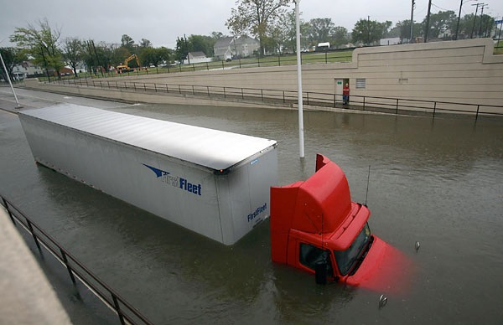
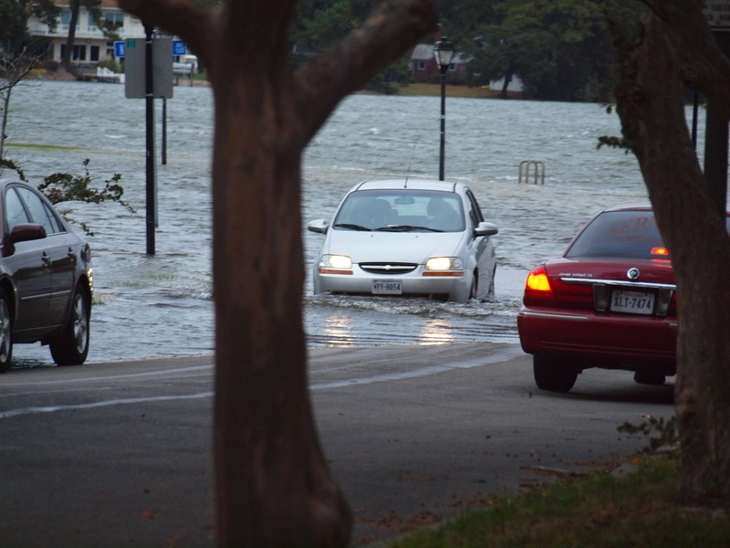
Example Hampton Roads
Today: 5 mm/year
(~1.5 feet/century)
Soon could get as high as:
20 mm/year (~6 feet/century)
Local Sea Level Rise leads to:
- more nuisance flooding
- higher risk of extreme floods
- a transient coast line
Modified from Church et al. (2010)

Slide 31
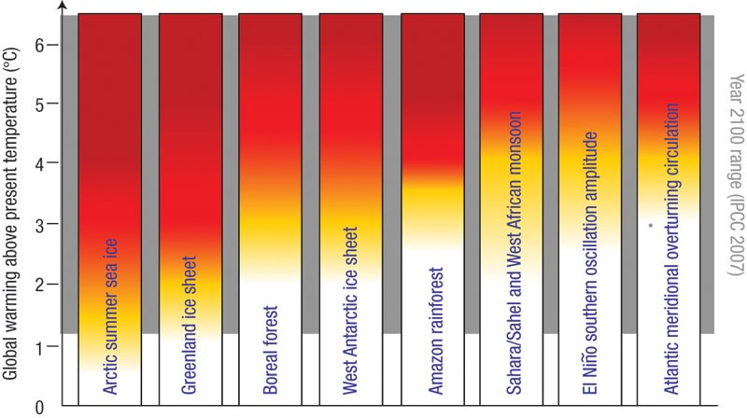
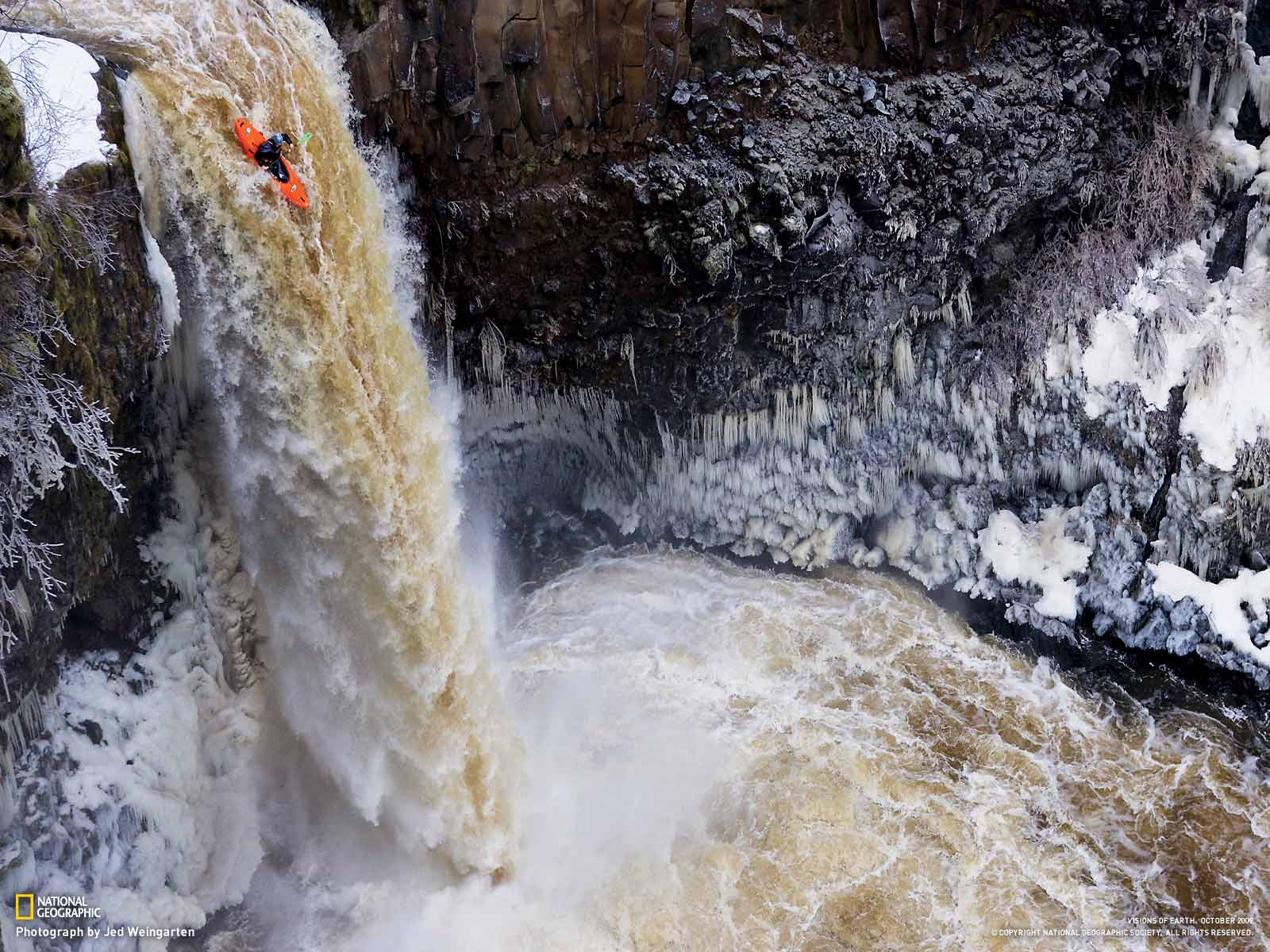
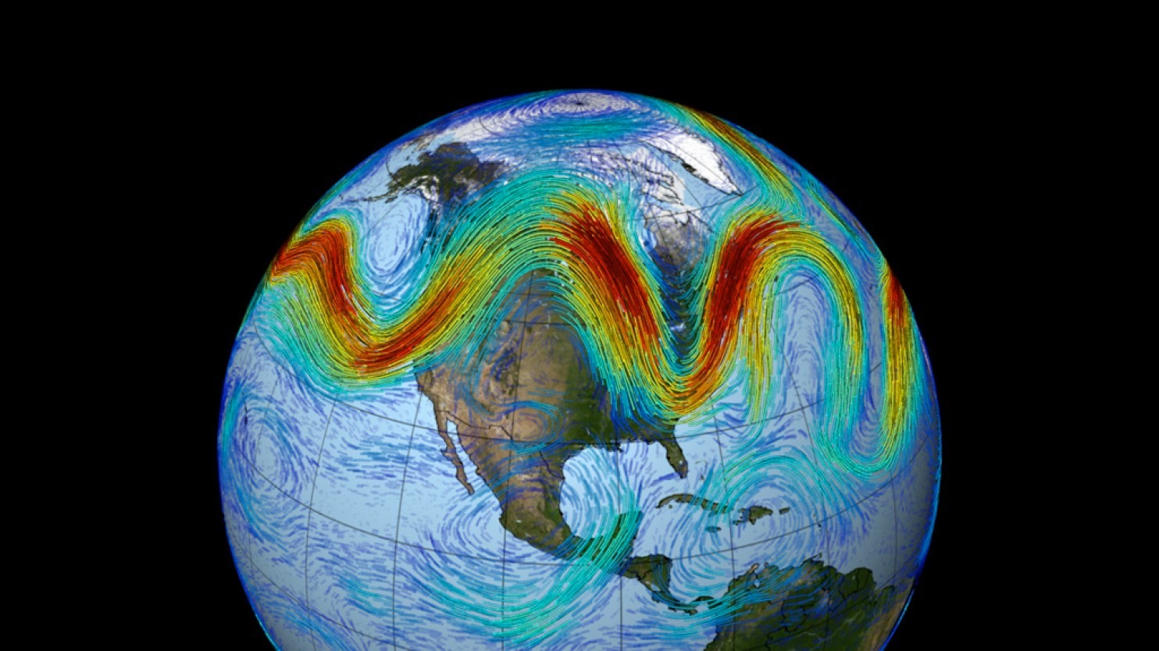
Understanding thresholds
The threshold is not where the boat goes over the edge, it is far up the river, when the people in the boat lose the option to get to the shore
On a big, unknown river, don’t go into the middle, stay close to the shore
Jim White
Many thresholds, including climate change related ones …
Lenton & Schellnhuber (2007) Nature Reports Climate Change
The warming of the Arctic could be a threshold we have crossed ...

Slide 32
Understanding thresholds
The threshold is not where the boat goes over the edge, it is far up the river, when the people in the boat lose the option to get to the shore
On a big, unknown river, don’t go into the middle, stay close to the shore
Jim White
Many thresholds, including climate change related ones …
Lenton & Schellnhuber (2007) Nature Reports Climate Change
The warming of the Arctic could be a threshold we have crossed ...

Slide 33
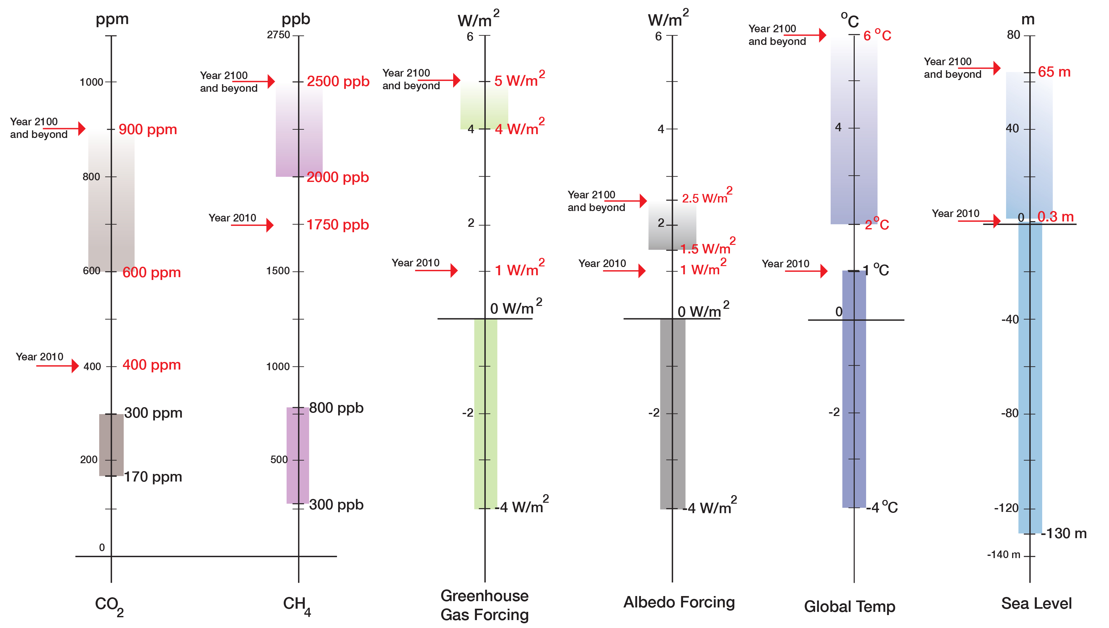
“Prognosis”
“Current State”
“Normal Range”
(800,000 years)

Slide 34
Our Commitment: The “>400 ppm CO2 World”:
Example: Pliocene, 5 to 3 Million Years ago
Temperature: 3 to 4ºC higher
Sea level: 5 to 40 m higher; global average on the order of 25 m higher than today

Slide 35
During the Holocene, climate and sea level were exceptionally stable
The Holocene was a “safe operating space for humanity”
During the last hundred years, we have introduced rapid and large changes
The system is already now outside the “normal range” and in the transition to the Post-Holocene
Our knowledge is changing very fast and we may not know all thresholds
There is a potential for surprises and we need to be prepared

Slide 36
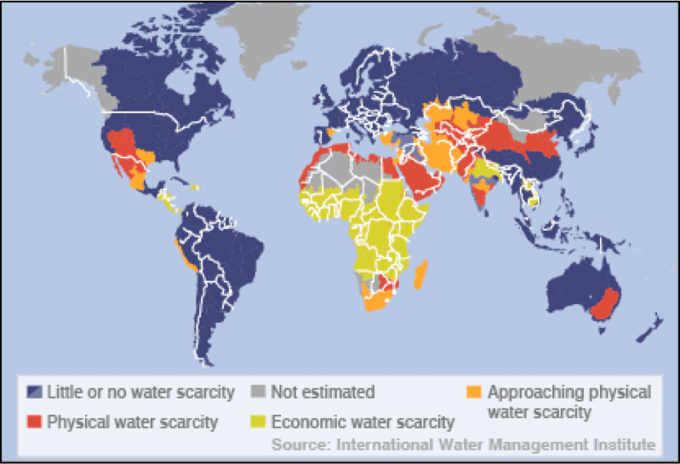
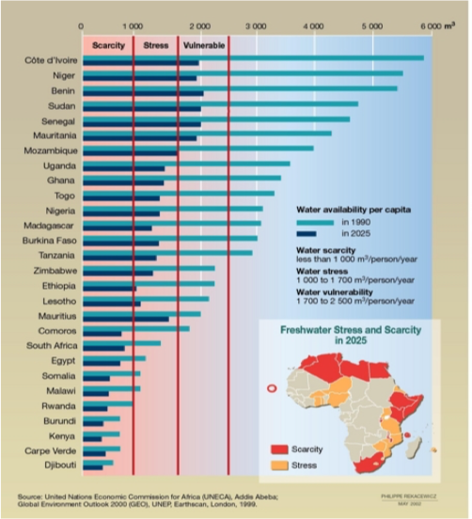
~2005

Slide 37
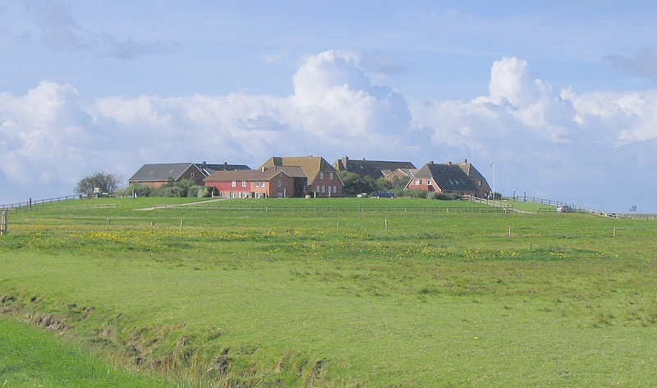
Plan A: Planning and preparing for a (somewhat) predictable future
Choose a range of plausible trajectories (for droughts, heat waves, sea level rise, extreme events, ...)
Determine the range of risks to be reduced based on these trajectories and vulnerabilities
Adapt land use, building codes, protective measures accordingly
Was used around the North Sea in Europe for almost 2,000 years to cope with small changes
The Therapy: “Lifestyle” Changes

Slide 38
Current paradigm:
“Sea level does not change very much, coastal zones change slowly, and the potential for surprises is low.”
New paradigm:
“Sea level may change rapidly and coastal zones can migrate fast.”
Consequence:
be prepared to leave
keep the coastal zone clean and prepared for inundation
have early warning systems in place

Slide 39
Plan B: Preparing for surprises, developing general resilience
Knowing the “worst case” and facilitate adaptation to unpredictable future:
understanding the vulnerabilities and comprehensively assessing the risks
including the worst cases (food, water, heat waves, droughts, storms, sicknesses, social unrest, wars, ...)
having early warning (for extreme events and rapid impacts)
Example of sea level rise:
making room for the water
a built environment for extreme floods (buildings and services)
preparing the coastal zone for future inundation
Living where it is safe,
working where it is needed

Slide 40
To cope with a moving coast line, we need, for example:
- Adaptive infrastructure moving with the coast line;
- Redefine/manage real estate property in the coastal zone;
- Redistribute risk between individuals, communities, states and the country;
- Learn to utilize the benefits of the coastal zone while reduce the risks.

Slide 41
During the Holocene, climate and sea level were exceptionally stable
The Holocene was a “safe operating space for humanity”
During the last hundred years, we have introduced rapid and large changes
The system is already now outside the “normal range” and in the transition to the Post-Holocene
Our knowledge is changing very fast and we may not know all thresholds
There is a potential for surprises and we need to be prepared
A paradigm shift is needed from“Sea level does not change very and changes in the coastal zone are gradual” to “Sea level can change fast and coastal zones can migrate rapidly.”
While utilizing the benefits of being close to the sea, we need to be prepare to move with the coastal zone

Slide 42
Being out of scale
Scaling law for metabolic rate:
Y = Y0 * M^{(3/4)}
Metabolic Rate
human: Y = 50 -100 Watt
Extended metabolic rate:
YE = Y + CE
(CE: total energy consumption)
Energy consumption per capita:
Global Average: YE = 2,735 Watt
M = 10 metric tons
Worst case: YE = 22,000 Watt
M = 170 metric tons
Mass
Blue Whale

Slide 43
Being out of scale
Scaling law for metabolic rate:
Y = Y0 * M^{(3/4)}
Metabolic Rate
human: Y = 50 -100 Watt
Extended metabolic rate:
YE = Y + CE
(CE: total energy consumption)
Energy consumption per capita:
Global Average: YE = 2,735 Watt
M = 10 metric tons
Worst case: YE = 22,000 Watt
M = 170 metric tons
Humanity has an extended metabolic rate equivalent to 14 Billion elephants
(2.7 Billion for the U.S. alone)
Mass
14 Billion elephants: a heavy “load’ for Earth

Slide 44
Economy is the link between humanity and Earth’s life-support system
“Sustainable Development is a development that meets the needs of the presence while safeguarding Earth’s life support systems, on which the welfare of current and future generations depends.” (Griggs et al., 2013)
Economy against humanity:
An economy that meets our needs by burning fossil fuels and destroying Earth’s life-support system is like a doctor who practices medicine by killing the patients.
Economy for humanity:
“An economy that meets our needs while safeguarding Earth’s life-support system,
on which the welfare of current and future generations depends.”
“What is good for Earth’s life support system is good for humanity”

Slide 45
“No problem can be solved with the same consciousness that created it.”
Albert Einstein
“It is difficult to get a man to understand something when his job depends on not understanding it”
Upton Sinclair

