Slide 1
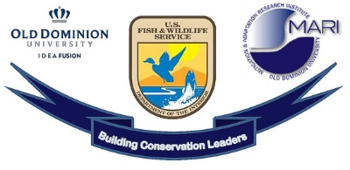
The Mitigation of Northern Snakehead Within Virginia
Morgan Thomas

Slide 2
“When one tugs at a single thing in nature, he finds it attached to the rest of the world.”
-John Muir

Slide 3
Morgan Thomas
Hi! I am Morgan Thomas.
I am a undergraduate student majoring in Biology and minoring in Conservation Leadership at ODU.
I am passionate about the outdoors and conservation.
This presentation outlines my amazing experience as an intern for Virginia DWR (Department of Wildlife Resources).

Slide 4
Mitigation of Northern Snakehead
Northern Snakehead are a nonnative species of piscivorous fish that have the potential to cause distress to Virginia waterways.
Northern Snakehead have a strong presence within the waters of Northeastern Virginia and it is important through mitigation efforts to prevent them becoming common within other parts of Virginia.

Slide 5
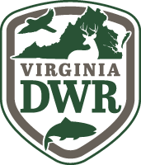
Mitigation of Northern Snakehead- State and Local Agencies
State and local agencies within Virginia are working very hard to ensure that Northern Snakehead do not decimate local populations of native species.
They are working within the agencies as well as getting community members involved with mitigation processes.
I personally interned with the Virginia DWR (Department of Wildlife Resources) and saw their mitigation efforts first hand.

Slide 6
Mitigation of Northern Snakehead- Community Involvement
Northern Snakehead can be confused with another species in the area, Bowfin. This can lead to confusion within the local communities.
Due to this it is important to properly identify Northern Snakehead for community members interested in helping with the mitigation processes.

Slide 7
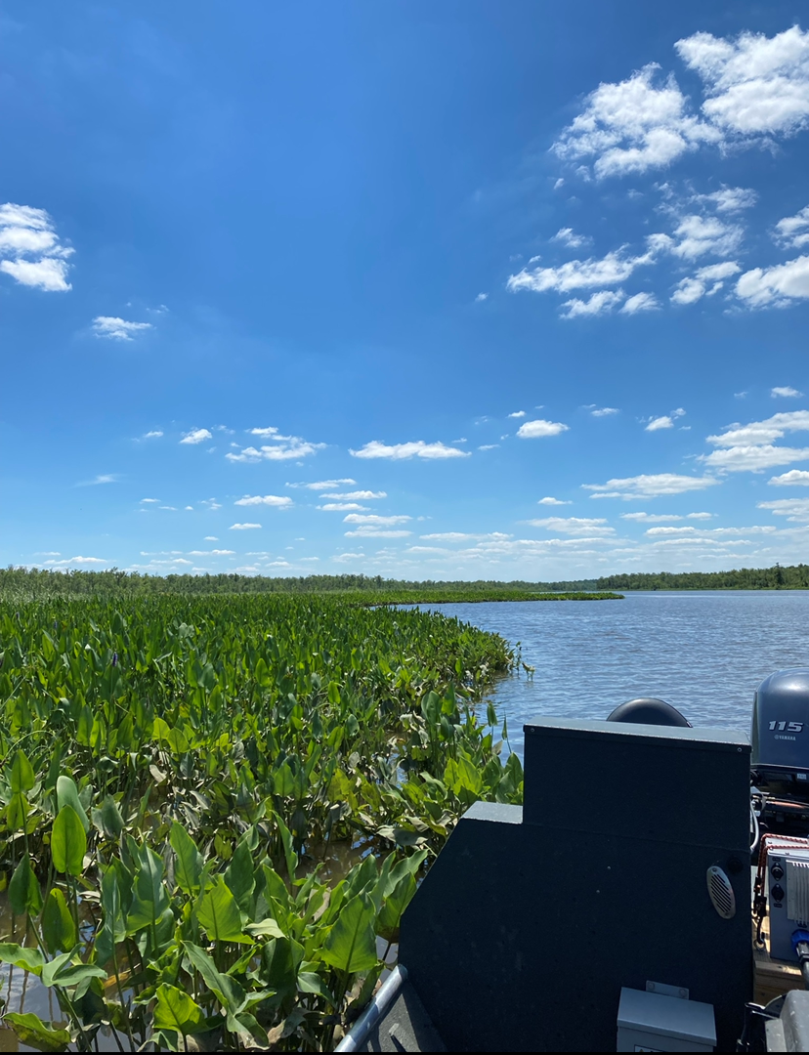
Mitigation of Northern Snakehead
Any questions??

Slide 8
Thank you for listening!!!

