Slide 1

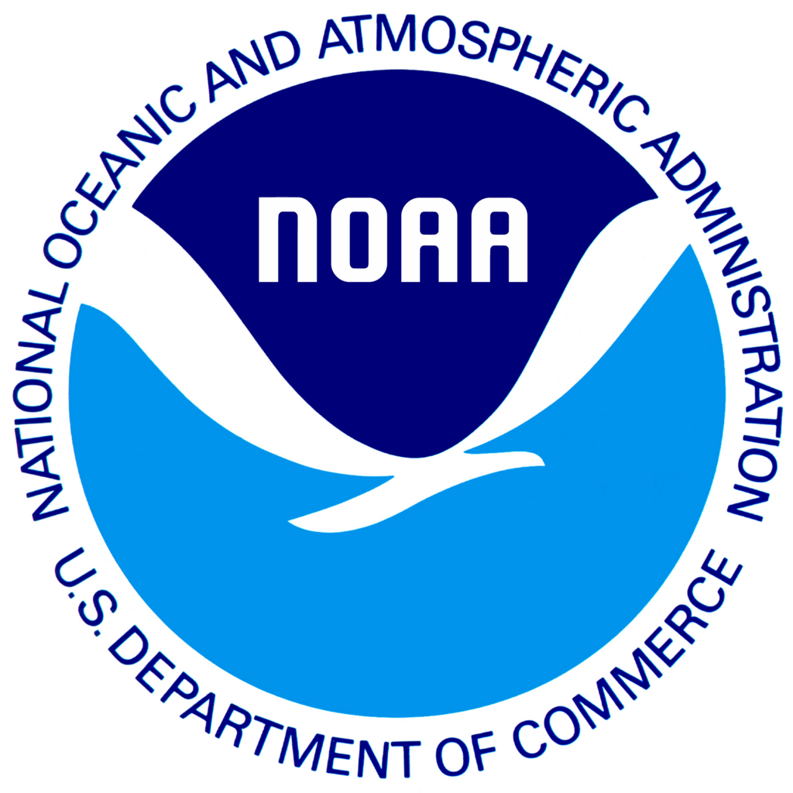
Sea Level Rise Scenarios for Coastal Adaptation
Adam Parris
Physical Scientist / RISA Program Manager
NOAA Climate Program Office

Slide 2
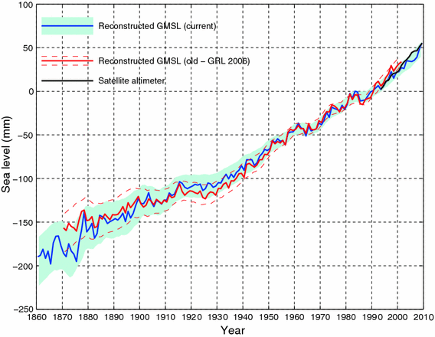
Sea level is rising - globally
Data Source: Church & White 2011

Slide 3
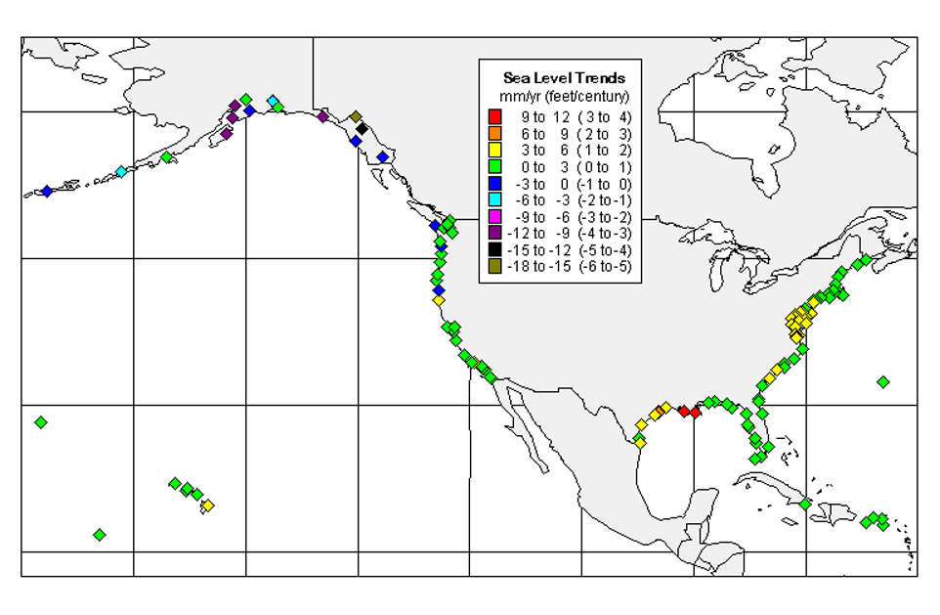
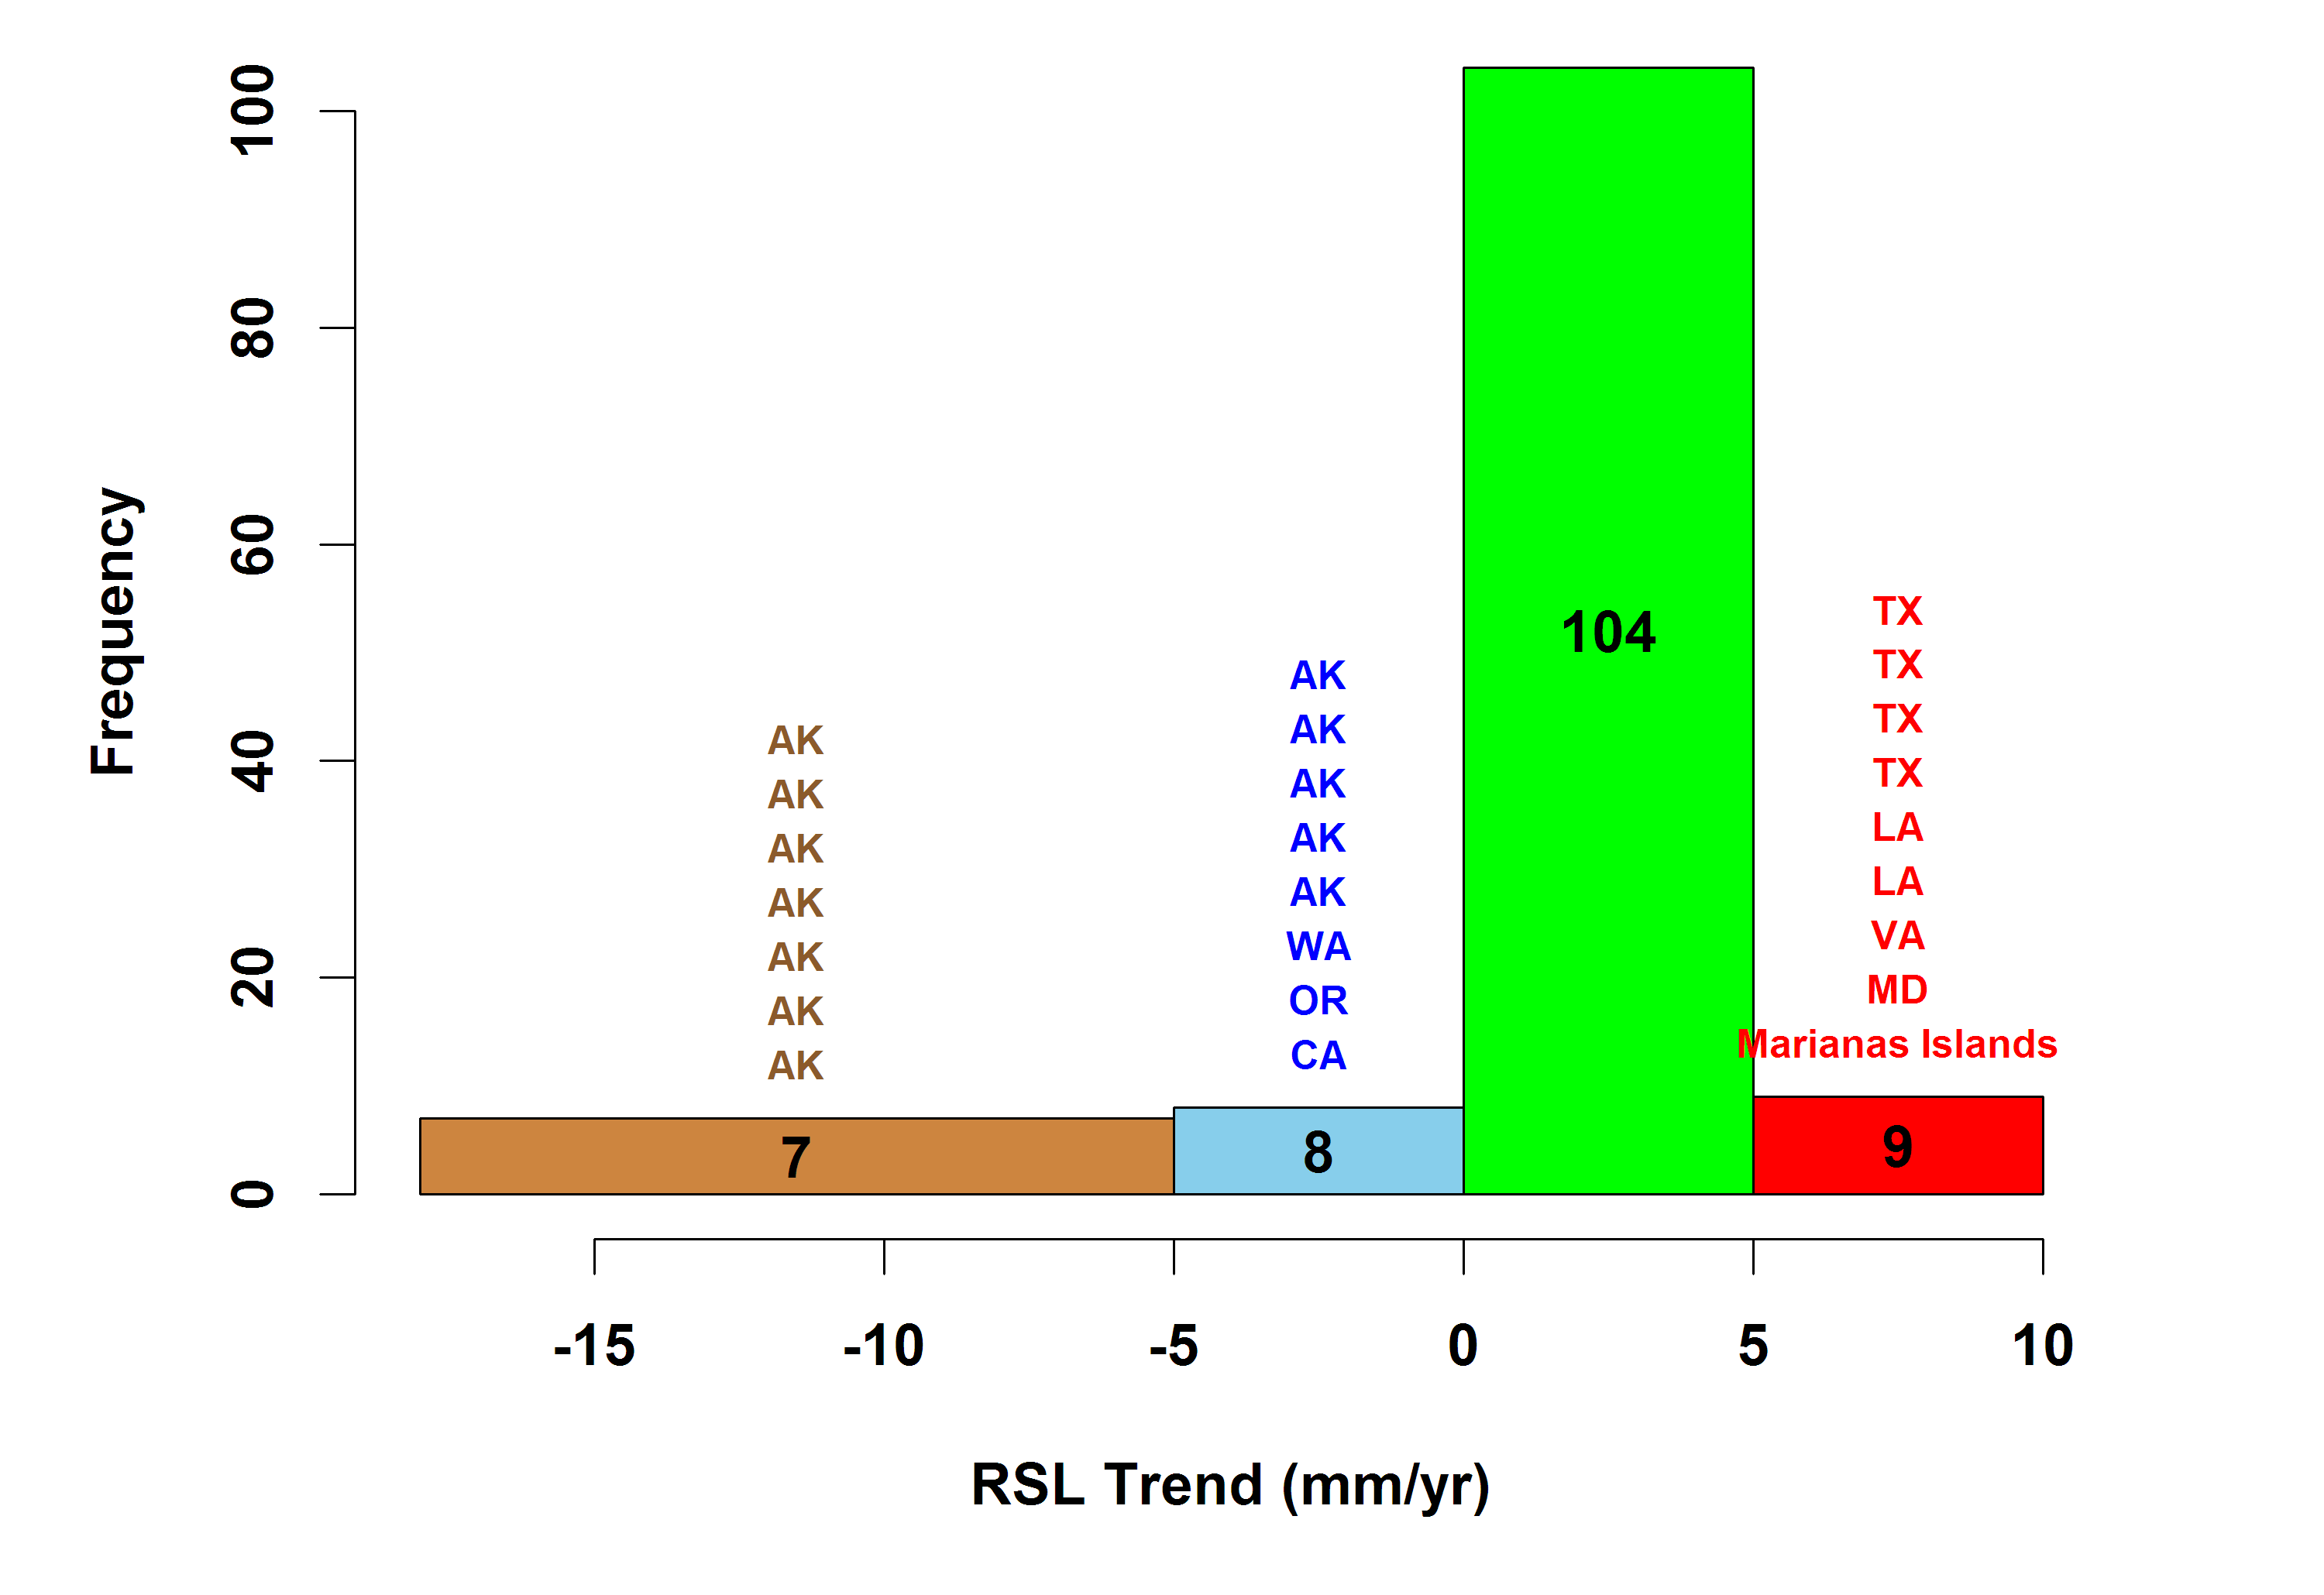
Sea level is rising - locally
Data Source: NOAA CO-OPS

Slide 4

Economic, cultural, and ecological assets near sea level

Slide 5
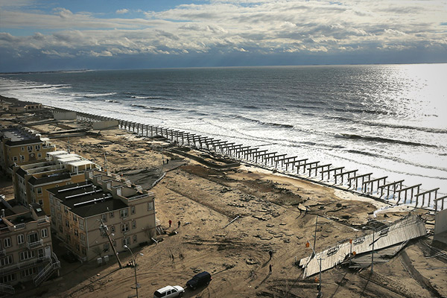
Any amount of SLR will increase coastal flooding
Spencer Platt Getty Images

Slide 6
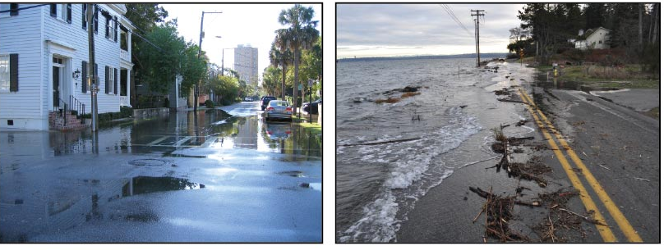
Flooding during high tides
Charleston, SC
Puget Sound, WA
Photo credits: (left) NOAA Coastal Services Center; (right) Ray Garrido, January 6, 2010, reprinted with permission by the Washington Department of Ecology

Slide 7
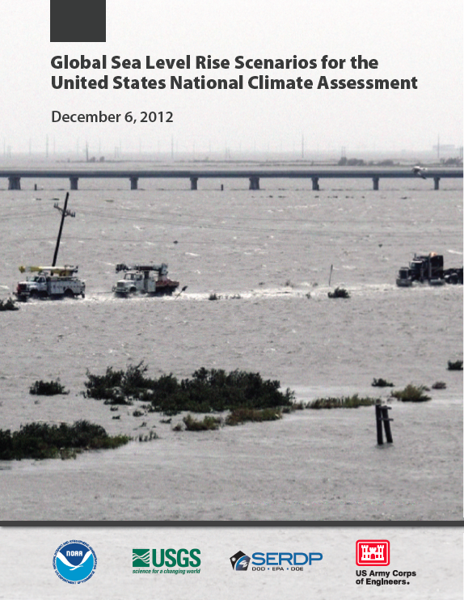





An interagency effort
Adam Parris, NOAA (Lead)
Peter Bromirski, Scripps Institution of Oceanography
Virginia Burkett, USGS
Dan Cayan, Scripps Institution of Oceanography & USGS
Mary Culver, NOAA
John Hall, DOD
Radley Horton, Columbia University
Kevin Knuuti, USACE
Richard Moss, University of Maryland, PNNL
Jayantha Obeysekera, South Florida Water Management District
Abby Sallenger, USGS
Jeremy Weiss, University of Arizona
Notes:
Integrate scenario planning approach into Fed agency and assessment community practice
Provide definitive statement of range of possible global mean SLR
Support comparable assessments across regions & sectors
Help connect local & regional context to global

Slide 8
SCENARIOS…
…ARE trajectories of environmental change for the purpose of risk and vulnerability assessment to inform the development of robust adaptation options
…ARE NOT predictions or projections of what will happen
…ARE NOT formed under the assumption of reducing uncertainty

Slide 9
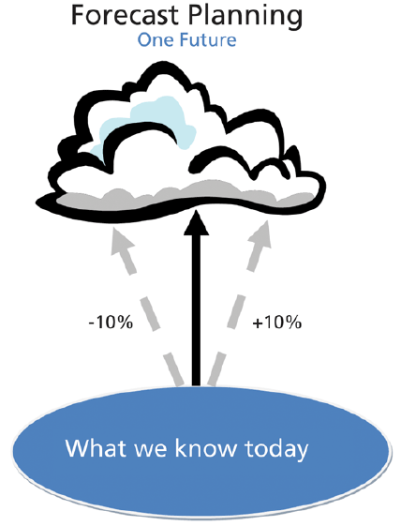
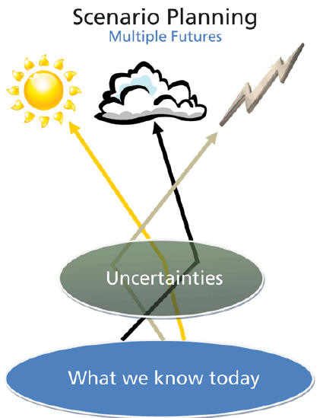
Why Scenario Planning?
Source: Global Business Network Weeks et al 2011

Slide 10
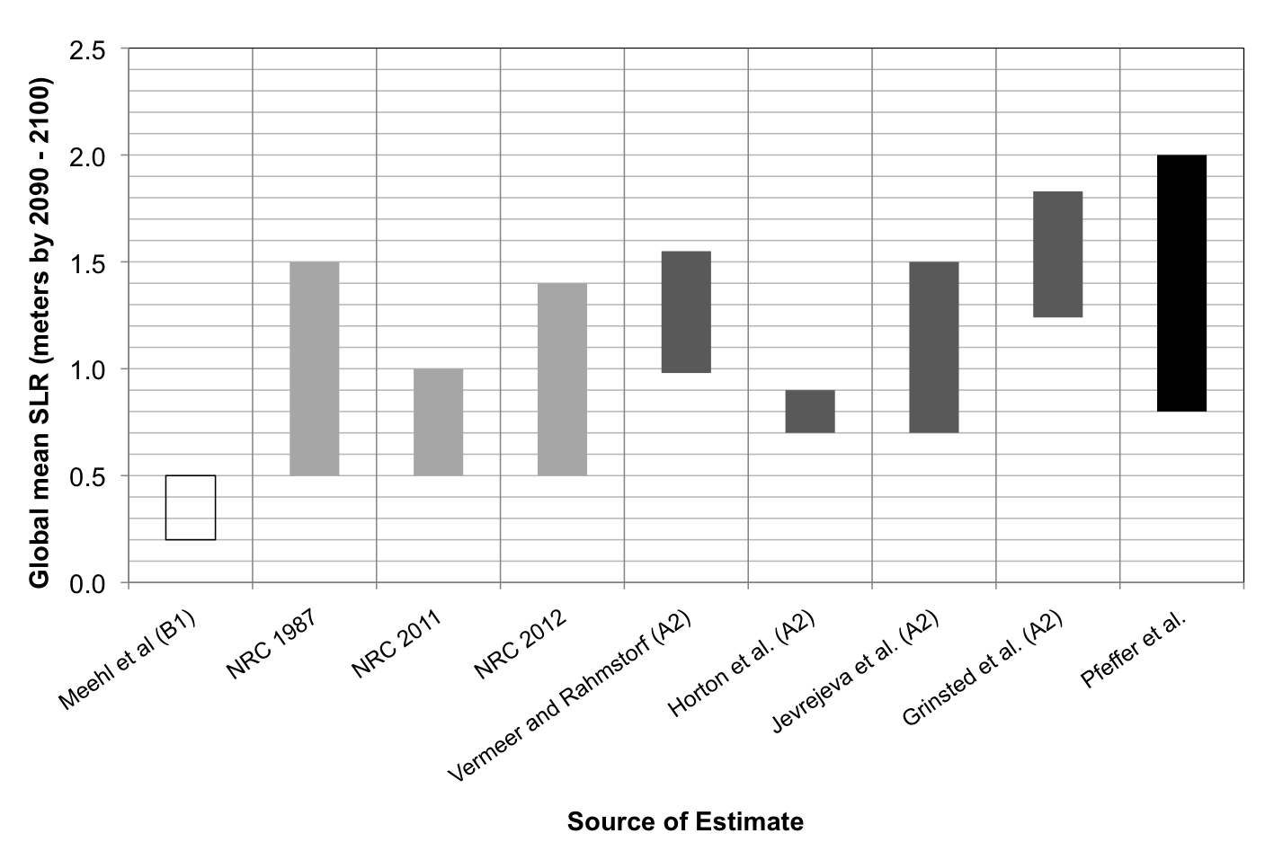
Just give me a number – please!

Slide 11
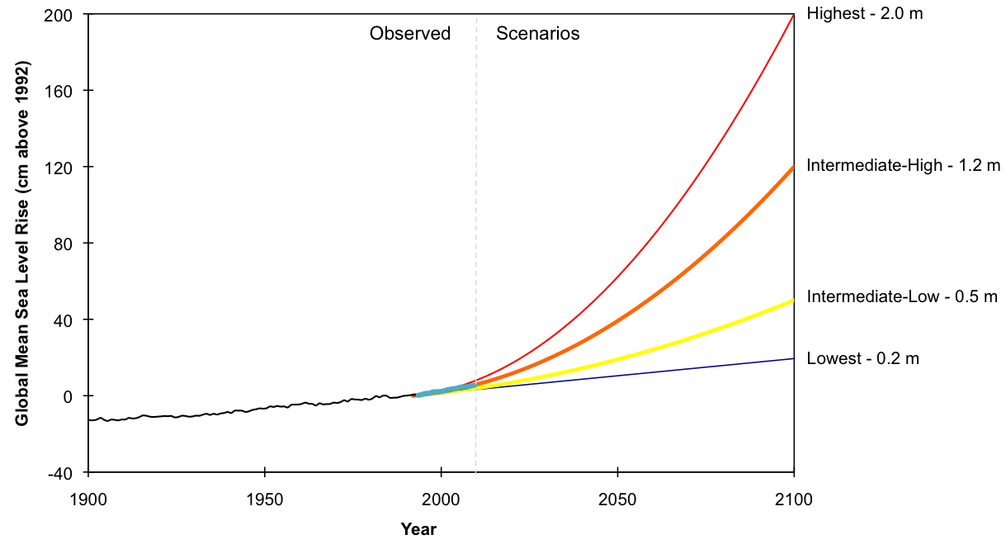
Global sea level rise scenarios

Slide 12
Risk-based framing
We have very high confidence (>9 in 10 chance) that global mean sea level will rise at least 0.2 meters (8 inches) and no more than 2.0 meters (6.6 feet) by 2100.
Confidence Level | Possible Contributing Factors
Very High | Strong evidence (established theory, multiple sources, consistent results, well documented and accepted methods, etc), high consensus
High | Moderate evidence (several sources, some consistency, methods vary and/or documentation limited, etc.), medium consensus
Medium | Suggestive evidence (a few sources, limited consistency, models incomplete, methods emerging, etc.), competing schools of thought
Low | Inconclusive evidence (limited sources, extrapolations, inconsistent findings, poor documentation and/or methods not tested, etc.), disagreement or lack of opinions among experts

Slide 13
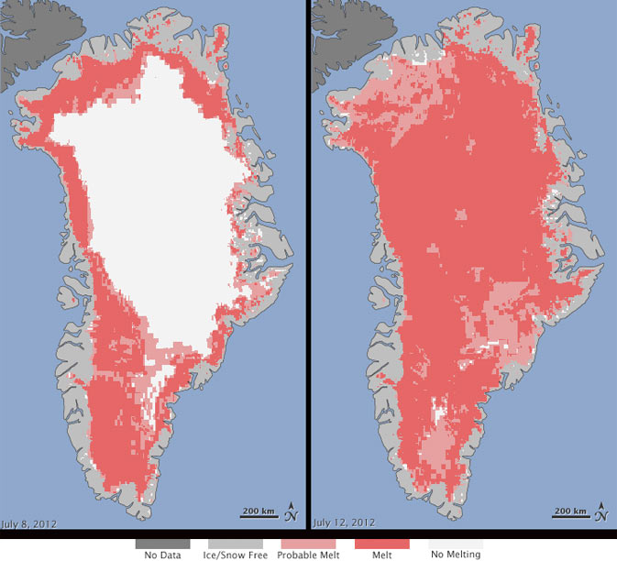
Greatest source of uncertainty?
Source: NASA

Slide 14

A decision analogy
Tomorrow there is a chance of rain, but what do you have planned for tomorrow?

Slide 15
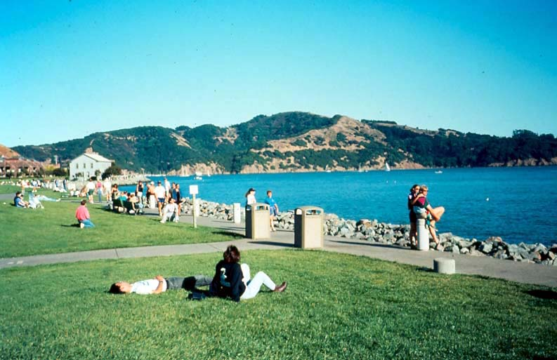
Why such a large scenario range?
Higher risk tolerance:
Greater flexibility to accommodate flooding
Lower consequence
Ability to change in near term
Lower risk tolerance:
Little flexibility to accommodate flooding
Higher consequence
Inability to change in near term

Slide 16
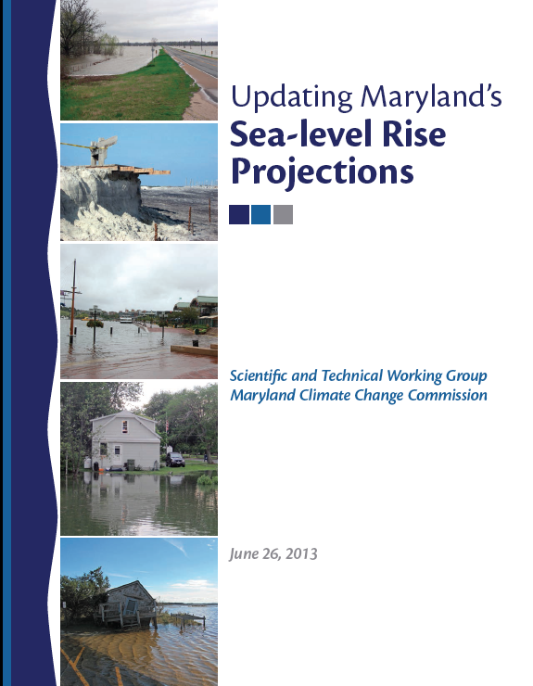
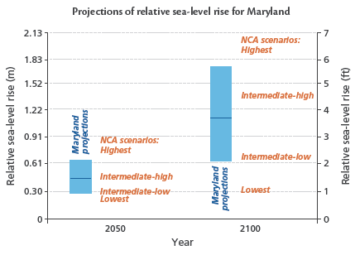
Adaptive risk management thru planning
Boesch, D.F., L.P. Atkinson, W.C. Boicourt, J.D. Boon, D.R. Cahoon, R.A. Dalrymple, T. Ezer, B.P. Horton, Z.P. Johnson, R.E. Kopp, M. Li, R.H. Moss, A. Parris, C.K. Sommerfield. 2013. Updating Maryland’s Sea-level Rise Projections. Special Report of the Scientific and Technical Working Group to the Maryland Climate Change Commission, 22 pp. University of Maryland Center for Environmental Science, Cambridge, MD.

Slide 17
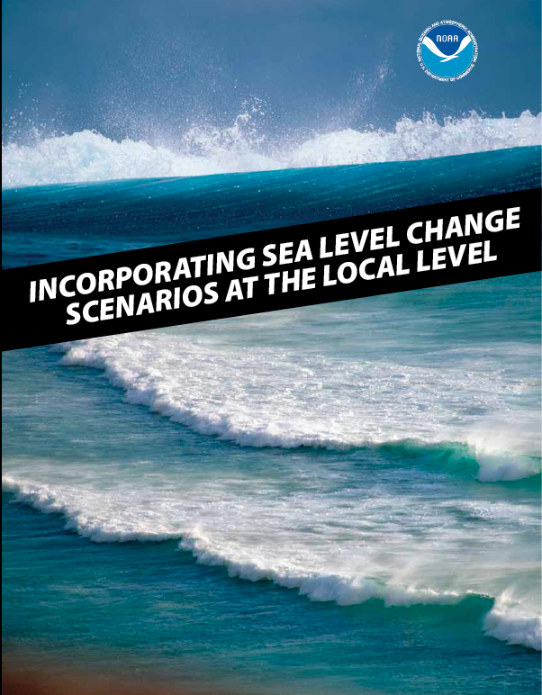
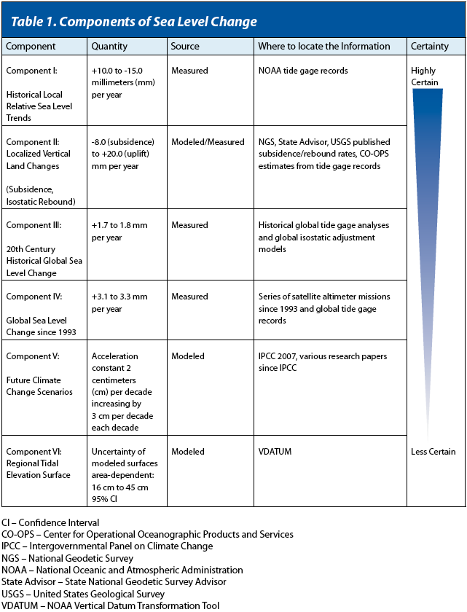
Build regional/local scenarios
✔
NOS SLR tech report http://www.csc.noaa.gov/publications/slc_tech.pdf
Incorporating Sea Level Change Scenarios at the Local Level - http://www.csc.noaa.gov/digitalcoast/publications/slcscenarios

Slide 18
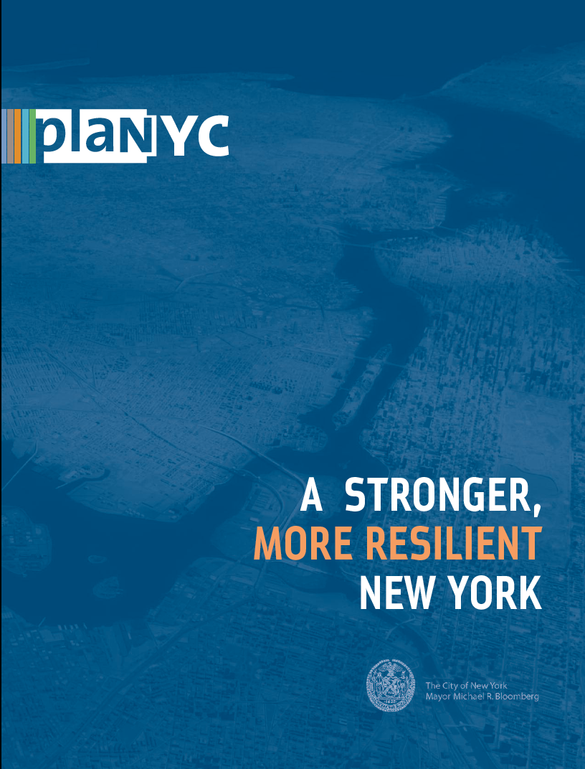
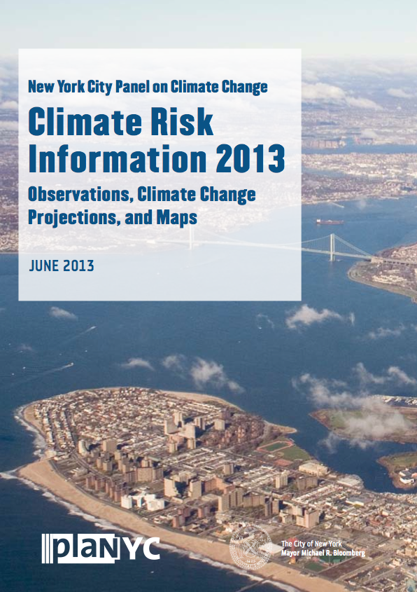
Visualization of future flood risk

Slide 19
Usable science supports choices, actions
The SLR Tool for Sandy Recovery was used for:
  16 local laws in 2013
  Natural Hazard Mitigation Plan
  Multi-purpose levee in Lower Manhattan
  Beach replenishment and dune construction
  Restored wetlands and a tidal barrier in Coney Island Creek
  ConEd rate case

Slide 20
Limiting factors from local/regional view
Additional analysis on flood recurrence required
Rates of Vertical Land Movement (VLM)
Shoreline change

Slide 21
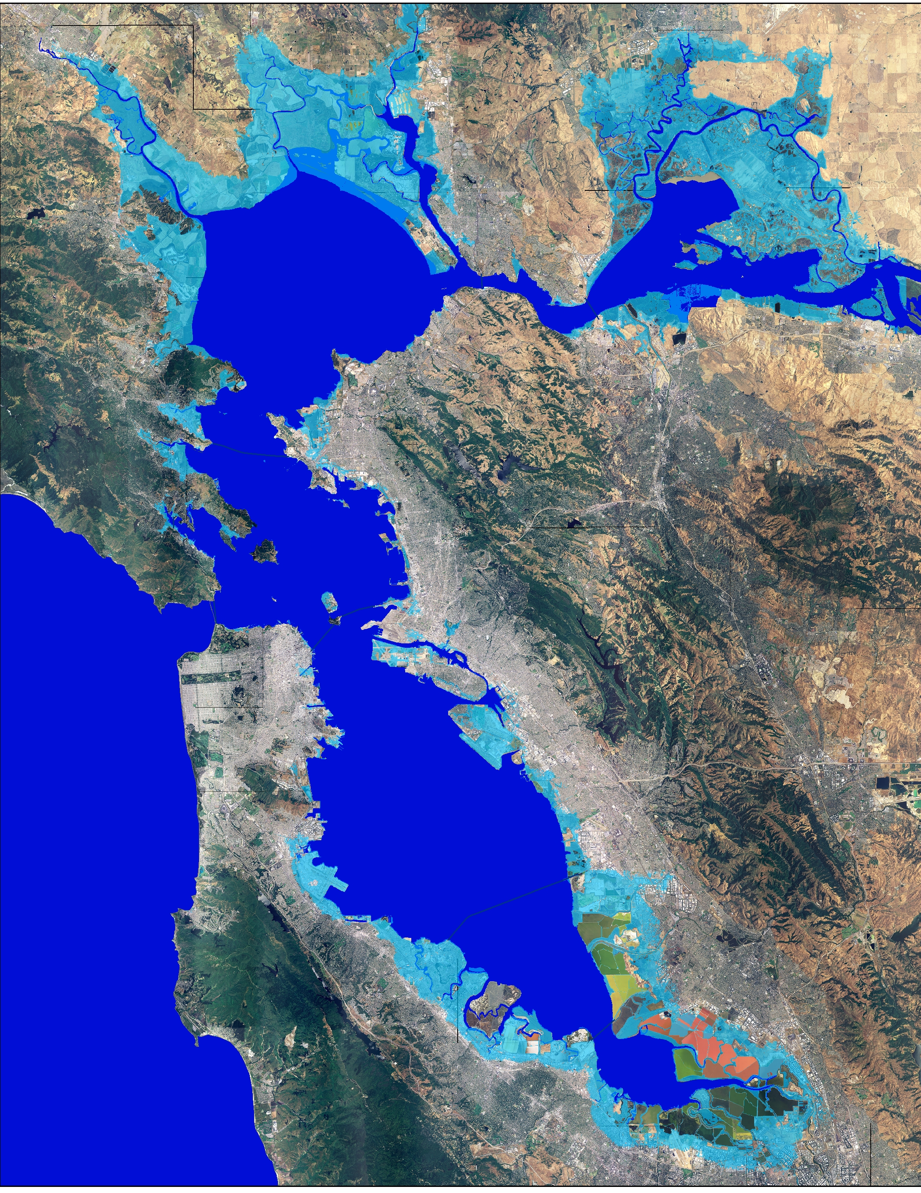
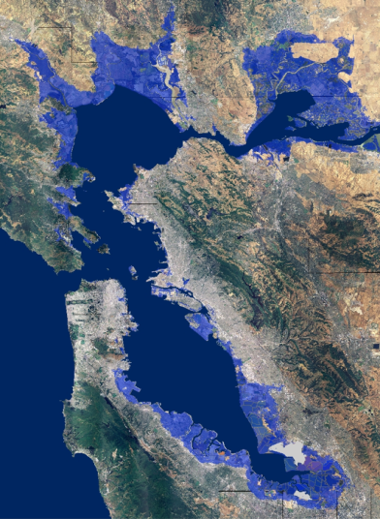
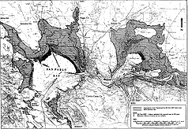
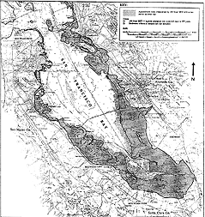
Don’t wait for perfect information
Pacific Institute, 1988
BCDC, 2007
USGS, 2009
Notes:
In 1988, BCDC approach the Pacific Institute about SLR and the economic impacts of SLR. Pac Institute used USGS topo maps to delineate the 1 meter contour and, within that area, looked at the value of habitat and development.
In 2009, USGS and again the Pacific Institute investigated economic impacts of SLR.
And the conclusions were largely the same.
These efforts were instrumental in exposing the issue of sea level rise and rallying political will, which is part of generating interest in the eyes of funders both in the region and in DC…

Slide 22
Resilience is a social process

