Slide 1
Preview Presentation
A Dutch Dialogue for the Tidewater
Integrated Water Management for Coastal Infrastructure Resilience
Organizing Sponsors:
Hampton Roads Planning District Commission
Embassy of the Netherlands McNeilan & Associates
Additional Sponsors:
Cities of: Norfolk, Virginia Beach & Hampton
_______, ______, _______
Contact Information: Tom McNeilan tom@mcneilan.com 757-761-0676 Ben McFarlane bmacfarlane@hrpdcva.gov 757-420-8300
tom@mcneilan.com bmcfarlane@hrpdcva.gov

Slide 2
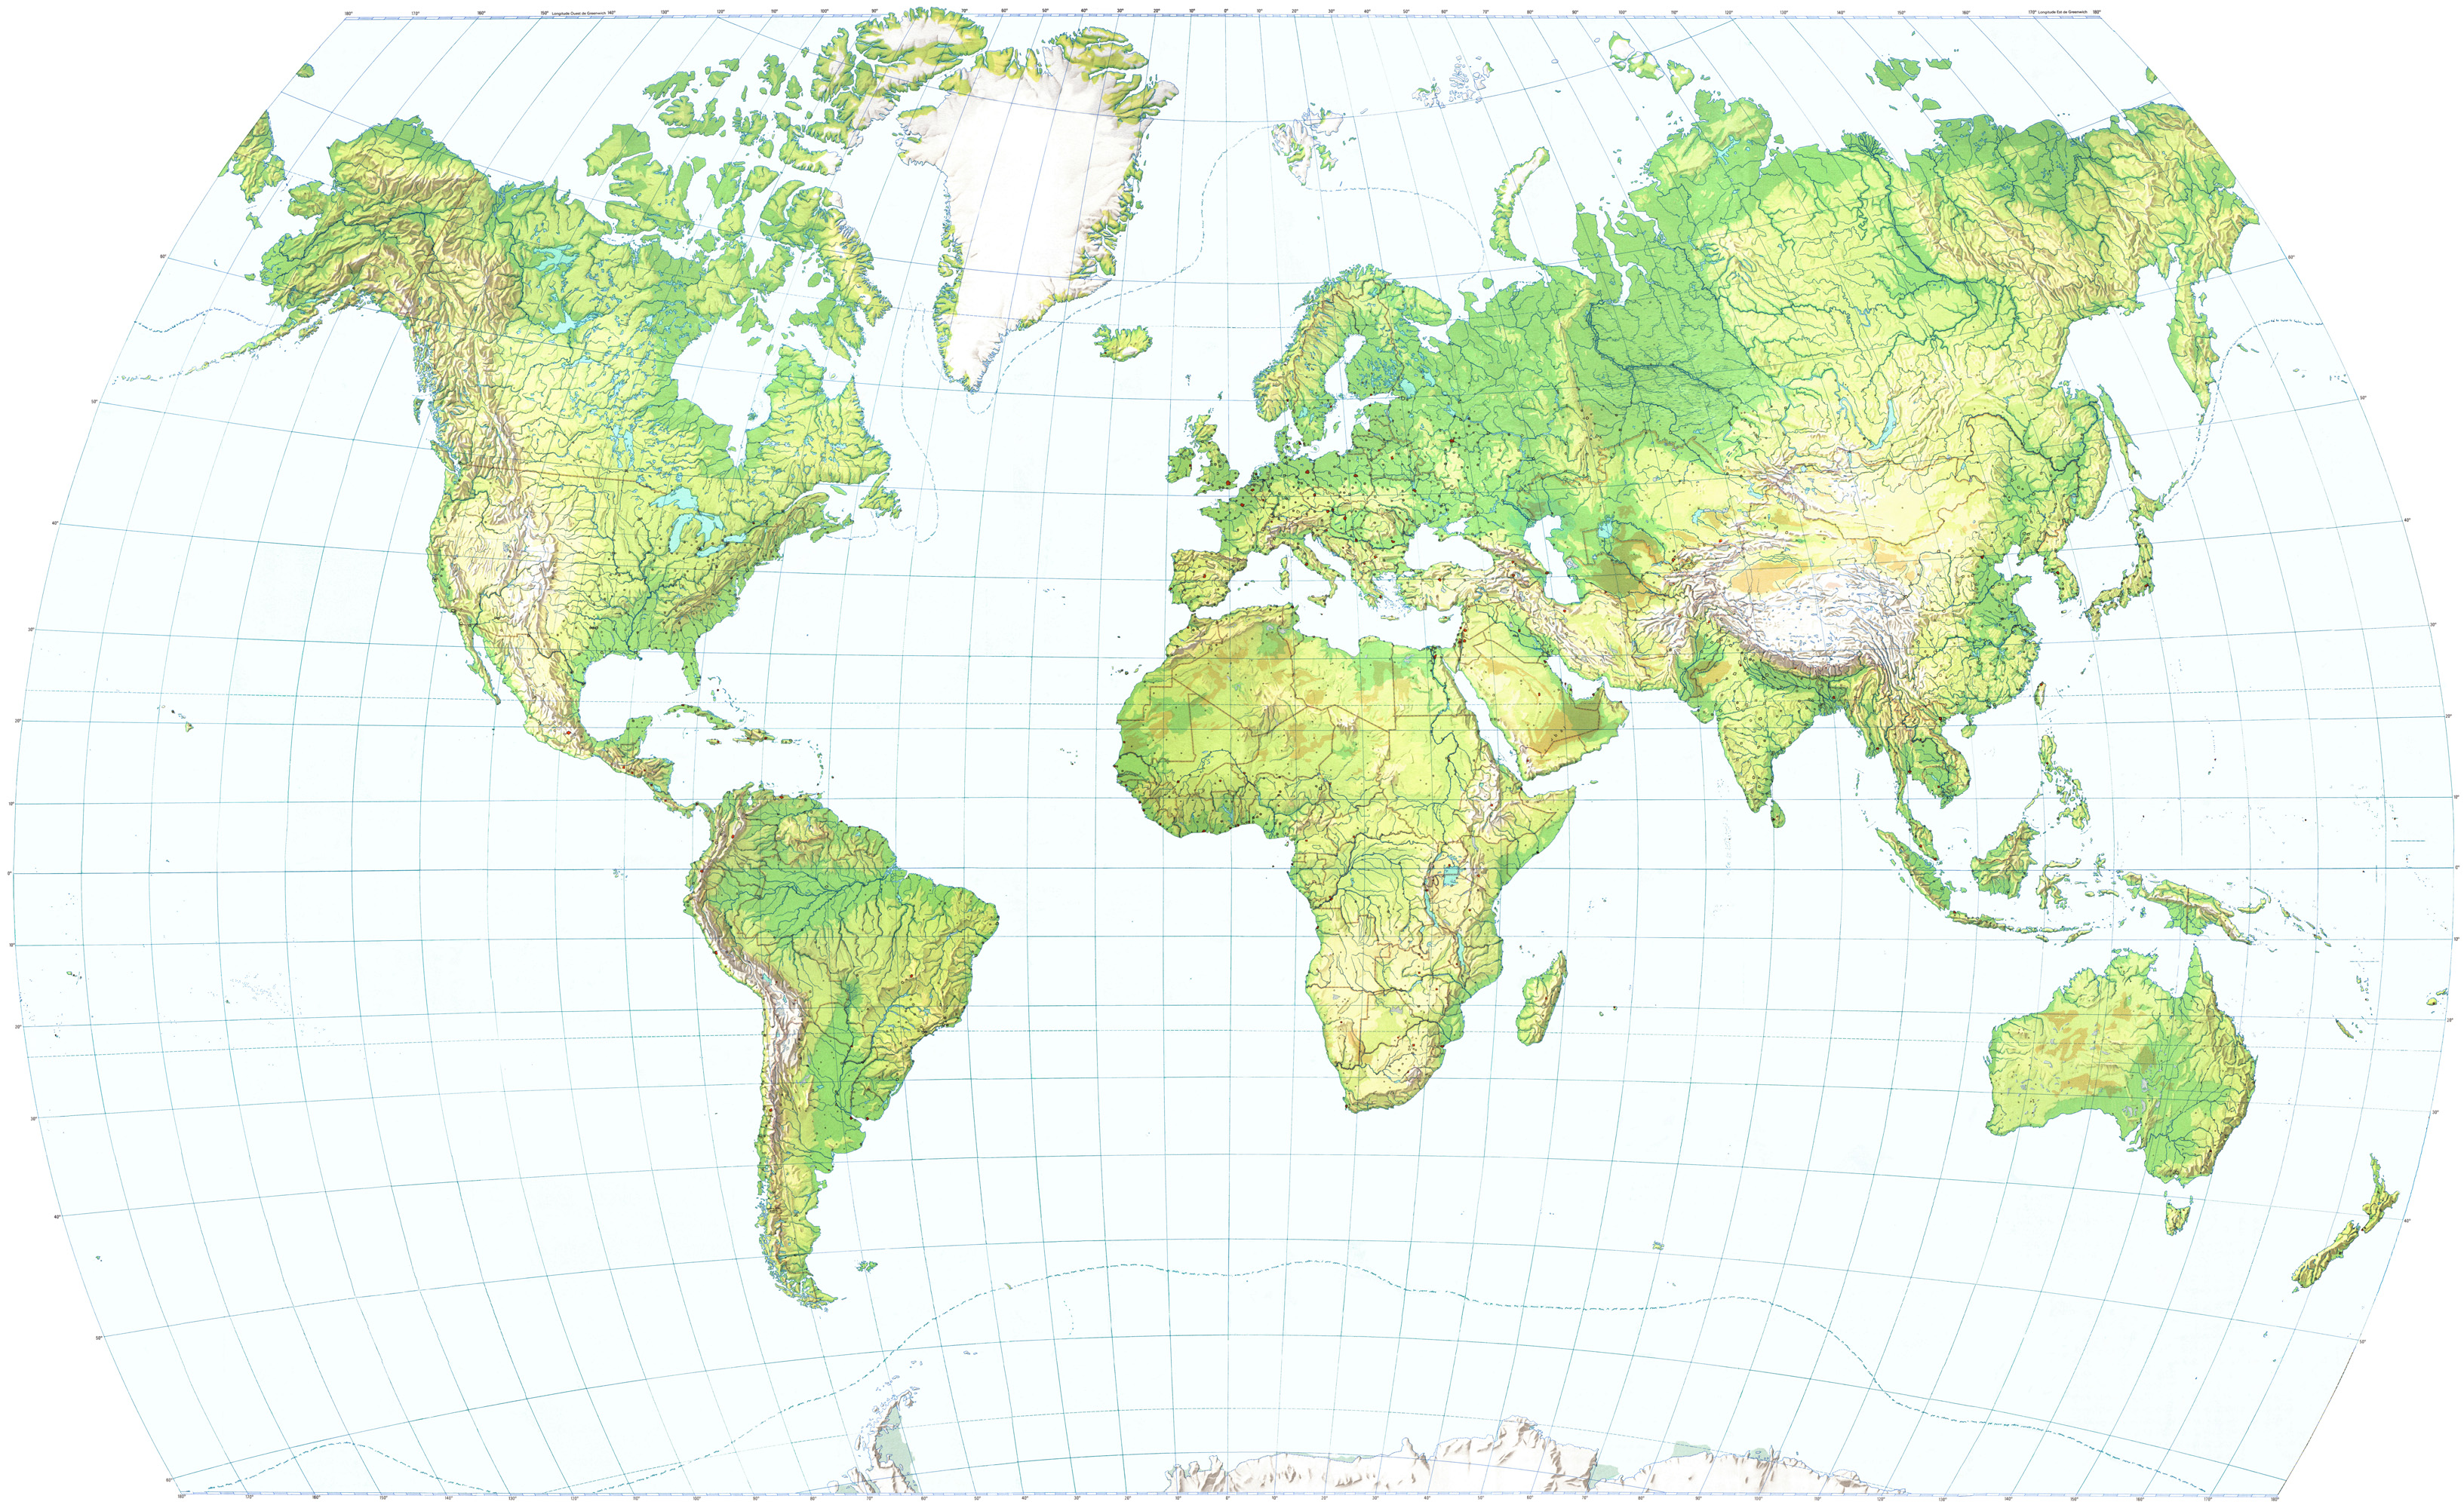
Global Perspective
If we accept that Sea Level is Rising (or that flooding is getting worse)
Then what is our vision for our grandchildren and great-grandchildren?
What is the Take Away from the experiences of the two most coastal flood-prone countries in the world?
The Netherlands
Bangladesh

Slide 3
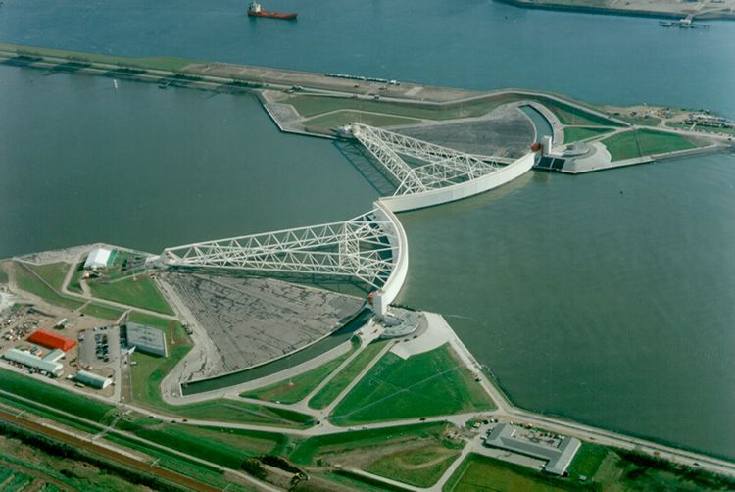
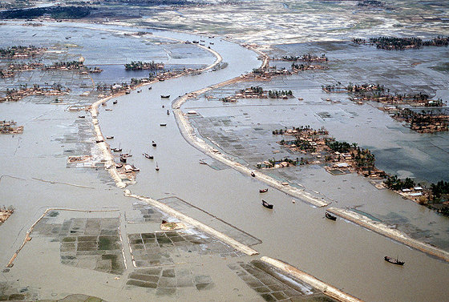
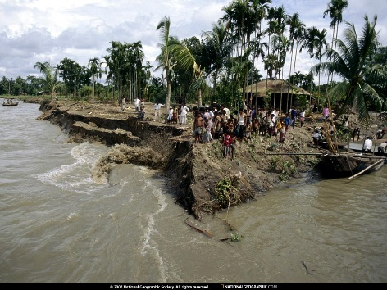
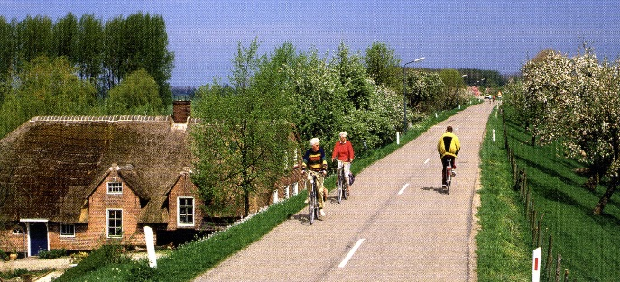
Optional Responses to Threat
What is the Take Away from the history & experience of two of the most flood-prone countries in the world?
The Netherlands
Investment
Bangladesh
Surrender

Slide 4
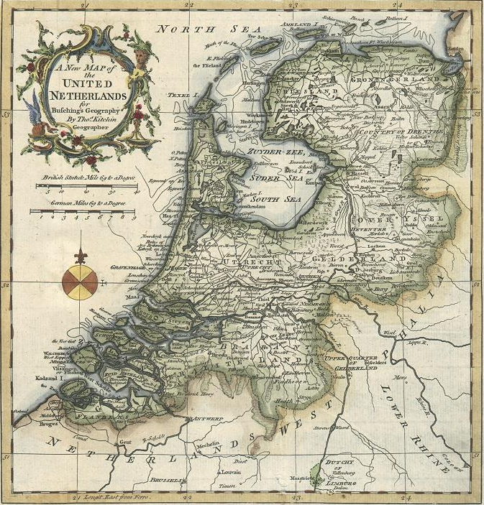
Dutch Landscape
A delta landscape, penetrated by rivers, subject to sea and river flooding with high- density urban areas and abundant agricultural lands
17 million people,
3rd most densely populated country
60% of people live in areas below sea level
22nd largest economy
70% of GDP produced in areas below sea level
subsiding land
Water management is a matter of national survival
water is an opportunity

Slide 5
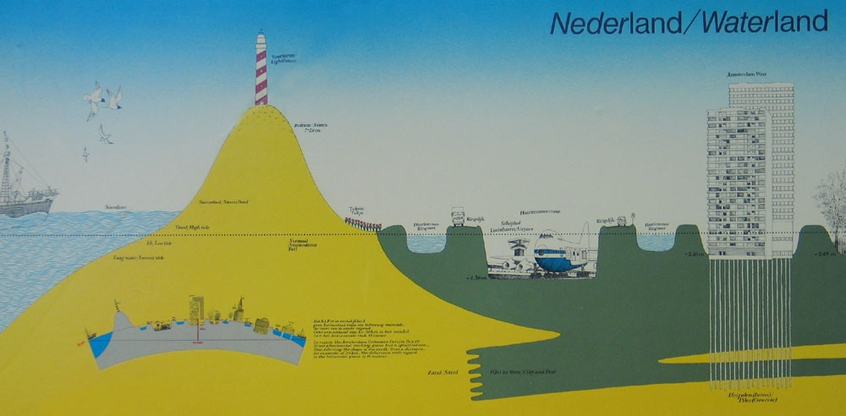
Dutch Landscape
A delta landscape, penetrated by rivers, subject to sea and river flooding with high-density urban areas and abundant agricultural lands

Slide 6
Dutch Landscape
A delta landscape, penetrated by rivers, subject to sea and river flooding with high-density urban areas, abundant agricultural lands and water management challenges
More extreme
storms
More intense
rainfall
Increased
river
discharge
+ 10%
Spatial
development
Sea level rise
(20 cm-->
60-85 cm/100y)‏
Increased
erosion
Decreased
river
discharge
- 60%
Salt
intrusion
Subsidence
10 cm/100yr

Slide 7
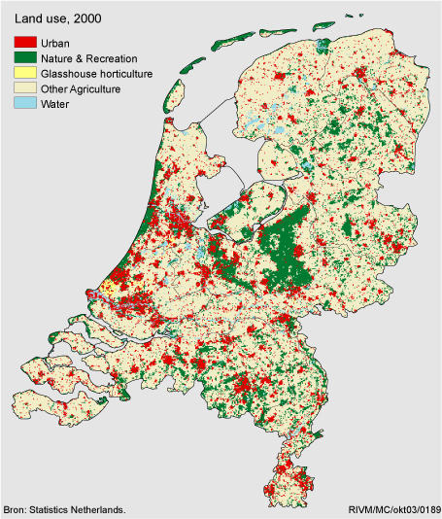
Dutch Landscape
Lowlands w/ High Density Urban Areas & Agricultural Lands
Land Use
Flood Prone Areas
Water is where the environment meets the economy

Slide 8
Dutch History
Evolving Perspectives - As the challenges increase, the response evolves
Responses have evolved from grey (hard) infrastructure to mixed grey (hard) and green (soft) responses

Slide 9
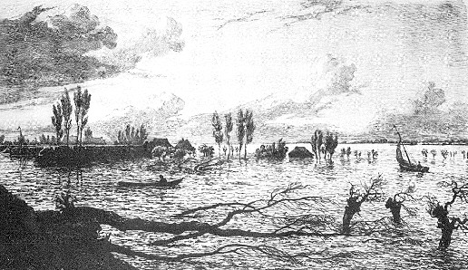
Dutch History
Transformation from Fighting the Seas to Living with Water
The Lowlands of Europe have a long history of catastrophic storms and flooding.
1421

Slide 10
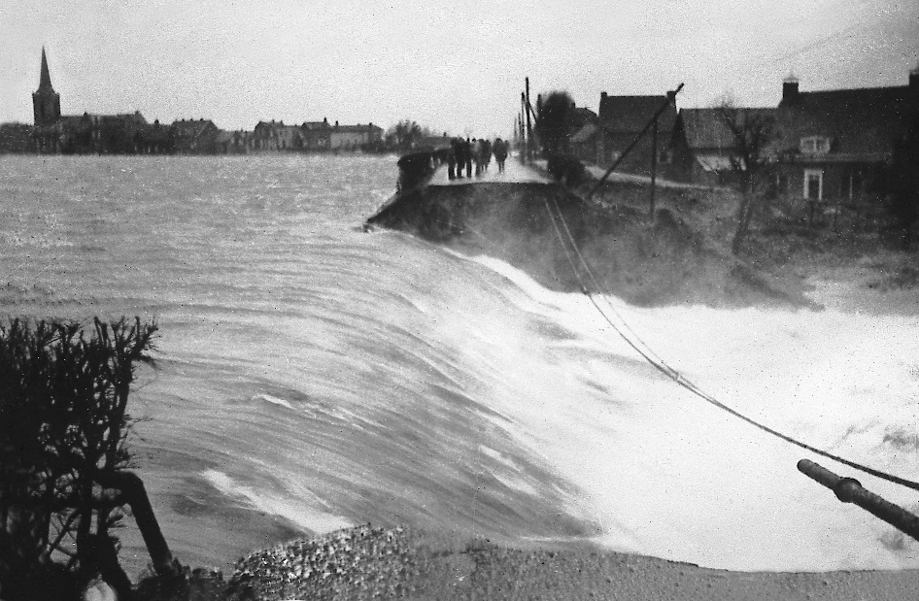
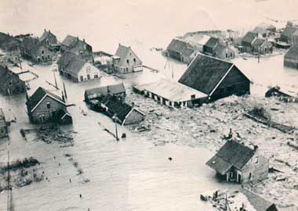
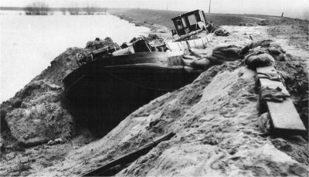
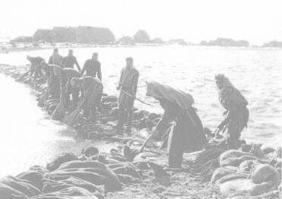
Dutch History
Transformation from Fighting the Seas to Living with Water
The Zeeland Sea Storm of 1953
1,835 lives lost
67 levee failures
500,000+ acres flooded

Slide 11
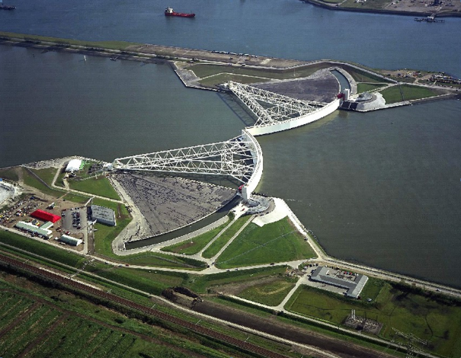
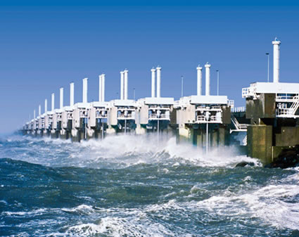
Dutch History
Transformation from Fighting the Seas to Living with Water
NL Response to Zeeland Sea Storm of 1953
1953 – 1st Delta Commission established
Priority for multiple lines of defense adopted
Safety standards with respect to storm events
1958 – Flood Risk Safety Standard Formalize
Late 1950s through early 1990s – a generation of dikes, levees, seawalls and gates constructed

Slide 12
Dutch History
Transformation from Fighting the Seas to Living with Water
NL Moving forward from additional lessons learned
Massive barriers cause unintended consequences
In the late 1990s – additional river flows, increased coastal storms and sea level rise cause flooding
2nd Delta Commission established
2006 – 2nd Delta Commission report
Additional protection will be required, BUT such protection shall be created within a context of an integrated water management approach – i.e. “green solutions”
Late 2000s – Establishment of Living with Water, Room for the River, Urban Water Management programs
2011-2014 – Implement research and prototype projects
2020 and beyond – €1B per year of project funding

Slide 13
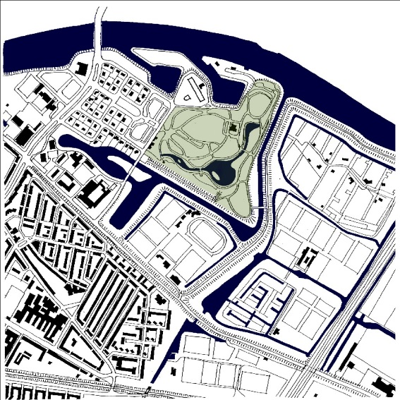
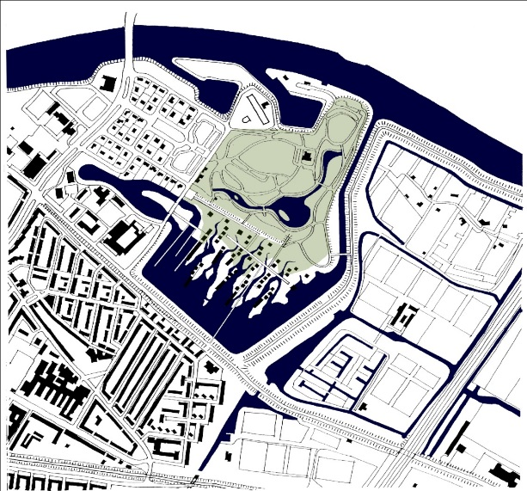
Dutch History
Transformation from Fighting the Seas to Living with Water
Living with Water and Room for the River Programs
Cost versus Benefits (which include economies created)
Tipping Point analyses
Adaptive management
No regrets approach
Alternate Beach Nourishment Approaches
Increase Water Storage & Recharge

Slide 14
Dutch Water Management Approach
Comparison of “Hard” versus “Soft” or “Grey” versus “Green”

Slide 15
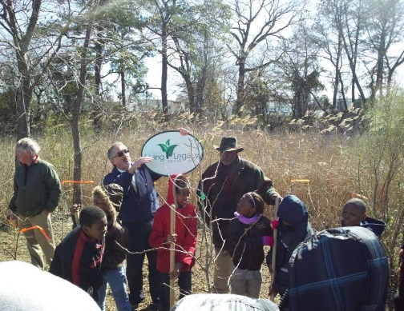
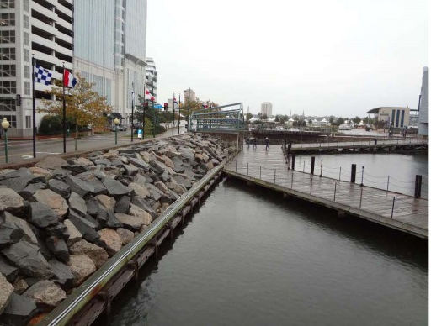
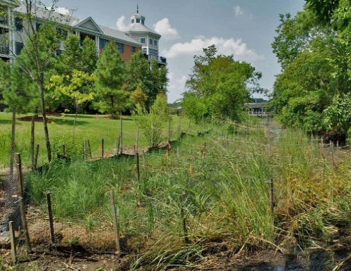
Dutch Approach to Water Management
Conditions and their variations - with Location & Time
Physical Impacts
Challenges
Opportunities
Live with Water Add Beauty Protect Investment Stimulate Economy Improve infrastructure

Slide 16
Dutch Approach to Water Management
Build consensus among all Stakeholder:
Infrastructure Owners
Governments
Local
Regional Agencies
Federal
Citizens
NGOs
Financiers
Insurers
For all types of Infrastructure
Utilities – Gas, Electrical, Other fuels
Transportation - Roads, Rail, Air and Water
Communication Networks
Food distribution
Health care distribution
Anything that affects life, safety and economic vitality
Recognize that consensus and funding follows a Vision.
Investment precedes benefits.

Slide 17
Dutch Approach to Water Management
Evaluation Process
Inundation mapping
Define project areas based on hydrologic boundaries
May include multiple planning districts
Identify project infrastructure options to mitigate coastal flooding
Prioritize projects based on
Risk
Investment
Benefit (includes preservation & expansion of tax base)
Project cost estimates to calculate costs of mitigation based on ground elevation and design elevation

Slide 18
Dutch Flooding Mitigation Planning
Mitigation Planning
Mitigation scenarios should include:
“grand” options,
watershed capital improvements,
local options (grade raises & house elevation) &
parcel-specific actions
A generation of actions are required
A programmatic approach is appropriate to:
Define priorities
Raise capital & Invest wisely
Leverage synergistic opportunities
Create wealth
Efforts can not be optimized in a vacuum – but rather need to be advanced in a regional framework

Slide 19
Dutch Flooding Mitigation Planning
Dutch Strategies to reduce flooding vulnerability include:
Defense – Improve flood protection
Water Management – Improve flood conveyance & flood water storage
Elevation – Raise ground and/or buildings & infrastructure
Protection – Adapt buildings and infrastructure
Preparedness – Anticipate threats and prepare
Modified from presentation courtesy of Deltares

Slide 20
Dutch Flooding Mitigation Planning
Storm Surge Mitigation Approach Options
Modified from graphic
courtesy of Arcadis

Slide 21
Dutch Flooding Mitigation Planning
Mitigation & Adaptation Strategies
Public Information, Notification and Education
Land use options & Government policy
Zoning regulations
Development requirements
Minimum floor elevations for house
Minimum floor elevation for garages and ancillary structures
Flood proofing vulnerable elevations
Foundation, structural, mechanical design requirements
Adaptation
Property Purchase & Small Projects
Flood proofing individual buildings
Non Infrastructure Options
Brick cover over water proofing
Steel door with gaskets that seal when closed
Notes:
21
21

Slide 22
Dutch Flooding Mitigation Planning
Decision Process for Evaluation of Flood Mitigation & Adaptation
Decisions based on:
Vision
Policy
Objectives
Cost-Benefit
Funding Opportunities
Assessment depends on:
Design storm
Design period
Mitigation options
Cost-Benefit
Funding
Decisions
Assessment
Environment
Data
Define physical environment and how water levels vary spatially with storms conditions
Tide gauge & stream flow data
Potential Sea Level Changes

Slide 23
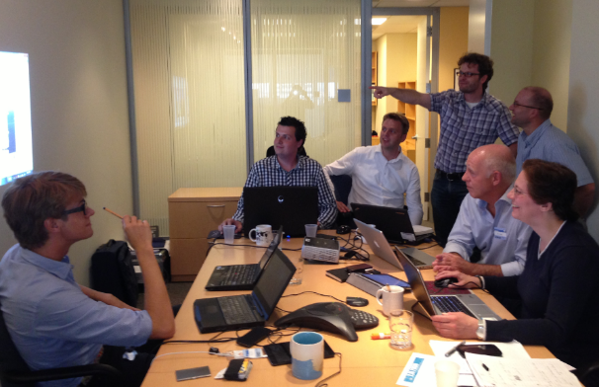
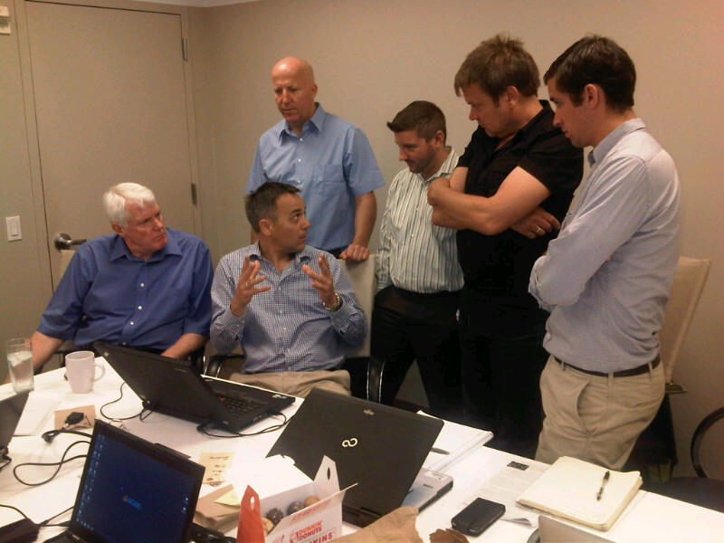
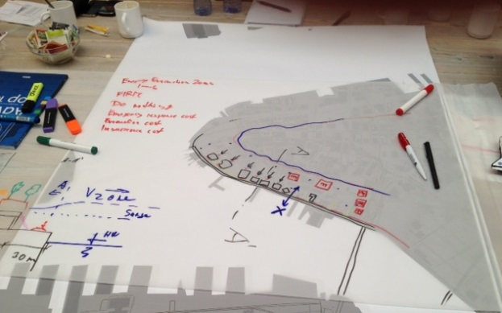
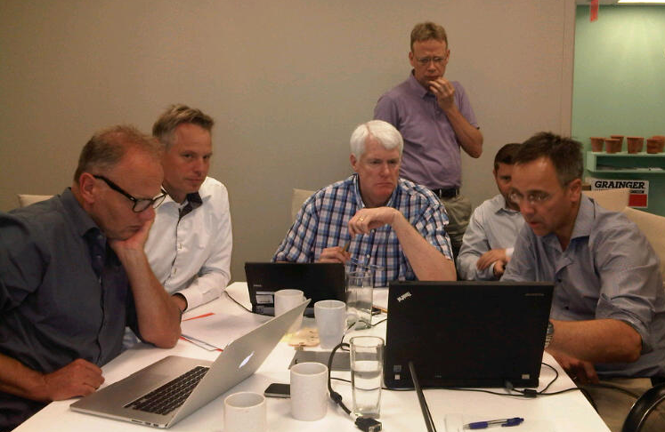
Dutch Dialogue for the Tidewater Preview
A Dutch Dialogue:
Includes local stakeholders and Dutch experts.
Includes: policy makers, planning experts, engineers, and financiers.
Is used to synopsize the local water management challenges and opportunities.
Identifies “areas” where flood mitigation and adaptation needs can be used to also enhance the environment, improve the livability of the landscape, create economic opportunity, and increase the tax base.
Includes hands-on conceptual project formulation.
Produces a report and presentation for future use.

Slide 24
Dutch Dialogue for the Tidewater Preview
21st Century Netherlands Water Management Outreach in the US
Dutch description of Hampton Roads: “It’s flat, green and there is water everywhere – It is just like home”

Slide 25
Dutch Dialogue for the Tidewater Preview
New Orleans (post Katrina) Example
Initial US - Dutch Discussions
Final Water Management Plan Published
Water Management Plan Efforts Initiated
Hurricane Katrina
Dutch Dialogue 1
Dutch Dialogue 3
Dutch Dialogue 2
2005
2006
2007
2008
2009
2015
2010
2011
2012
2013
2014

Slide 26
Dutch Dialogue for the Tidewater Preview
New Orleans (post Katrina) Water Management Plan
Courtesy of Greater New Orleans Regional Economic Development Inc. – Waggoner & Ball – Bosch Slabbers
Pre-Katrina System – Technocratic pump and drain “system” designed to move water as fast as possible
Proposed Approach – Slow – Store & Use – Drain Excess

Slide 27
Dutch Dialogue for the Tidewater Preview
New Orleans (post Katrina) Water Management Plan
Courtesy of Greater New Orleans Regional Economic Development Inc. – Waggoner & Ball – Bosch Slabbers
APPROACH: Divide City into “Water Basins” based on Natural Landscape

Slide 28
Dutch Dialogue for the Tidewater Preview
New Orleans (post Katrina) Water Management Plan
Courtesy of Greater New Orleans Regional Economic Development Inc. – Waggoner & Ball – Bosch Slabbers
GOAL: Develop Designs that: 1) are efficient and that Work, 2) enhance the Environment 3) improve the Quality of Life, and 4) add to the Tax Base

Slide 29
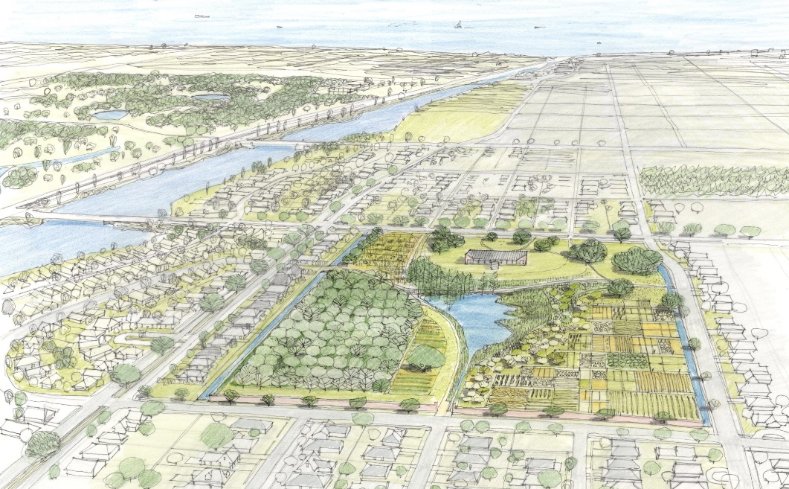
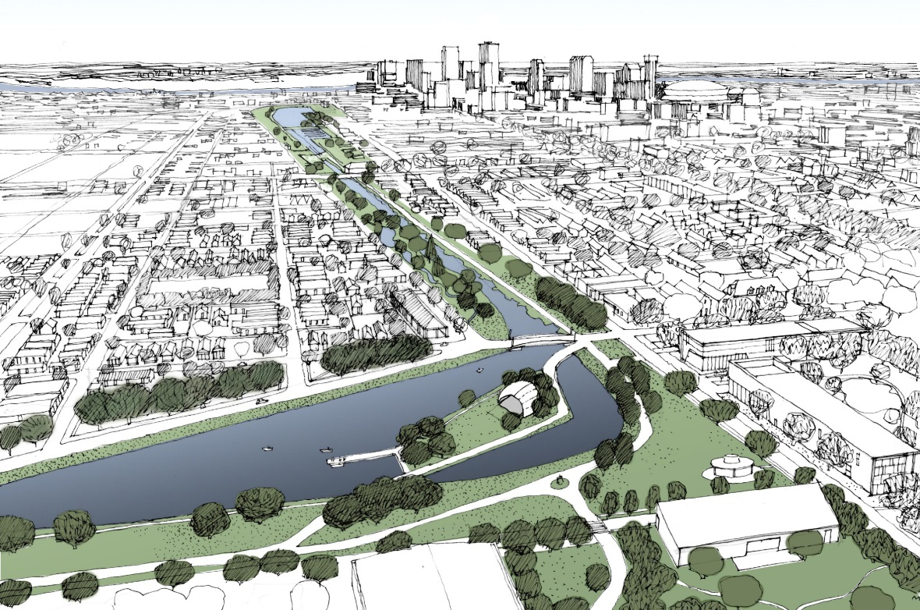
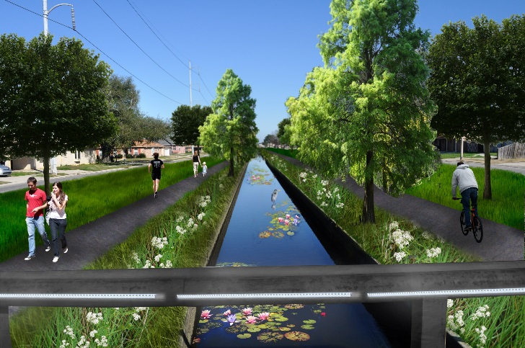
Dutch Dialogue for the Tidewater Preview
New Orleans (post Katrina) Water Management Plan
Courtesy of Greater New Orleans Regional Economic Development Inc. – Waggoner & Ball – Bosch Slabbers
GOAL: Develop Designs that: 1) are efficient and that Work, 2) enhance the Environment 3) improve the Quality of Life, and 4) add to the Tax Base

Slide 30
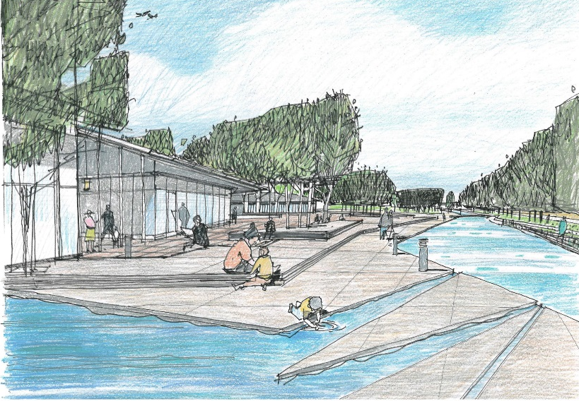
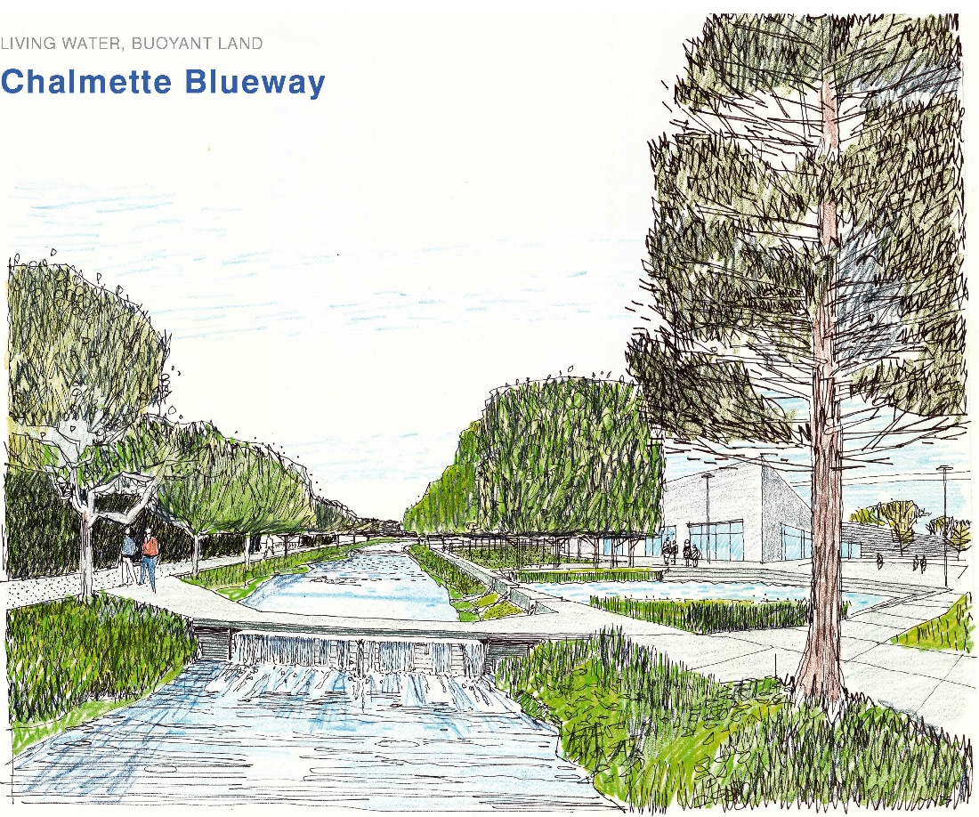
Dutch Dialogue for the Tidewater Preview
New Orleans (post Katrina) Water Management Plan
Courtesy of Greater New Orleans Regional Economic Development Inc. – Waggoner & Ball – Bosch Slabbers

Slide 31
Dutch Dialogue for the Tidewater Preview
New Orleans H2O Management Plan
Cost versus Benefits over 50 years Courtesy of Greater New Orleans Regional Economic Development Inc.. – Waggoner & Ball
Total Benefits

Slide 32
Dutch Dialogue for the Tidewater Preview
New York Example
H2O9 Forum (part of 400-year anniversary of founding of New Amsterdam celebrations)
2nd H2O9 Forum
Superstorm Sandy
U Formulation Published
US – NL MOU Signed
US – NL Workshop
2009
2015
2010
2011
2012
2013
2014

Slide 33
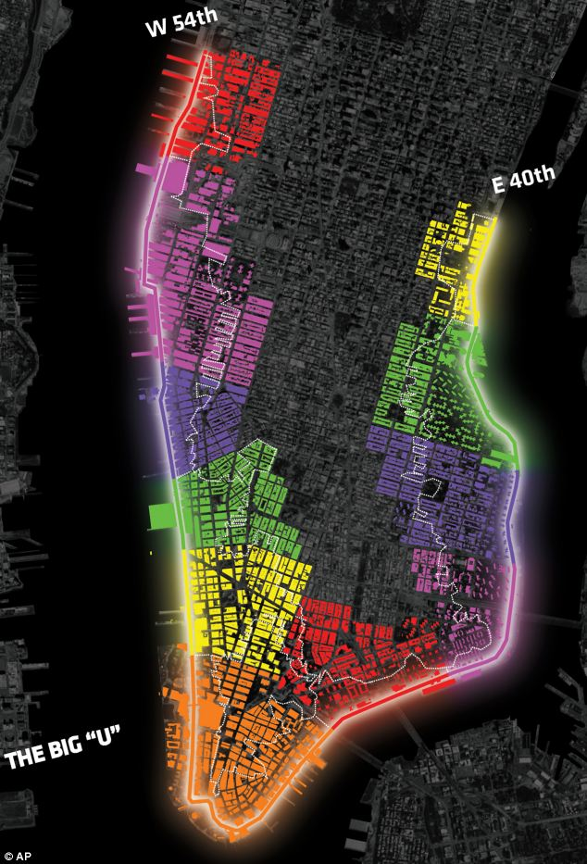
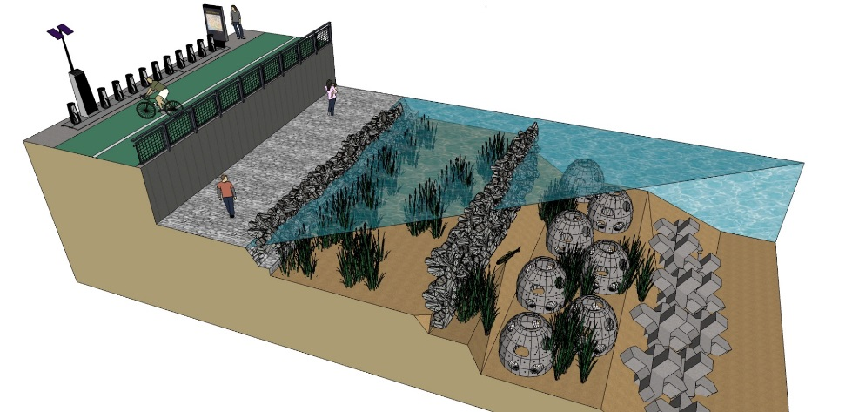
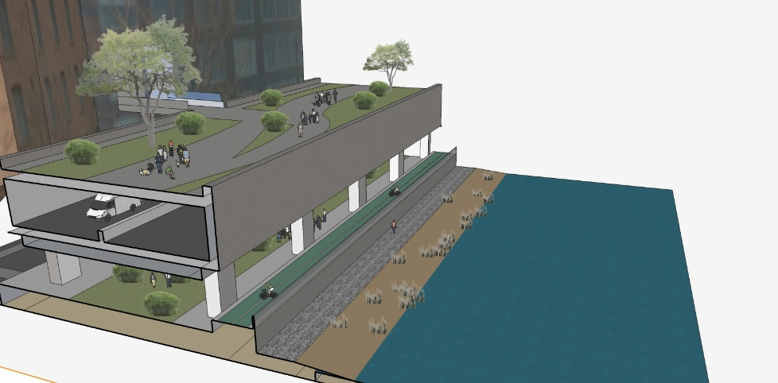
Dutch Dialogue for the Tidewater Preview
New York Example - Manhattan
Area-specific approaches to each section of waterfront

Slide 34
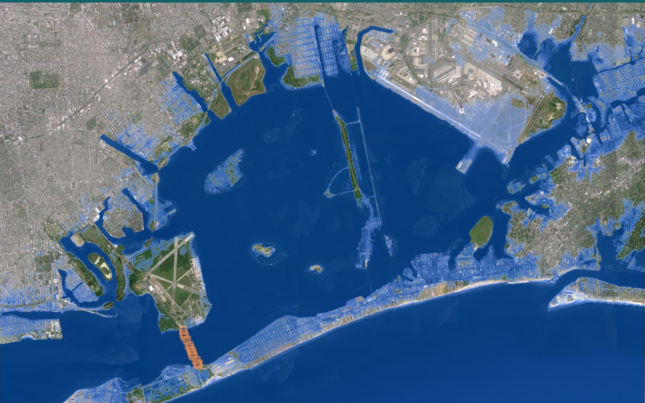
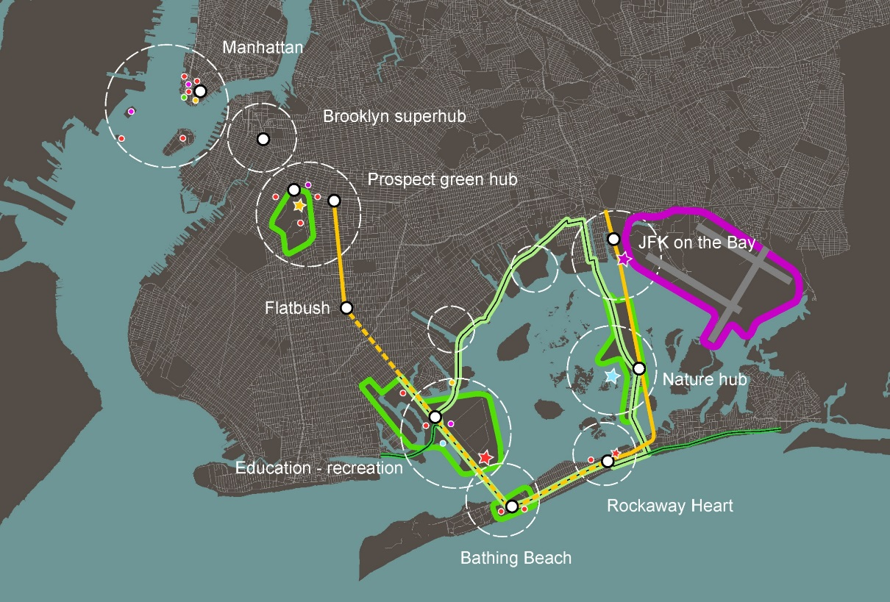
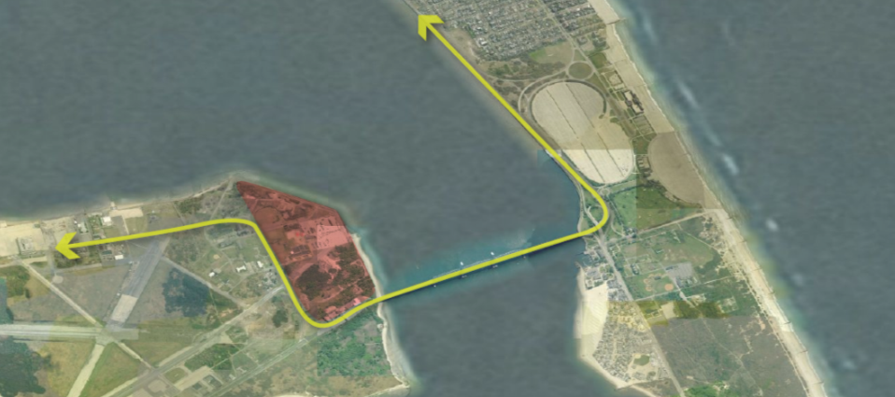
Dutch Dialogue for the Tidewater Preview
New York Example – Jamaica Bay
Super storm Sandy Flooding
Regional Interconnectivity Enhancements Coupled with Flood Mitigation Projects
High-value redevelopment area
Tidal Gate with Subway line

Slide 35
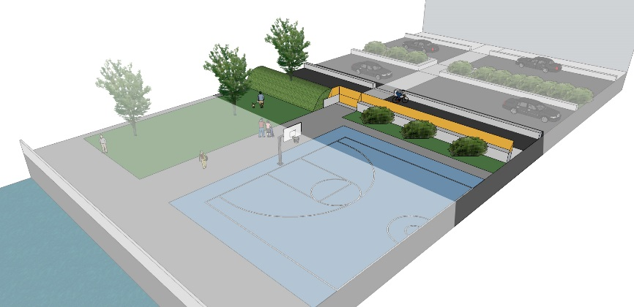
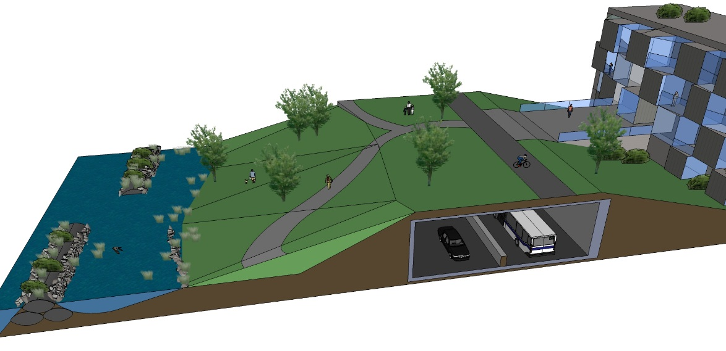
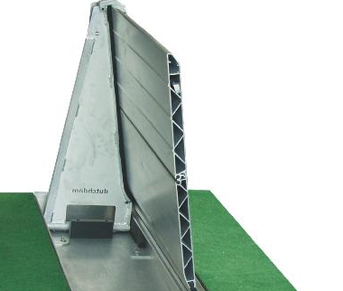
Dutch Dialogue for the Tidewater Preview
New York Example – Jamaica Bay
Super storm Sandy Flooding
Conceptual section with park above seawall
Deployable “Dutchdam” floodwall
Conceptual section along ocean or bay shoreline

Slide 36
Dutch Dialogue for the Tidewater Preview
San Francisco Bay Examples Courtesy of Arcadis

Slide 37
Dutch Dialogue for the Tidewater Preview
San Francisco Bay Examples Courtesy of Arcadis

Slide 38
Dutch Dialogue for the Tidewater Preview
Living in low-lying coastal areas requires choices
to paraphrase from the Dutch 2008 Delta Commission report:
The effects of (sea level rise) will put more pressure on the safety of low-lying areas ..... everybody needs to form a clear picture of what we can expect (as that occurs) to determine ways to cope with those challenges ….. and to define how the changes can create future opportunities.
We must begin to prepare now to pro-actively invest to meet those challenges. To not be prepared, is to surrender.

