Slide 1
The United Nations’ 2030 Agenda for Sustainable Development
The 2030 Agenda is a “Road to Dignity.”
It is the best agreement humanity has ever reached on a global level.
It has a fundamental impact on large parts of the World.
Hans-Peter Plag, Old Dominion University, Norfolk, VA, USA

Slide 2
The United Nations’ 2030 Agenda for Sustainable Development
About Sustainable Development
The 2030 Agenda: A Road to Dignity
The Goals
What is being done to reach the Goals
Society through the Eyes of the Goals
What is missing?
What can you do?
Hans-Peter Plag, Old Dominion University, Norfolk, VA, USA

Slide 3
Prologue
Why is sustainable development of paramount importance for a prosperous future of humanity?

Slide 4
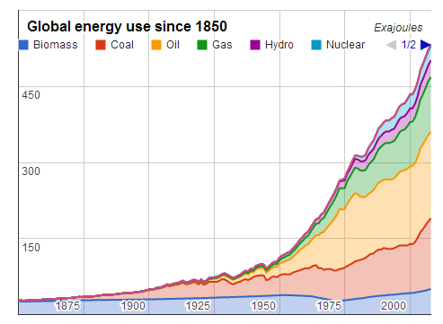
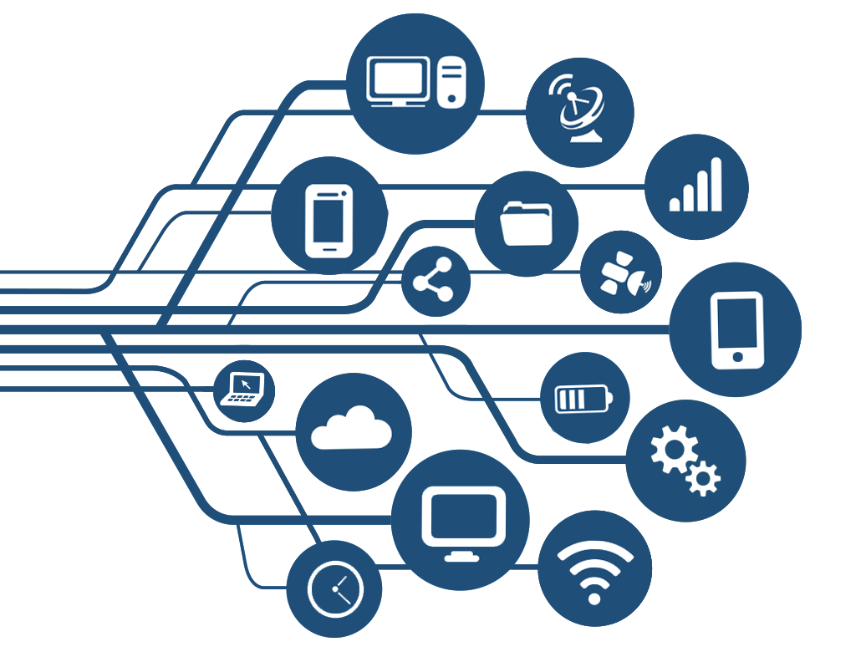
Prologue
Homo sapiens: An Exceptional Success Story
Goal of economy is to create “human wealth”
Accumulate, accumulate, …
Later (Keynes, Lebov):
Consume, Consume, …
Colonizers
Holocene
Single-Species Dominance
Post-Holocene
Technology and access to fossil fuels facilitate economic growth
Adam
Smith
10⁶
10⁵
10⁴
10³
10²
10¹
10⁰
10¹
10²
10³
Years BP
2000
Years
Population
4 M
50 M
1.6 B
5.3 B
6.0 B
6.9 B
12 B?
?
Total energy use
<10⁻⁶ TW
<10⁻³ TW
0.5 TW
10.0 TW
12.8 TW
16.5 TW
>100.0 TW?

Slide 5
Prologue

Slide 6
Prologue

Slide 7
Prologue

Slide 8
Prologue

Slide 9
Prologue
Malthus, 1798: Every population wants to, and will grow, to its limits.
2019: We are still “growth-addicted”:
population;
economy;
wealth;
inequality;
resource usage;
pollution;
extinction;
…
That is why sustainable development with limited growth is of paramount importance for a prosperous the future of humanity!
Growth-addiction is dangerous if all limits to growth are removed …
Published in 1964
Published in 1972

Slide 10
The United Nations’ 2030 Agenda for Sustainable Development
About Sustainable Development
The 2030 Agenda: A Road to Dignity
The Goals
What is being done to reach the Goals
Society through the Eyes of the Goals
What is missing?
What can you do?

Slide 11
About Sustainable Development
The history of sustainable development in the United Nations dates back to:
United Nations Conference on the Human Environment
(Stockholm Conference)
Stockholm, Sweden
June 5-16, 1972

Slide 12
About Sustainable Development

Slide 13
About Sustainable Development
"Sustainable development is development that meets the needs of the present without compromising the ability of future generations to meet their own needs".
Published in 1987

Slide 14
About Sustainable Development

Slide 15
About Sustainable Development
The world leaders who gathered at the Summit committed their nations to a new global partnership to reduce extreme poverty, and set out a series of time-bound targets, with a deadline of 2015, that have become known, since the Millennium Summit, as the Millennium Development Goals.
The Millennium Development Goals are to:
eradicate extreme poverty and hunger;
achieve universal primary education;
promote gender equality and empower women;
reduce child mortality;
improve maternal health;
combat HIV/AIDS, malaria and other diseases;
ensure environmental sustainability; and
develop a global partenership for development.
On environmental protection, the Millennium Declaration stated that no efforts must be spared to counter the threat of the planet being irredeemably spoiled by human activities. Therefore, the participants of the Summit resolved to adopt a new ethic of conservation and stewardship.
The Millennium Summit was a meeting among many world leaders lasting three days from 6 September^{[1]} to 8 September 2000^{[2]} at the United Nations headquarters in New York City. Its purpose was to discuss the role of the United Nations at the turn of the 21st century.^{[3]} At this meeting, world leaders ratified the United Nations Millennium Declaration.^{[4]}
Wikipedia

Slide 16
About Sustainable Development
15. We risk the entrenchment of these global disparities and unless we act in a manner that fundamentally changes their lives the poor of the world may lose confidence in their representatives and the democratic systems to which we remain committed, seeing their representatives as nothing more than sounding brass or tinkling cymbals.
Earth Summit II or Rio +10
14. Globalization has added a new dimension to these challenges. The rapid integration of markets, mobility of capital and significant increases in investment flows around the world have opened new challenges and opportunities for the pursuit of sustainable development. But the benefits and costs of globalization are unevenly distributed, with developing countries facing special difficulties in meeting this challenge.
13. The global environment continues to suffer. Loss of biodiversity continues, fish stocks continue to be depleted, desertification claims more and more fertile land, the adverse effects of climate change are already evident, natural disasters are more frequent and more devastating, and developing countries more vulnerable, and air, water and marine pollution continue to rob millions of a decent life.
12. The deep fault line that divides human society between the rich and the poor and the ever-increasing gap between the developed and developing worlds pose a major threat to global prosperity, security and stability.
11. We recognize that poverty eradication, changing consumption and production patterns and protecting and managing the natural resource base for economic and social development are overarching objectives of and essential requirements for sustainable development.

Slide 17
About Sustainable Development
The future we want
The future we want
https://sustainabledevelopment.un.org/rio20

Slide 18
About Sustainable Development
2. Poverty eradication is the greatest global challenge facing the world today and an indispensable requirement for sustainable development. In this regard, we are committed to freeing humanity from poverty and hunger as a matter of urgency.
3. We therefore acknowledge the need to further mainstream sustainable development at all levels, integrating economic, social and environmental aspects and recognizing their interlinkages, so as to achieve sustainable development in all its dimensions.
4. We recognize that poverty eradication, changing unsustainable and promoting sustainable patterns of consumption and production and protecting and managing the natural resource base of economic and social development are the overarching objectives of and essential requirements for sustainable development. We also reaffirm the need to achieve sustainable development by promoting sustained, inclusive and equitable economic growth, creating greater opportunities for all, reducing inequalities, raising basic standards of living, fostering equitable social development and inclusion, and promoting the integrated and sustainable management of natural resources and ecosystems that supports, inter alia, economic, social and human development while facilitating ecosystem conservation, regeneration and restoration and resilience in the face of new and emerging challenges.

Slide 19
About Sustainable Development
B. Sustainable development goals
…
248. We resolve to establish an inclusive and transparent intergovernmental process on sustainable development goals that is open to all stakeholders, with a view to developing global sustainable development goals to be agreed by the General Assembly.
…
250. We recognize that progress towards the achievement of the goals needs to be assessed and accompanied by targets and indicators, while taking into account different national circumstances, capacities and levels of development.
251. We recognize that there is a need for global, integrated and scientifically based information on sustainable development. In this regard, we request the relevant bodies of the United Nations system, within their respective mandates, to support the regional economic commissions in collecting and compiling national inputs in order to inform this global effort. We further commit to mobilizing financial resources and capacity-building, particularly for developing countries, to achieve this endeavour.

Slide 20
The United Nations’ 2030 Agenda for Sustainable Development
About Sustainable Development
The 2030 Agenda: A Road to Dignity
The Goals
What is being done to reach the Goals
Society through the Eyes of the Goals
What is missing?
What can you do?

Slide 21
The 2030 Agenda
2012 - 2015: Developing the Sustainable Development Goals
United Nations’ Agencies
International Research Forum
Inter-agency and Experts Group on Sustainable Development Goals Indicators
Many others
IRF, 2013

Slide 22
The 2030 Agenda
Adaptation and Sustainability Science
}
What might happen?
Possible threats and hazards
System Knowledge
Knowing the system trajectory
}
Goal Knowledge
What do we want to happen?
}
How can we impact the system trajectory?
Transformational Knowledge
Adaptation Science
Sustainability Science
Transformation knowledge
Facilitating pathways
System knowledge
Current state and trends
Goal knowledge
desirable future

Slide 23
The 2030 Agenda
Planetary stability must be integrated with United Nations targets to fight poverty and secure human well-being, argue David Griggs and colleagues

Slide 24
The 2030 Agenda

Slide 25
The 2030 Agenda
"Sustainable development is development that meets the needs of the present without compromising the ability of future generations to meet their own needs”. 1986
“Sustainable Development is a development that meets the needs of the present while safeguarding Earth’s life support systems, on which the welfare of current and future generations depends.” (Griggs et al., 2013)

Slide 26
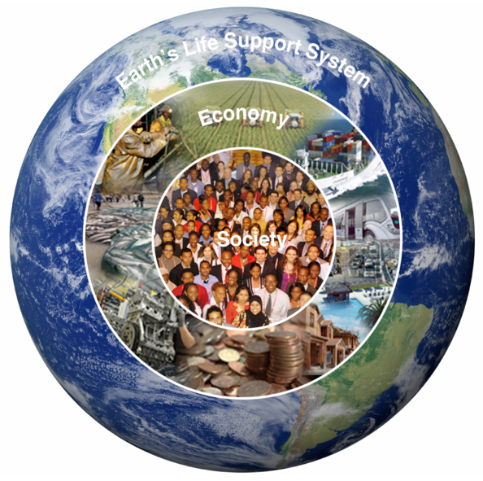
The 2030 Agenda
"Sustainable development is development that meets the needs of the present without compromising the ability of future generations to meet their own needs”. 1986
“Sustainable Development is a development that meets the needs of the present while safeguarding Earth’s life support systems, on which the welfare of current and future generations depends.” (Griggs et al., 2013)
Plag, 2016

Slide 27
The 2030 Agenda
2015: United Nations General Assembly accepts 2030 Agenda

Slide 28
The 2030 Agenda
2015: United Nations General Assembly accepts 2030 Agenda
The Goals and targets will stimulate action over the next fifteen years in areas of critical importance for humanity and the planet:
People We are determined to end poverty and hunger, in all their forms and dimensions, and to ensure that all human beings can fulfil their potential in dignity and equality and in a healthy environment.
Planet We are determined to protect the planet from degradation, including through sustainable consumption and production, sustainably managing its natural resources and taking urgent action on climate change, so that it can support the needs of the present and future generations.
Prosperity We are determined to ensure that all human beings can enjoy prosperous and fulfilling lives and that economic, social and technological progress occurs in harmony with nature.
Peace We are determined to foster peaceful, just and inclusive societies which are free from fear and violence. There can be no sustainable development without peace and no peace without sustainable development.
Partnership We are determined to mobilize the means required to implement this Agenda through a revitalised Global Partnership for Sustainable Development, based on a spirit of strengthened global solidarity, focussed in particular on the needs of the poorest and most vulnerable and with the participation of all countries, all stakeholders and all people.

Slide 29
The United Nations’ 2030 Agenda for Sustainable Development
About Sustainable Development
The 2030 Agenda: A Road to Dignity
The Goals
What is being done to reach the Goals
Society through the Eyes of the Goals
What is missing?
What can you do?

Slide 30
The SDGs
Each Goal comes with up to 10 Targets
Each Target comes with up to two indicators
Specific targets are important for governments to focus on
Indicators are also important for governments to report on
Goals are also a framework for changing morality and ethics
Achieving the goals needs requires buy-in at all levels

Slide 31
The SDGs
eradicate extreme poverty
reduce by half all poverty
proportion of population in extreme poverty
proportion of population in relative poverty

Slide 32
The SDGs
national policies
proportion of government spending

Slide 33
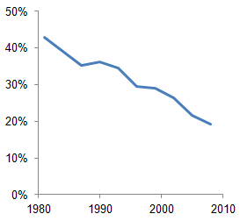
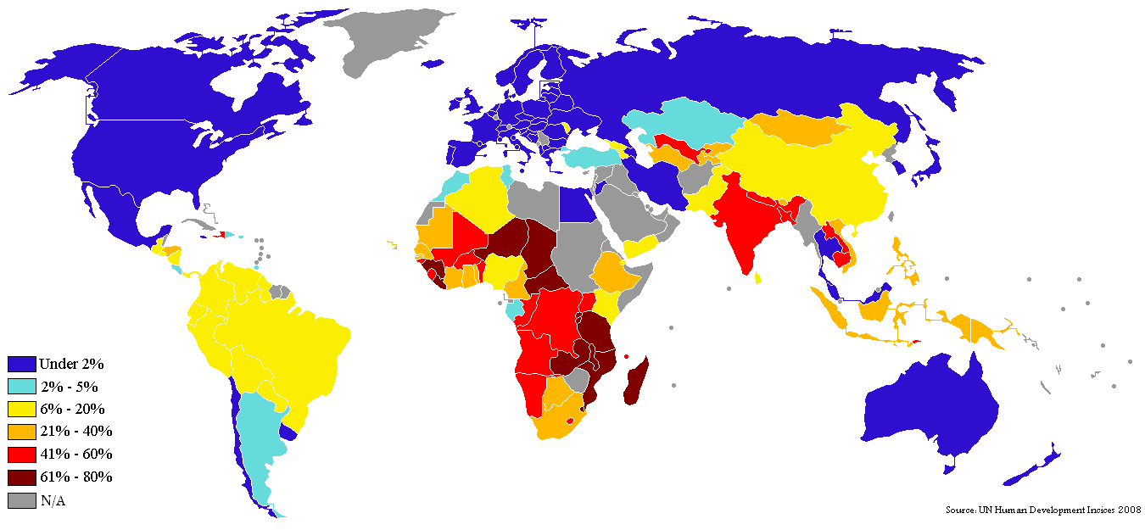
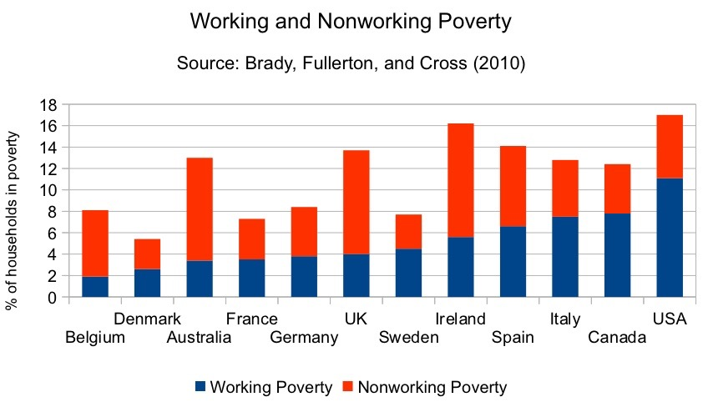
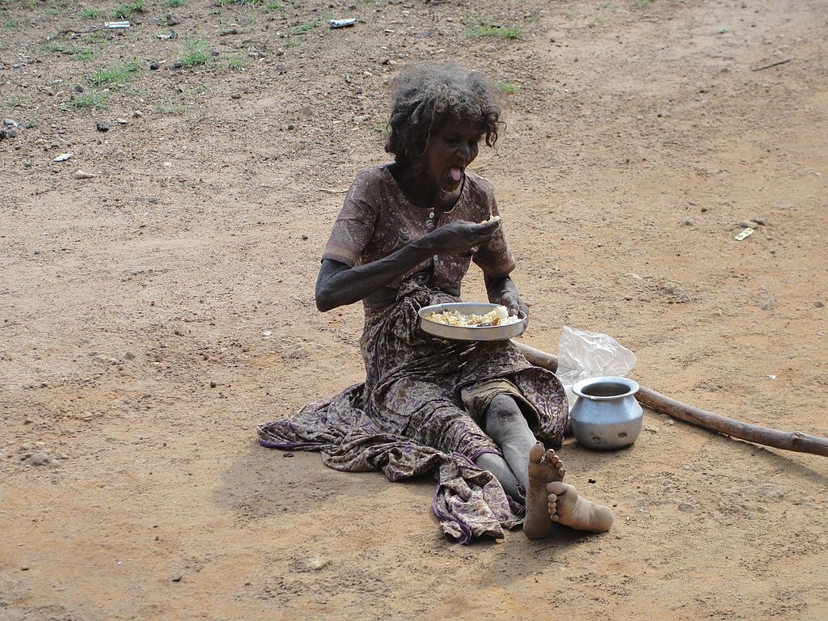
The SDGs
Percentage of global population in extreme poverty
Percentage of population living on less than $1 a day (2008-2009), UN Human Development Index, 2008
The SDGS are about real-world problems, about people suffering, …

Slide 34
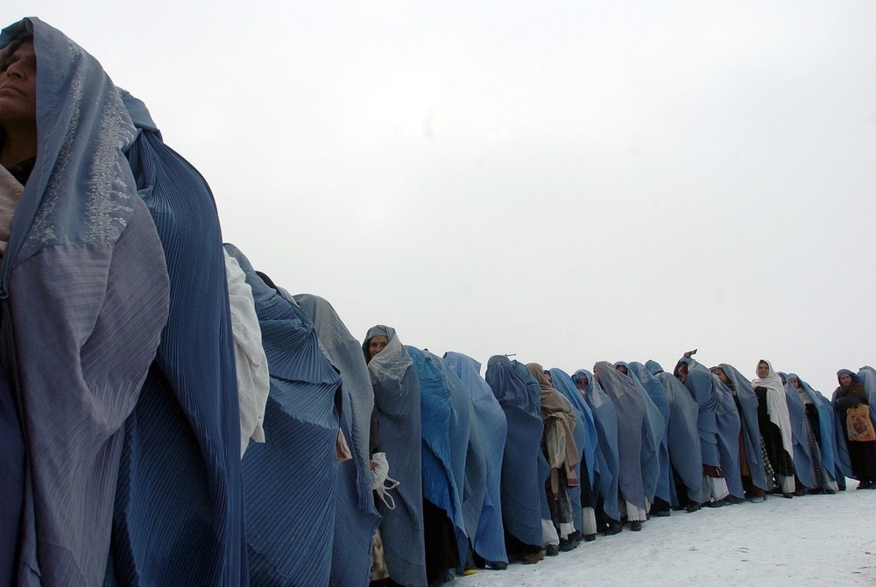
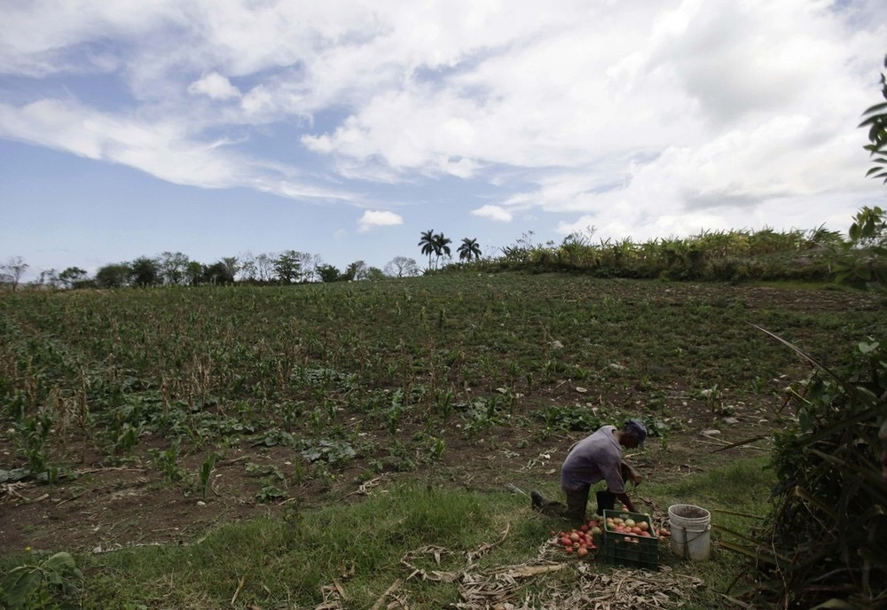
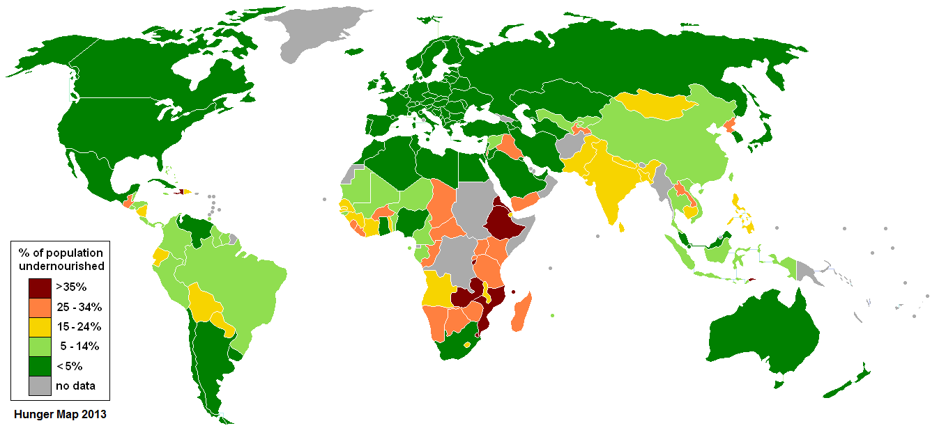
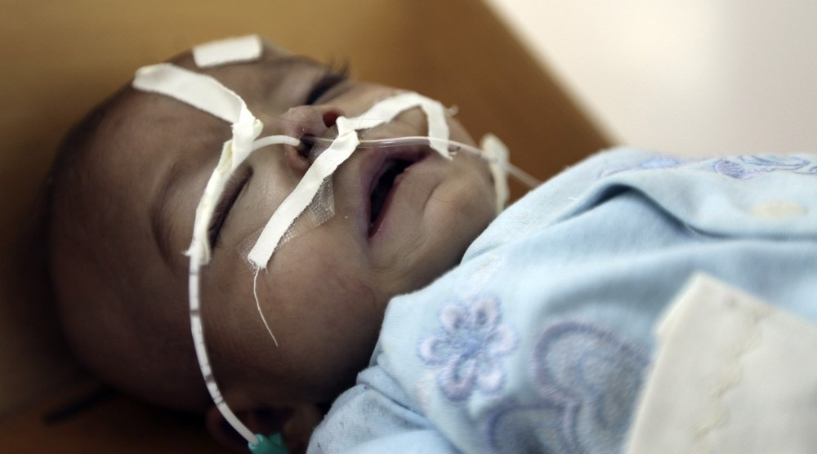
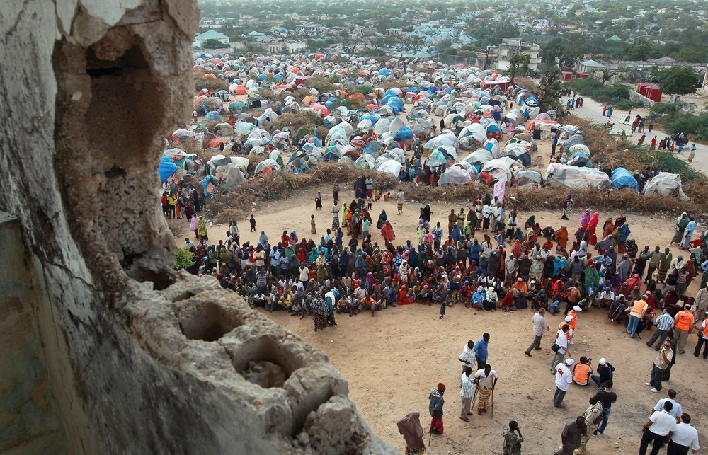
The SDGs
Percentage of population undernourished

Slide 35
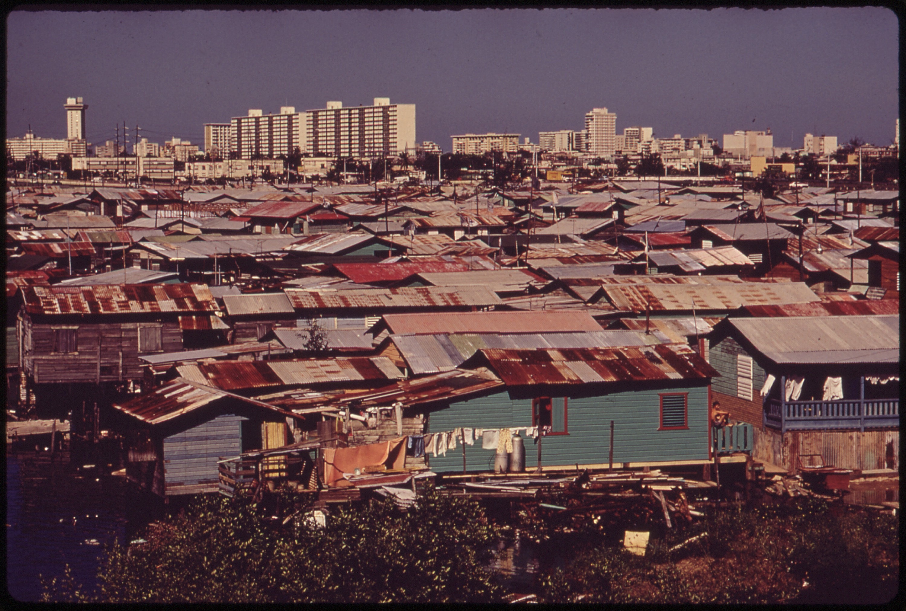
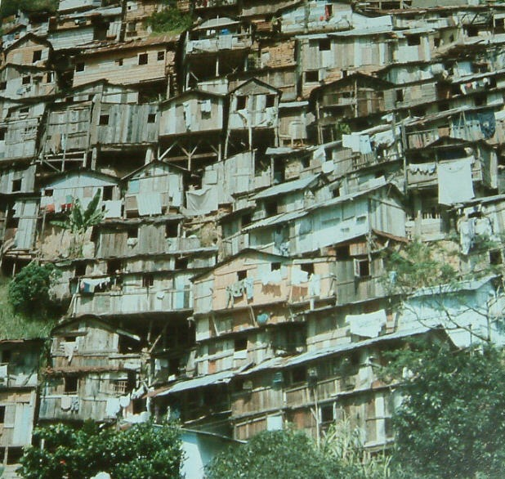
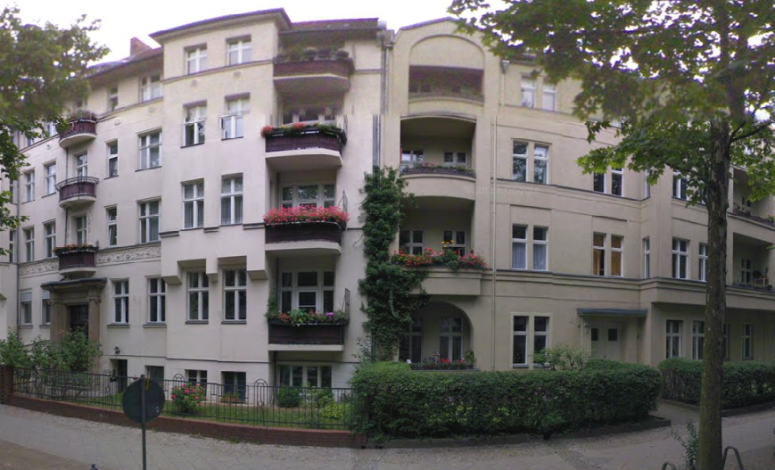
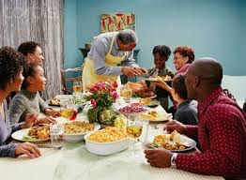
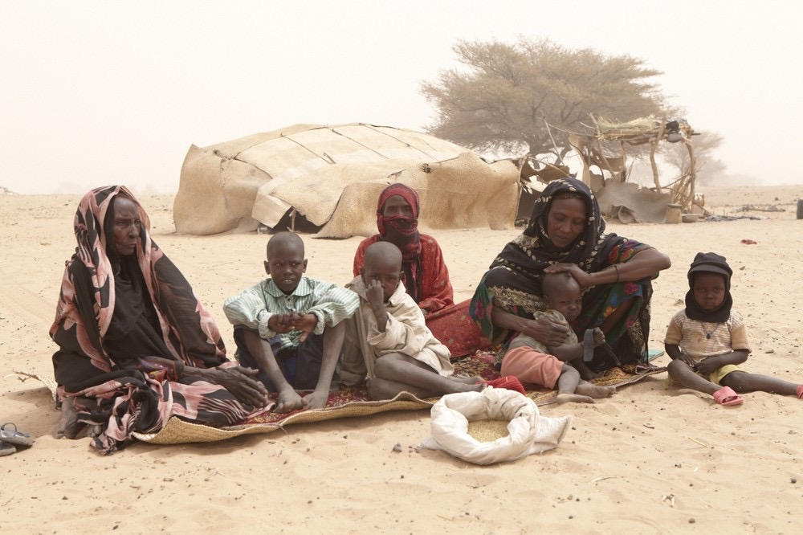
The SDGs

Slide 36
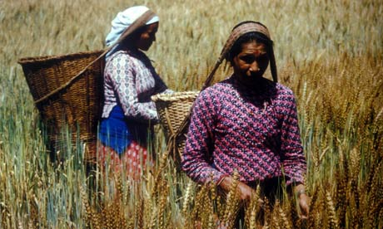
The SDGs
Women make major contributions to crop production.
Women have the least access to the means for increasing yields and moving from subsistence crops to market-oriented production
Women carry out 70% of the global work hours
but they only earn 10% of the global salary

Slide 37
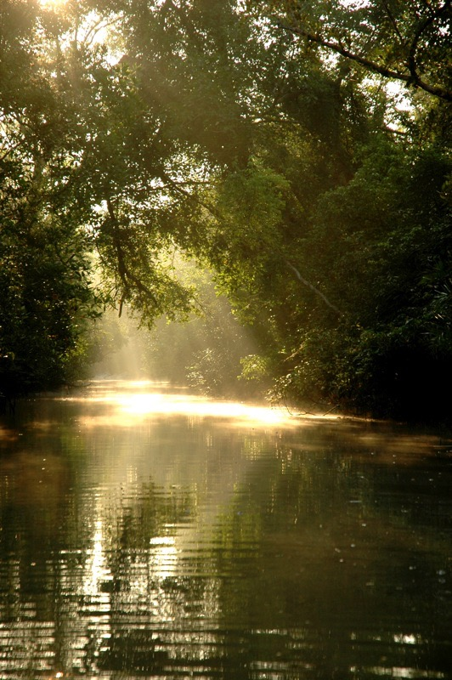
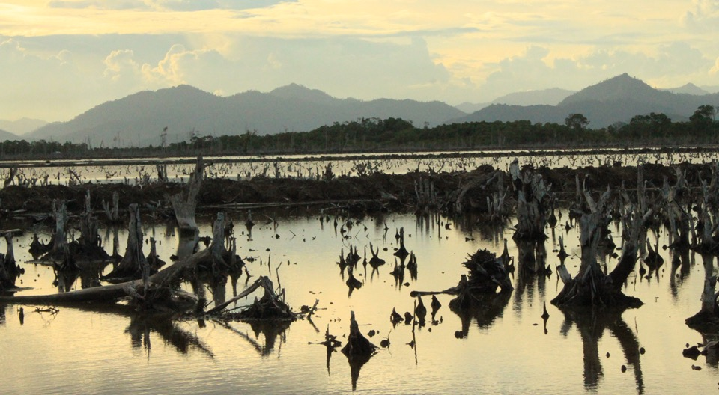
The SDGs
Mangroves
A Tragedy for our Oceans
Continuing heavy loss of mangrove forests represents a real tragedy for our oceans and the extensive life-support systems mangroves engender.
About half of mangrove loss has occurred in the last 50 years, mostly in the last two decades, due to:
shrimp farming
tourism
urbanization
agriculture expansion
roadways
marinas, and
other intrusive developments.

Slide 38
The SDGs
Mangroves link many of the SDGs …

Slide 39
The United Nations’ 2030 Agenda for Sustainable Development
About Sustainable Development
The 2030 Agenda: A Road to Dignity
The Goals
What is being done to reach the Goals
Society through the Eyes of the Goals
What is missing?
What can you do?

Slide 40
What is being done to reach the SDGs?

Slide 41
What is being done to reach the SDGs?

Slide 42
What is being done to reach the SDGs?

Slide 43
What is being done to reach the SDGs?

Slide 44
What is being done to reach the SDGs?

Slide 45
What is being done to reach the SDGs?

Slide 46
What is being done to reach the SDGs?

Slide 47
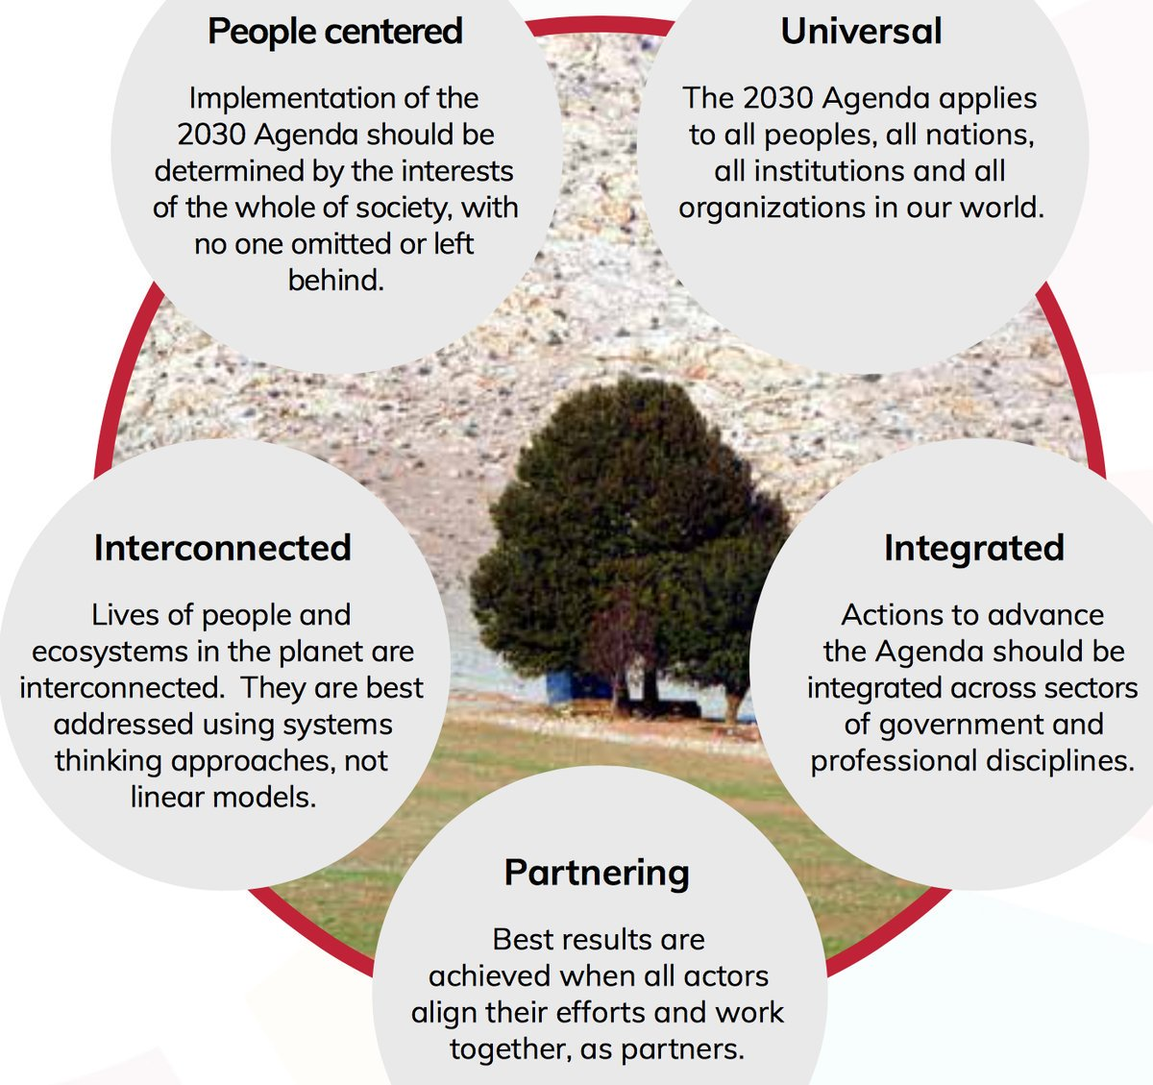
What is being done to reach the SDGs?

Slide 48
What is being done to reach the SDGs?

Slide 49
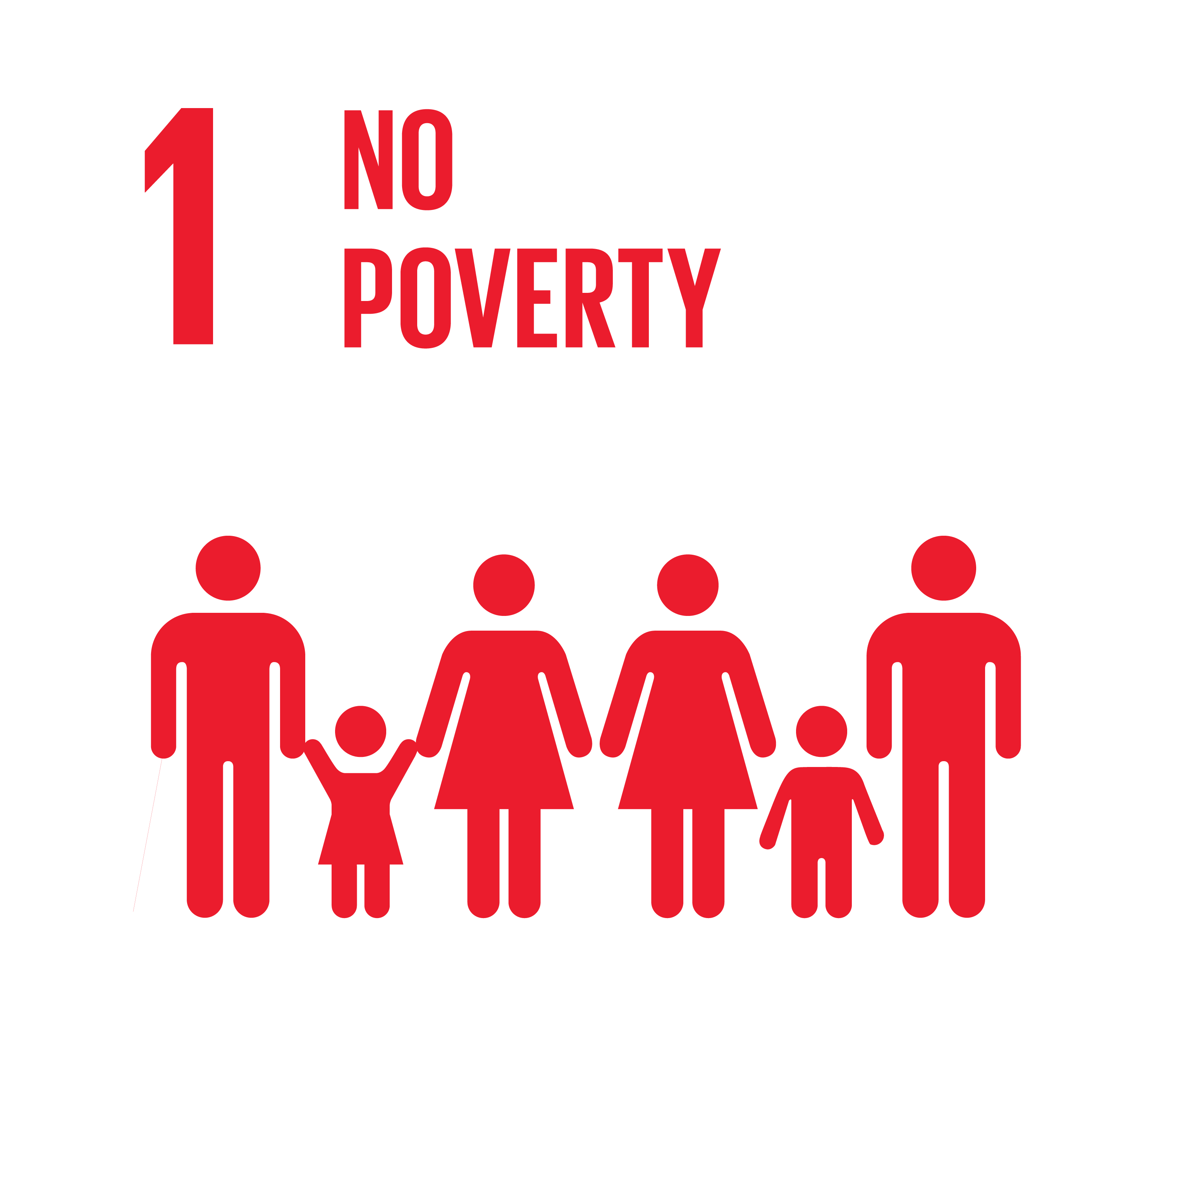
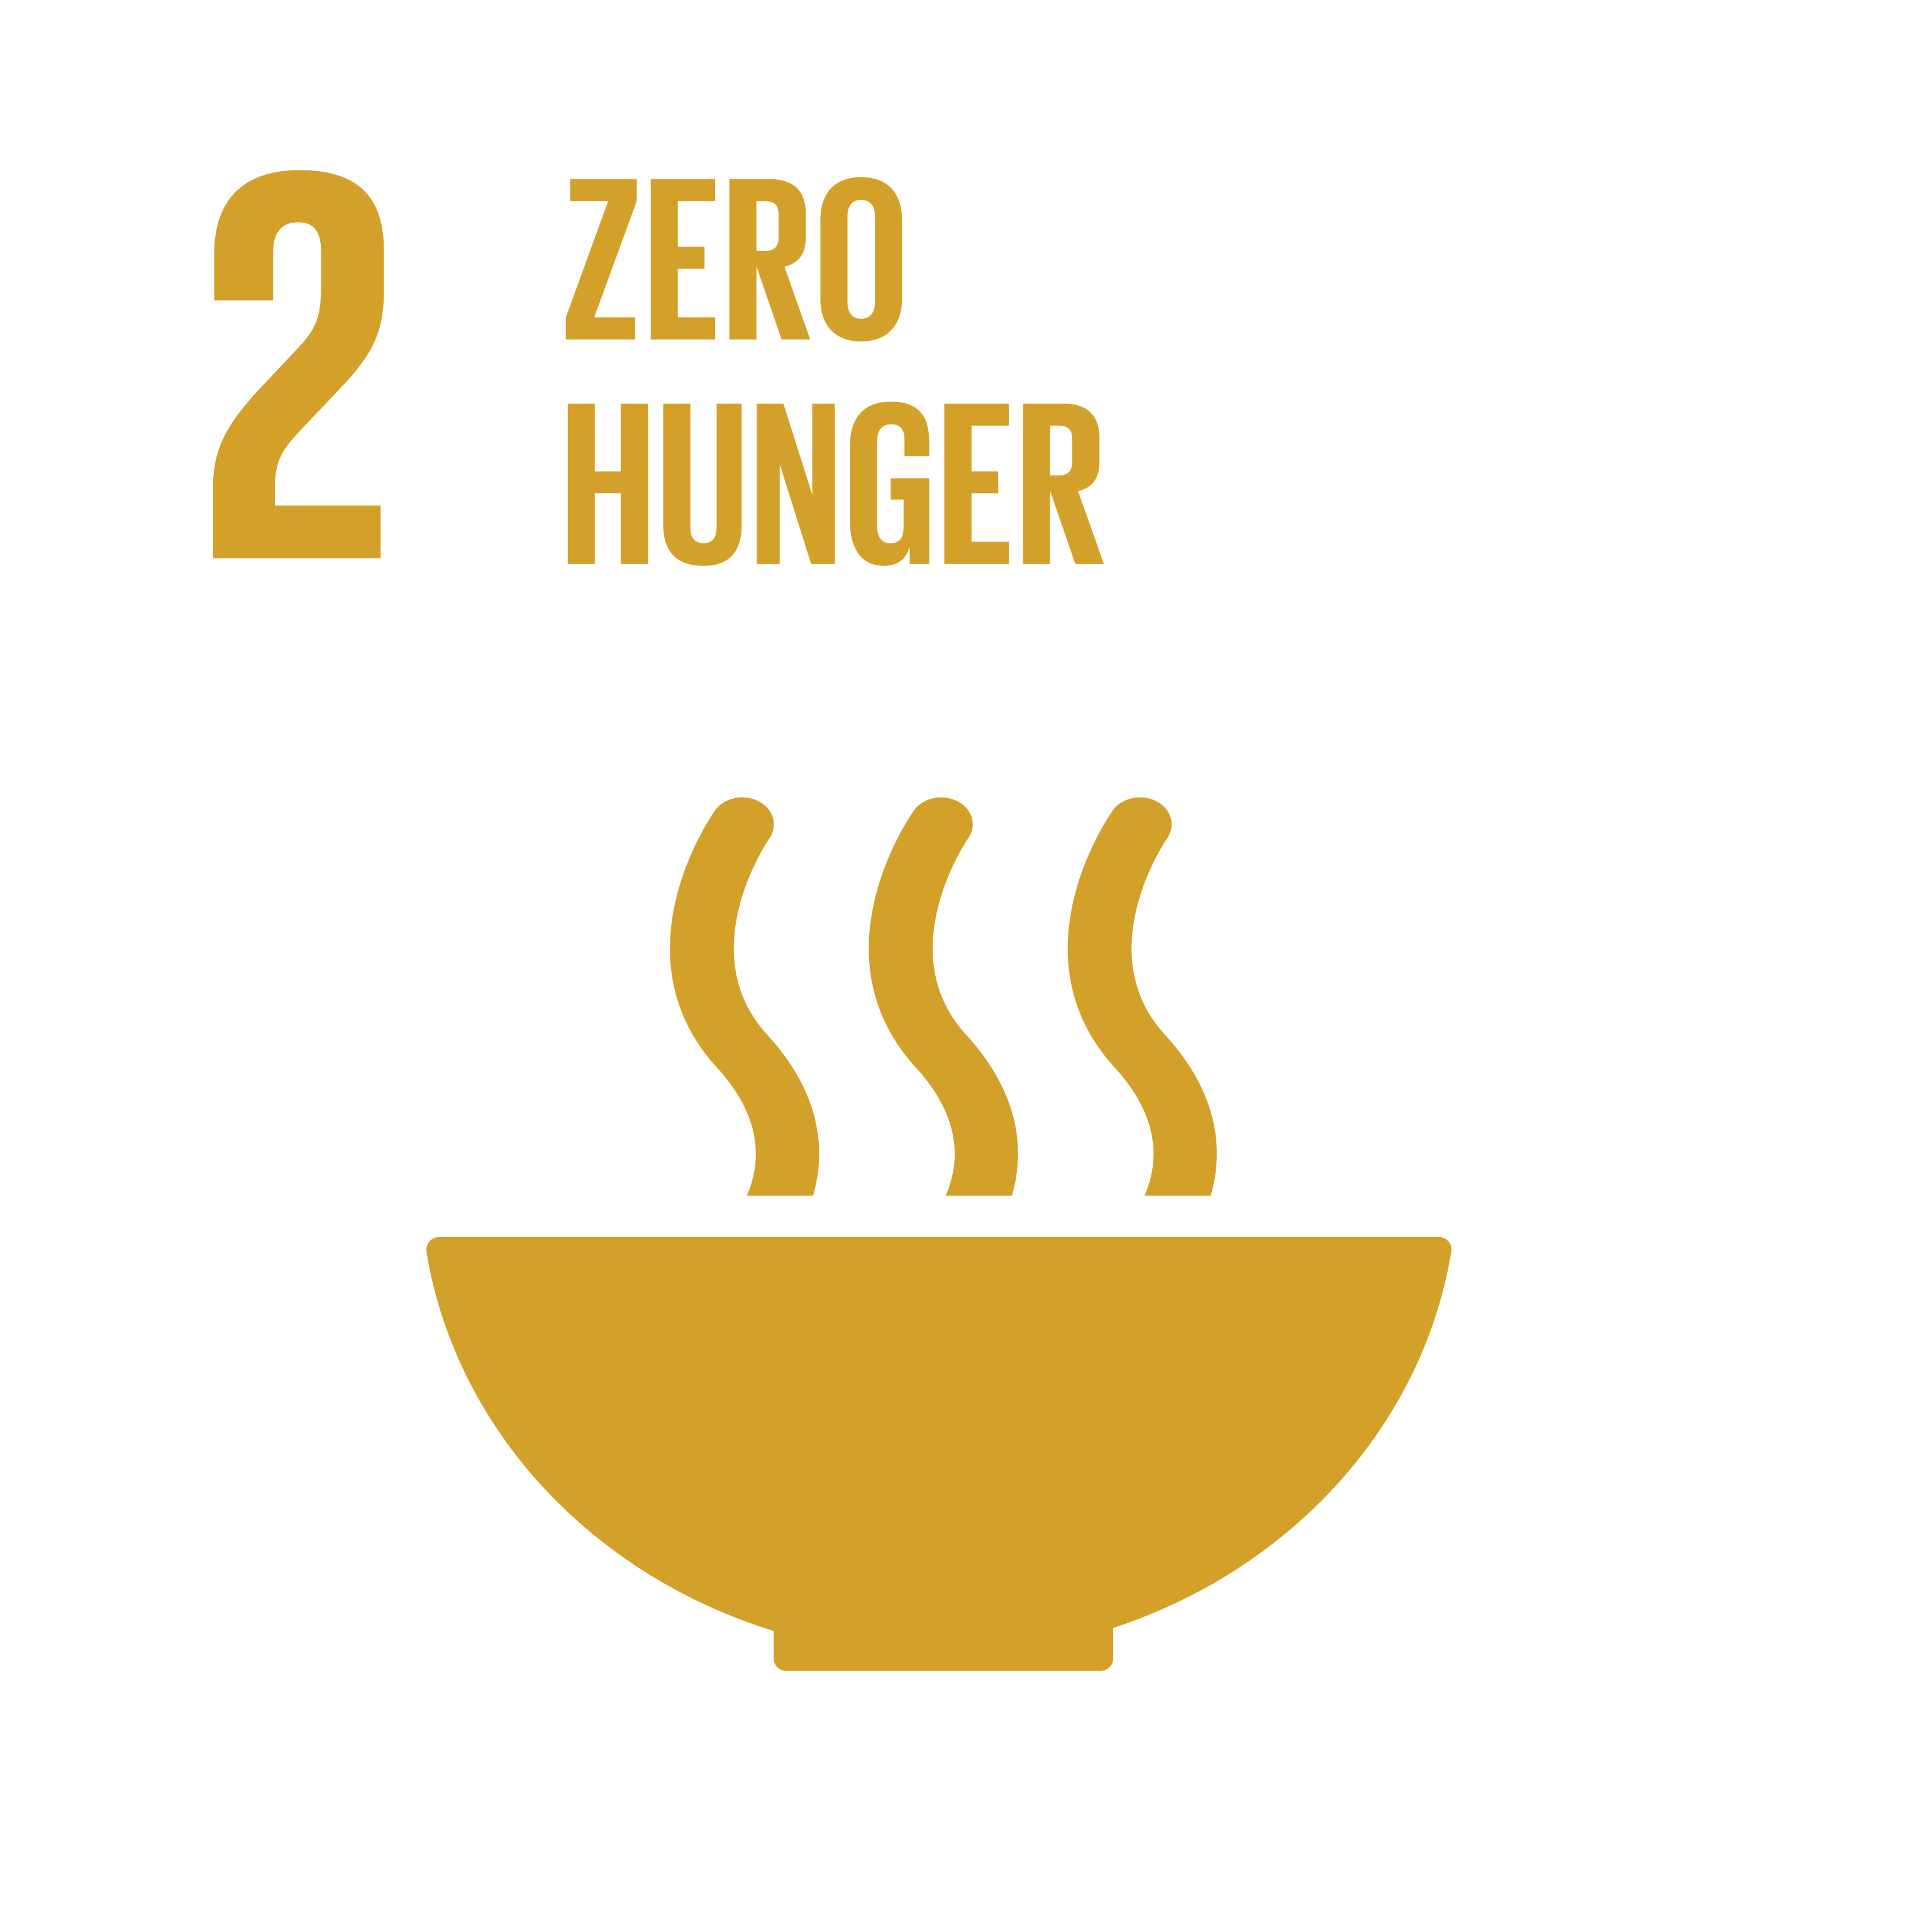
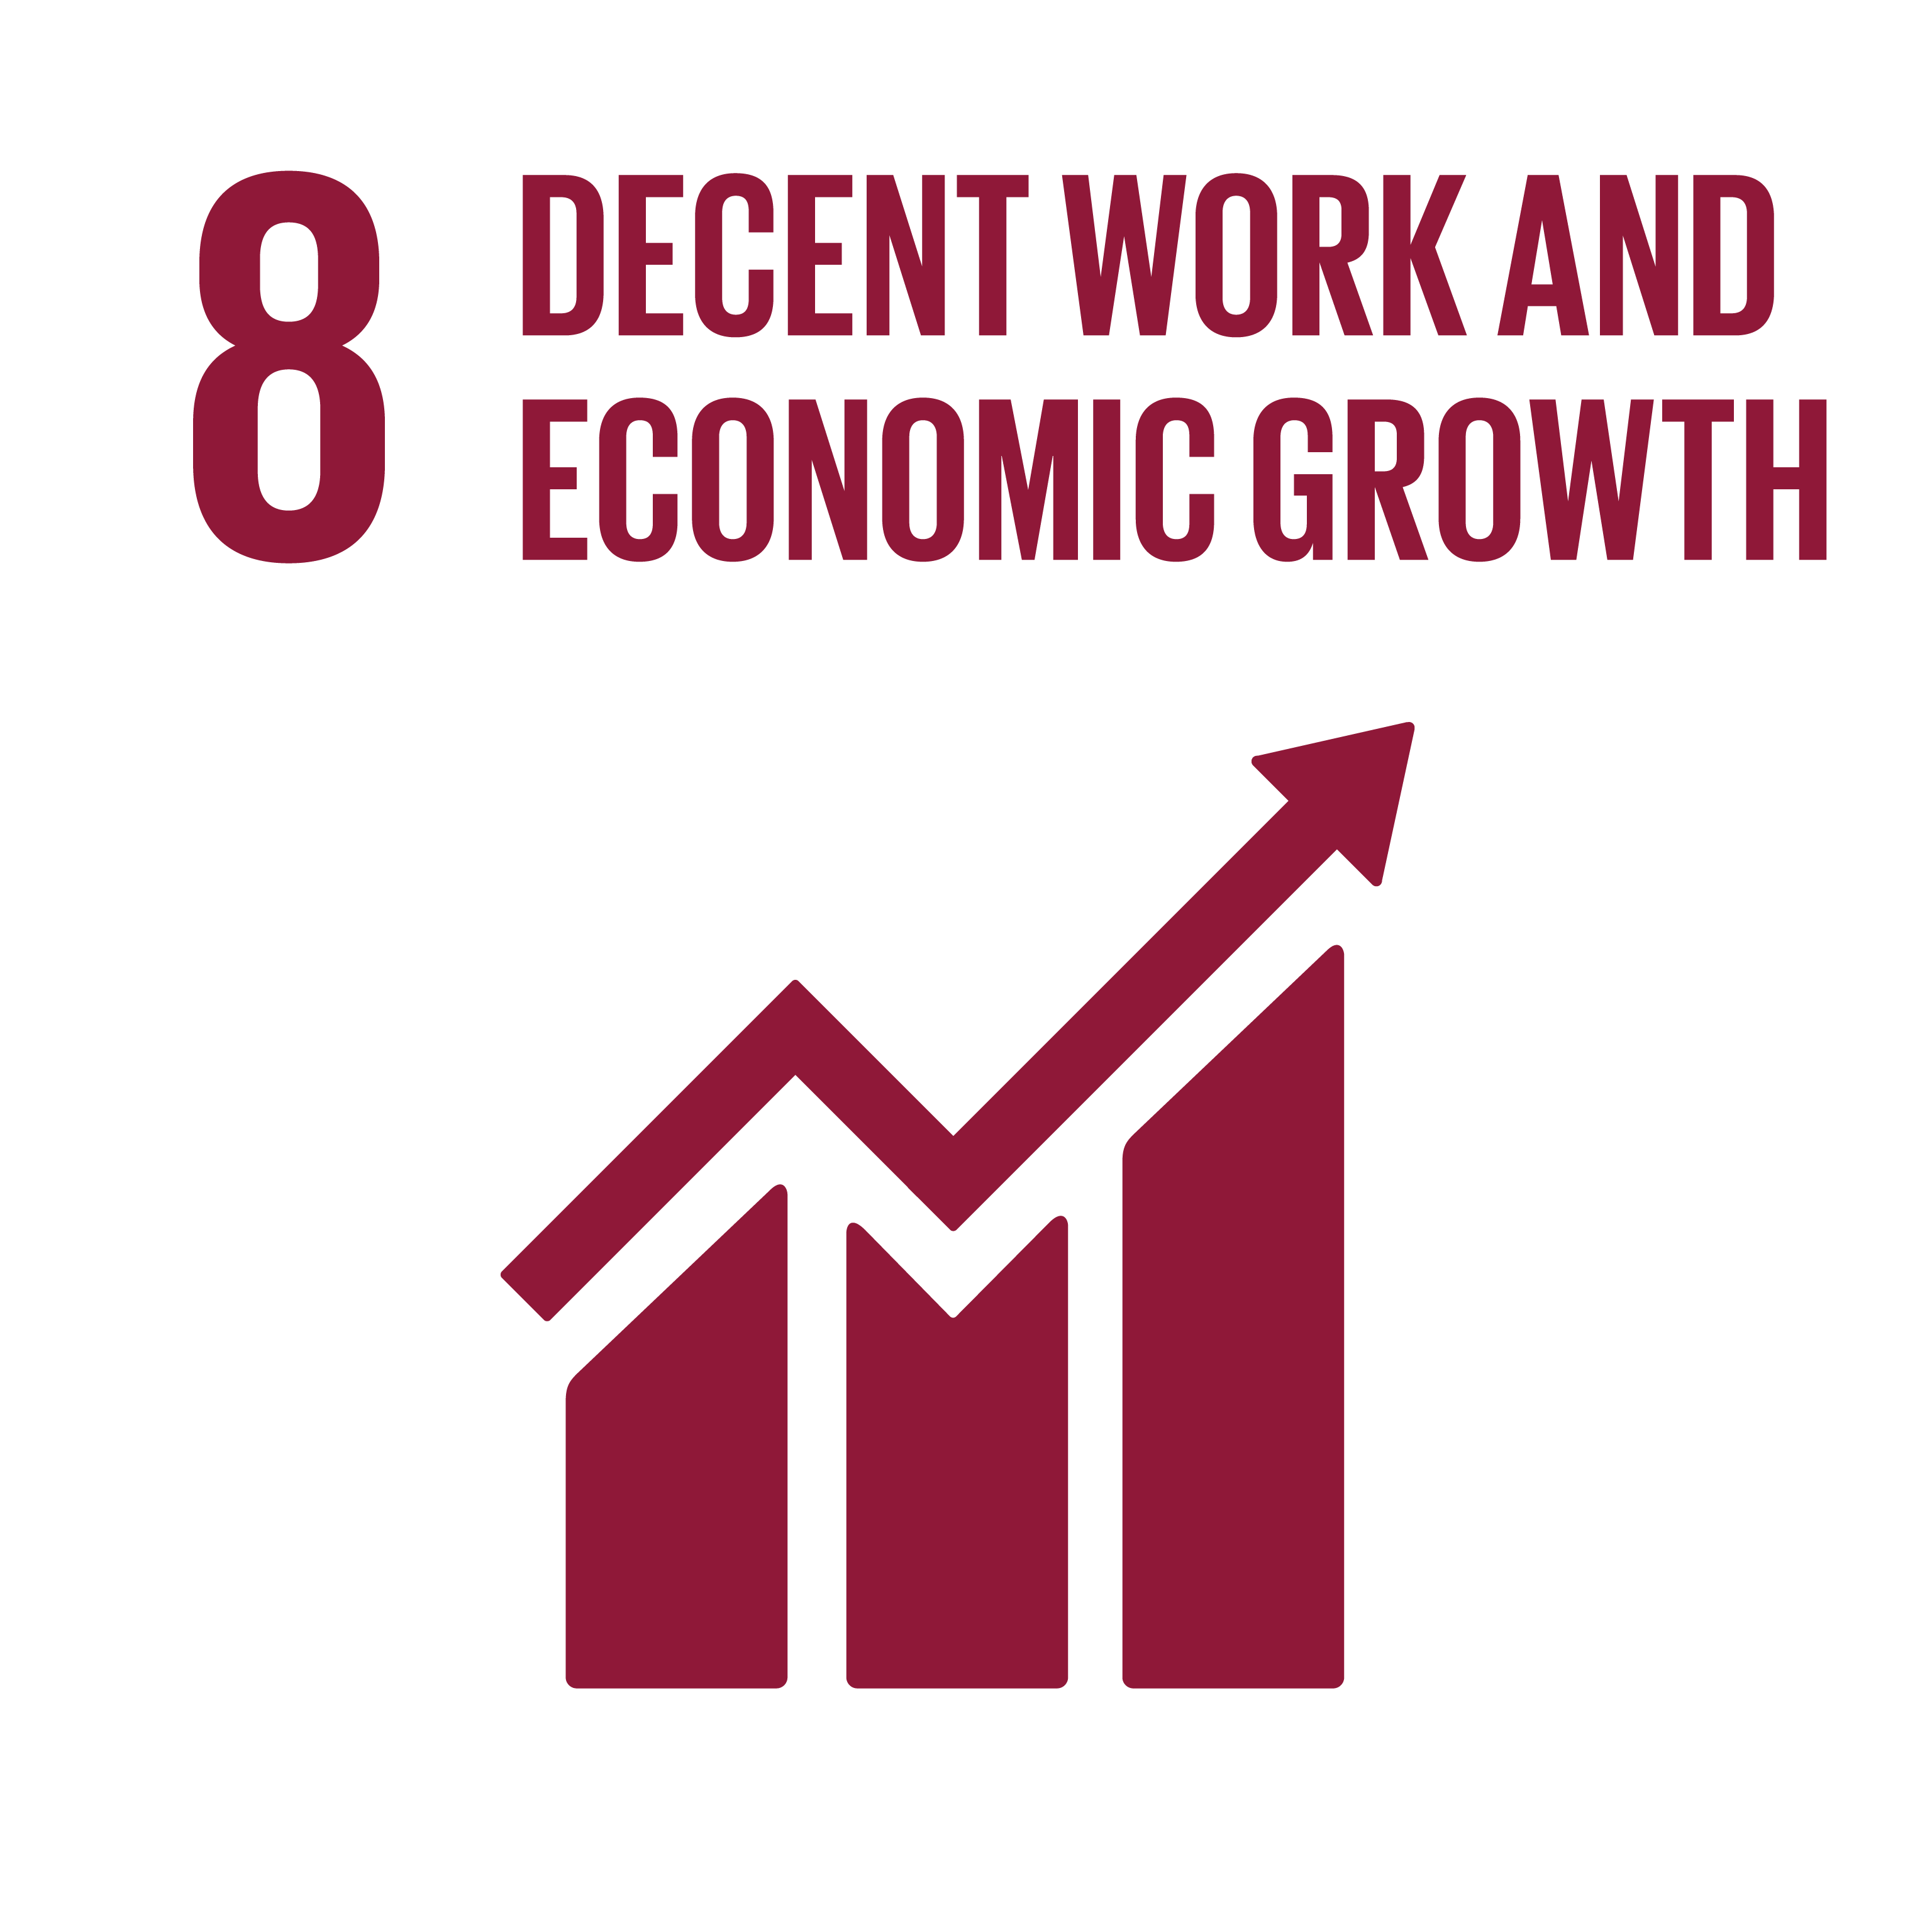
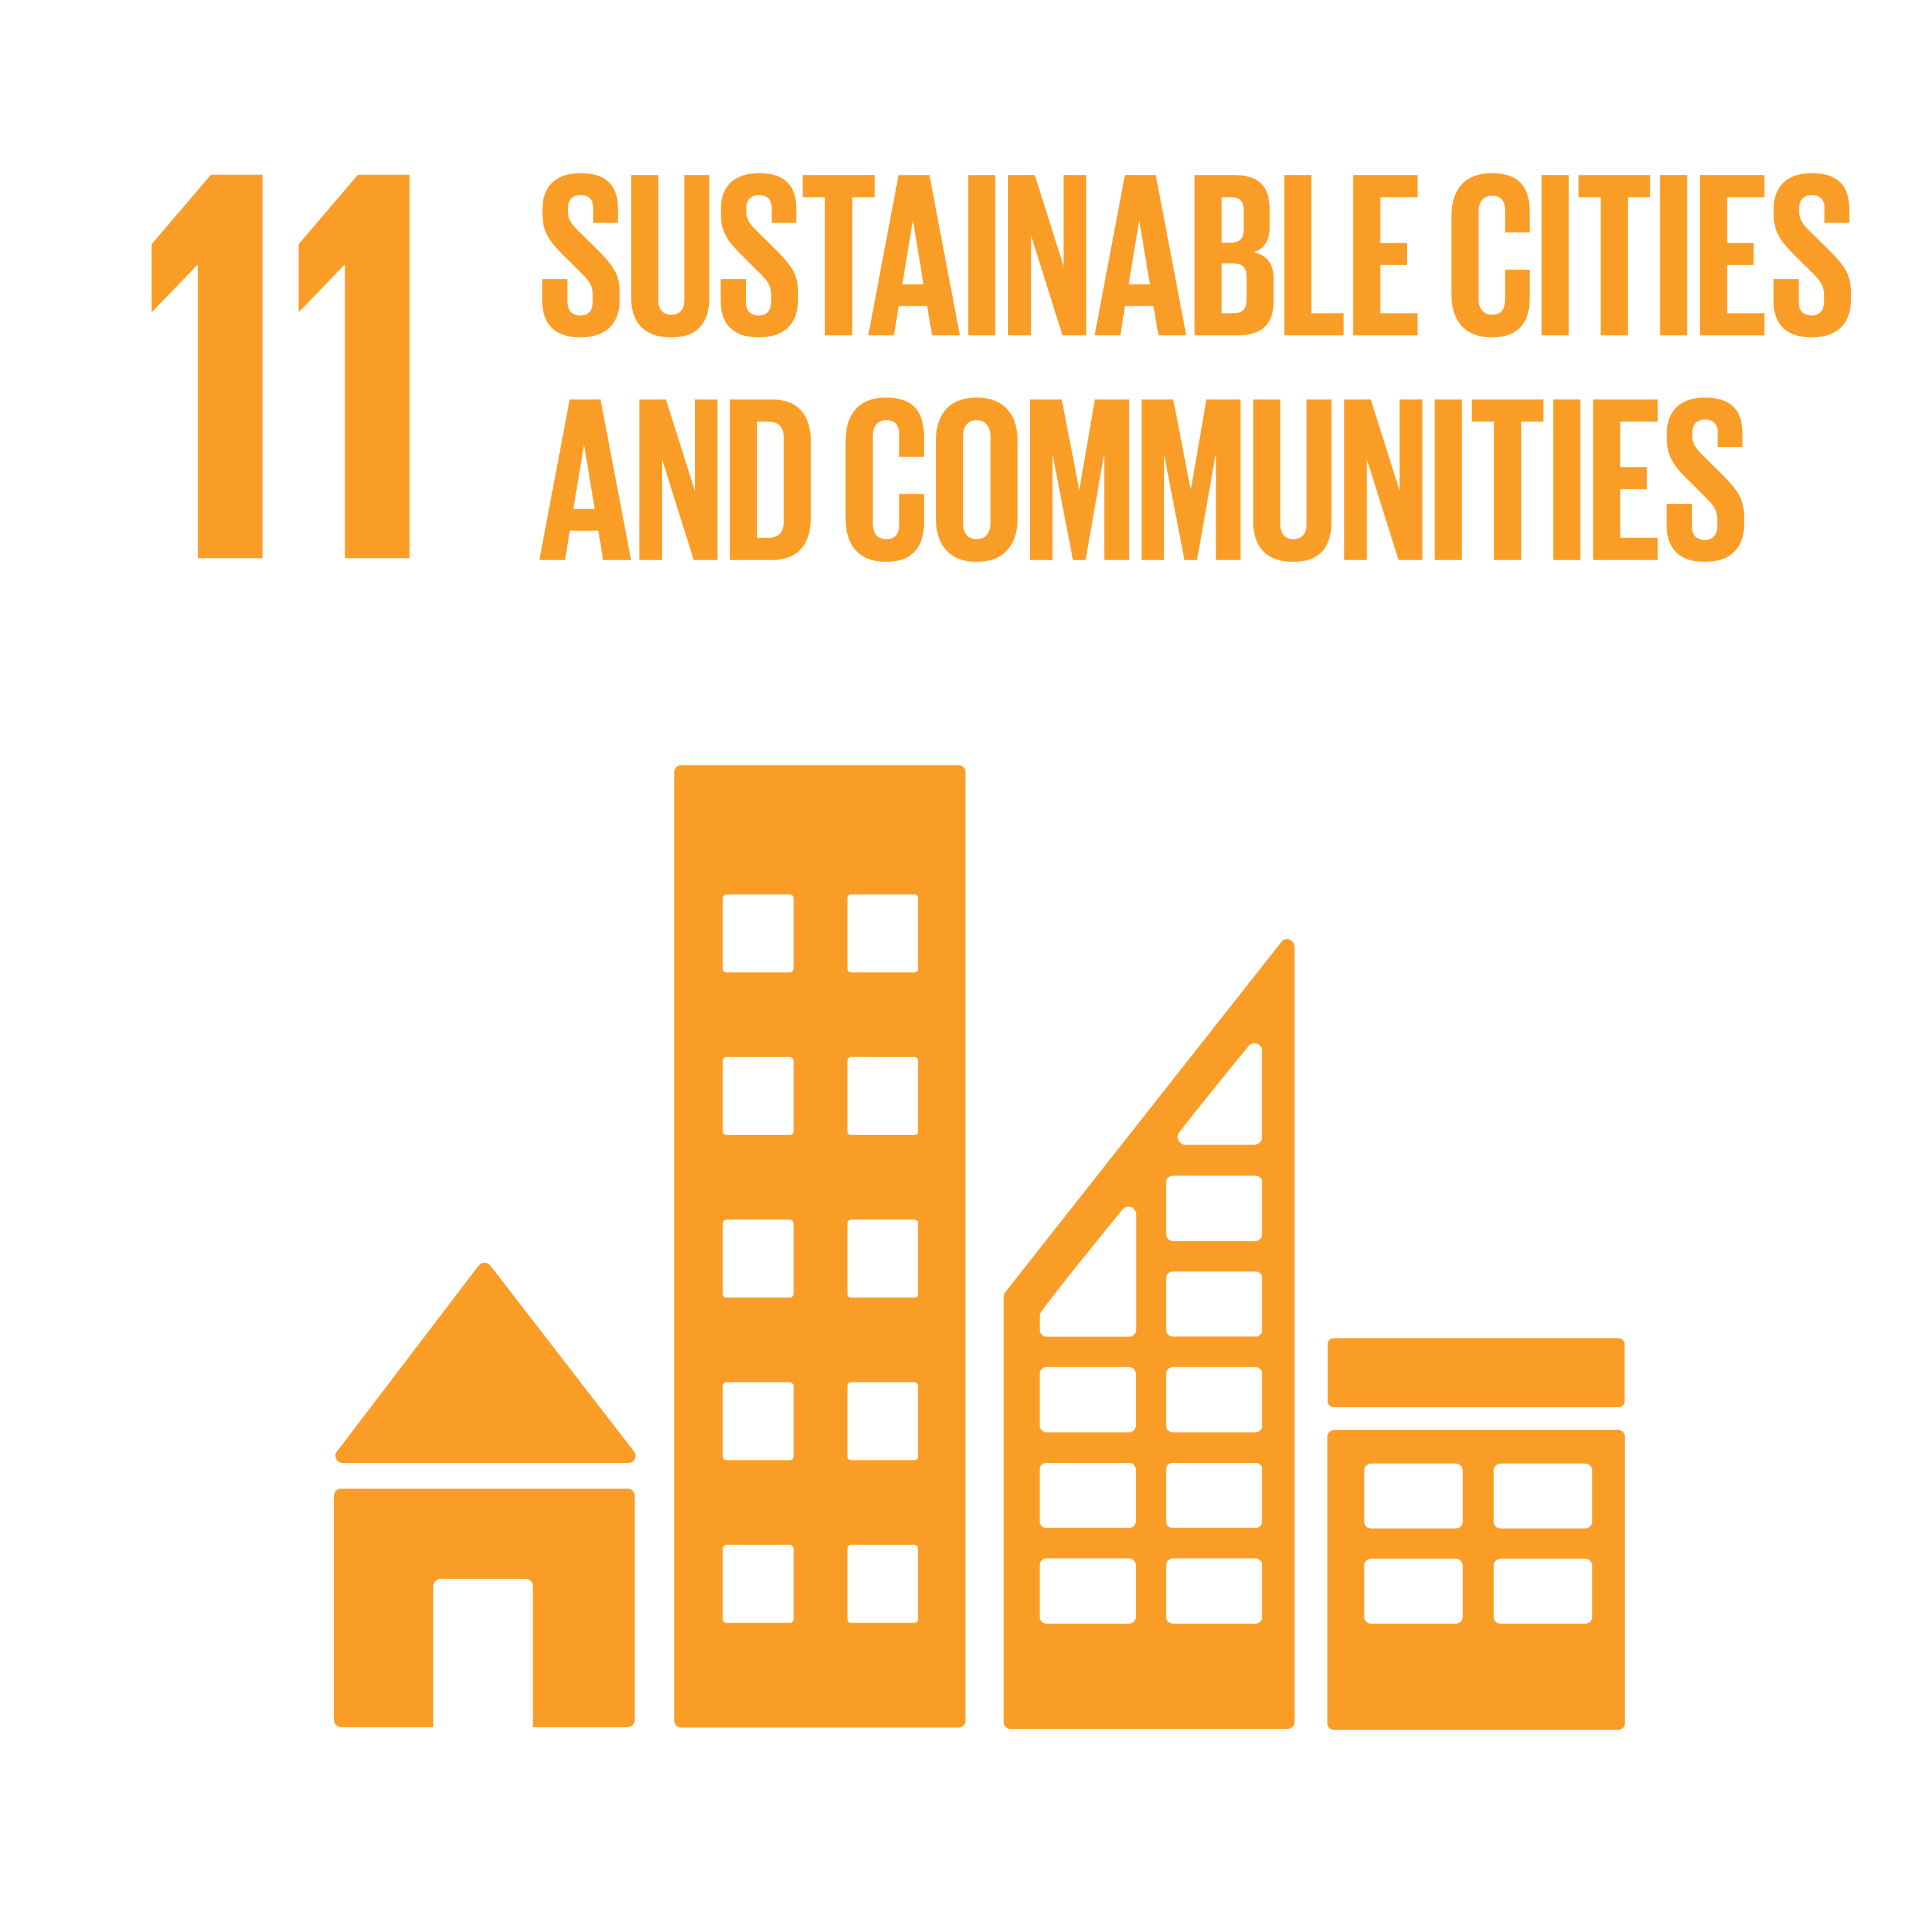
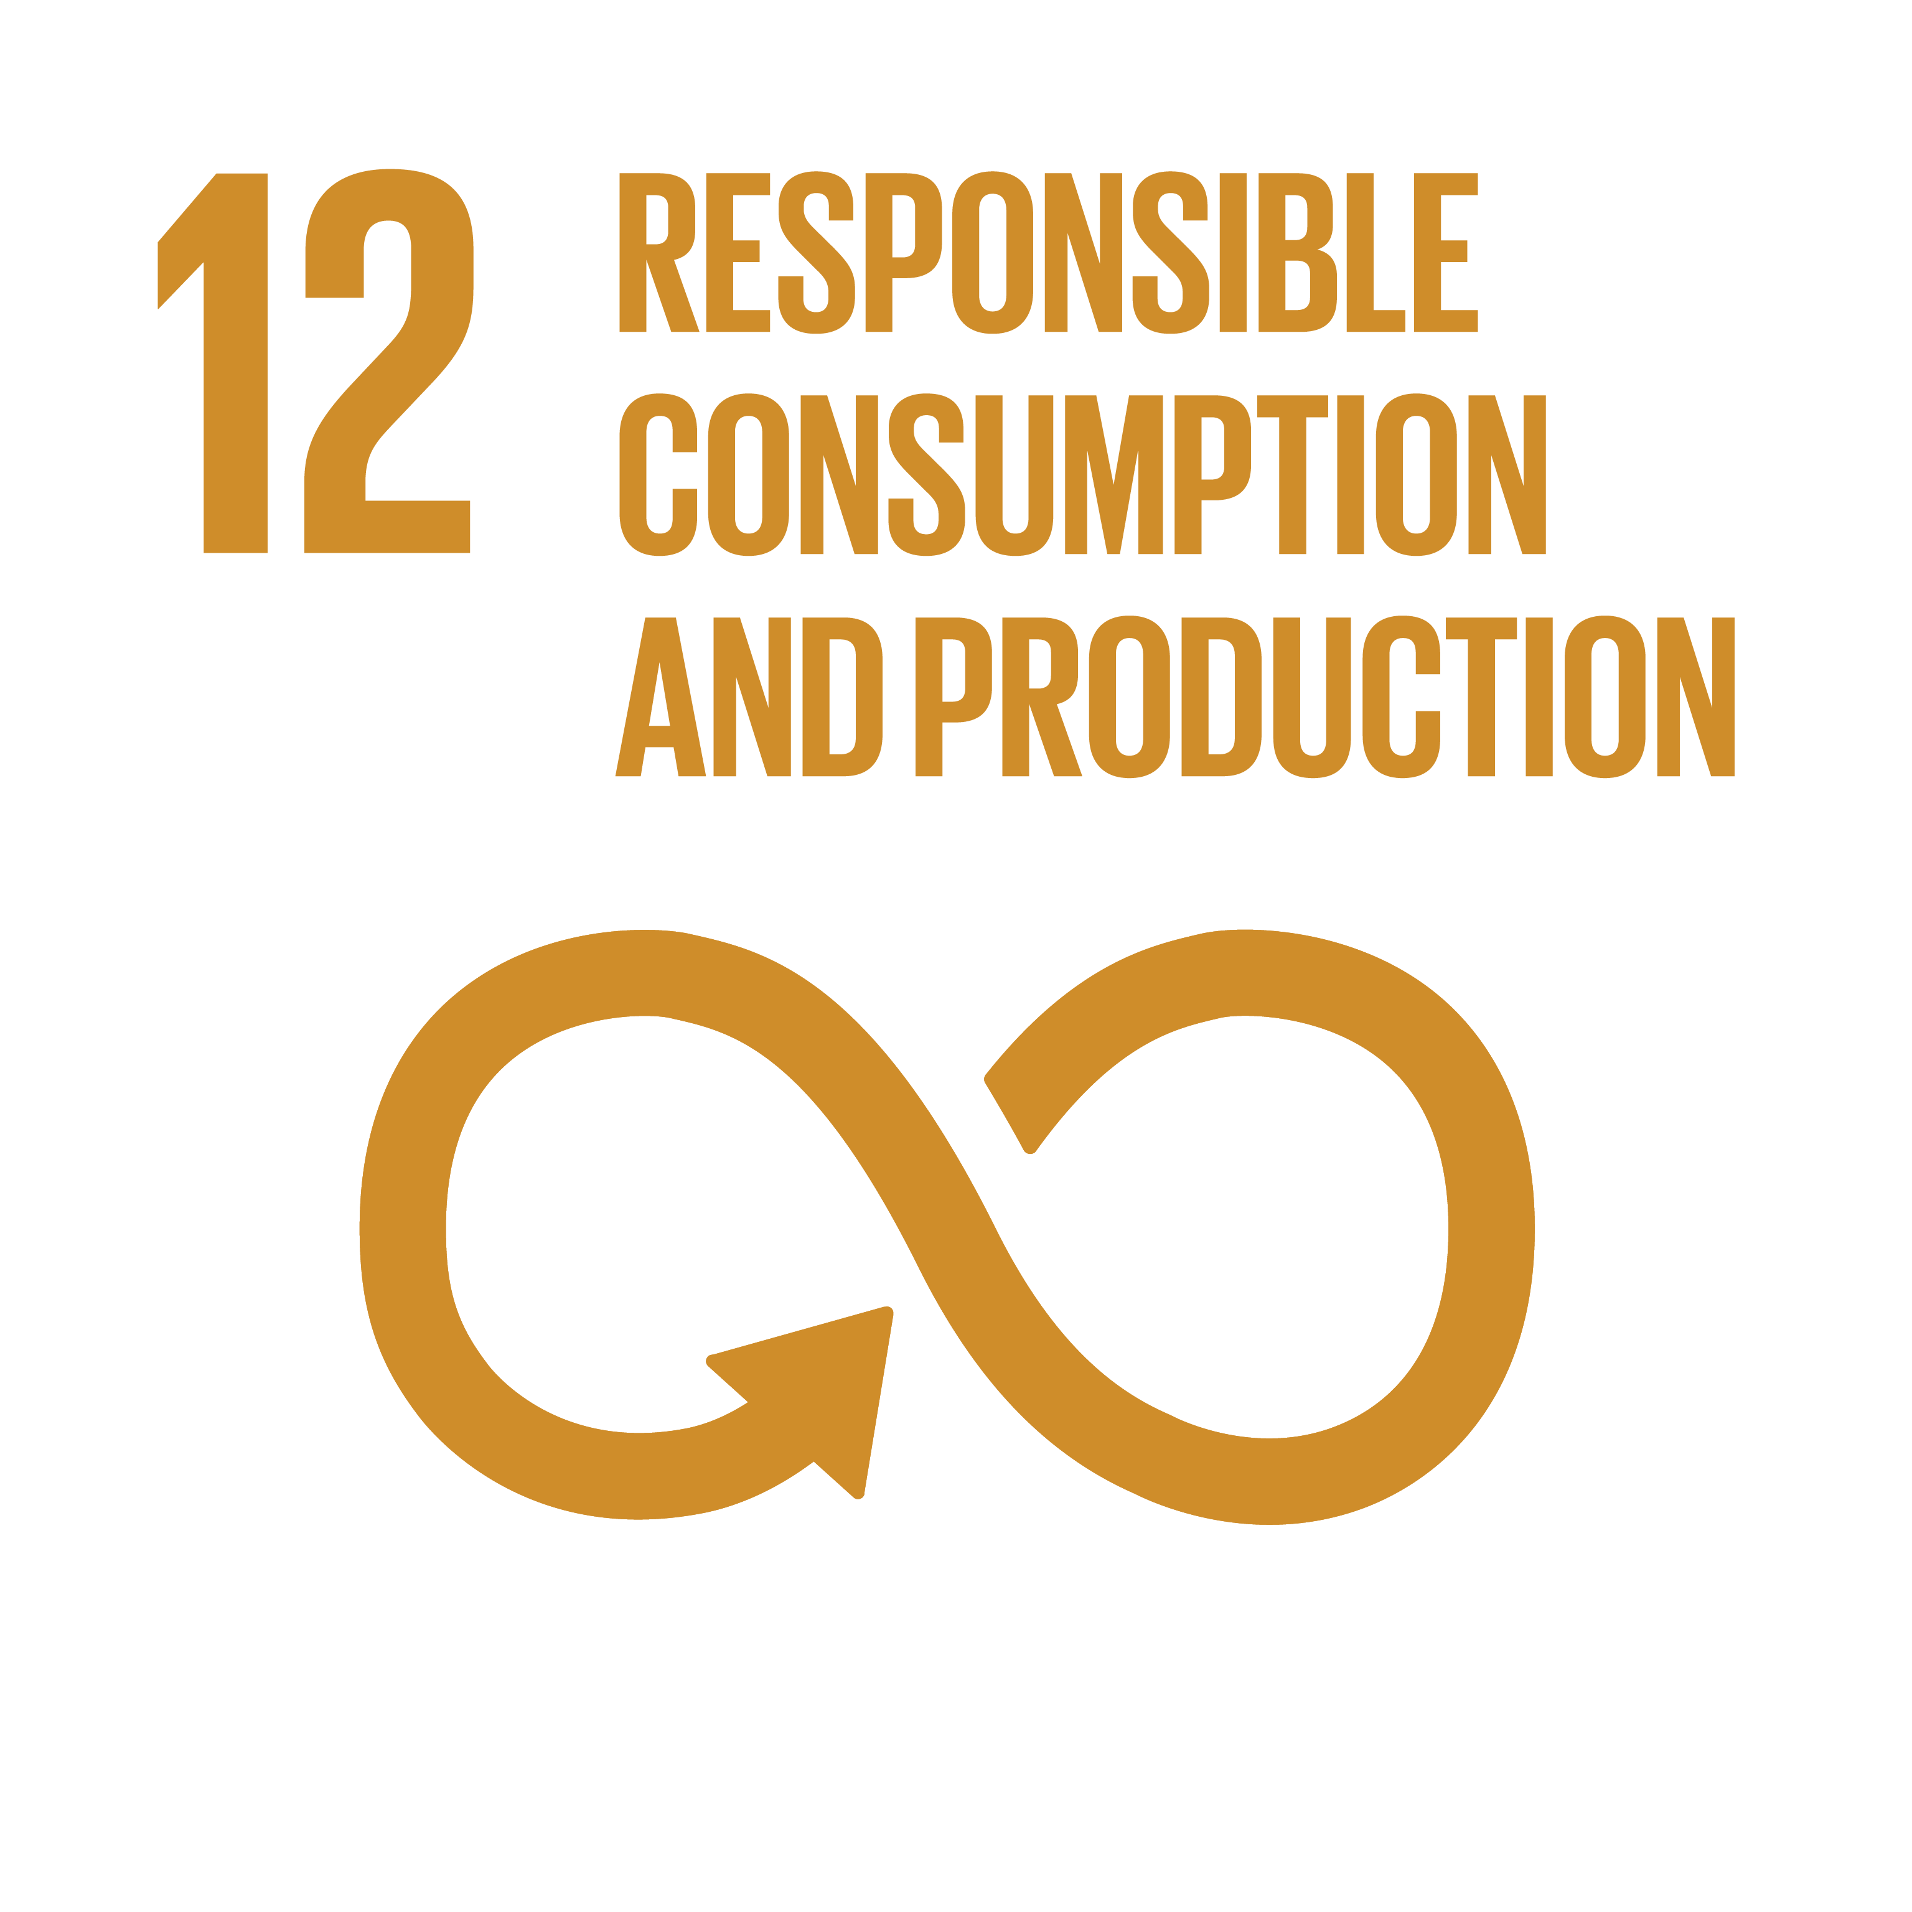
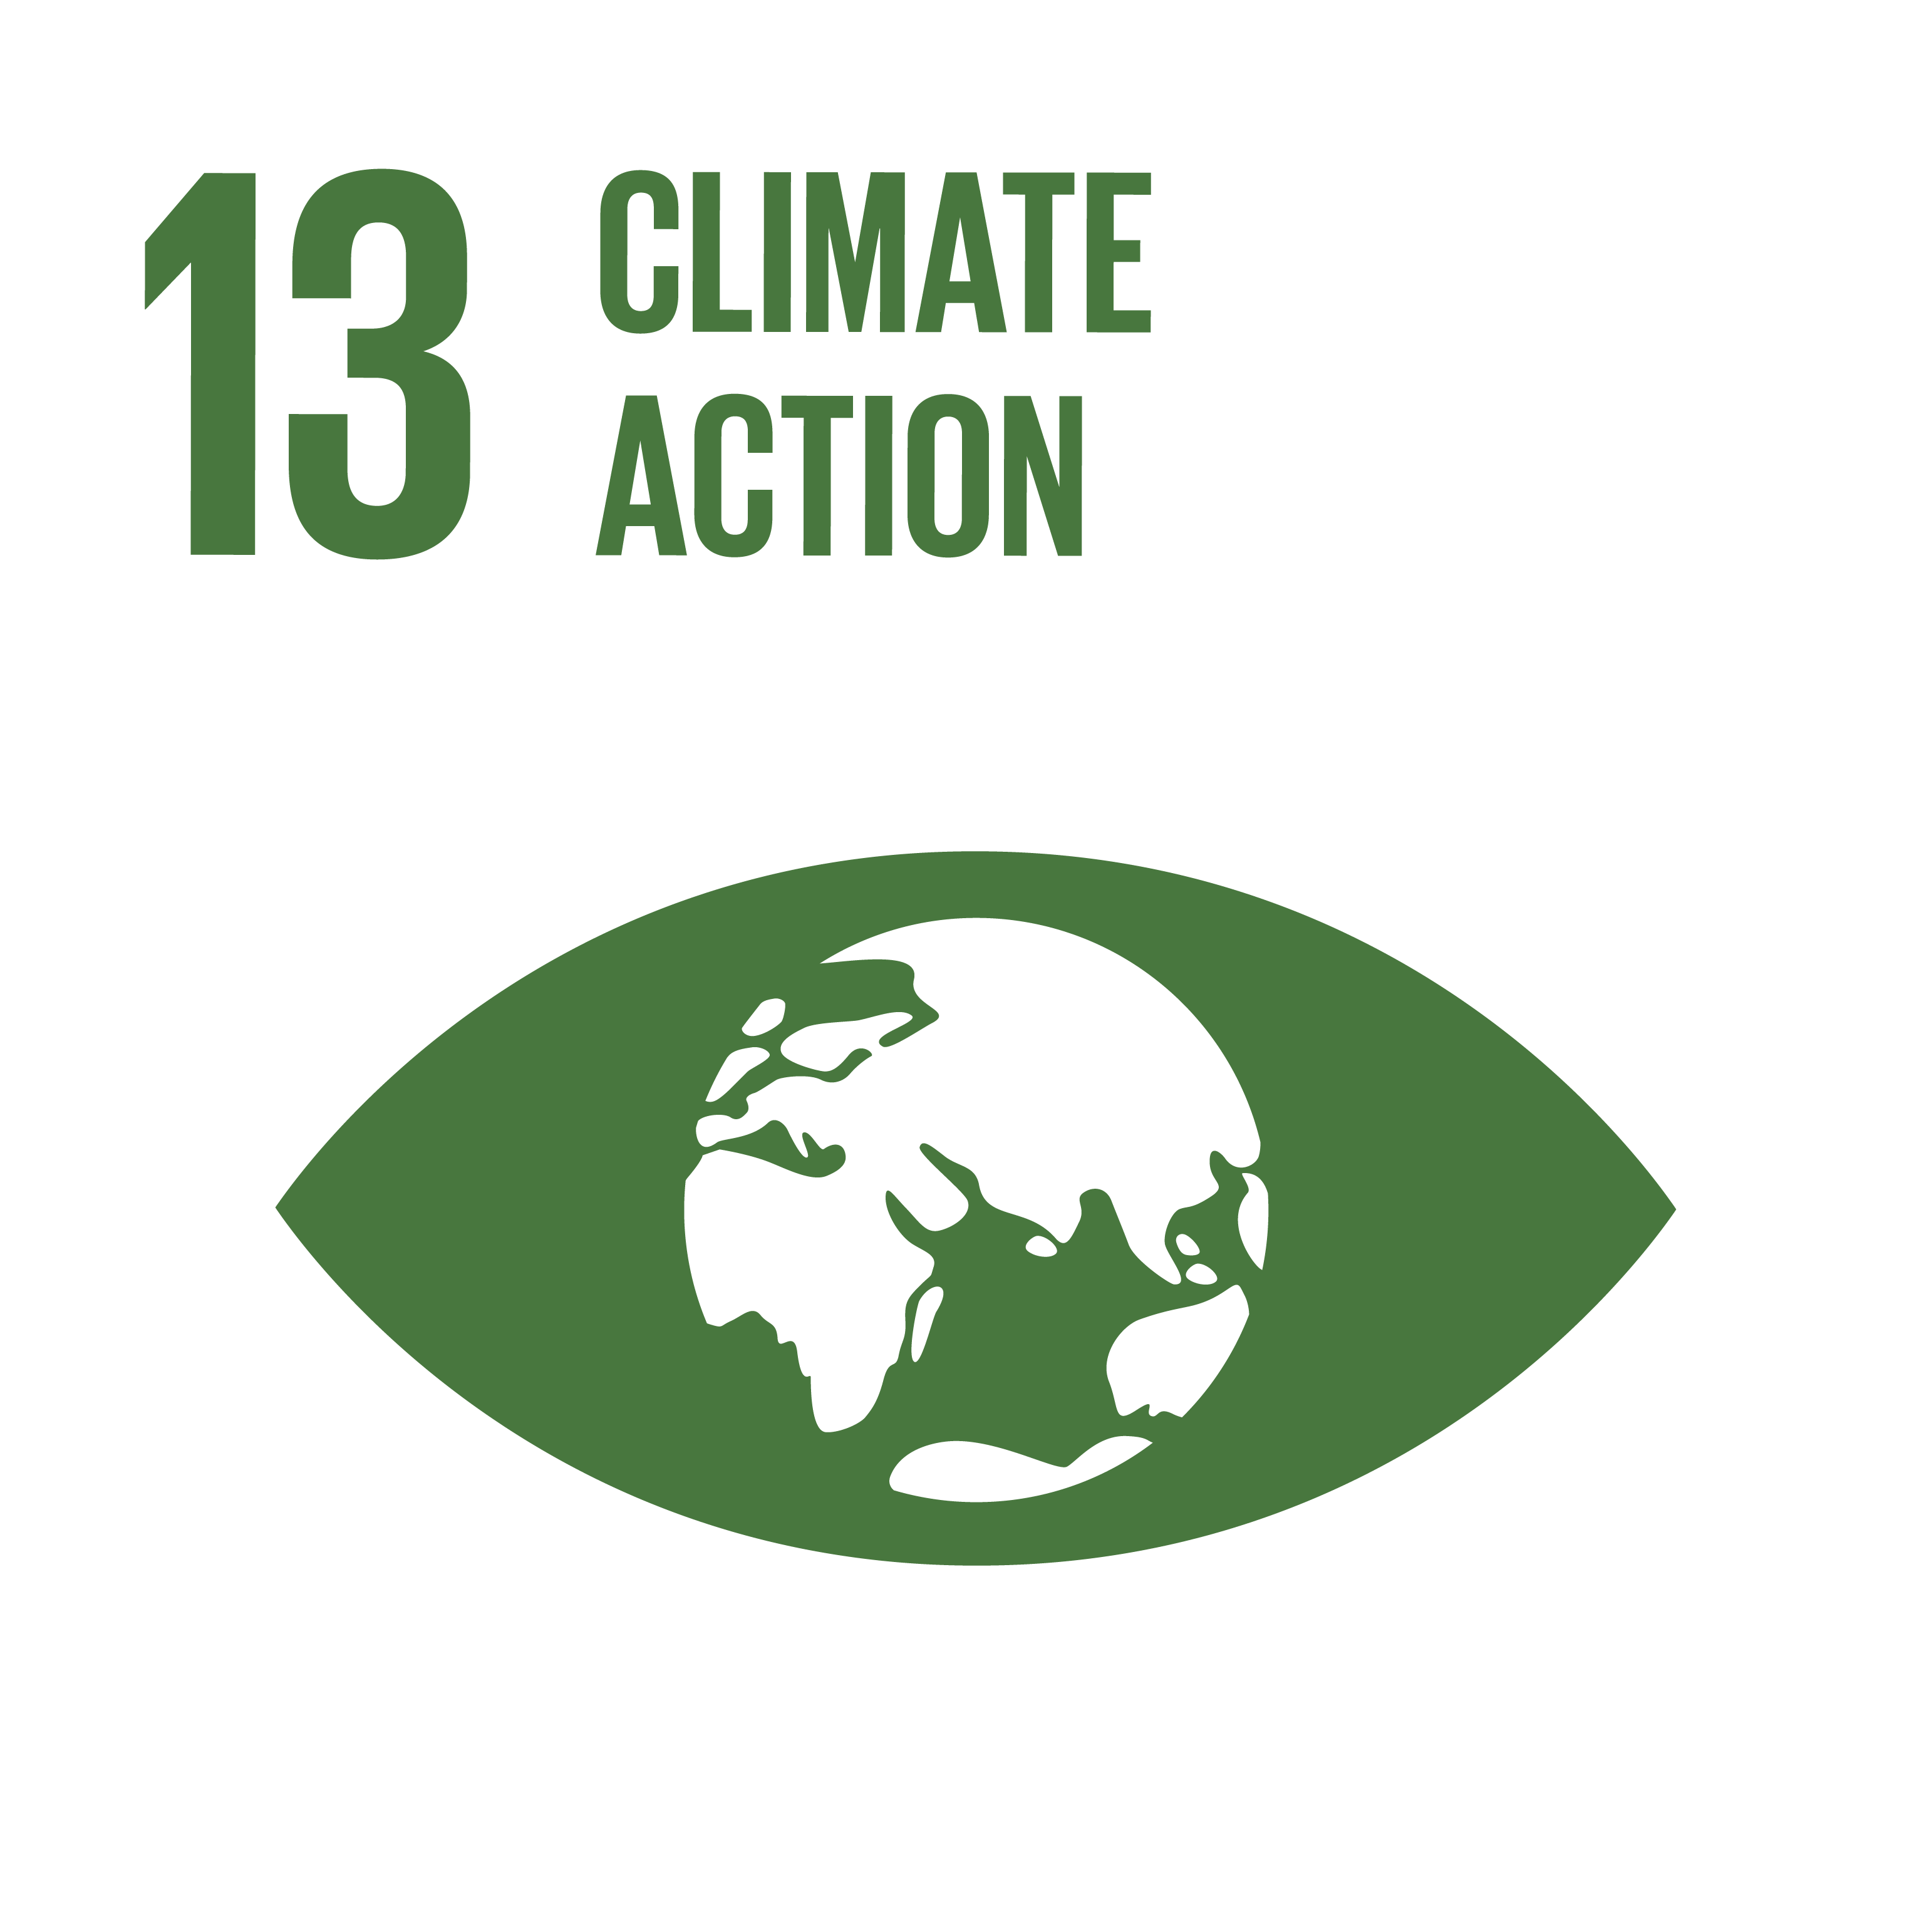
What is being done to reach the SDGs?

Slide 50
What is being done to reach the SDGs?

Slide 51
What is being done to reach the SDGs?
SDG 12 and SDG 14

Slide 52
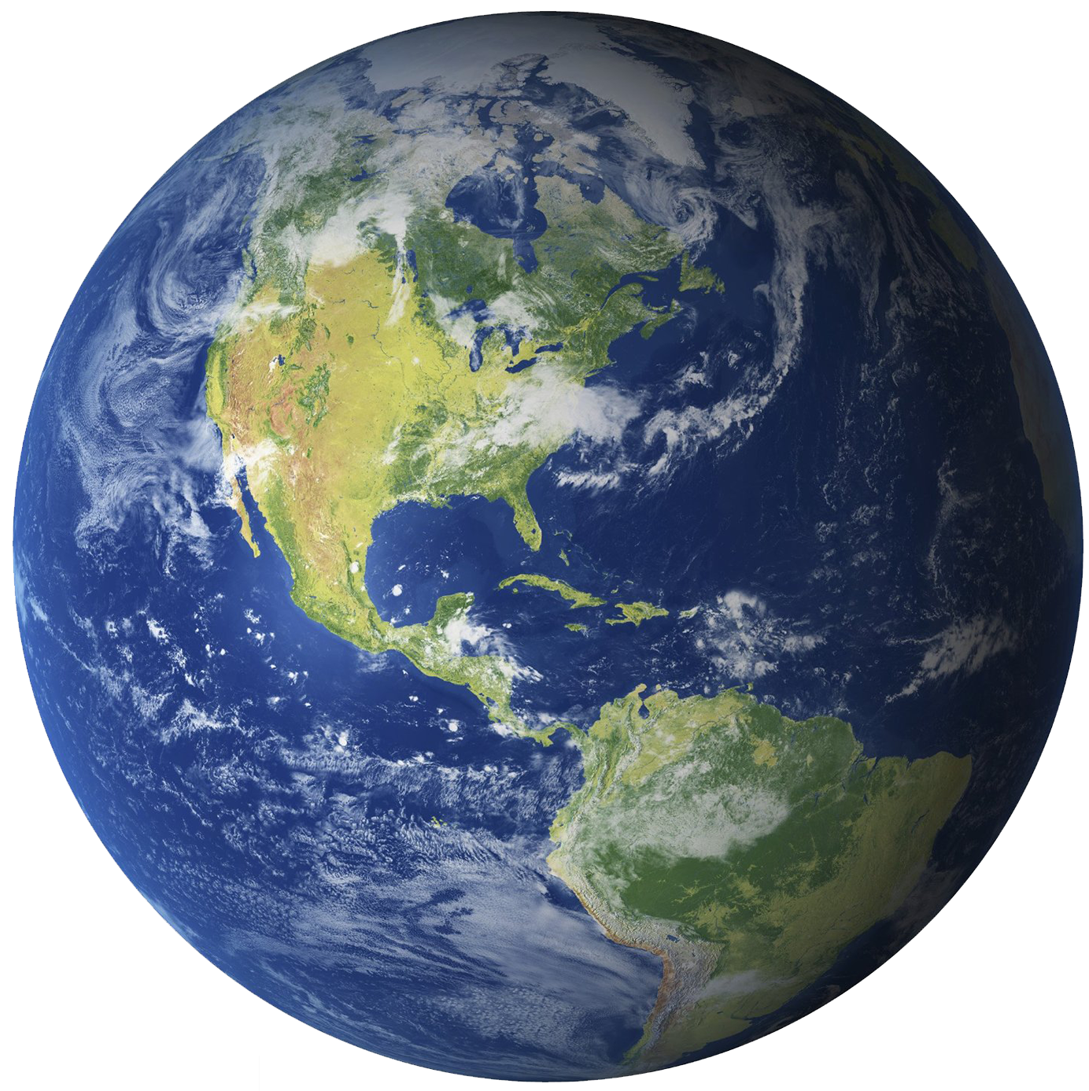
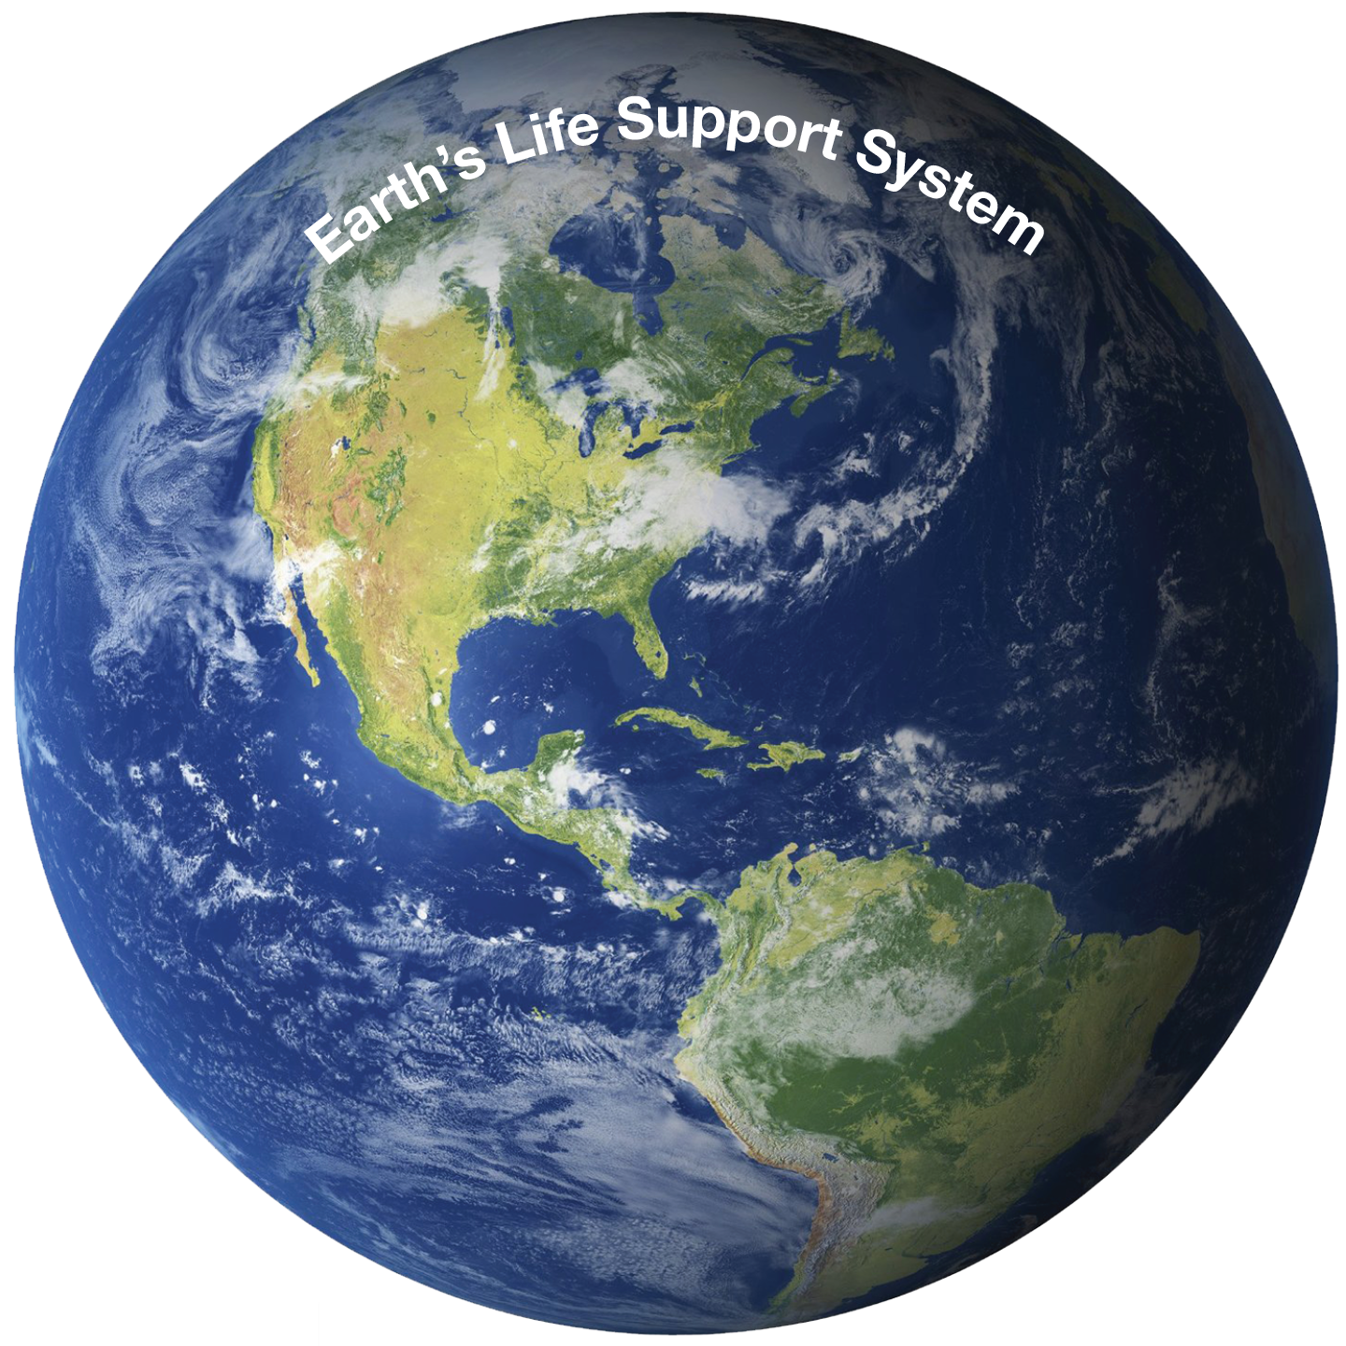
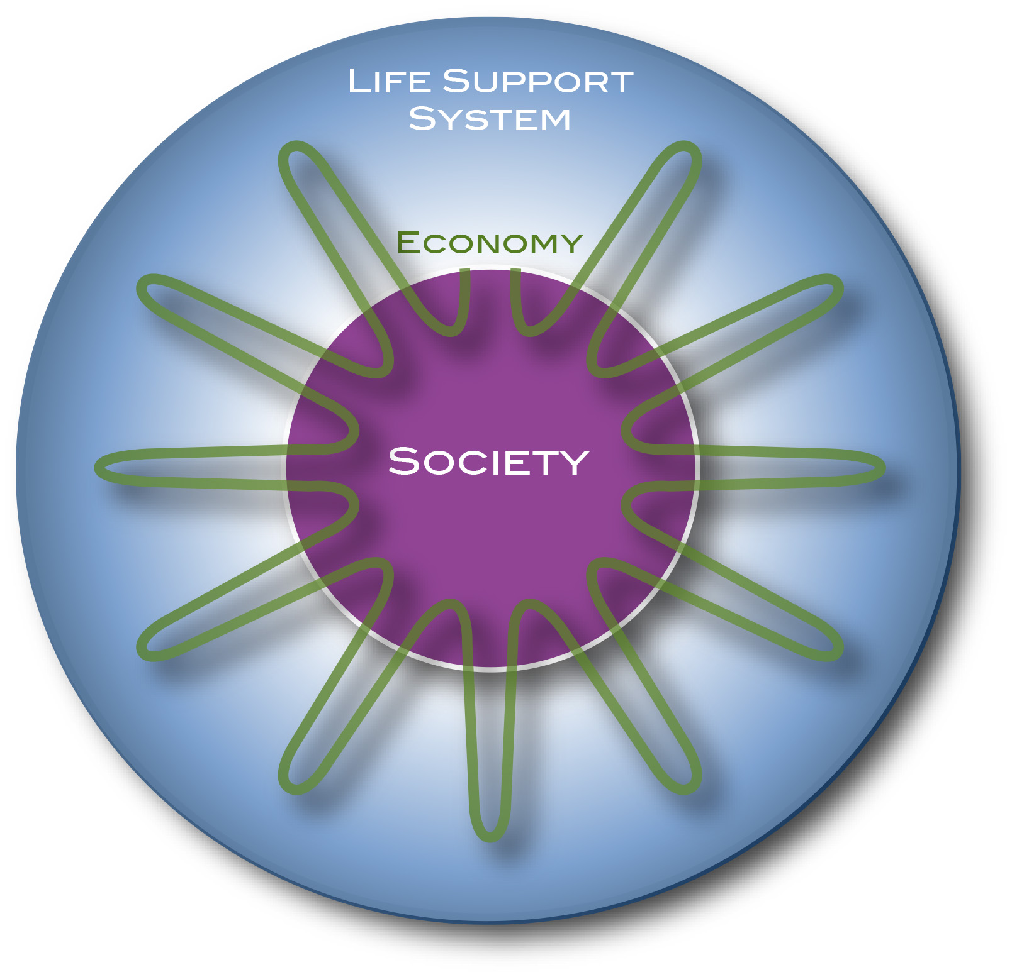
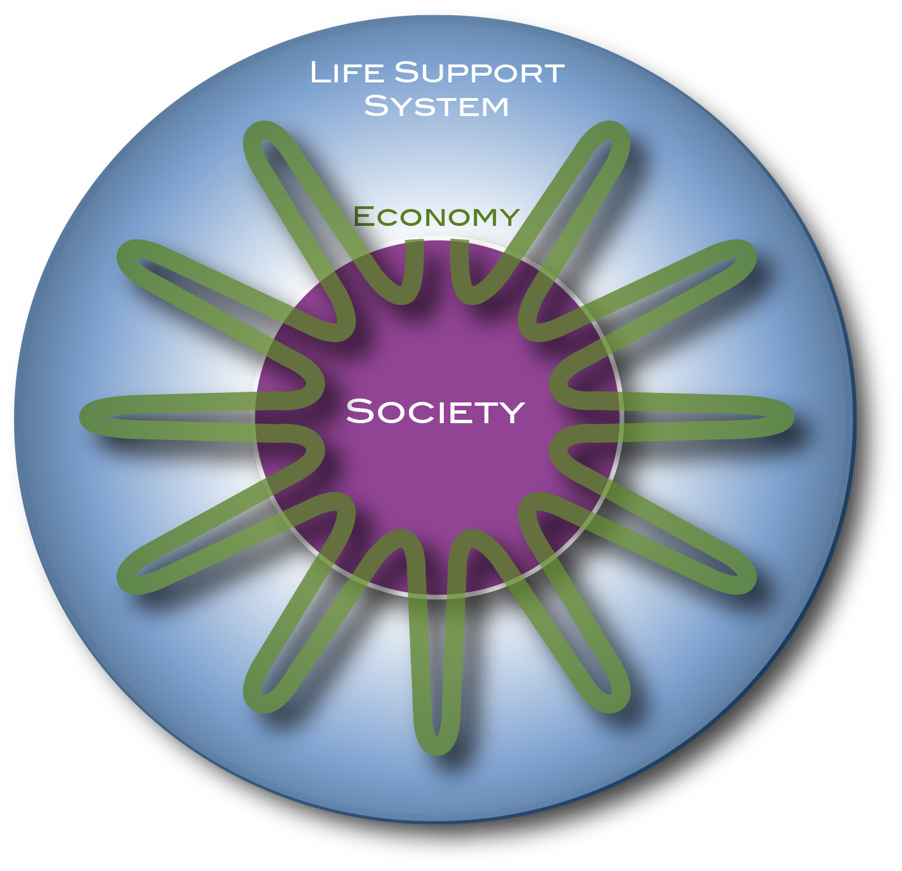
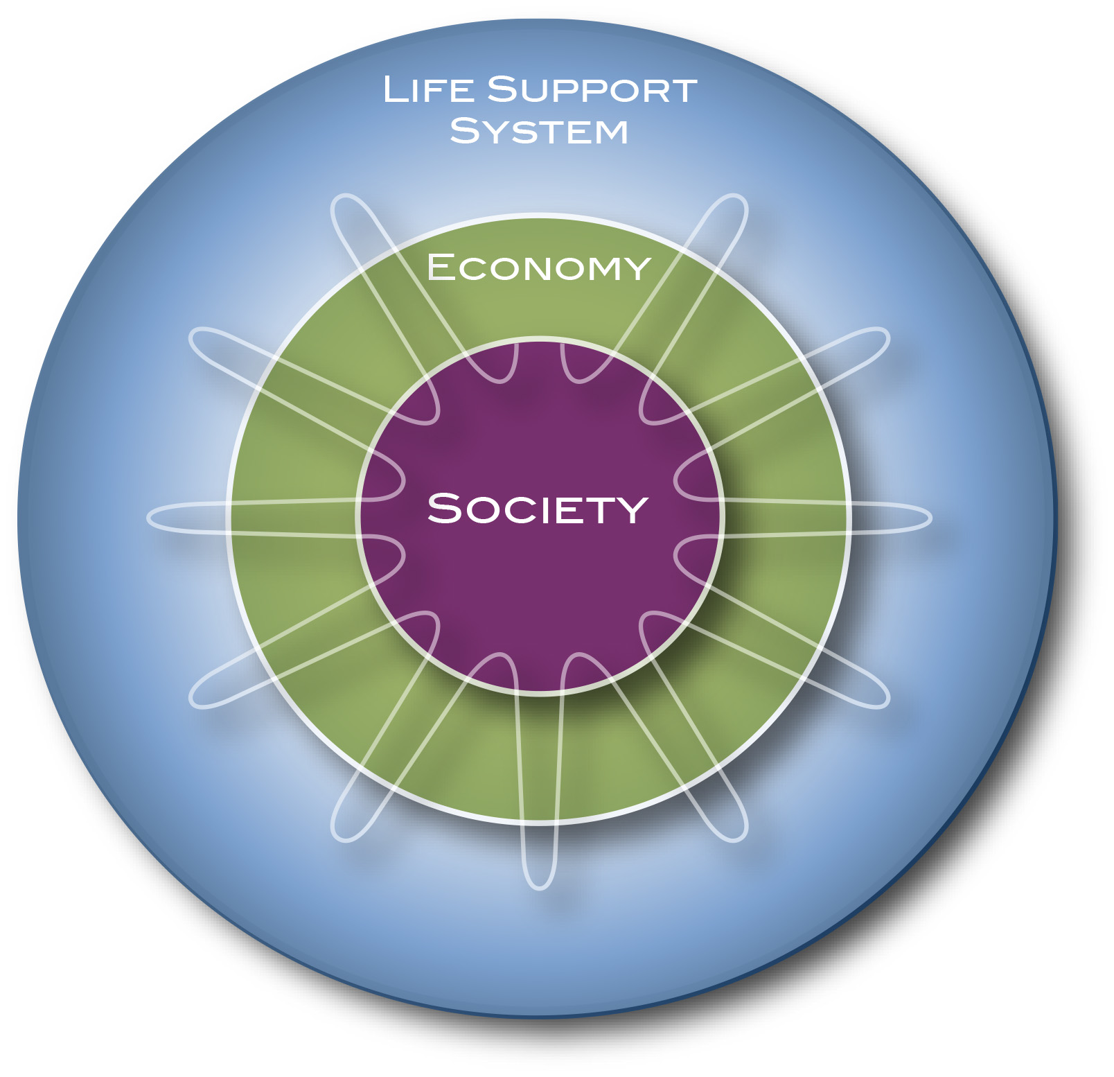
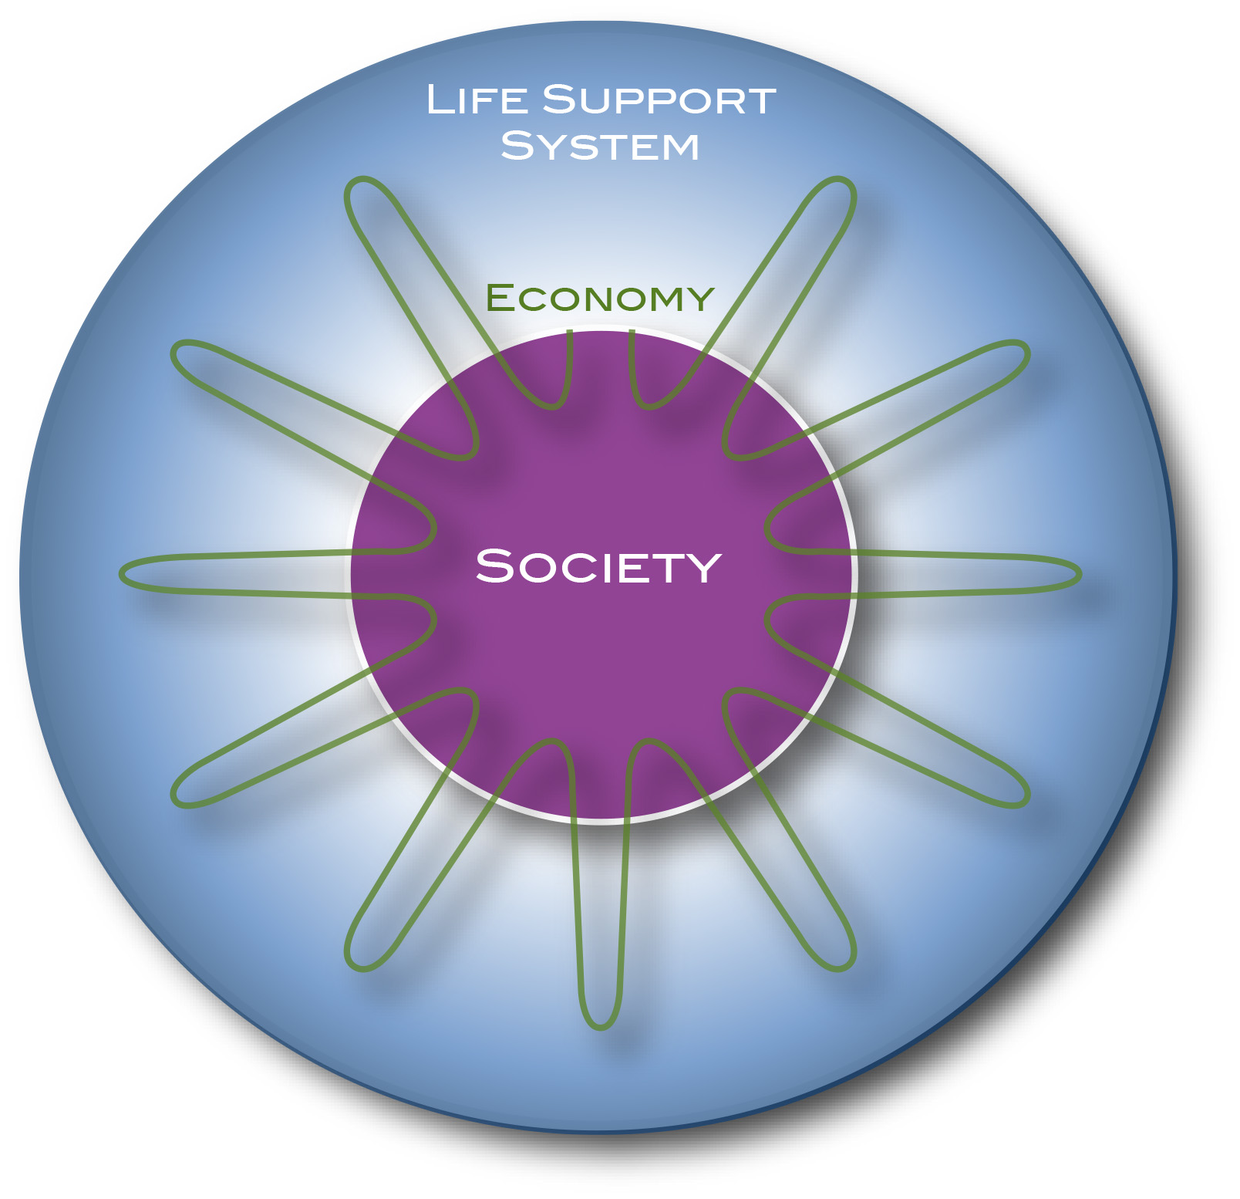
What is being done to reach the SDGs?
Interconnection through Planetary Physiology
Earth: Life-Support System for many species
FLOWS
Everything is about Flows
Flows have accelerated in the last 200 years

Slide 53
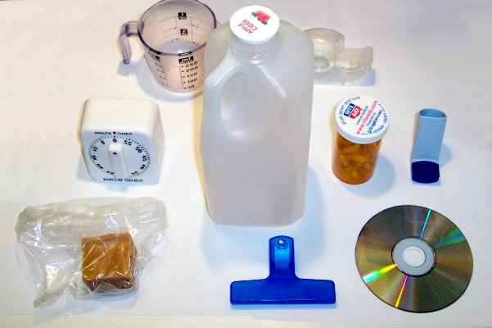
What is being done to reach the SDGs?
FLOWS
Understanding Modern Global Change is all about Flows
Flows have accelerated in the last 200 years
Many new flows have been created

Slide 54
400 million tons (Mt)
What is being done to reach the SDGs?
448 Mt in 2015
}
A LIFETIME OF PLASTIC
The first plastics made from fossil fuels are just over a century old.They came into widespread use after World War II and are found today in everything from cars to medical devices to food packaging. Their useful lifetime varies. Once disposed of, they break down into smaller fragments that linger for centuries.
Average usetime: 5 years
Build.+Const.: 72 Mt, 35 yrs
Industrial mach.: 3 Mt, 20 yrs
Transportation: 30 Mt, 13 yrs
Electrical: 19 Mt, 8 yrs
Textiles: 65 Mt, 5 yrs
Consum. prod.: 46 Mt, 3 yrs
Packaging: 161 Mt, <0.5 yrs
LIFETIMES:
100 to 5000 years
161Mt < 6 months
JASON TREAT AND RYAN WILLIAMS, NGM STAFF
SOURCE: ROLAND GEYER, UNIVERSITY OF CALIFORNIA, SANTA BARBARA
https://www.nationalgeographic.com/magazine/2018/06/plastic-planet-waste-pollution-trash-crisis/

Slide 55
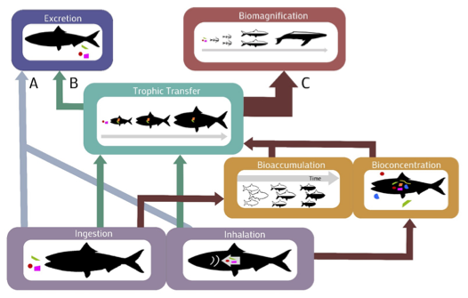
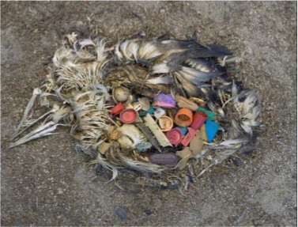
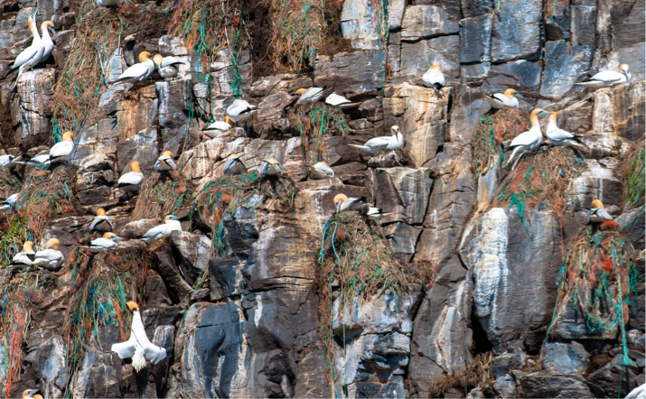
Based on Feedback: The Earth’s Life-Support System and sustainability
Plastics and micro plastics in the marine food web …
FLOWS
… comes back to humans
Understanding Modern Global Change is all about Flows
Flows have accelerated in the last 200 years
Many new flows have been created
Many flows have been changed or interupted

Slide 56
What is being done to reach the SDGs?
A transformation of the mainstream economic model is of paramount importance for reaching the SDGs

Slide 57
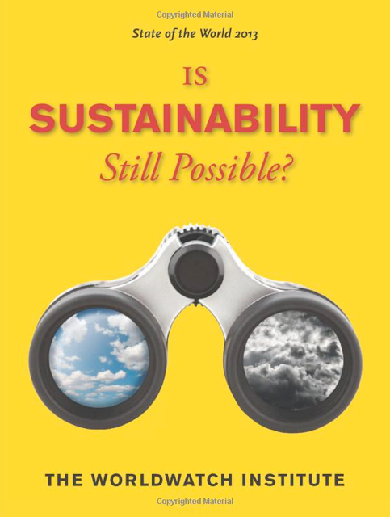
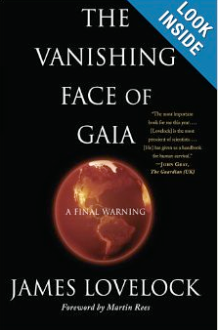
What is being done to reach the SDGs?
Role of Economy
If Ecological Footprint calculations are even roughly accurate, humanity is currently consuming the ecological capacity of 1.5 Earths. That suggests that no more than 4.7 billion people could live within the planet’s ecological boundaries without substantially reducing average individual consumption.
Lovelock (and many others):
Planet is on a run-away path; could reach a warm state (5ºC warmer) already in 2050
Carrying capacity of the planet would be reduced to 1 Billion
Recommendation: look for the lifeboats

Slide 58
What is being done to reach the SDGs?
Role of Economy
If Ecological Footprint calculations are even roughly accurate, humanity is currently consuming the ecological capacity of 1.5 Earths. That suggests that no more than 4.7 billion people could live within the planet’s ecological boundaries without substantially reducing average individual consumption.
Engelman, 2013

Slide 59
What is being done to reach the SDGs?
Role of Economy
The current mainstream model of the global economy is based on a number of assumptions about the way the world works, what the economy is, and what the economy is for. These assumptions arose in an earlier period, when the world was relatively empty of humans and their artifacts. Built capital was the limiting factor, while natural capital was abundant. It made sense not to worry too much about environmental “externalities,” since they could be assumed to be relatively small and ultimately solvable. It also made sense to focus on the growth of the market economy, as measured by gross domestic product (GDP), as a primary means to improve human welfare. And it made sense to think of the economy as only marketed goods and services and to think of the goal as increasing the amount of these that were produced and consumed.
The Worldwatch Institute. State of the World 2013: Is Sustainability Still Possible? (Kindle Locations 2921-2927). Island Press. Kindle Edition.
Increasing the flows became the sole means of economy to create “built” (human wealth
Published in 1776

Slide 60
What is being done to reach the SDGs?
Role of Economy
For almost a century, the consumption of products has been the dominant paradigm and mindset.
John Maynard Keynes (“The General Theory of Employment, Interest and Money”, 1936):“I should support at the same time all sorts of policies for increasing the propensity to consume. For it is unlikely that full employment can be maintained, whatever we may do about investment, with the existing propensity to consume.”
Victor Lebow (1955): “Our enormously productive economy … demands that we make consumption our way of life, that we convert the buying and use of goods into rituals, that we seek our spiritual satisfaction, our ego satisfaction, in consumption … we need things consumed, burned up, replaced and discarded at an ever-accelerating rate.”

Slide 61
The Diagnosis: Degrading the Earth’s Life-Support System
Role of Economy
In 2008, people around the world used 68 billion tons of materials, including metals and minerals, fossil fuels, and biomass. That is an average of 10 tons per person— or 27 kilograms each and every day. That same year, humanity used the biocapacity of 1.5 planets, consuming far beyond what the Earth can sustainably provide.
Assadourian, 2013
World Extraction of Non-Renewable Materials
The urban population in the developing world will double by 2030. The implications are staggering. One is that we have 20 years to build as much urban housing as was built in the past 6,000. Reinhard Goethert, School of Architecture and Planning, MIT, 2010.

Slide 62
Role of Economy
Women carry out 70% of the global work hours
but they only earn 10% of the global salary
Raworth, 2013

Slide 63
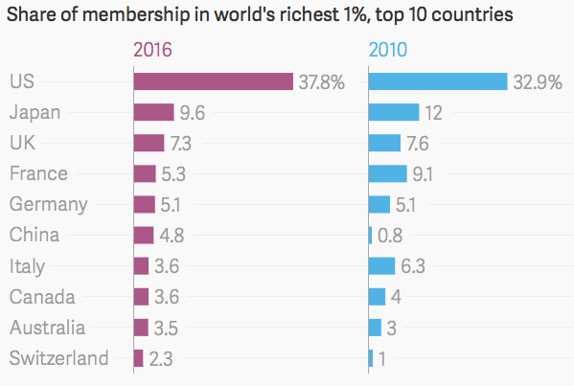
The Diagnosis: Degrading the Earth’s Life-Support System
Role of Economy
What, then, is the biggest source of stress on planetary boundaries today? It is the excessive consumption levels of roughly the wealthiest 10 percent of people in the world and the resource-intensive production patterns of companies producing the goods and services that they buy. The richest 10 percent of people in the world hold 57 percent of global income. Just 11 percent of the global population generates about half of global CO2 emissions. And one third of the world’s “sustainable budget” for reactive nitrogen use is used to produce meat for people in the European Union, just 7 percent of the world’s population.
Raworth, 2013
Wealth Distribution:
Top 1%:
2000 49.6%
2009 45.4%
2016 50.8%
Top 5%:
2000 77.2%
2009 73.7%
2016 77.7%
Top 10%:
2000 89.4%
2009 86.5%
2016 89.1%

Slide 64
What is being done to reach the SDGs?
Sustainability and Economy
An economy that damages the Earth’s life-support system is an “economy against humanity”
An economy that meets our needs by degrading Earth’s life-support system is like a doctor who practices medicine by making the patients sick.
Reaching the SDGs: enabling a transition to an
“economy for humanity”
“An economy that meets our needs while safeguarding Earth’s life-support system, on which the welfare of current and future generations depends.”
Enabling prosperity, security:
- without degradation of the Earth’s life-support system
- without growth
- with more equality

Slide 65
What is being done to reach the SDGs?

Slide 66
What is being done to reach the SDGs?

Slide 67
What is being done to reach the SDGs?

Slide 68
What is being done to reach the SDGs?

Slide 69
What is being done to reach the SDGs?
How can we bring the SDGs to the people?

Slide 70
What is being done to reach the SDGs?

Slide 71
What is being done to reach the SDGs?
Global intergovernmental
Global NGOs
Global intergovernmental
Global NGOs
Global intergovernmental
Global NGOs
experts
Regional NGOs
Regional intergovernmental
experts
National NGOs
Regional NGOs
Regional intergovernmental
National NGOs
Regional NGOs
Regional intergovernmental
experts
National NGOs
experts
Geospace for SDGs
Participatory Modeling
stakeholders
Governments
Governments
stakeholders
people
Governments
top-down, formal, exclusive, lack of transparency, openness
bottom-up, informal, inclusive, transparent, open

Slide 73
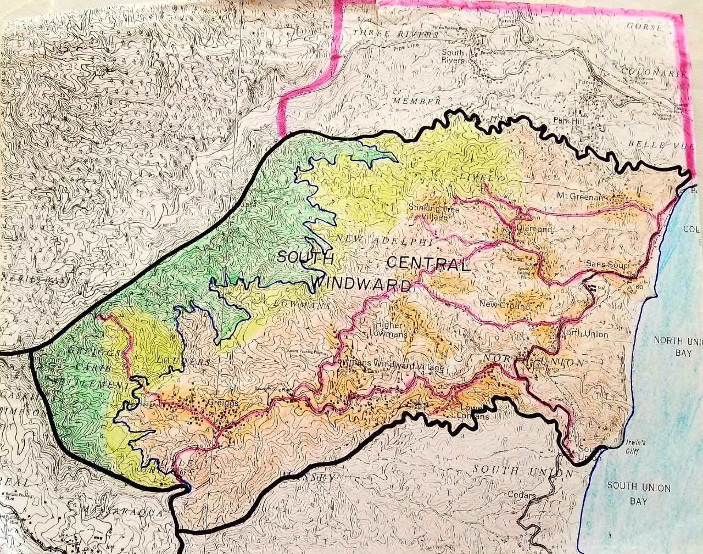
What is being done to reach the SDGs?
Population: ~ 11,000

Slide 74
What is being done to reach the SDGs?
Everything is about Flows
Flows between human communities and the Earth’s life-support system are controlled by
ethics
morality
economic rules
Ethics
Morality
Economy

Slide 75
What is being done to reach the SDGs?
Changing morality of degrading the Earth’s life-support system
As Pope Francis puts it in his ecological teaching document, Laudato Si’: “To blame population growth instead of extreme and selective consumerism on the part of some, is one way of refusing to face the issues. It is an attempt to legitimise the present model of distribution, where a minority believes that it has the right to consume in a way which can never be universalised, since the planet could not even contain the waste products of such consumption.”
September 1, 2016: He called for care for the environment to be added to the seven spiritual works of mercy outlined in the Gospel that the faithful are asked to perform throughout the pope’s year of mercy in 2016.

Slide 76
The United Nations’ 2030 Agenda for Sustainable Development
About Sustainable Development
The 2030 Agenda: A Road to Dignity
The Goals
What is being done to reach the Goals
Society through the Eyes of the Goals
What is missing?
What can you do?

Slide 77
Society through the eyes of the SDGs
We often ask questions like:
What can we do to support SDG implementation and monitoring?
We don’t ask:
What and who are these Goals?
How can a SDG be successful?
What does a goal need to grow into a successful goal?
A new Paradigm:
Giving each SDG its own life
Seeing the world through the eyes of a SDG
Realizing, the world is not prepared for the goals

Slide 78
Society through the eyes of the SDGs
The Life of a SDG: How to grow into a successful SDG?
What do all the other guys need to do so that I can be successful??
How am I going to impact the other guys?
What do I need to learn?
Am I on the right track?
2030
Do I understand the challenge?
T 2.5
T 2a
Who is going to be impacted?
T 2.1
T 2.2
T 2b
T 2.4
T 2.3
Who can help me?
What should I do?
2015
Plag, 2017

Slide 79
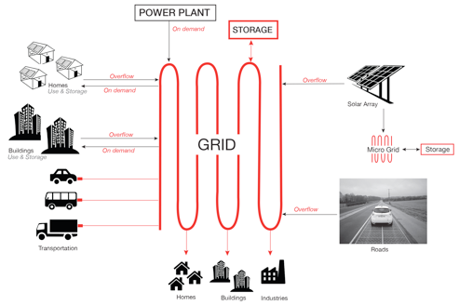
Society through the eyes of the SDGs
Public Services through the eyes of SDGs
Example: Electrical power service
SDG 1: distributed ownership
SDG 2: Food-Water-Energy nexus
SDG 3: no pollution
SDG 4: local expertise
SDG 5: equal participation of women
SDG 6: no water pollution
SDG 7: clean energy
SDG 8: strong worker involvement
SDG 9: good work conditions
SDG 10: distribution of gain and equal access
SDG 11: community sustainability
SDG 12: responsible use of resources
SDG 13: very low emissions
SDG 14 + 15: no pollution, land use
SDG 16: no social unrest and tensions
SDG 17: involvement of all

Slide 80
The United Nations’ 2030 Agenda for Sustainable Development
About Sustainable Development
The 2030 Agenda: A Road to Dignity
The Goals
What is being done to reach the Goals
Society through the Eyes of the Goals
What is missing?
What can you do?

Slide 81
What is missing?
SDG Indicators:
More than 80% are on the built environment and society/economy
Very few are directly related to environmental variables.
Planetary stability must be integrated with United Nations targets to fight poverty and secure human well-being, argue David Griggs and colleagues
(Griggs et al., 2013)
The environment has not been integrated sufficiently
Plag and Jules-Plag, 2019

Slide 82
What is missing?
Homo sapiens and Earth
Human environment
300 million tons of humans and
700 million tons of domesticated animals
400 million domesticated dogs
600 million domesticated cats
1.5 billion cows
20 billion chicken
81% of Earth’s surface changed significantly by humans
Earth’s Energy Imbalance increased by roughly 10,000,000 times above pre-human values
Non-Human environment
100 million tons of wild animals (more than 2 kg)
200,000 wolfs
40,000 lions
900,000 African buffalo
50 million penguins
5% of Earth surface still untouched

Slide 83
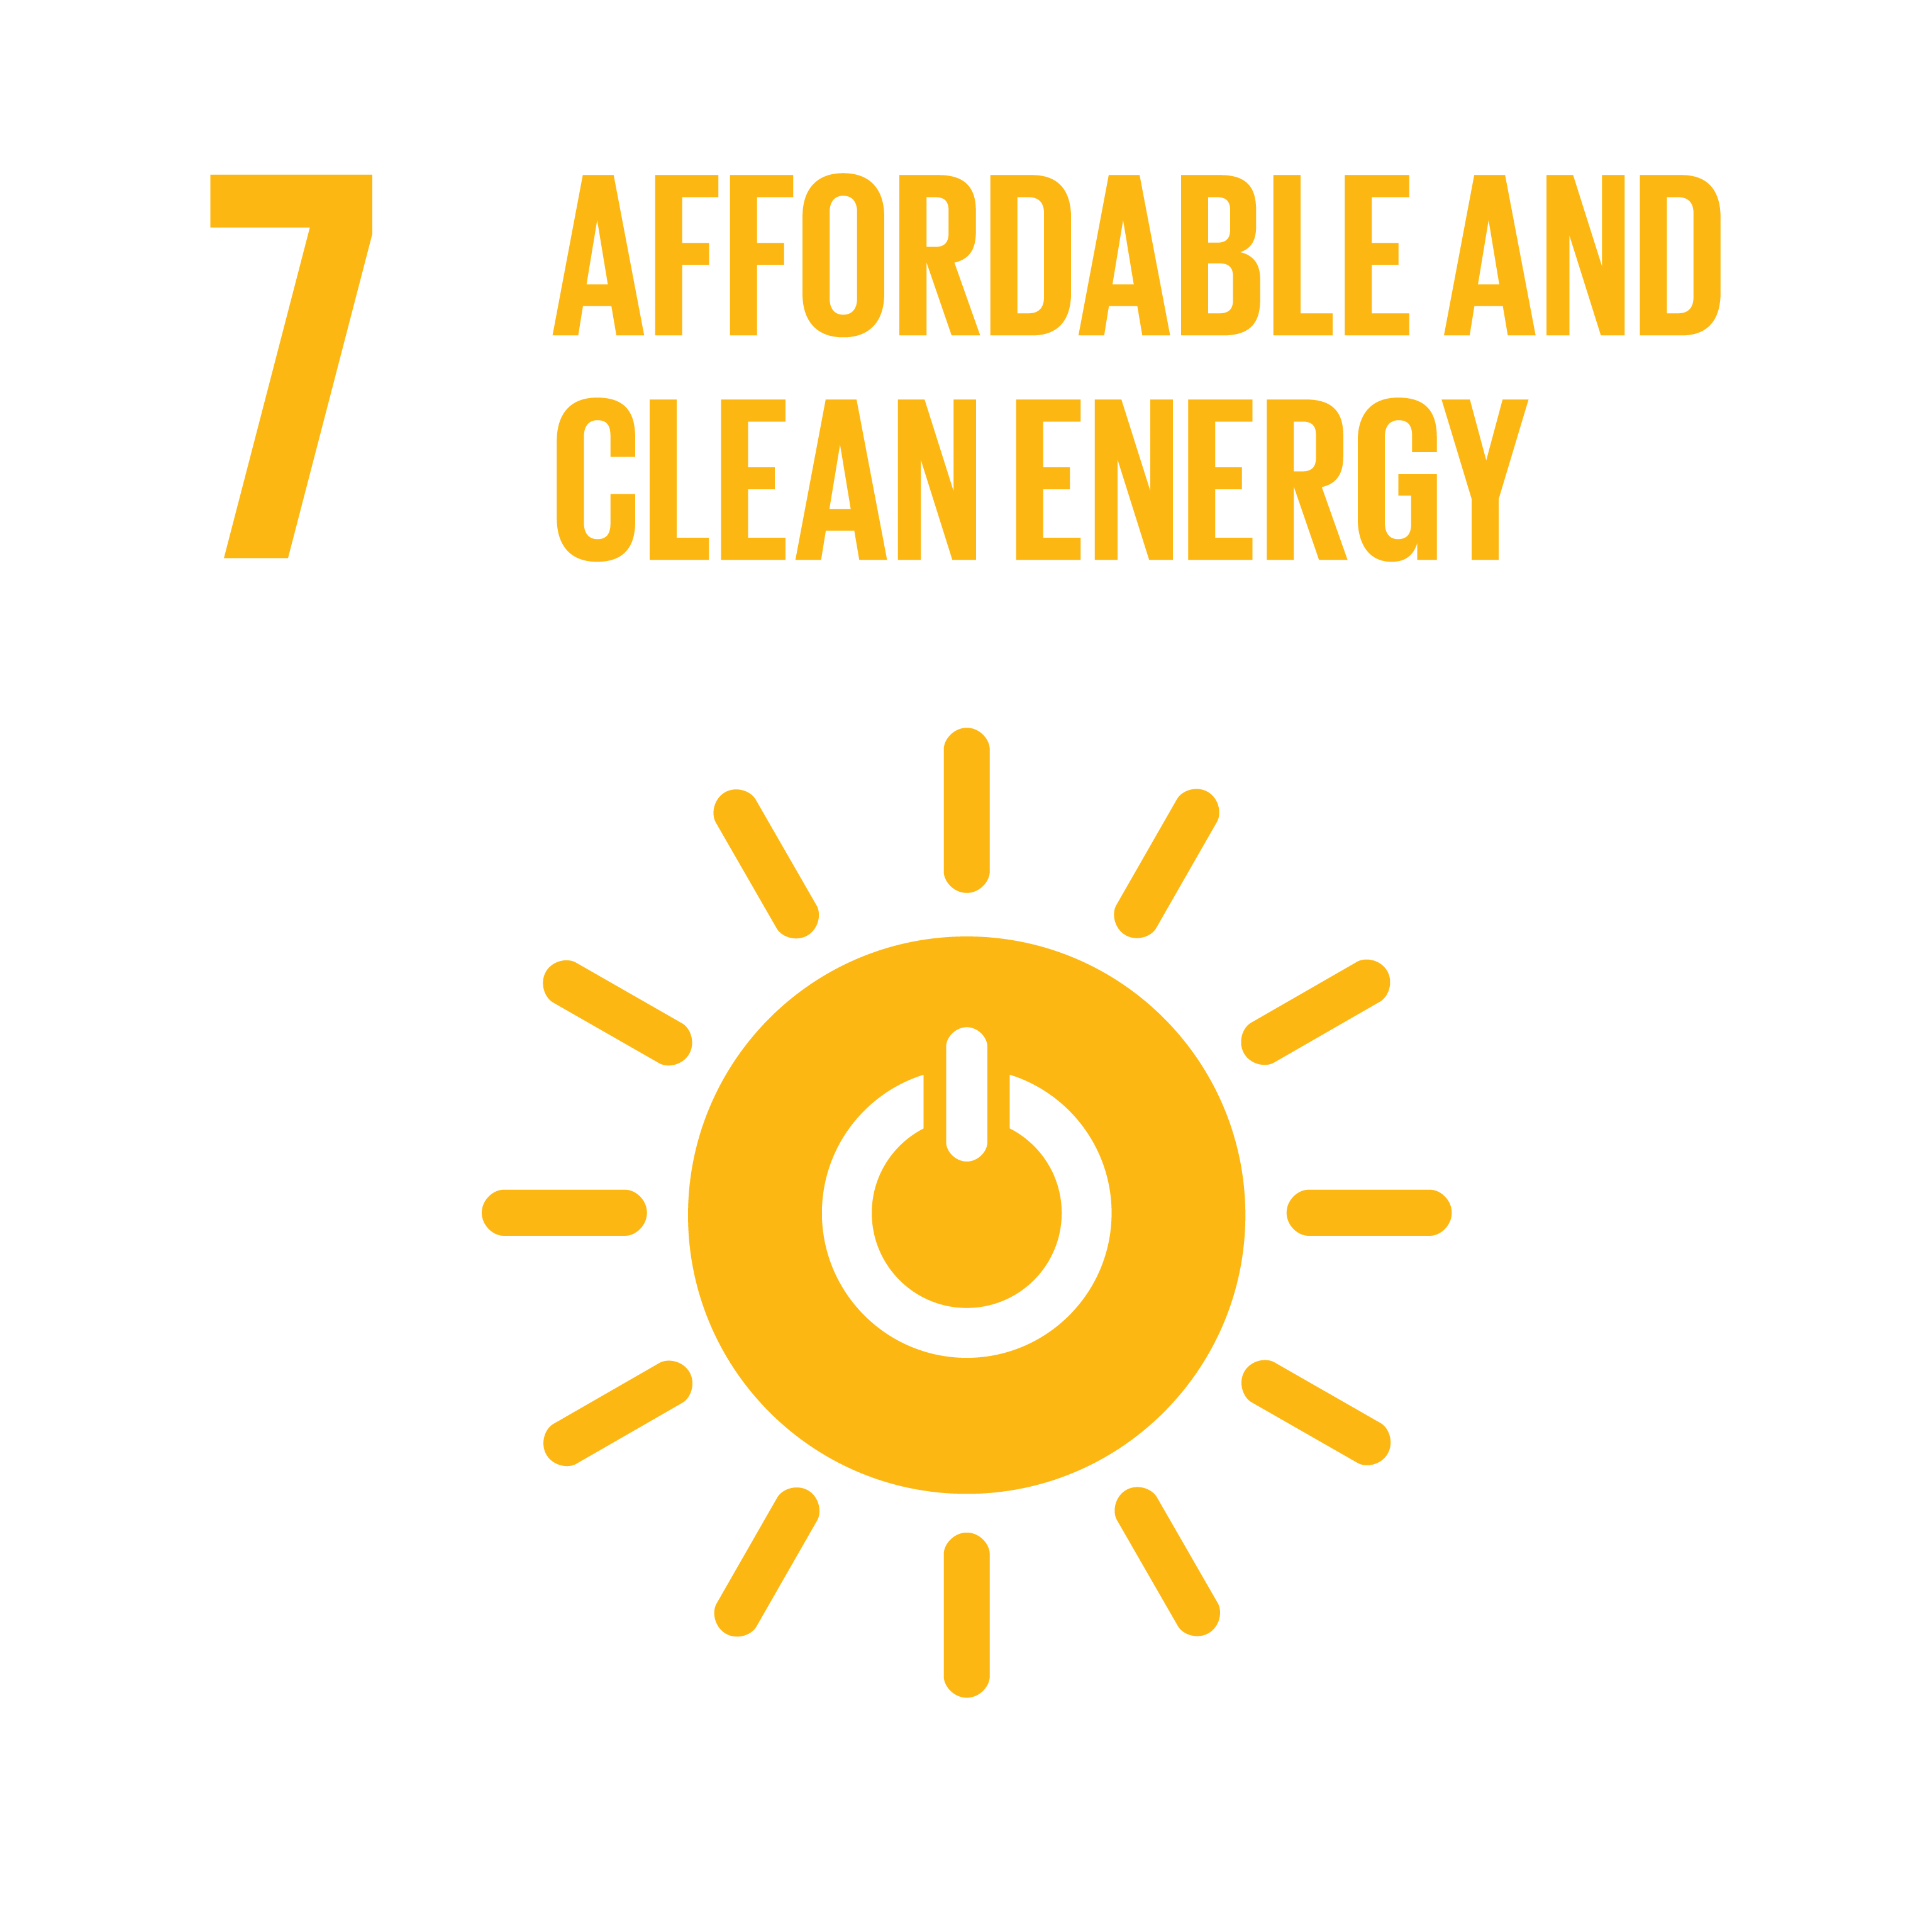
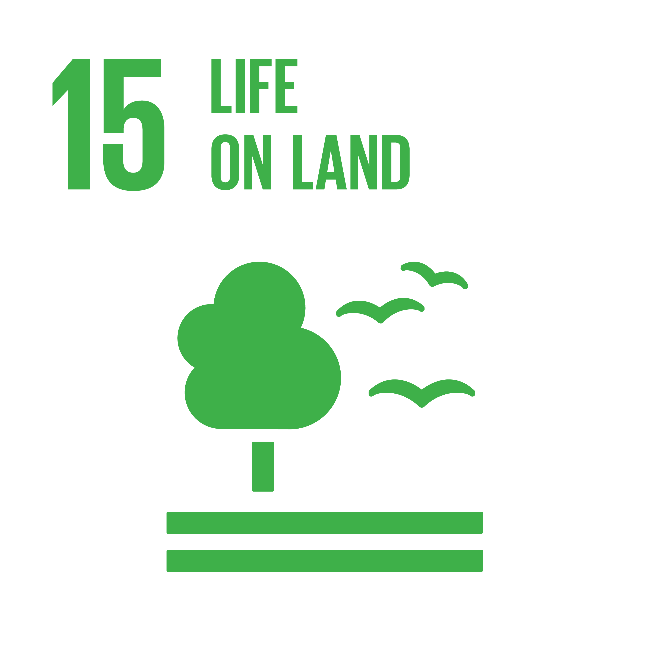
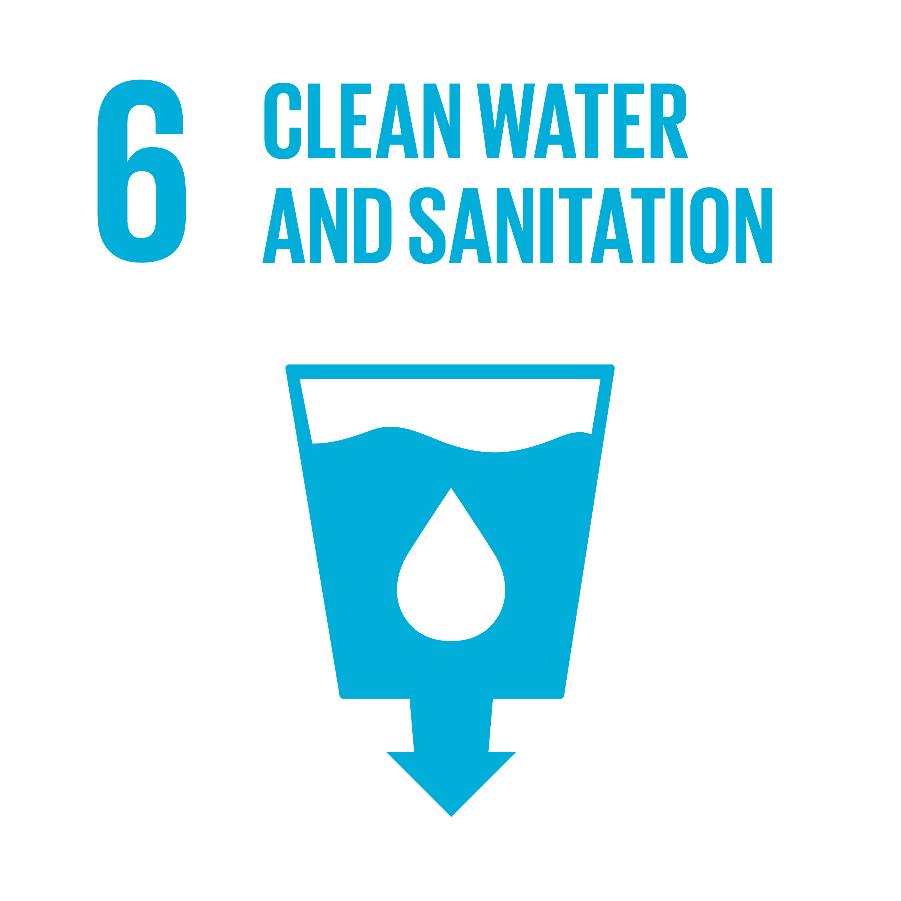
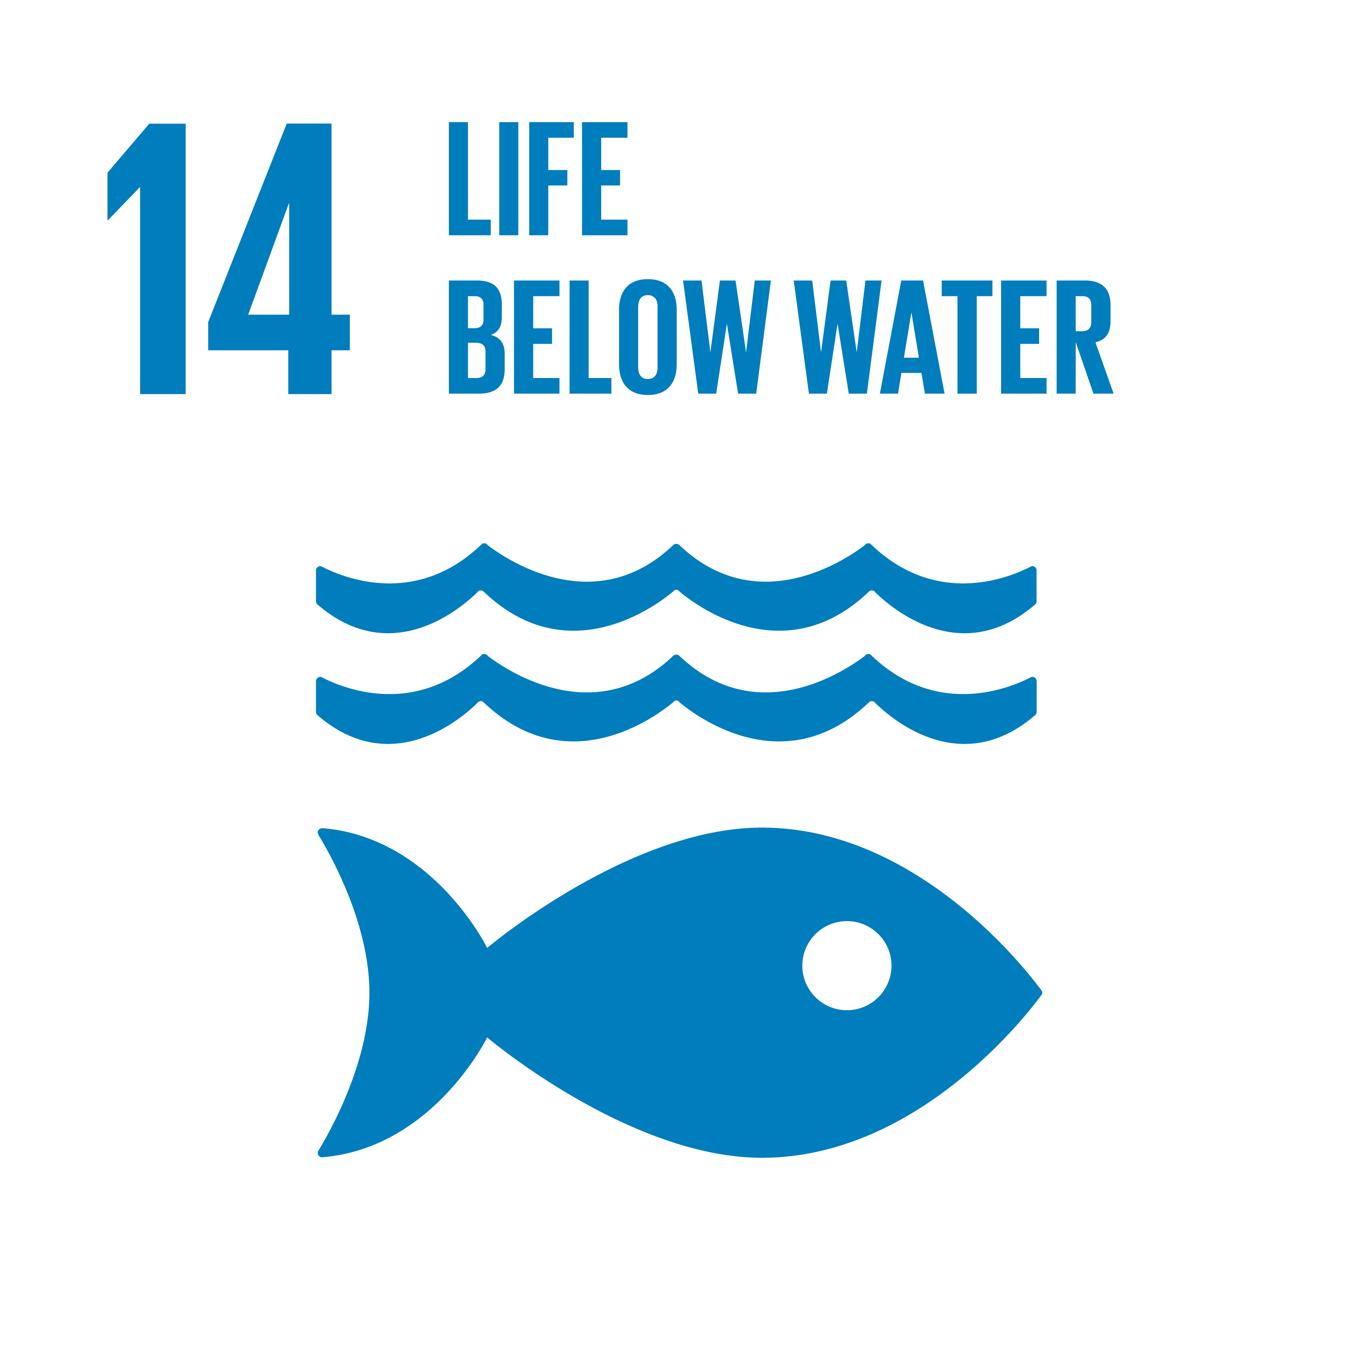
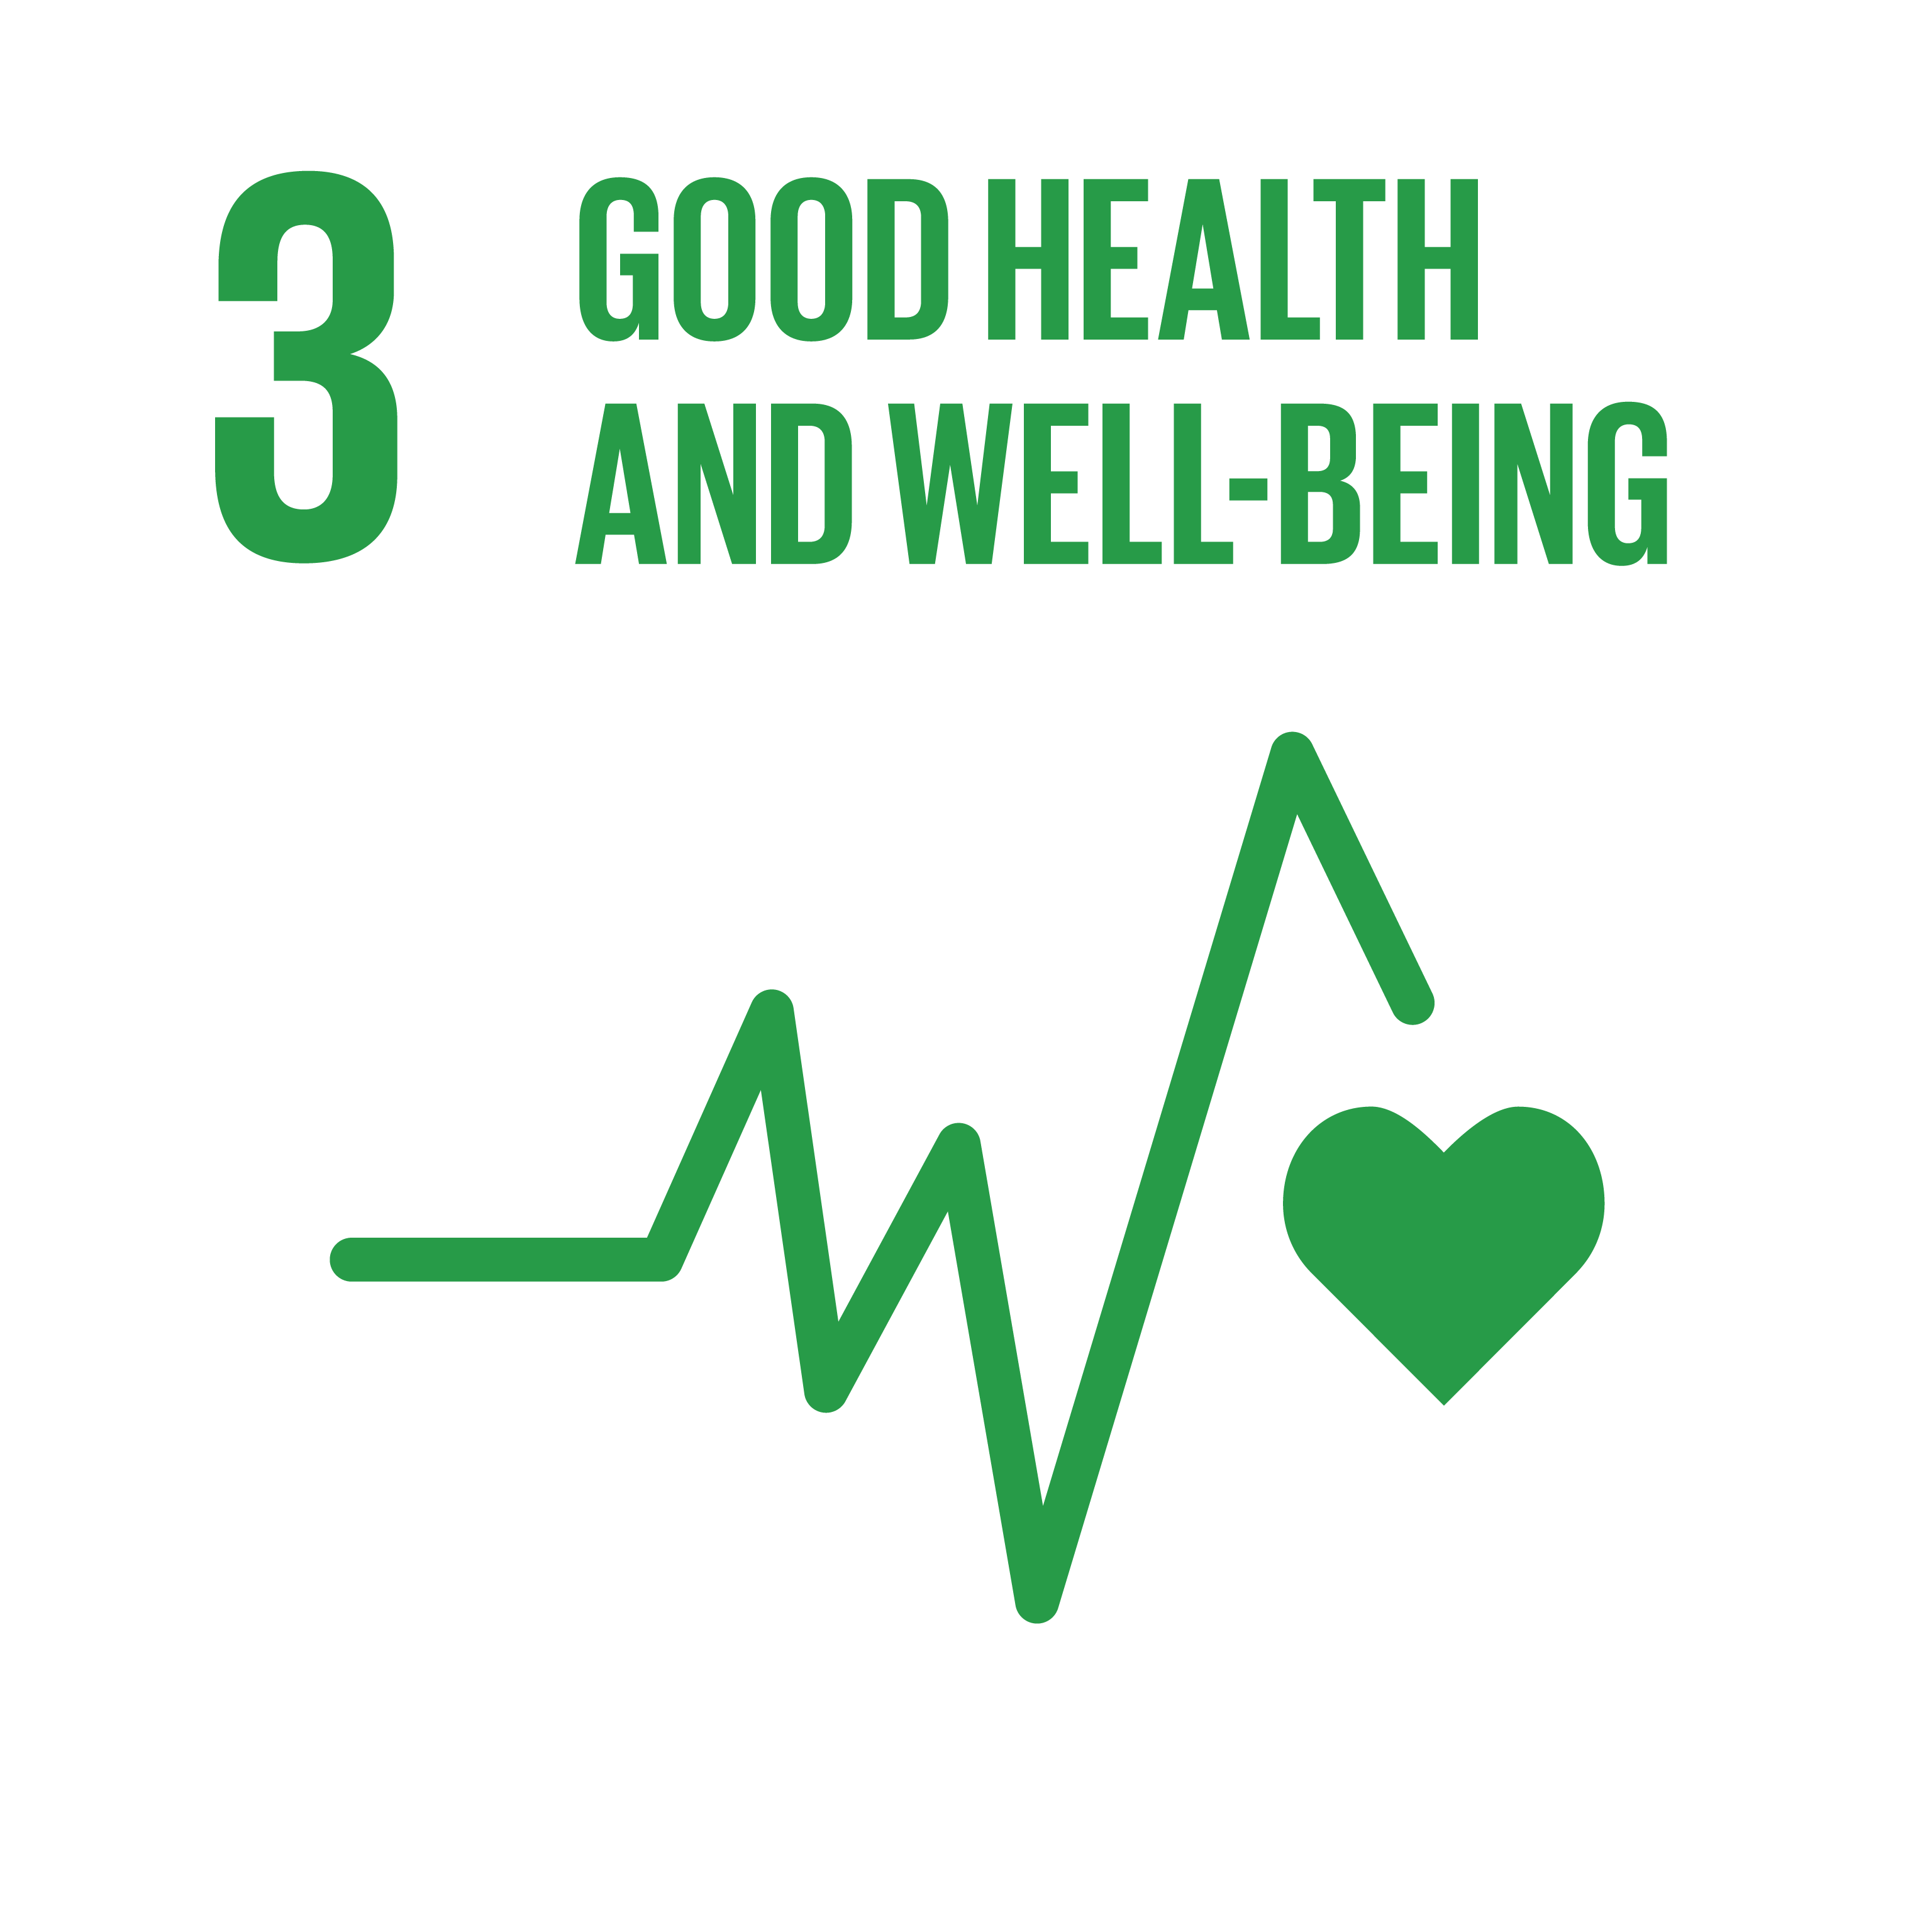
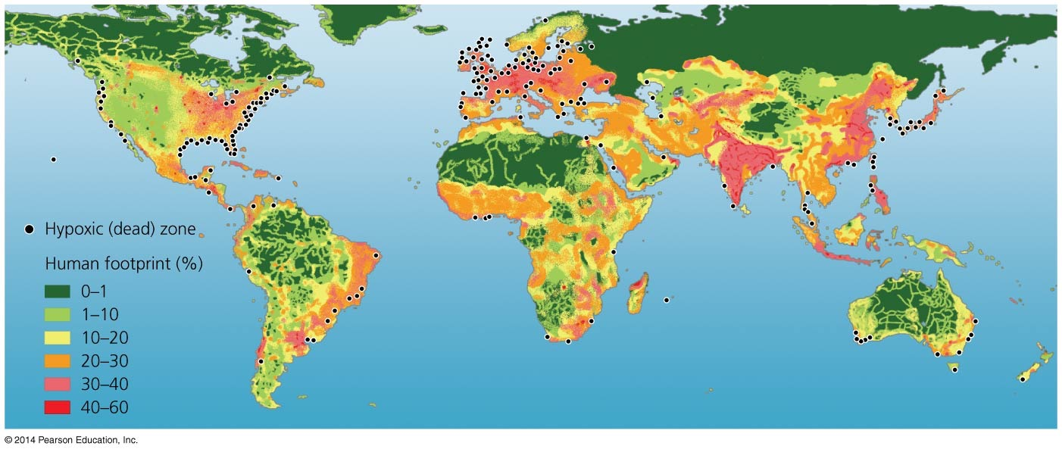
What is missing?
Feeding a growing Population
Accelerating energy flow by accelerating C cycle
Accelerating N and P cycles
Changing land use
Overload of ocean with nutrients
Toxins
Overload of ocean with carbon
Extinction
On their quest to learn more about toxic substances produced by cyanobacteria, Dr. Paul Cox and his team discover a link between cyanobacteria and ALS, Alzheimer's, and Parkinson's.
Hypoxic (dead) zones
Director: Bo Landlin, 2017
18
RESPONSIBLE
PROCREATION
0
Missing: SDG 0

Slide 84
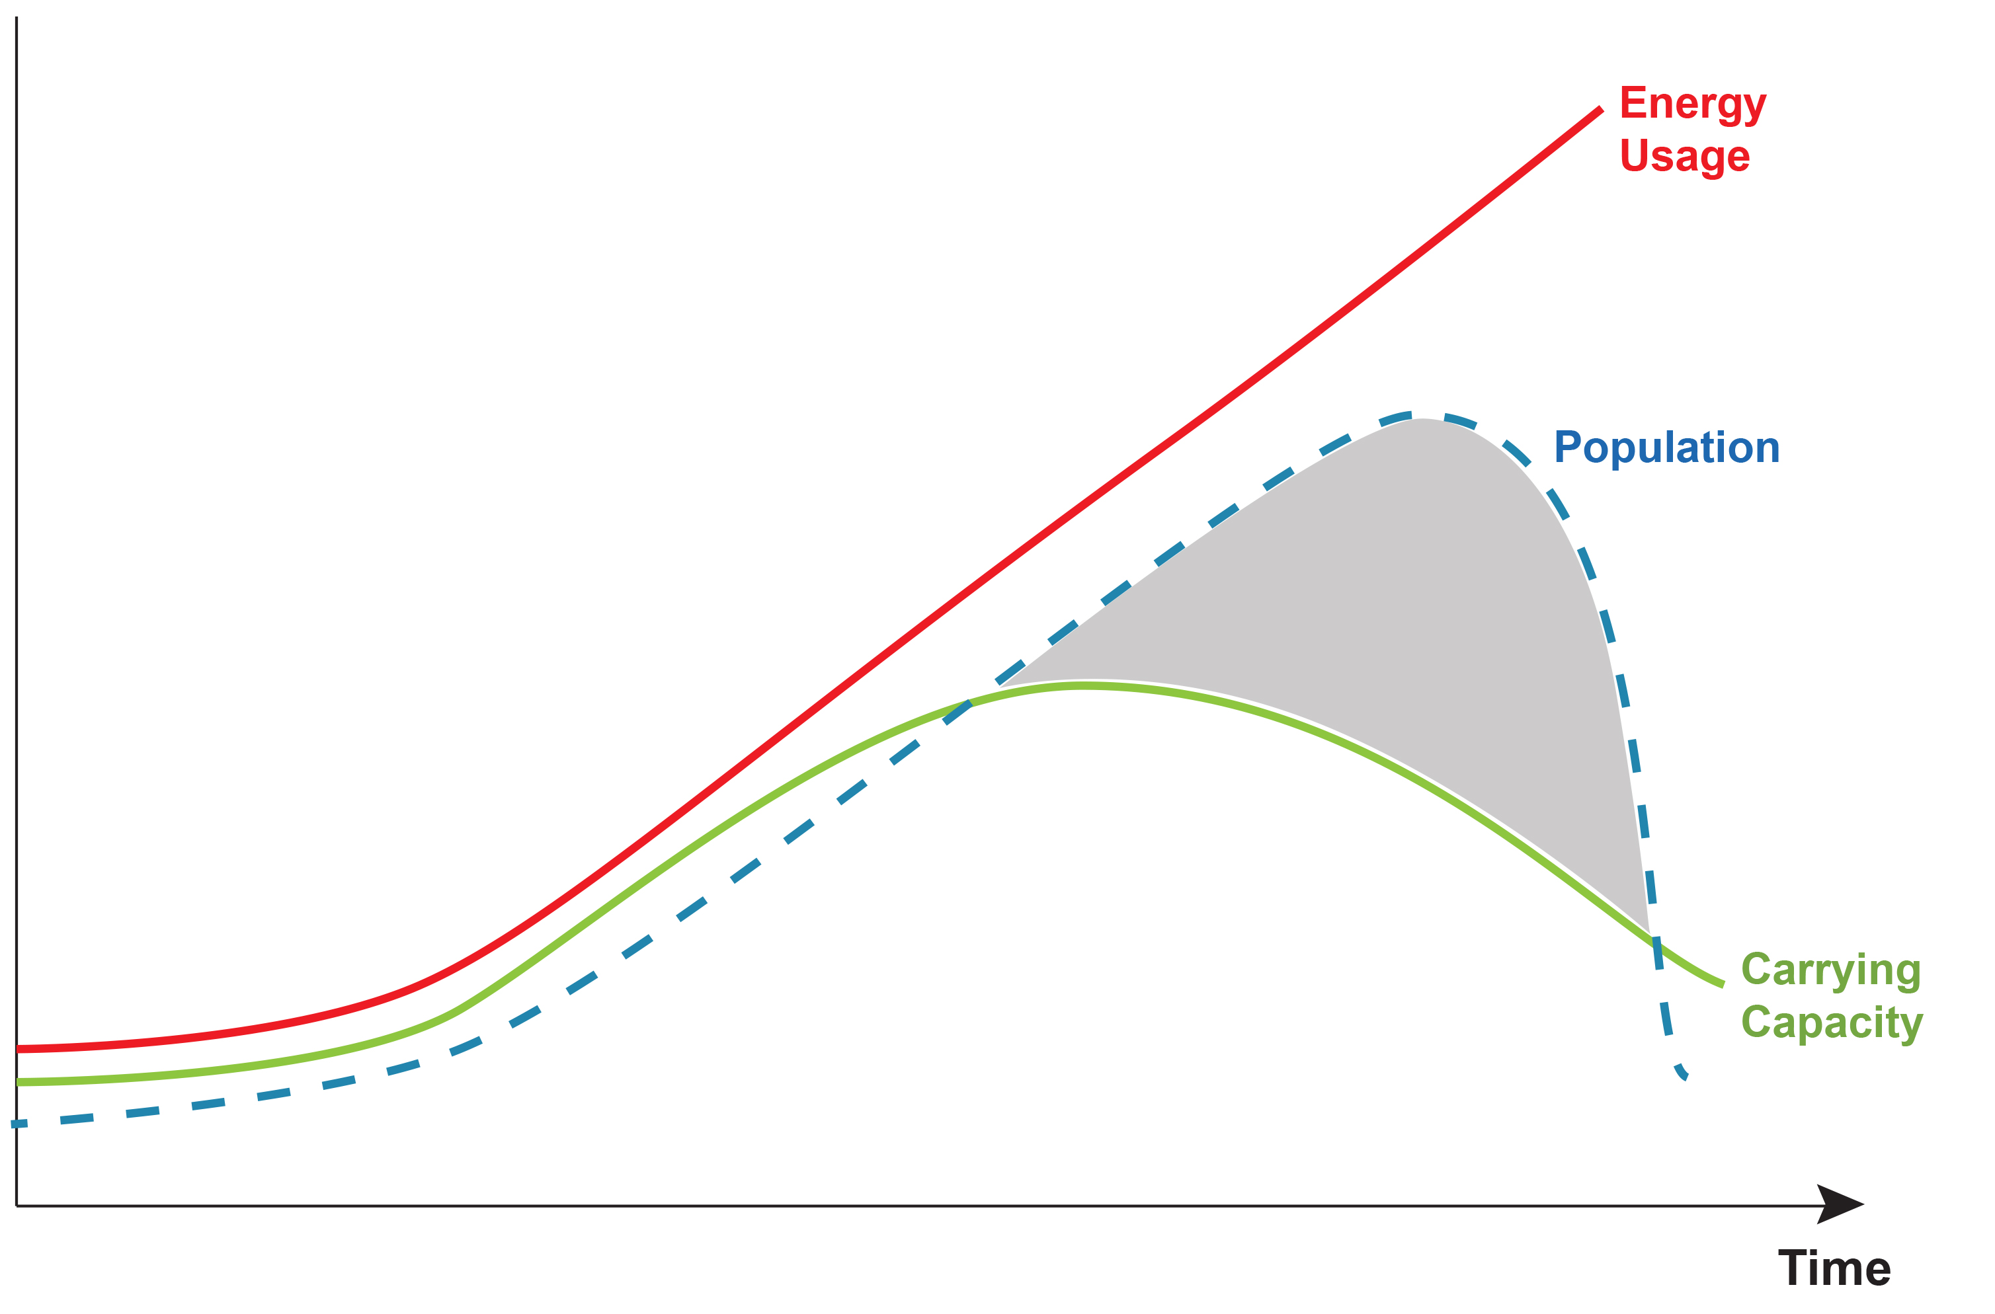
What is missing?

Slide 85
The United Nations’ 2030 Agenda for Sustainable Development
About Sustainable Development
The 2030 Agenda: A Road to Dignity
The Goals
What is being done to reach the Goals
Society through the Eyes of the Goals
What is missing?
What can you do?

Slide 86
What you can do
https://sdghub.com/goodlifegoals/

Slide 87
What you can do
https://sdghub.com/goodlifegoals/

Slide 88
What you can do
https://sdghub.com/goodlifegoals/

Slide 89
What you can do
https://sdghub.com/goodlifegoals/

Slide 90
What you can do
https://sdghub.com/goodlifegoals/
Get involved
Help make tomorrow better than today

Slide 91
The United Nations’ 2030 Agenda for Sustainable Development
The 2030 Agenda is the best agreement humanity has ever reached on a global level
&
It can be a “Road to Dignity.”

