Slide 1
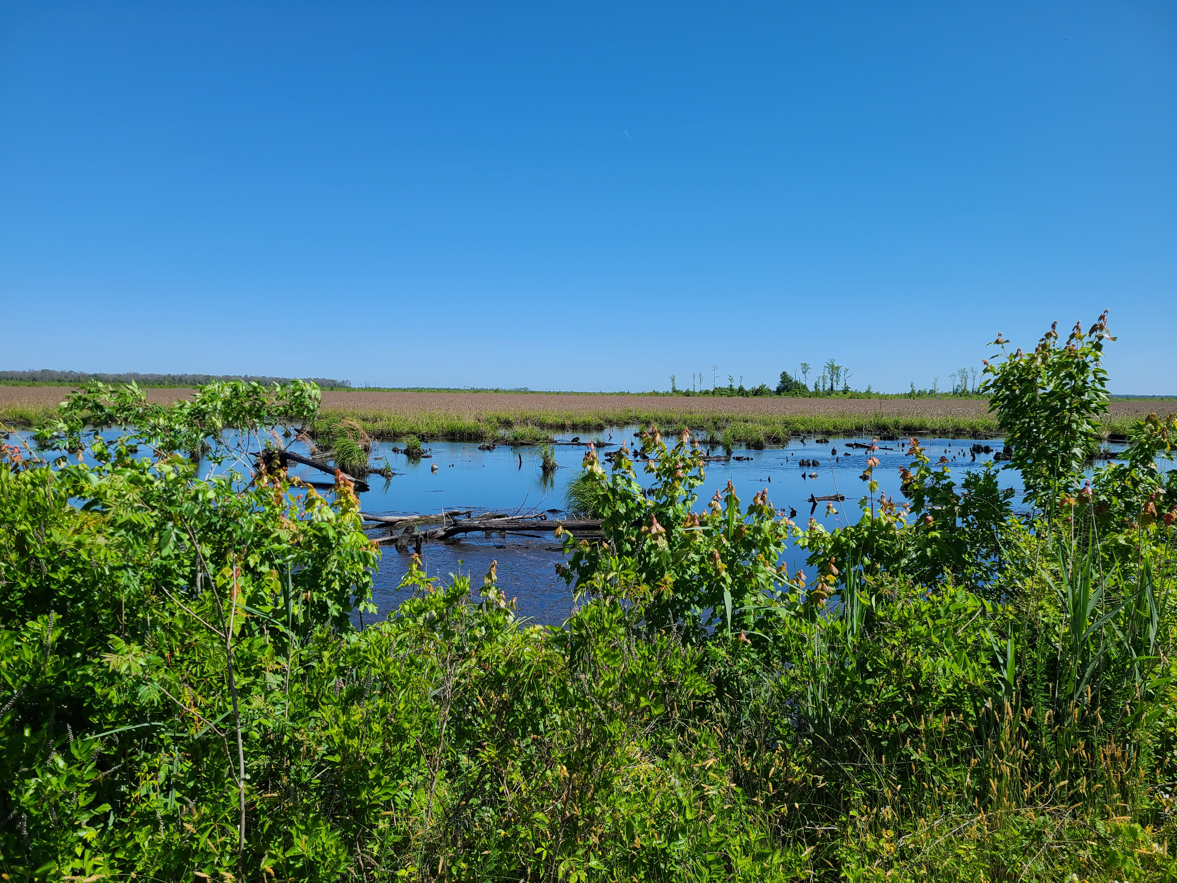
Earth, Water and Fire: The future of Great Dismal Swamp National Wildlife Refuge (GDSNWR) in a changing climate --- Old Dominion University, Summer 2021
Presentation by
Keigan Thornton

Slide 2
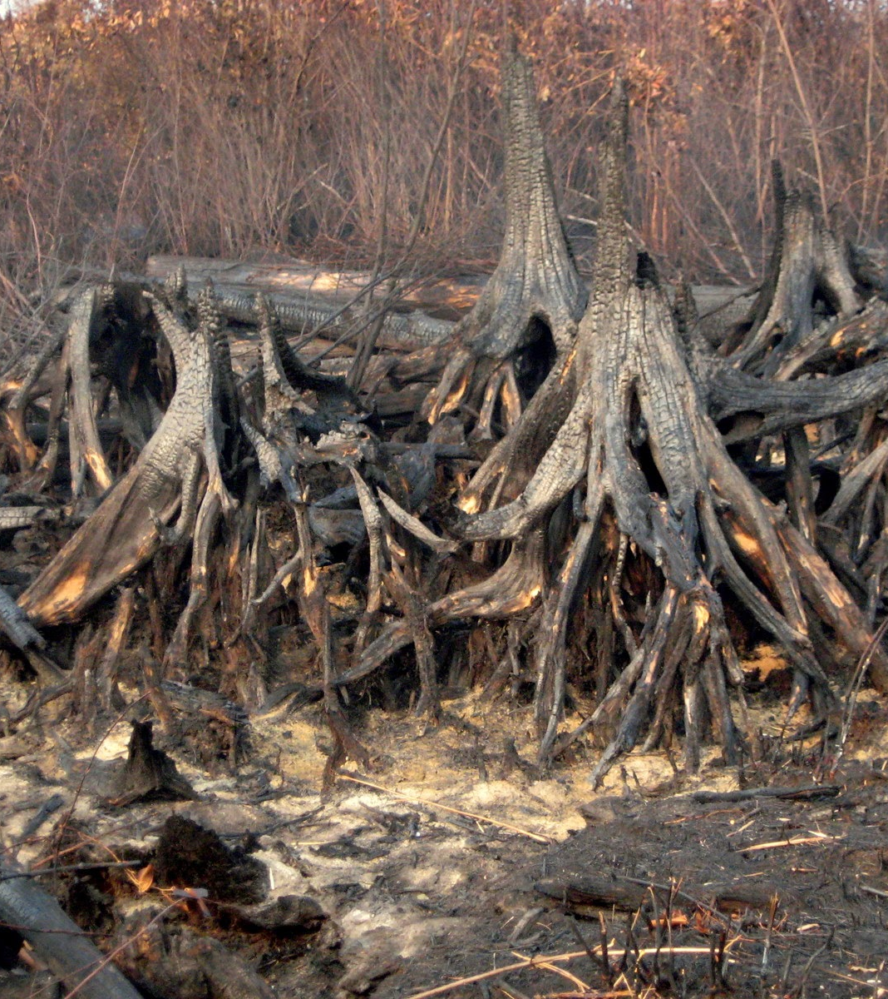
“Not everything that is faced can be changed, but nothing can be changed until it is faced.” - James Baldwin.
Exposed tree roots at GDSNWR after 2011 fire (Sanders, 2011)

Slide 3
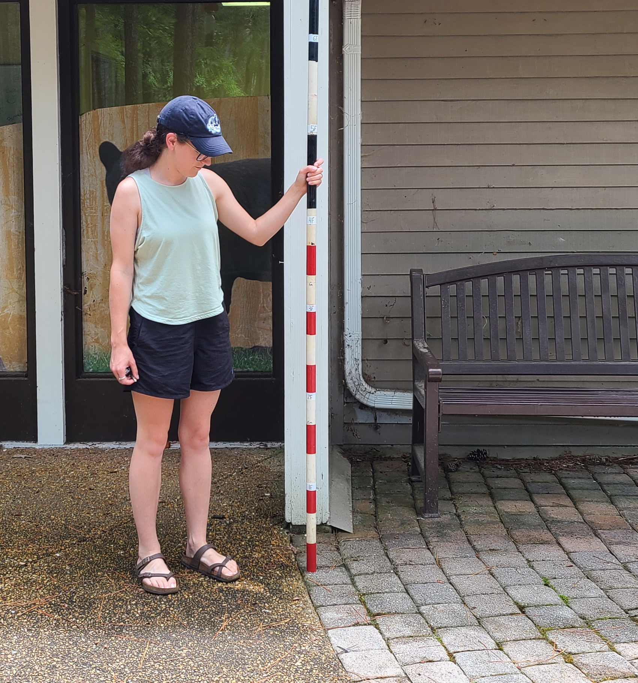
Meet the Research Team
My research partner, Michala Hendrick Graduate Student studying Park, Recreation and Tourism Studies and the Conservation Leadership Certificate Program
Me, Keigan Thornton Undergraduate Student studying Biology and Conservation Leadership

Slide 4
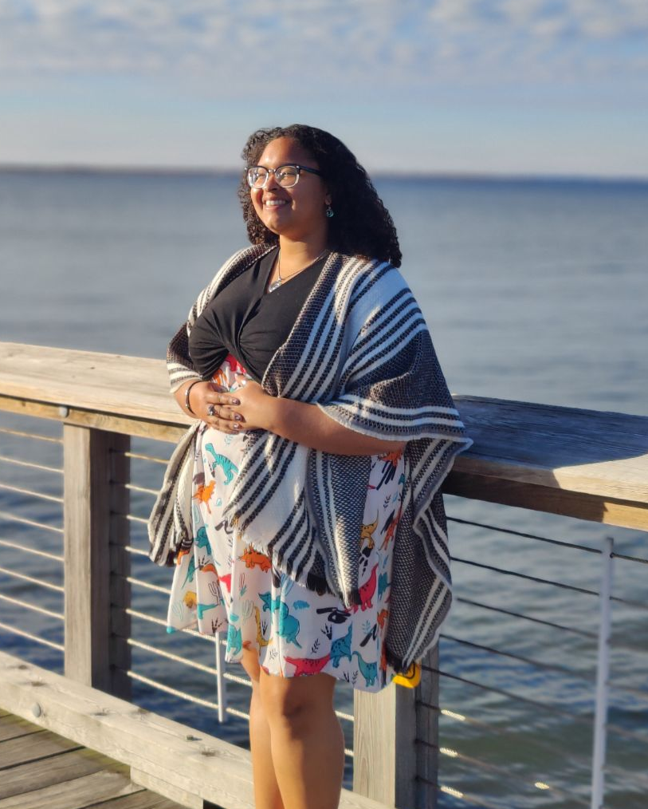
About Me
Undergraduate at Old Dominion University Class of 2021
Major in Biology and Minor in Conservation Leadership
Academic Interests:
Ecology and community interactions, conservation science, scientific illustration and animal behavior
Personal Interests: Tabletop gaming, digital/traditional art, and gardening with native plants

Slide 5
About the Project
What is the problem in the Great Dismal Swamp National Wildlife Refuge?
How to use prescribed fire in GDSNWR in an altered ecosystem
How to best ensure Refuge management monitors the environment
How do we ensure communication is effective between Refuge management and the community.

Slide 6
MARI Case Study Approach
Visual Fuel Load Assessments
Stakeholder Involvement
Understanding how understand and manage prescribed fire practices within the GDSNWR
Case study format used to create, and deliver research regarding a problem.
Fieldwork that took place in Summer 2021 to asses possible fuel loading and fire presence in GDSNWR
Survey creation and distribution to understand local understanding
Notes:
Other examples of presentation enhancements might include audio clips, charts and graphs, or accompanying handouts or worksheets.

Slide 7
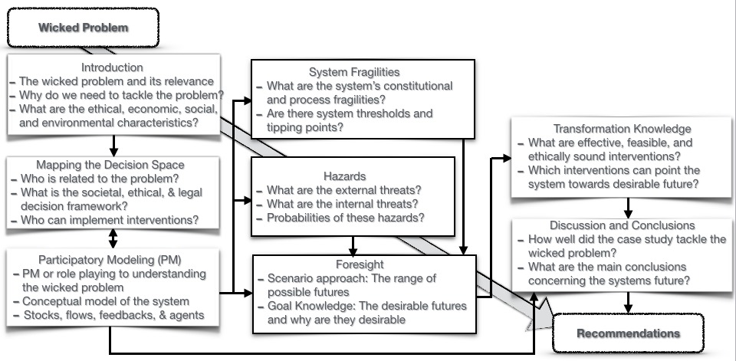
The MARI Case Study Approach
A method of research designed for tackling wicked problems related to sustainability, mitigation of threats, and adaptation to changes.

Slide 8
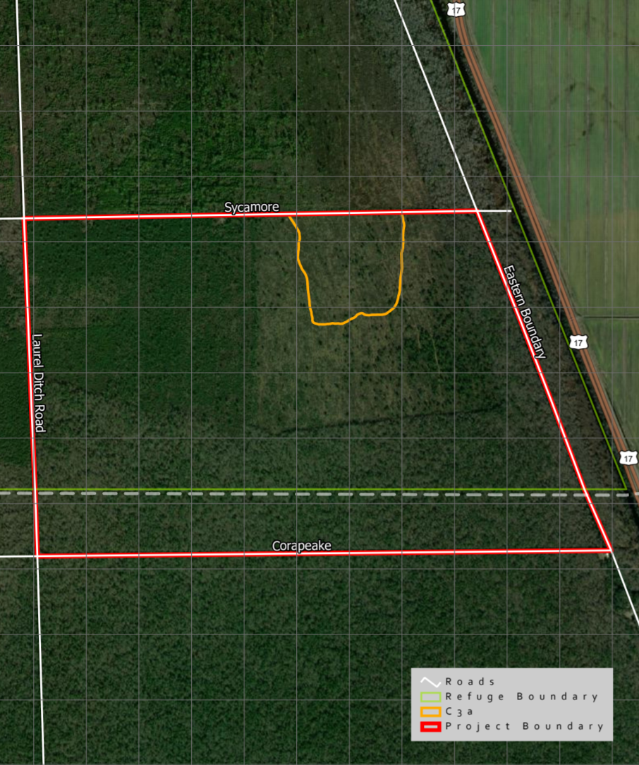
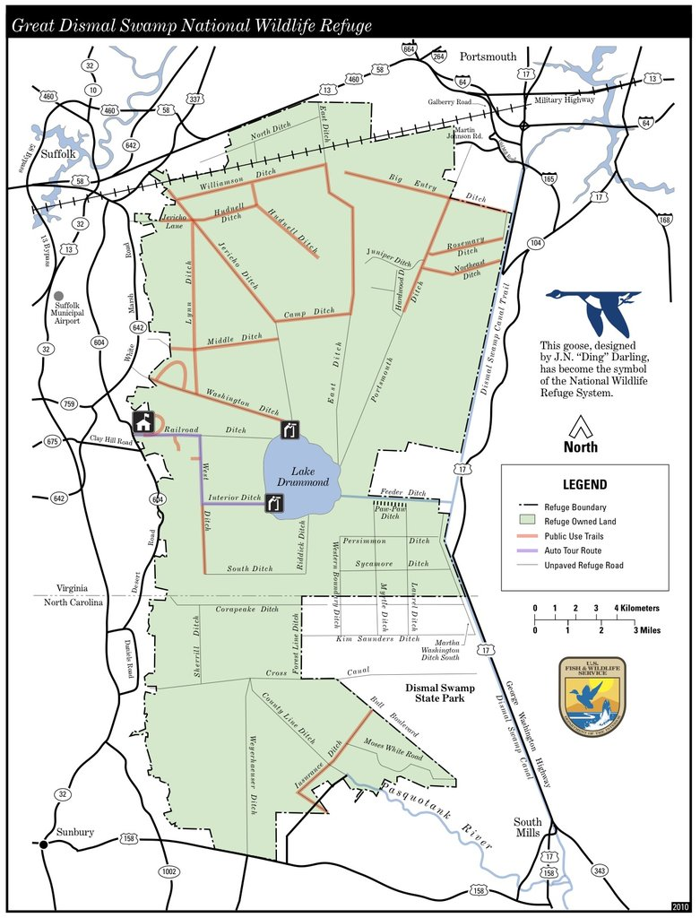
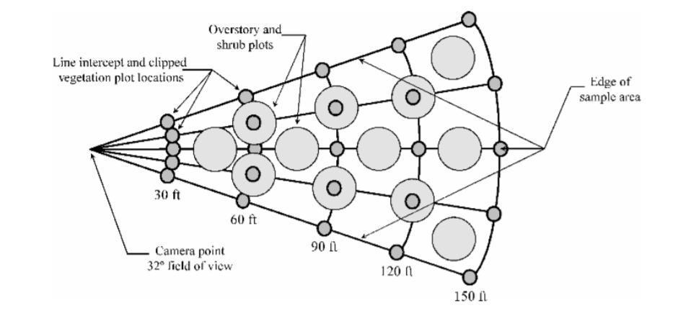
Fuel Load Assessments
Photos taken to understand how to measure vegetation and understand what fire may do to the altered system
Area where perimeter photos were taken.
How much space each photo assessed.

Slide 9
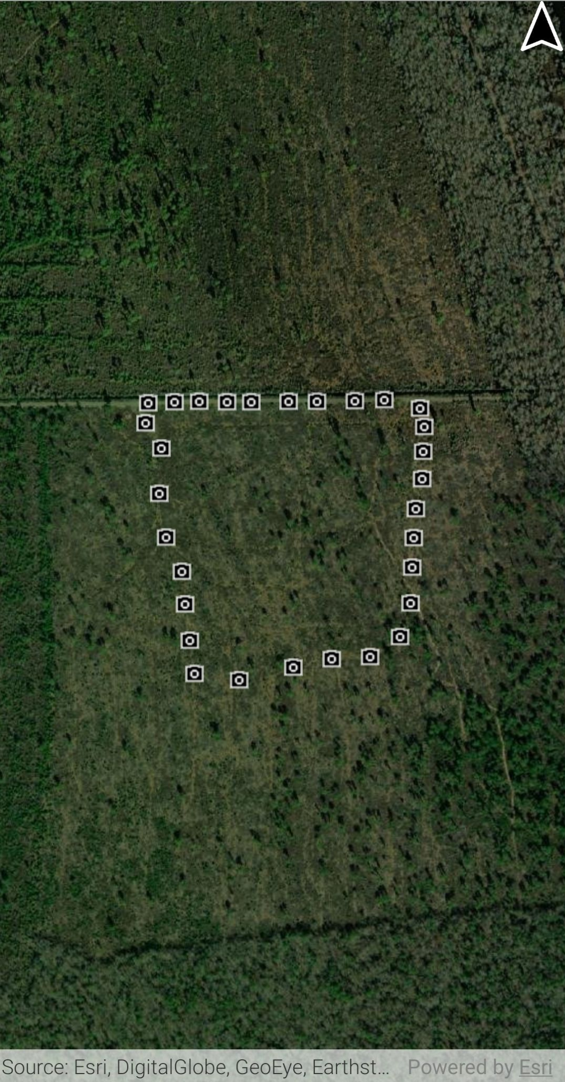
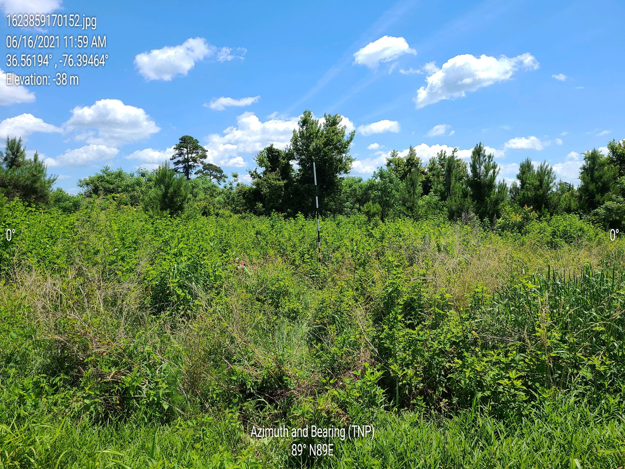
Fuel Load Area and Photo Example
On left – Markers for 30 photos taken of perimeter area in C3 block of the GDSNWR
Above – Example of fuel load photo with date, time, latitude and longitude in upper left corner and bearing in bottom center.

Slide 10
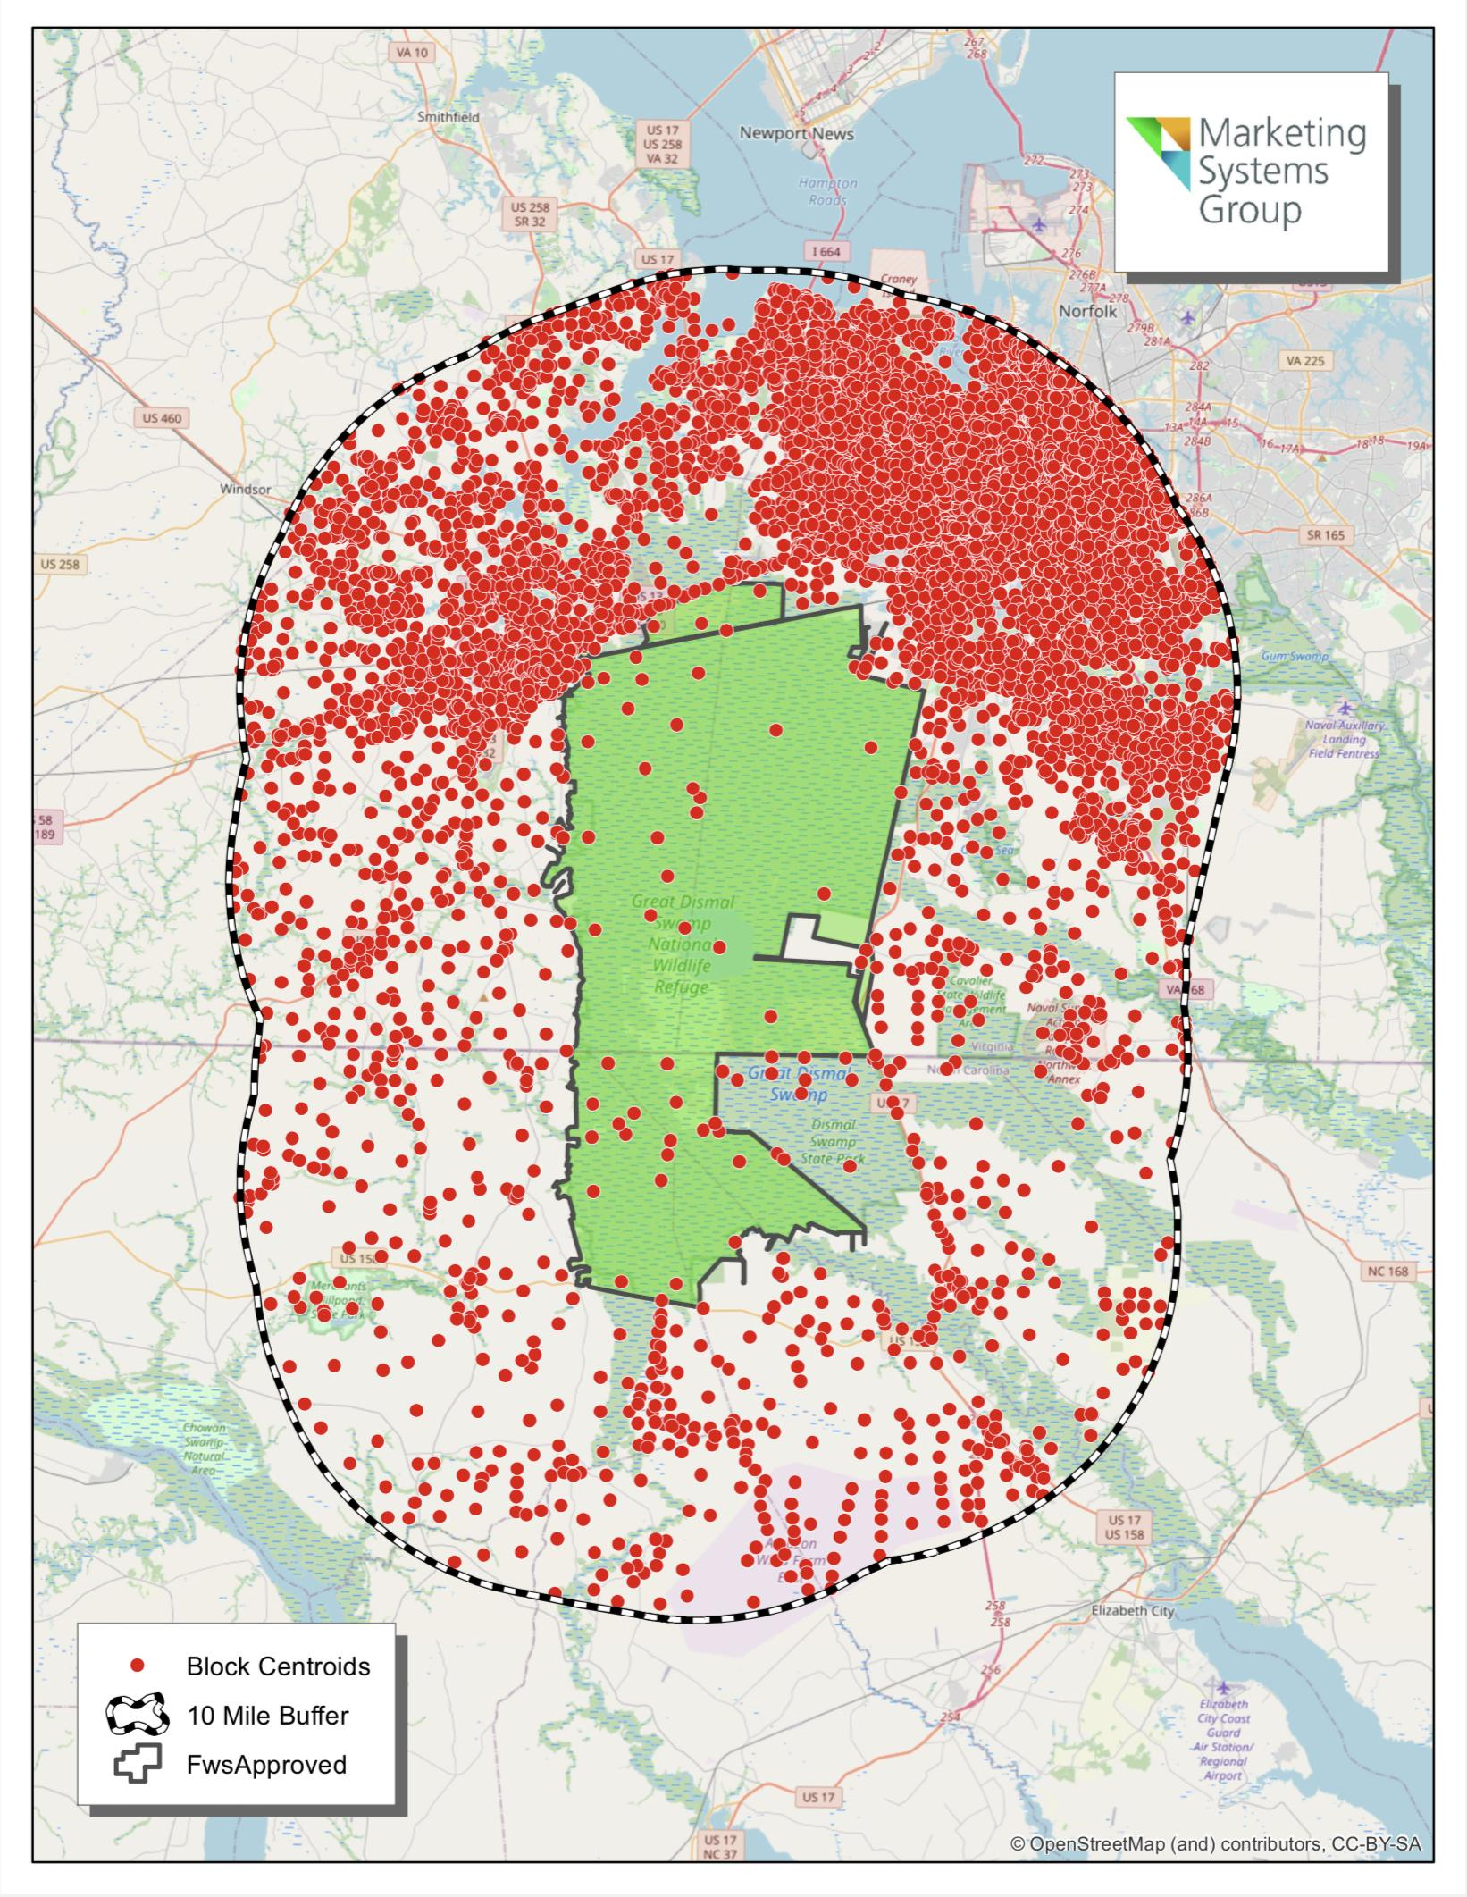
Public Perceptions of Prescribed Fire Management
Address based sample of 3,500 residents surrounding the refuge paired with on-site surveying of visitors.

Slide 11
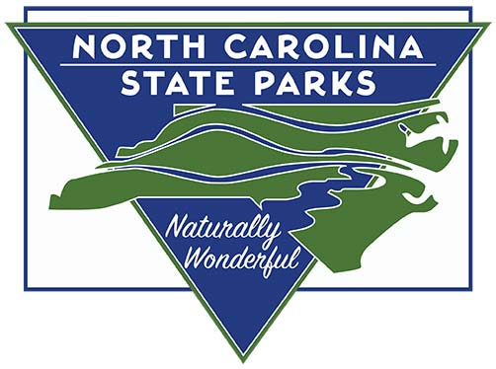
Stakeholder Involvement
Though our project focuses on the Great Dismal Swamp National Wildlife Refuge, other key stakeholders have been considered.

Slide 12
Outcome of research during the summer…?
More information is needed!
Management and Fire Staff need more collaboration
Re-evaluating the Comprehensive Conservation Plan the Refuge has in place may be necessary to understand effective management practices.
Public interaction could be expanded more to cover more socially and culturally relevant stakeholders.
Little to no change in the system state could cause the system to deteriorate or collapse in the worst case scenario

Slide 13
Personal experience from summer research…?
Beforehand I was interested in field work, but now being able to actively participate makes me feel like I can make a difference.
Interacting with Fish and Wildlife employees made me feel welcome in the field
Interacting with the community to inform and educate can sometimes feel like the biggest impact
Biggest Lesson Learned: Adapt to the weather, and start early in the summer

Slide 14
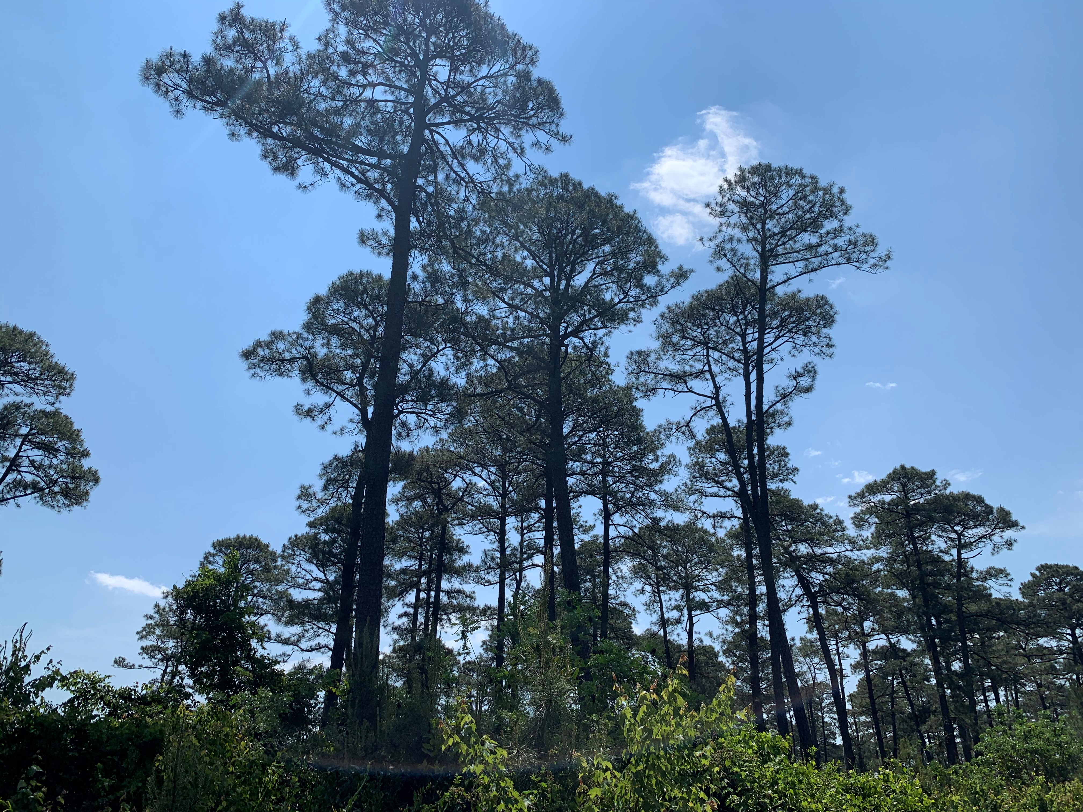
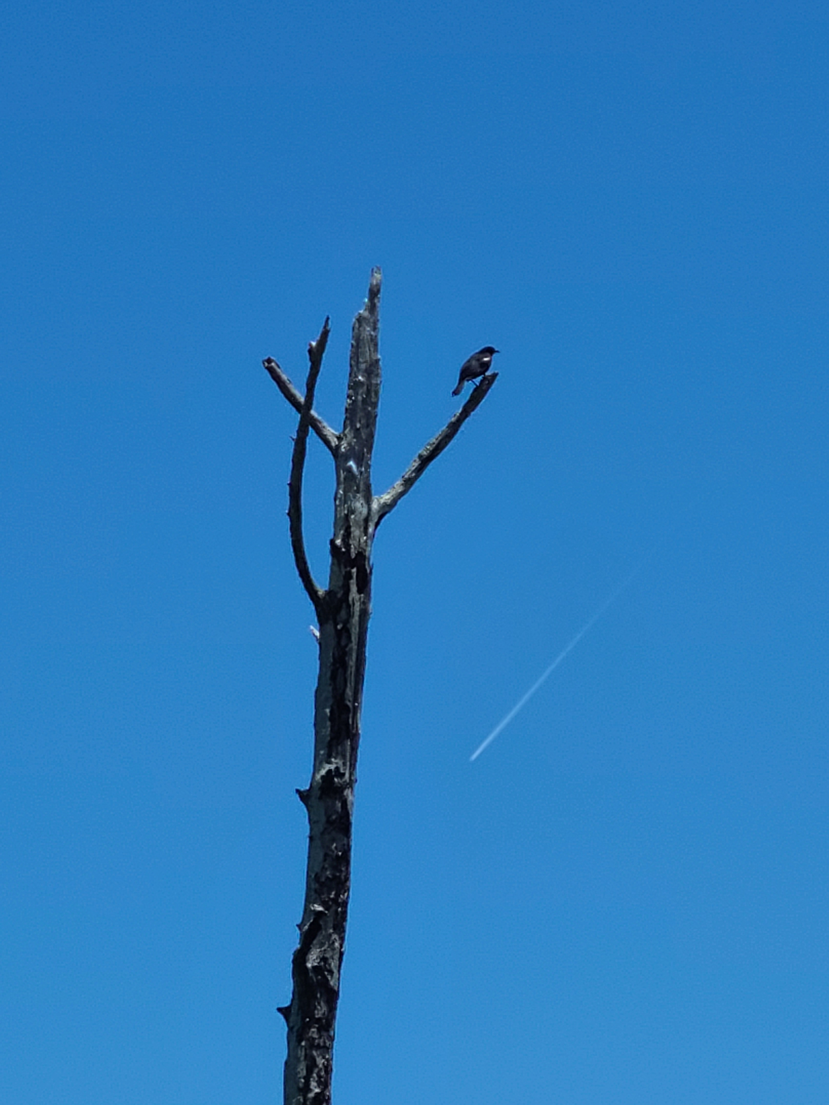
Thanks for your time!
If you would like to contact me for additional information or a follow-up please contact me at:
Email – kthor005@odu.edu
Phone – (703)398-0490
Pond pines in the C3 block, south eastern portion of Great Dismal Swamp National Wildlife Refuge
Photo by Keigan Thornton, 2021
Red-winged Blackbird perched on a tree in the GDSNWR burn scar.
Photo by Keigan Thornton , 2021
Notes:
Always include a closing slide with “thanks” and contact information.

