Slide 1
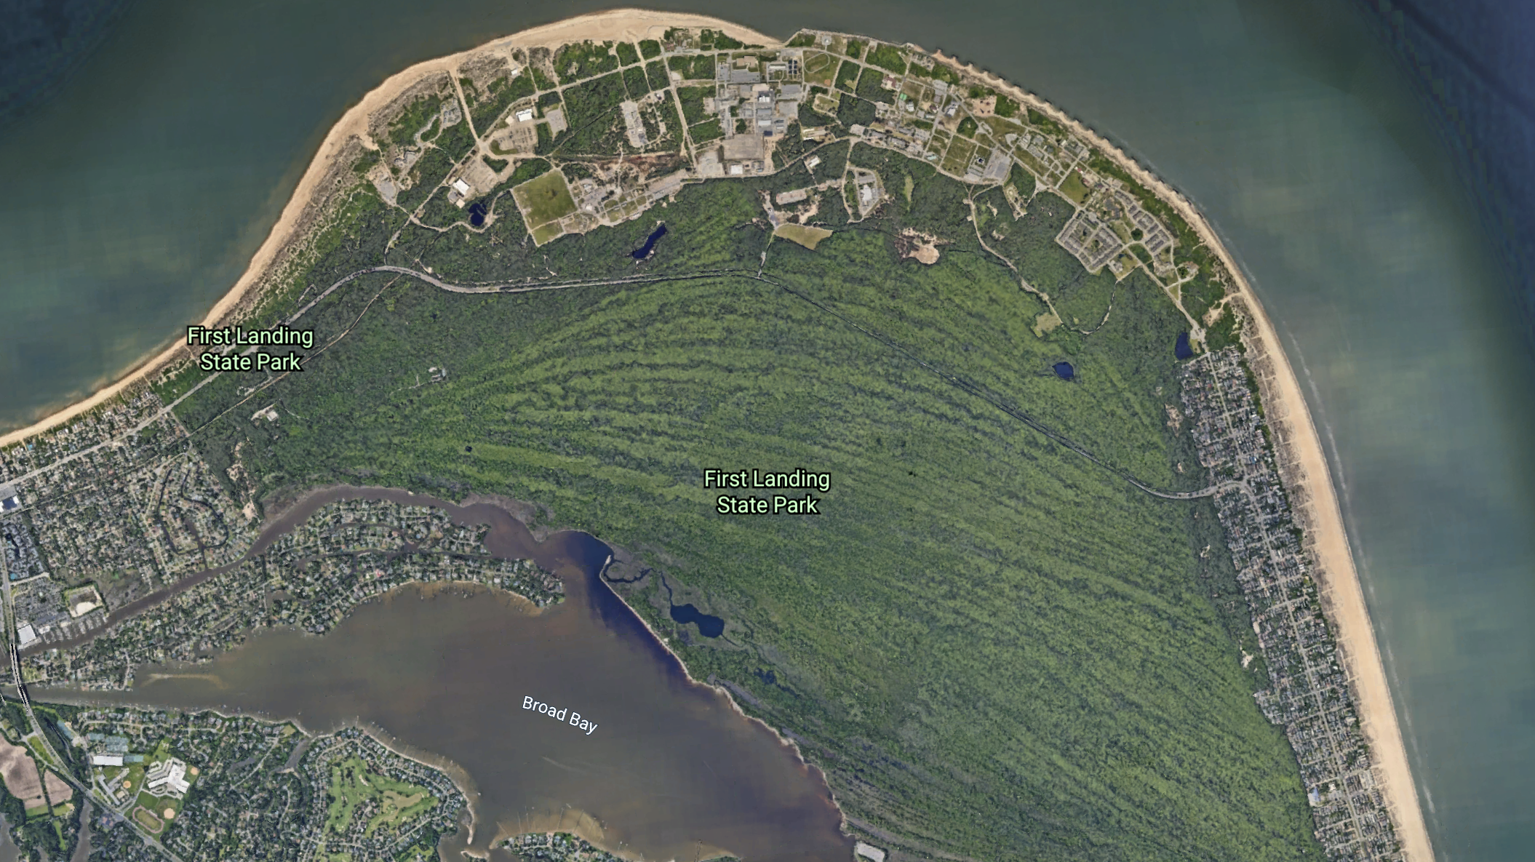
First Landing State Park
Presented by: Kelly Jones

Slide 2
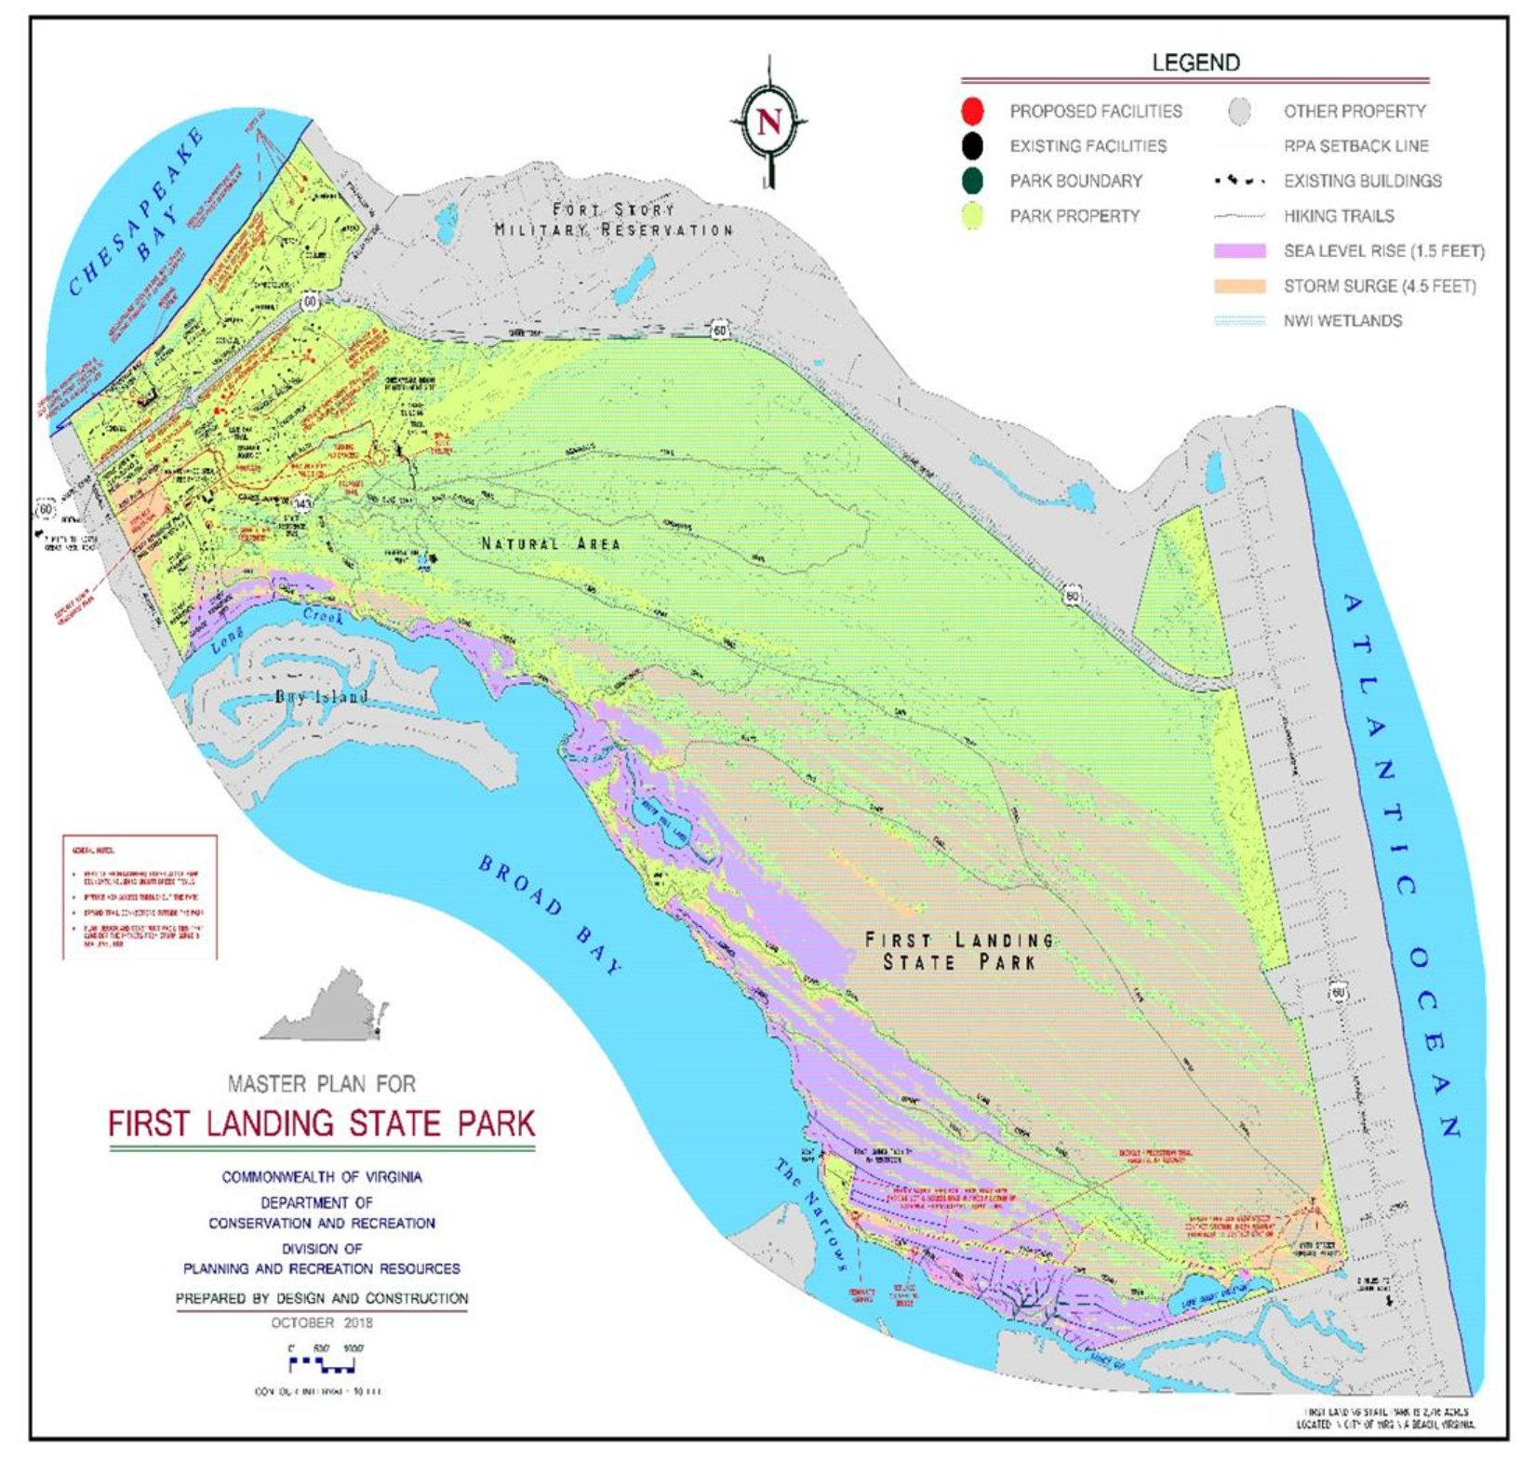
Background
First Landing State Park, originally Seashore State Park, established in 1936
It is located in the northeastern corner of Virginia Beach, Virginia in the United States
The park brings in over 1 million visitors a year
Contains 2,888 acres, the park includes over 19 miles of trails and1.5 miles of beaches located on the mouth of the Chesapeake Bay
The area is environmentally unique as well, including back dunes, tidal marshes, swamps, and a maritime forest community
It is the northernmost limit for semi-tropical species and the southernmost limit for temperate species.
Migratory birds use this land as a necessary nesting ground

Slide 3
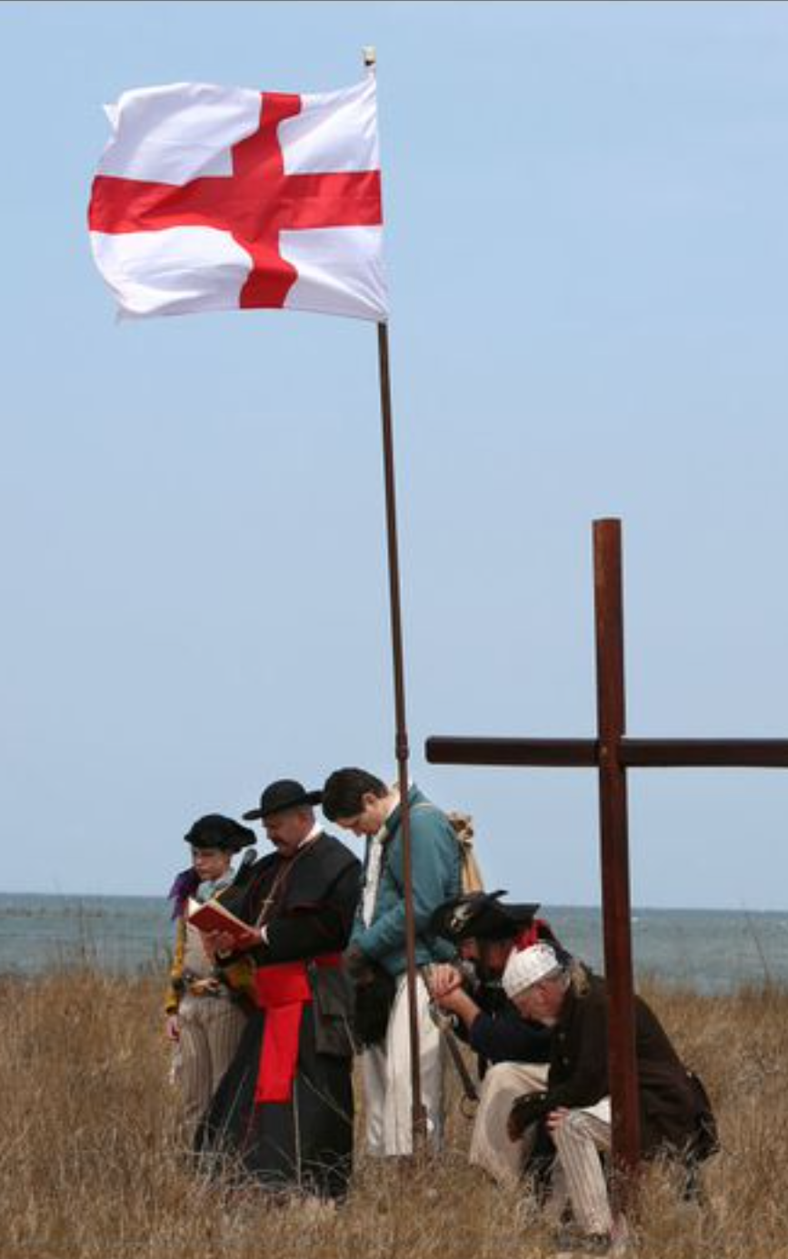
History
Chesapeake Indian Tribe once covered this land but were brutally massacred by the Powhatan nation to the west. The Powhatan’s were told of a conquering threat from the east, and knowing of only the Chesapeake people, slaughtered them about 1606-1607. The ships of English colonists arrived from London in April of 1607
The Powhatan Tribe worked with Virginia State and First Landing to place the remains of the Chesapeake Indians in a burial ground in the park. People come to this spot to pay respects to the tribe and learn of the past culture
The park is named for the location in which the first English Colonists landed in 1607, where they said to have placed a cross
The was originally named Seashore State Park and was opened in 1936 by an all Africa-American group from the Civilian Conservation Corp
Theses men built roads, trails, 6 cabins, and administrative and maintenance buildings
In 1999, Seashore State Park was renamed as First Landing State Park to recognize the first landing of the colonists.
The park today is 2,888-acres, has 20 cabins, over 200 campsites, and about 19-miles of trails but no longer contains the symbolic cross that represents the landing of the colonists
It is highly attractive to residents and tourists because of the rich history and prime location so close to oceanfront Virginia Beach. People also have a lot of interest in the deep and rich history
First Landing Festival's Historic Reenactment
By STEVE EARLEY
Reenactors bow their heads in prayer on the dunes lining Chesapeake Bay during the First Landing Festival's Historic Reenactment and Celebration at First Landing State Park in Virginia Beach on Saturday, March 26, 2016. (Steve Earley)

Slide 4
Graduate Conservation Leadership
Old Dominion University, Mitigation and Adaptation Research Institute: Graduate Conservation Leadership Certificate Program
Based on a Memorandum of Understanding between the U.S. Fish and Wildlife Services (FWS) and MARI at ODU, a graduate Certificates in Conservation Leadership was implemented in 2016 until 2019. Since then, MARI has continued the program
The Program has a research agenda in conservation under climate change and sea level rise
To complete the program there are 3 courses and 1 internship requirement
FLSP was an excellent candidate for an internship, as they have worked closely with the program leader, Dr. Hans-Peter Plag to place 2 other students
The internship includes working at the park to learn the intricate details of how the park is managed and completing a case study.

Slide 5
Case Study
As a part of the internship, a case study was conducted
2 other case studies have been completed on the impacts of climate change and sea level rise on aspects of the park, with another in progress
It was important to look at the bigger picture for my case study:
First Landing State Park is an important tourist attraction and important educational and recreation spot for residents
Sea level rise is a challenge that First Landing State Park and Southeastern Virginia will face
These factors provided for adequate questions for the case study of:
Climate Change and Sea-Level Rise: Potential Impacts on the Socio-Economic Role of First Landing State Park for the Region

Slide 6
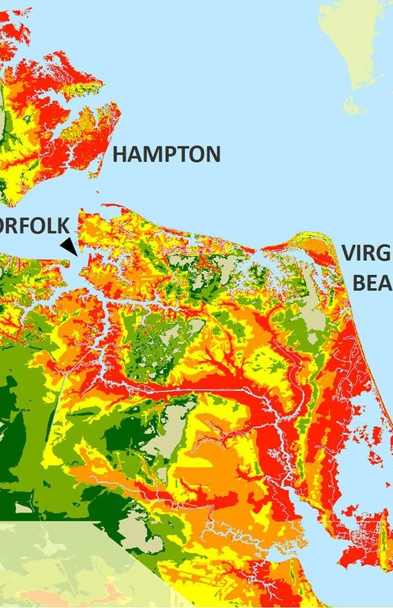
The Challenge
First Landing is a major tourist attraction due to the beautiful beaches, trails through the unique habitats, and lodging.
Climate change and sea level rise pose a threat to low elevation areas like the park and Virginia Beach.
Destruction from these events lowers the appeal for tourists and poses an economic threat to the surrounding community.
The National Oceanic and Atmospheric Administration (NOAA) displayed the current relative rate of sea level at the Chesapeake Bay Bridge Tunnel, VA at +5.92 mm/year based on monthly mean sea level between 1975 to 2017 (COOPS, 2018).
SLR and climate change are likely to change the habitat communities of the park. The unique habitats found in the park so close to oceanfront Virginia Beach are a major reason for visitors to the park. FLSP is one of the most populated parks in Virginia
FLSP plays an important socio-economic role in the Hampton Roads, particularly Virginia Beach, area.
The challenge is to ensure that FLSP can maintain this important role during a time of SLR and climate change. Recommendations for this case study will be given to FLSP in order to address this issue.

Slide 7
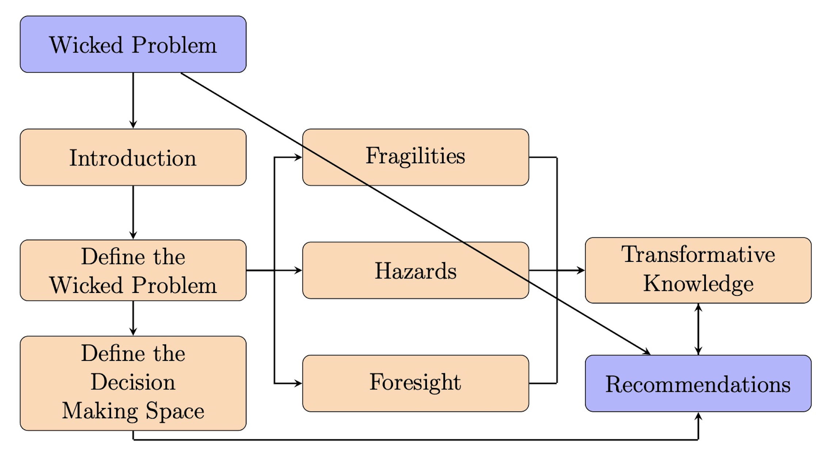
Methodology
The Case Study Template has been developed as a part of the Conservation Leadership Program
The template takes a transdisciplinary approach to real-world wicked problems with the goal to develop recommendations for a target audience
The tool begins with a wicked problem
The case study of FLSP and the local community seeks to assess the impacts of hazards related to climate change, SLR, and economic challenges in the area.

Slide 8
Decision Making Space

Slide 9
Participatory Modeling
FLSP: Our mission is to protect the natural environment, while providing outdoor recreation, environmentally educational programs, and historic preservation of the area (FLSP Business Plan). We have limited resources to engage in extra activities that do not align with the mission or that create more work hours or funding within the mission statement.
Local Residents: We love utilizing the park for recreational activities as well as the variety of educational programs. FLSP is a unique environment and our goal is to continue to use it as long as it is economical.
Tourists: FLSP provides us with outdoor recreational activities and contains a rich history. Many come for the campgrounds near the beach, while others come for the historic areas. Others come to visit Virginia Beach or other local cities and find it for good walking and biking trails. We want it to remain active to provide these for us, and without them we would have to find somewhere else.
VB Businesses: FLSP bring in tourists and is good for the shops, restaurants, and accommodations. We think that the park enhances our business and would like for it to continue to bring in people.

Slide 10
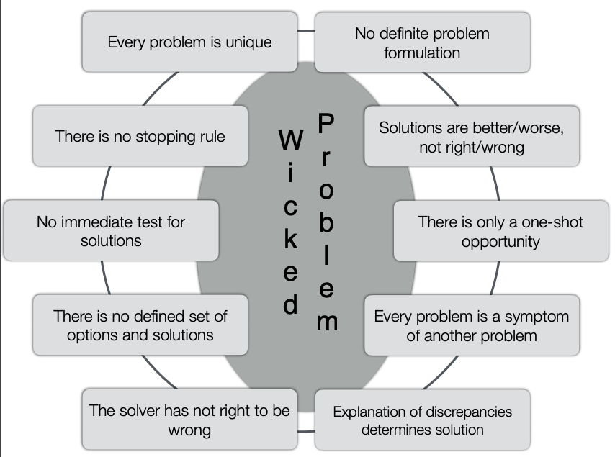
Wicked Problem
Wicked Problems are societal problems rooted in the environment.
Wicked Problems were first defined by Rittel & Webber (1972) as problems that fit ten specified criteria:

Slide 11
Goal Statement
A goal statement was created based on the perspectives of the stakeholders and the restrictions of the regulators to begin the process of defining a wicked problem.
This goal statement combines the mission of the VDCR and FLSP with the goals of the local community.
The goal statement derived is to maintain FLSP’s natural land while providing educational and recreational activities for locals and tourists in order to maintain FLSP’s socio-economic role in the community.

Slide 12
The System

Slide 13
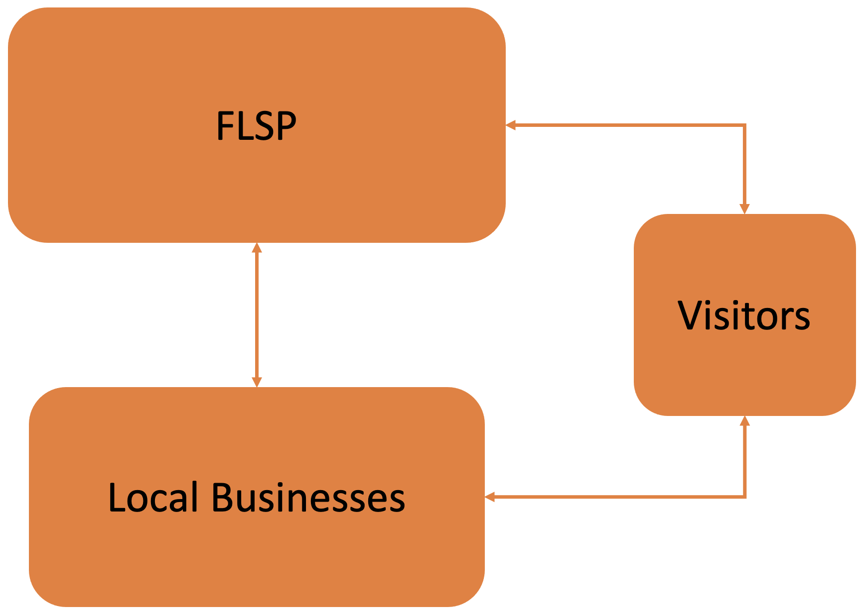
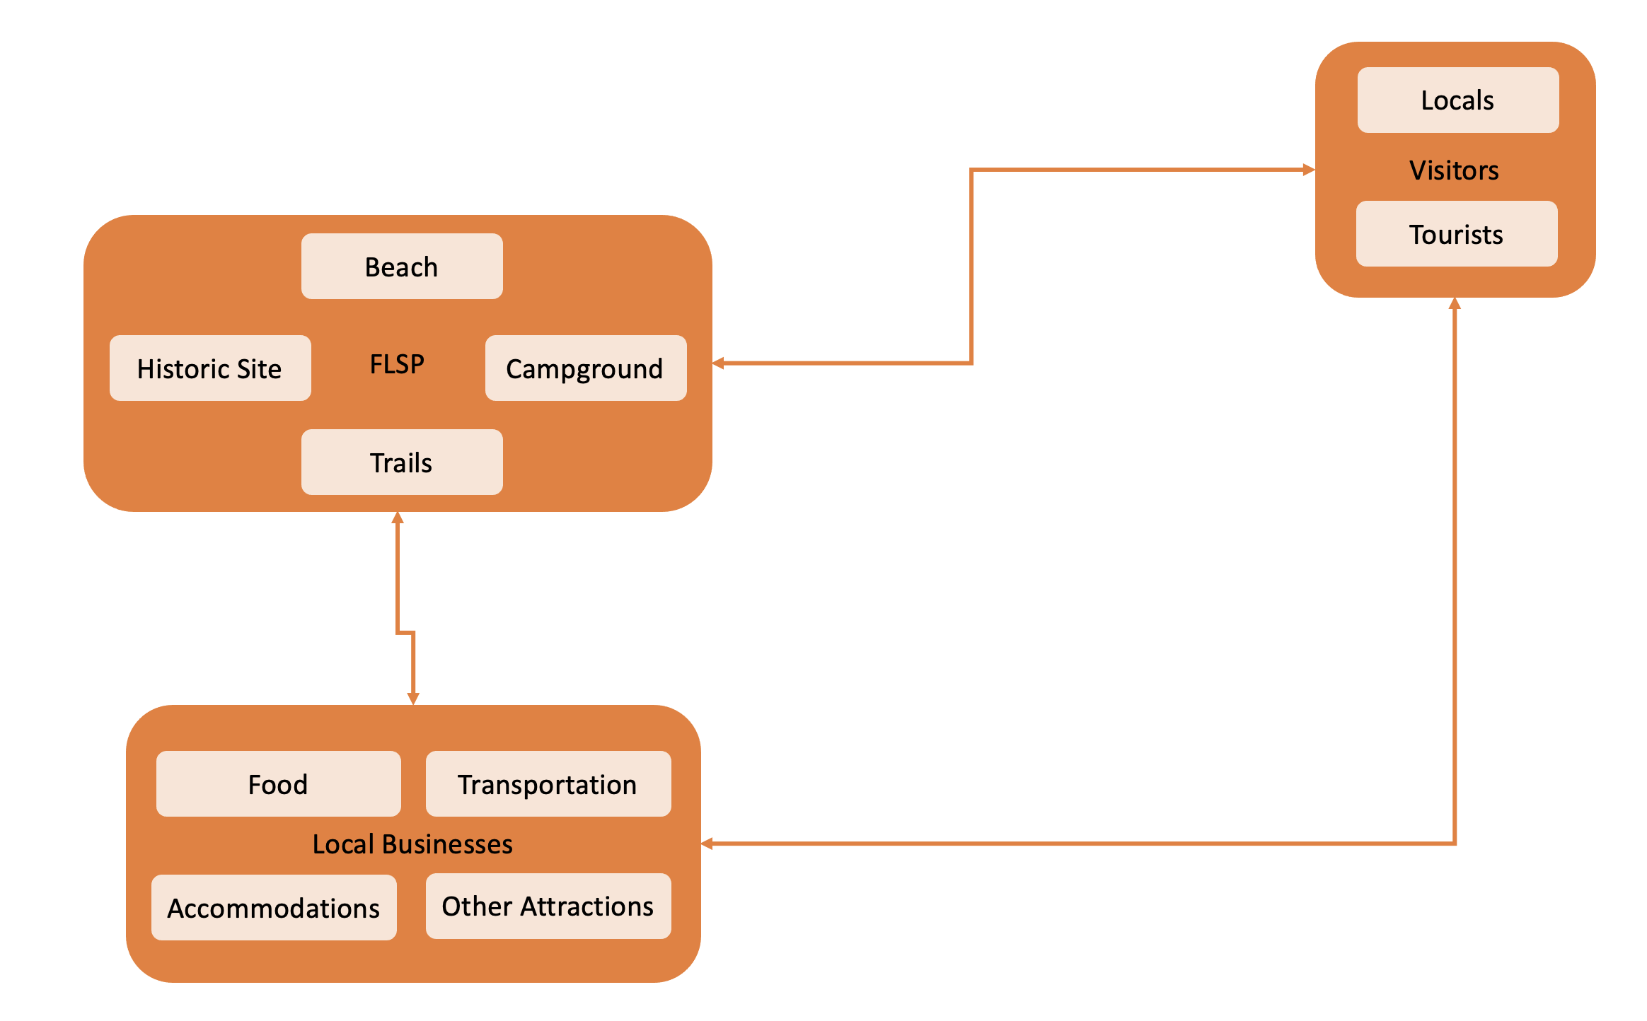
System
Initially, the crucial elements included FLSP, the Virginia Beach community, and the park’s visitors (above).
These elements were broken up with consideration that the people are moving from one stock to another, people are the flow unit.
These are respectfully separated into a light peach color to show attractions and infrastructure; locals and tourists; food, transportation, accommodations, and other attractions (below).

Slide 15
System Fragilities

Slide 17
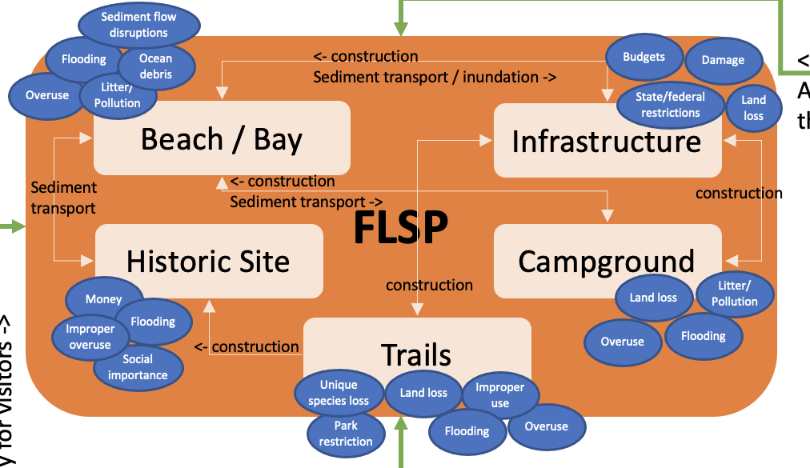
The high-level system is fragile to the park losing attractiveness to tourists and to residents. The second-level fragilities that are characteristics include:
The Beach/Bay are fragile to being unclean, ocean debris, flooding, and overuse.
The campgrounds are fragile to uncleanliness, usage amounts, and flooding.
The historic sites are fragile to loss of social importance.
The trails are fragile to unattractiveness through fragilities of overuse, improper use, land loss, and unique species loss.
The park infrastructure and historical sites are fragile to unattractiveness as well, but are not broken down into separate fragilities.

Slide 18
Another high-level fragility for FLSP is that visitors could no longer be able to come to the park. Closure of the park would result in devastation for the park’s ability to maintain itself, let alone what would happen to the surrounding communities.
The Beach / Bay areas are fragile to flooding, sediment flow disruptions, and biological debris which are characteristics of changing park openness.
The campgrounds are fragile to land loss is a characteristic of the high-level fragility of closure.
The historic sites are fragile to loss of preservation funding, land loss, increased improper usage, and flooding.
The trails are fragile to land loss, flooding, and park regulations.
The park infrastructure, such as roads, visitor and maintenance buildings, and other built structures, are fragile to budget cuts, state and federal restrictions, land loss, and damage.

Slide 19
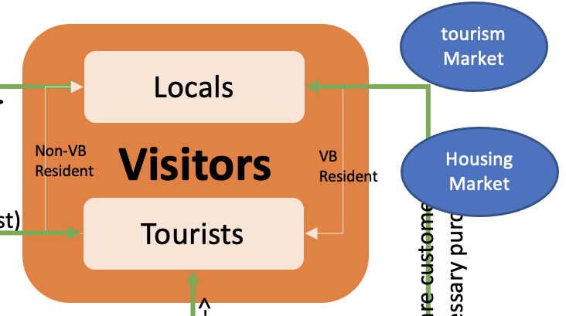
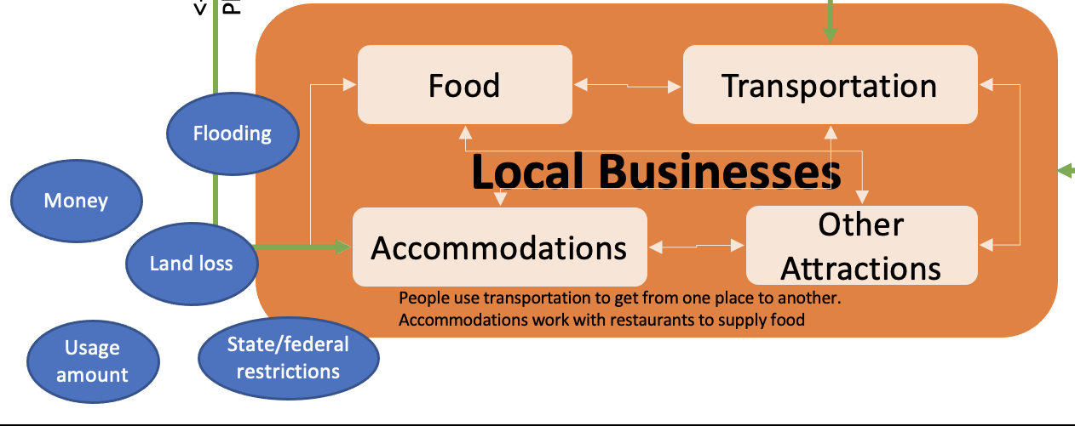
While it was important to look at the fragilities of the park on a deeper level, the stocks of local businesses and park visitors have more general fragilities that apply to the high-level stocks.
Structural damage of any of the local businesses is a characteristic of the high-level fragility of closure and income loss.
Land loss can be exploited by natural and human hazards and is a clear characteristic of closure.
Regulations made by the local, state, and federal agencies. All local businesses are required to follow regulations, some protecting the business, and some protecting the customers.
Economic downfall and income loss are second-level fragilities that are directly correlated with the high-level.

Slide 20
The high-level fragility of being able to remain open and receive income is specified by the second-level fragilities listed above. This refers to FLSP visitors and includes both local residents and the tourists that travel into Virginia Beach.
Income changes are a second-level fragility that can potentially change the ability of a visitor to leave their home.
Changing desires can be influenced by state, national, or global health problems; societal pressures; and weather events.
Physical abilities of people is another fragility that has an impact on the high-level one.
Restrictions set by local, state, and federal agencies typically prevent local businesses and attractions to allow people but, as seen during COVID-19, they can also prevent people from traveling, or even leaving their homes for unnecessary goods and services.
Fragilities are an inherent part of the high-level and second-level systems and can be clearly identified from the conceptual and stock-and-flow models.

Slide 21
Hazards

Slide 22
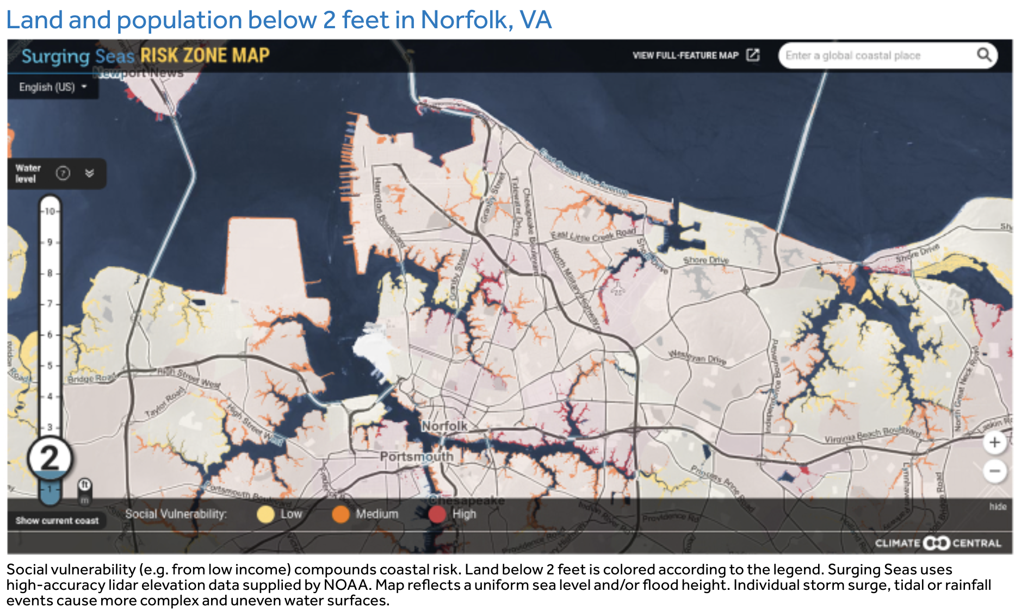
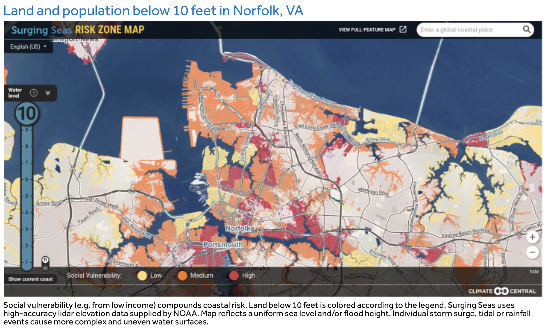
Sea Level Rise and Climate Change
Virginia Beach, including FLSP, is at a major risk for SLR because of the low elevation and intricate series of tidal rivers that run throughout the area.
Norfolk and Virginia Beach, Virginia are currently flood areas.
Just looking at 2ft flooding in Norfolk is a 100% probability of occurrence by 2030, 2050, and 2100 (Central, 2020).
If we look at flood risks increasing in height above sea level, the probability of likelihood before 2030 and 2050 decreases.
Looking out to 2100, the probability of Norfolk flooding at 10ft to a very wide range of 4% to 92% (Central, 2020).
The construction of barriers or addition of sand to beaches exploits the fragility of the beach and bay changes to sediment flux

Slide 23
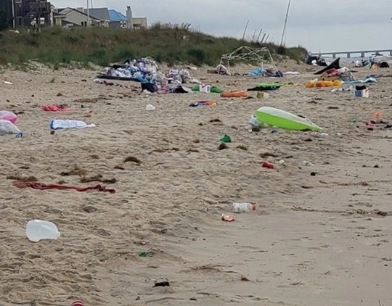
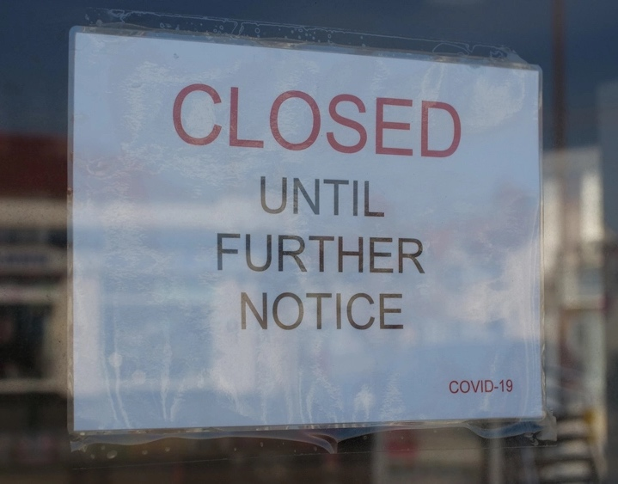
Amount of People
FLSP is fragile to overuse, while the local businesses are fragile to under-use.
The probability of overuse occurring at the state park is great with each year due to increased amount of tourism.
COVID-19 has also resulted in more local people wanting to get outdoors and find educational, active places to recreate.
COVID-19 also resulted in a large decline in visitors to local businesses. Businesses were mandated to close for many weeks and when re-open there were and are many restrictions on the amount of people inside and out.
Virginia Beach is at risk of uncleanliness due to the fragility and exploitation through the amount of people and lack of societal pressure to avoid littering and pollution.
FLSP, as well as the local businesses, are negatively impacted by litter and pollution because it changes the perception of the visitors on the area. If there area is unclean, visitors will chose to go to a different location.

Slide 24
Economic Downfall
FLSP is fragile to budgeting restrictions. They apply and receive money from the VDCR and therefore, are dependent on the Virginia economy.
Local businesses are dependent on the local economy in order to keep the businesses going.
State, national, and even global economies impacts the tourism industry. With weaker economies tourists are less likely to travel, and therefore less likely to come to Virginia Beach.
Government Restrictions
Local, state, and federal restrictions determine not only the rules and regulations of FLSP, but also the rules and regulations of local businesses and people.
The state and federal agencies are also able to make rules and regulations for the amount of people allowed in the park, and the guidelines necessary for park use.
This is seen during COVID-19. Local businesses are also subject to rules and regulations made by local, state, and federal agencies to ensure the safety of visitors.

Slide 25
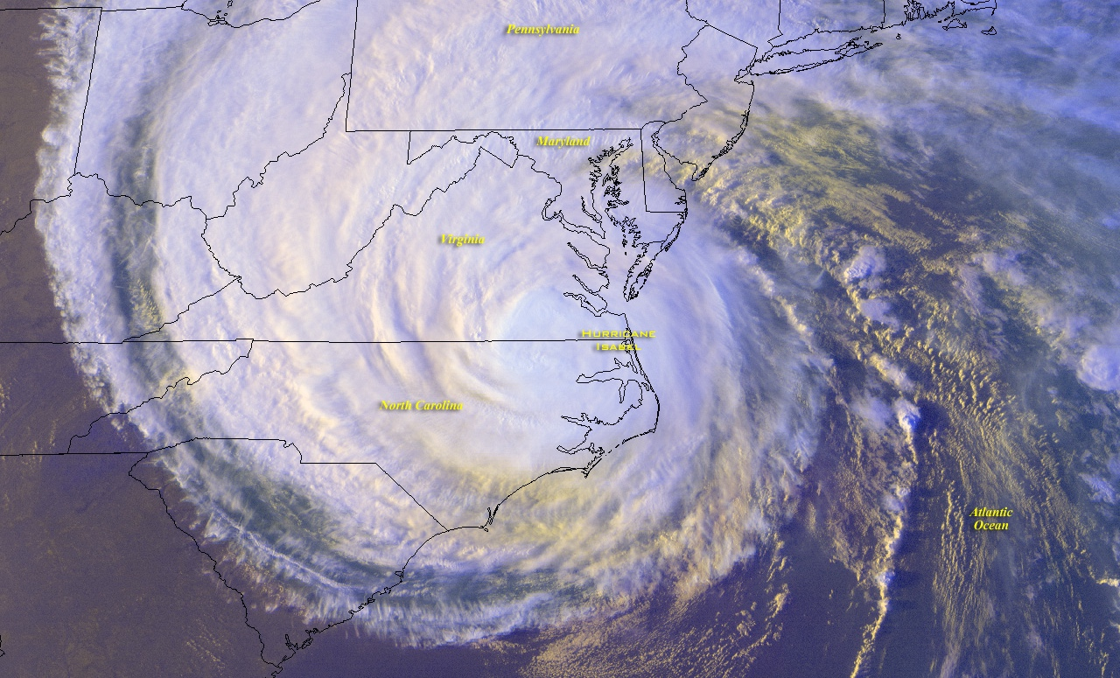
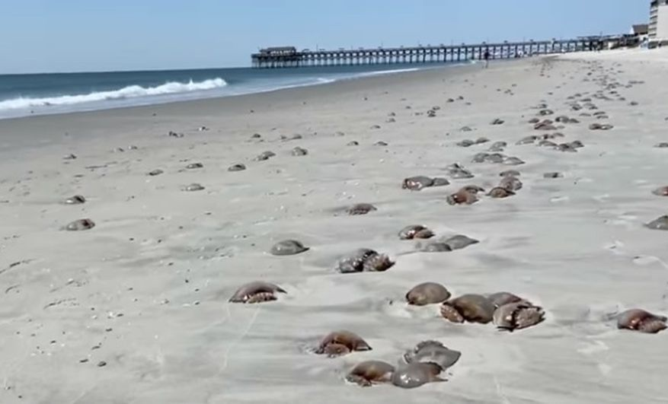
Social Pressure
Finally, the fragility of changing desires impacts the flow of people from home to the local businesses and FLSP.
Weather, changing health and health risks, changing physical abilities, and economic loss are all hazards that exploit this risk.
If there are weather or health warnings not only in Virginia Beach, but also in nearby areas or states, people are less likely to travel than if the weather is nice and there are no health risks.
The beaches are also vulnerable to losing societal interest through ocean debris by way of marine pollution or biological events.
Recently, there has been more biological events that cause bay waters to smell or be dangerous to people. These include extreme algal blooms, jellyfish blooms, or decaying marine flora pushing into the beaches.

Slide 26
Foresight

Slide 27
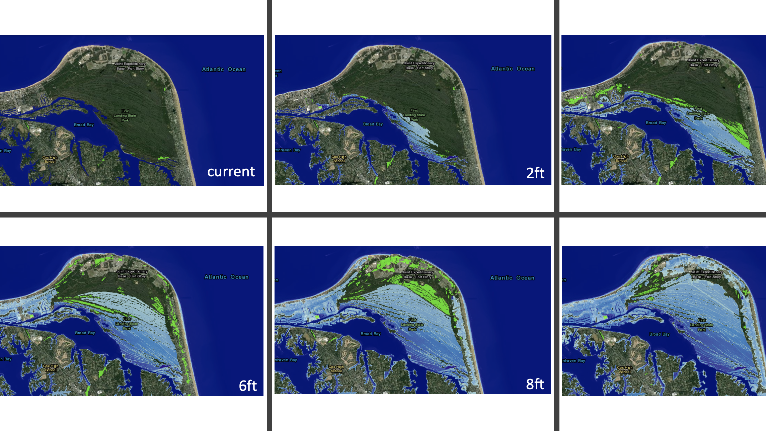
SLR and Climate Change: Norfolk
At current sea level, the park is 2,888-acres
4 feet above current sea level:
Approximately 7mi of the 19mi of trails will be completely submerged by mean high tidewater, while about 3miwill be inundated during extreme high tide events.
At 10 ft FLSP will have 500 or less acres of land
All of the trails will be inundated and mostly unable to be utilized.
The campground area will also be inundated, except the area closest to the road and to Fort Story.
The cabins, visitor center, and maintenance buildings will also be inundated.
The unique marshes, dunes, and forests will no longer exist and the attraction to the land will be lost.

Slide 28
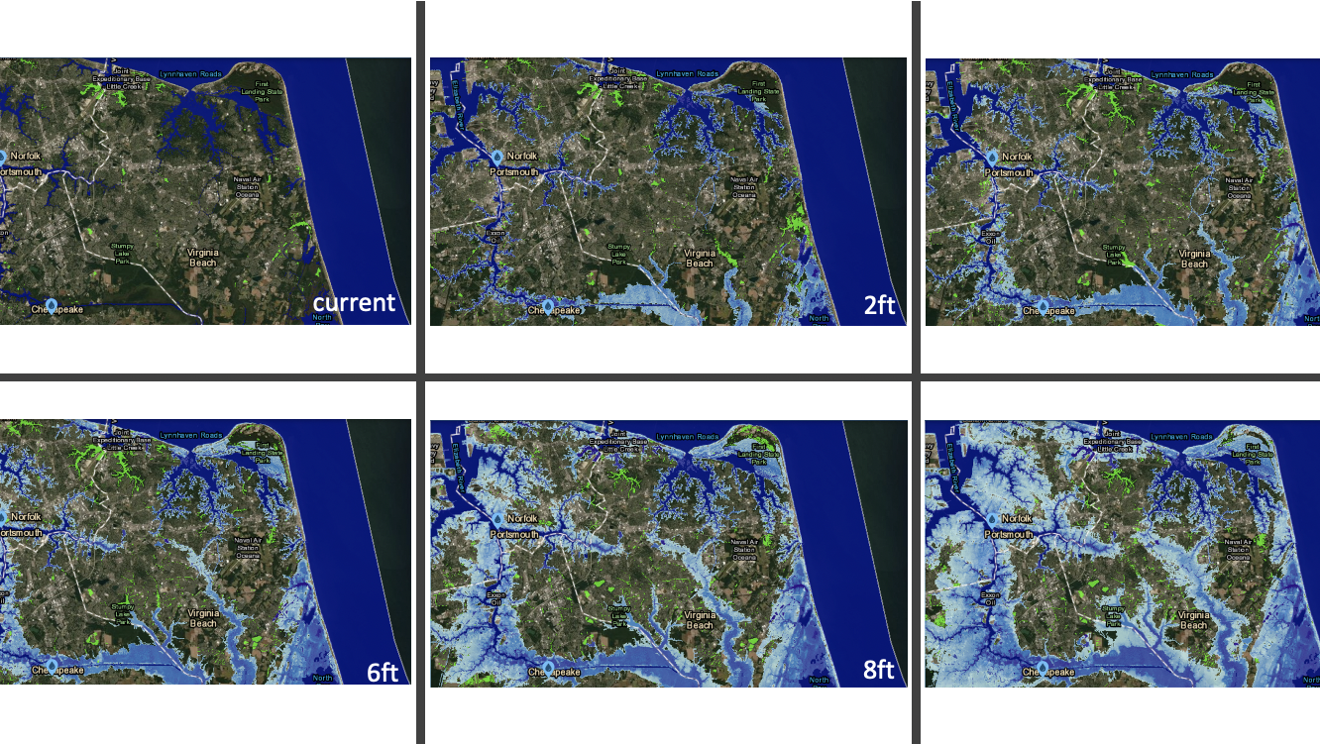
SLR and Climate Change: Virginia Beach
At 4 feet SLR, the Virginia Beach community will be inundated from North Bay flooding north to northwest.
The North Landing river will also expand from 0.25mi across between Pungo Ferry Rd and W Landing Road to 0.5mi or more.
During storm surge and flooding events, the river could expand even greater.
At 10 feet above current high tide, Norfolk is completely inundated, there is only small areas above the new sea level that are not flooded and are now islands.
Portsmith is also inundated, leaving Chesapeake and Virginia Beach to be disconnected from the rest of Virginia
There are areas of land not flooded, but this leaves islands disconnected by saltwater rivers and would be extremely fragile to storms.
Virginia Beach is no longer a thriving tourist destination as the beach front businesses and attractions are under the tide level. The new coast lines are full of debris and are not sandy beaches, but old properties or grasslands.

Slide 29
Economic Stability
Local, state, federal, and global economies impact the ability for FLSP to maintain its socio-economic role.
State economy is growing, people are feeling comfortable with their personal finances and are wanting to travel.
The influx of money to businesses and the communities allows them to stay updated and clean, providing for more tourists to have the desire to visit. FLSP provides a much-needed space for recreational activities.
The high-use park is able to request more state money for repairs and growth.
Federal and global economic growth is also correlated with the growth of the state and local economies.
Local, state, national, and global economies are in recession is negative to the tourism industry, and therefore negative to Virginia Beach and FLSP.
People are not traveling on regular vacations but are staying home and saving money or spending it in their own communities.
Restaurants and retailers are closed, and their owners can no longer provide for themselves or their families. Eventually, many of these must close their doors permanently.
The community becomes desolate as more shops, businesses, and restaurants close and residents leave the area. The tourists, when later are able to travel, do not want to visit Virginia Beach because it is unclean, sad, and has limited attractions.
As the economy declines and residents move away, FLSP loses local visitors as well and cannot sustain itself.

Slide 30
Interventions

Slide 31
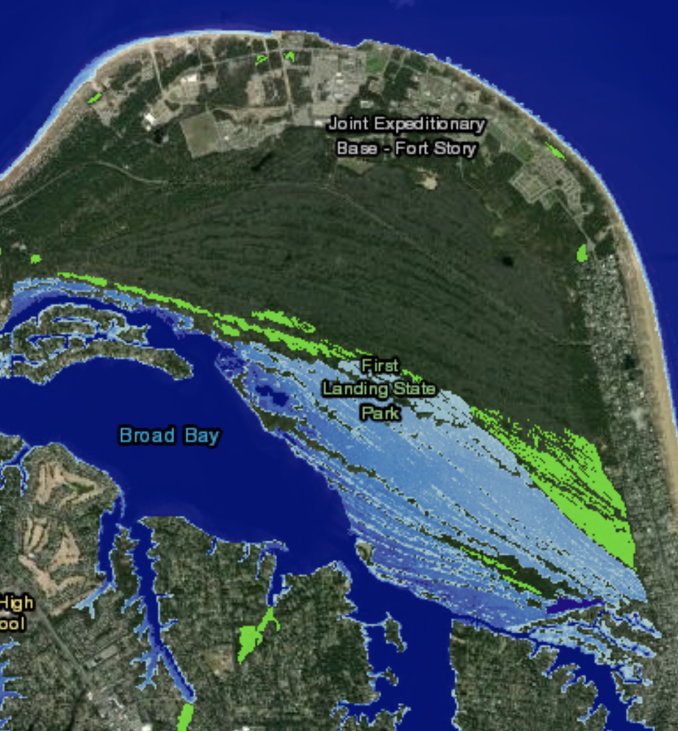
Interventions Addressing Sea Level Rise
FLSP is an important tourist attraction due to the unique ecosystems as well as the various beaches, camping, and trails that provide excellent outdoor recreation.
Natural Interventions:
Add sediment to the beaches, building natural dikes, and increasing vegetation and marshland.
Bringing in sediments to build up the beaches of the bayside of the terrain would delay to impacts of SLR.
Unfortunately, this method would also greatly impact the unique ecosystems by covering them up and potential inviting invasive species to the park.
Expanding marshes and vegetation would also slow the erosion of the inland-most areas, first inundated by SLR.
Do nothing, allow for natural migration and inundation to occur
Use the inundation as study areas and educational programs for the community

Slide 32
Interventions Addressing Societal Pressures
Virtual Spaces are able to be utilized effectively for communication and can be used for community world
Virtual interventions:
VDCR updates the already existing virtual platform to include more information and park videos on the parks page.
VDCR allows for a staff member at the park to post about the park on a regular basis on existing platforms
FLSP work with others to create a new virtual platform
A space featuring videos of the park that include unique species, the unique environments, the history, and more.
Ability to facilitate discussion between experts of the park and the people trying to learn and engage in the park.
This virtual intervention could also have a membership fee for some of the content or costs for virtual programming which would maintain revenue flow during off seasons or when people cannot travel.

Slide 33
Interventions Addressing Economic Issues
Currently FLSP is located in the city of Virginia Beach, but there is not a lot of interaction between the two.
The park, the businesses, and the local government work more hand-in-hand and provide more transportation of activities and events between the two, there could be a stronger economic relationship.
Building programs that work more effectively with VB and its residents will ensure longer term incentive for the residents to engage with FLSP. Investing in the community is a key factor here.
Increase funding from VDCR to FLSP in order to increase cleanliness, keep the park updated, and limit costs to residents.
FLSP creates a membership fee for full access to the new virtual space
If other, smaller parks, were to engage with virtual platforms and marketing techniques, their revenue could increase

Slide 34
Recommendations

Slide 35
Addressing Sea Level Rise
Recognizing that:
Sea Level Rise is a continuous threat to the area
The missions of the VDCR and FLSP are to maintain natural environments for educational and recreational activities
Acknowledging that:
FLSP is only one of the many state parks and is not the sole focus of VDCR, but provides a major revenue source for the state park system
Virginia Beach has many small businesses and other tourist attractions to encourage community growth, but that FLSP is one of the largest outdoor recreational locations
The southeastern end of Virginia Beach is also likely to be affected by sea level rise first, as it is at the lowest elevation in the area and closest to the ocean inlets.
It is recommended that the Virginia Department of Conservation and Recreation and First Landing State Park:
Allow the natural inundation to occur
Use this natural process as an educational experience and encourage tourists to come and learn about the changing environment
As a part of the history, beaches have been migrating forever and can be included in the discussion when talking about the colonist’s landing site. Showing images of the beach changes could be a good display

Slide 36
Addressing Societal Pressures
Recognizing that:
Technology today allows for virtual spaces to be semi-equivalent to in-person needs
Global pandemics, such as COVID-19, and other global societal pressures are major hazards for today’s society
Tourism is fragile to the emotions of people traveling
Acknowledging that:
FLSP and Virginia Beach are fragile to these implications
FLSP and Virginia Beach are interconnected provide one-another with necessary economic importance
Virtual Spaces are not utilized enough to support FLSP or Virginia Beach local businesses
It is recommended that the Virginia Department of Conservation and Recreation and First Landing State Park:
The VDCR update the already existing virtual platform to include more information and park videos on the parks page.
Another intervention would be for the VDCR to allow a person from the park’s staff to post events, health and safety information, and fun activities or facts about the park on a regular basis on Twitter, Instagram, and other current social media applications
FLSP could work with others to create a virtual platform where there could be a space for a facilitation of knowledge sharing. This space should be able to host people who want to ’go’ to the park without being there in person and should be able to facilitate discussion between experts of the park and the people trying to learn and participate in the park.

Slide 37
Addressing Economic Issues
Recognizing that:
SLR and climate change can cause physical destruction
Societal pressures lead to people being unable to travel and therefore lead to economic loss
Acknowledging that:
FLSP is fragile to revenue loss caused by physical destruction, societal desires, and governmental restrictions changing the amount of people able to come to the park. Local businesses are fragile to these changes in revenue as well
FLSP and local businesses are interconnected and are important economically to one-another
It is recommended that the Virginia Department of Conservation and Recreation and First Landing State Park:
The park, the businesses, and the local government work to build programs that work more effectively with Virginia Beach and its residents will ensure longer term incentive for the residents to engage with FLSP.
This can be done by having some local restaurants host booths on the park property to sell food. Some businesses selling local merchandise could also host booths. The park could also provide more transportation between oceanfront and the park to increase tourists flow around the area
Take the virtual intervention of creating a new virtual space and include a membership fee for some of the content or costs for virtual programming.

Slide 38
References
See Climate Change and Sea-Level Rise: Potential Impacts on the Socio-Economic Role of First
Landing State Park for the Region document
Pierceall, K. 2019. Actors re-create 1607 landing in Virginia Beach at First Landing Festival. Pilot Online. https://www.pilotonline.com/news/article_7e9f3ab0-8f03-5ff4-9838-50d5524dcc91.html
Brown, J. 2019. Report: Hampton Roads among most vulnerable to hurricanes. Pilot Online. https://www.pilotonline.com/business/article_504dfaf5-2844-5879-8a5e-5ed8feca2c8d.html

