Slide 1
CL 668 Internship: Lynnhaven River NOW
By Daniel Martin

Slide 2
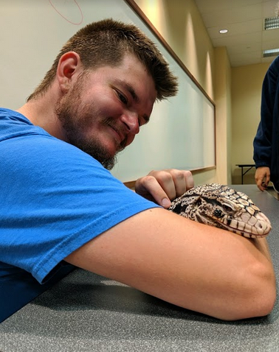
About Me
Majored in geology from Northern Kentucky University
Passionate about promoting sustainability and conservation
Recently undertook an internship at the Lynnhaven River NOW organization

Slide 3
Wild Celery Restoration
Worked alongside Dr. Sarah Sweeten from Virginia Tech
Tested protective cage designs for reintroduced plantings of Vallisneria americana
Planted in 4 sites in the Virginia Beach area

Slide 4
Reforestation Project
Surveyed three Virginia Beach city parks for reforestation efforts
Gathered LIDAR data and satellite imagery to virtually assess planting sites
Researched native tree species to ascertain good candidates with high salt and moisture tolerance

Slide 5
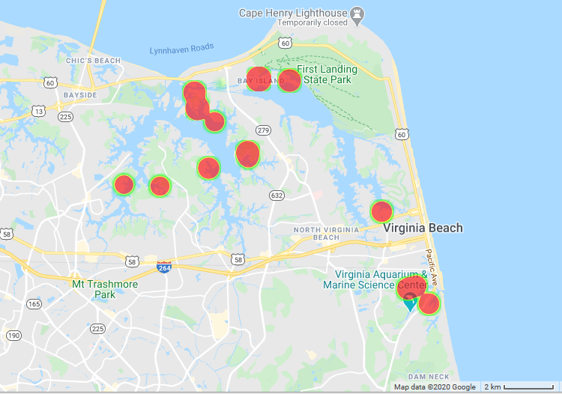
Oyster Spat Census
Collected oyster cages deployed last year
Counted number of new oyster spats
Mapped oyster spat concentration as well as oyster spat concentration over time

Slide 6
Oyster Castle Reconstruction
Helped repair oyster castles destroyed by Army Corps of engineers
Emplaced over 600 individual oyster castles

Slide 7
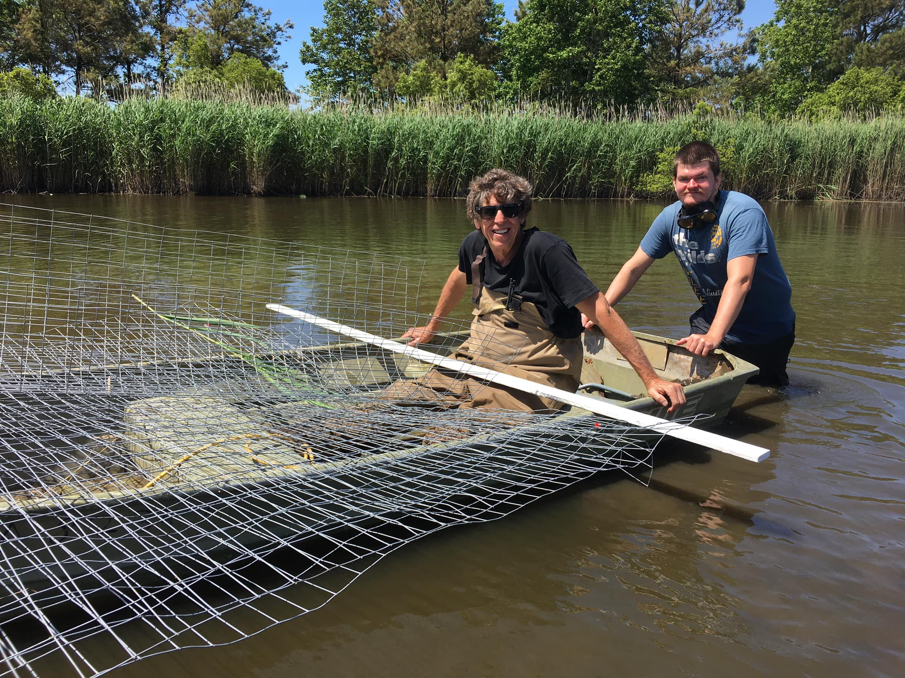
Overview
Important Concepts
Balancing internship and research was difficult at times
Working firsthand in conservation fieldwork was very rewarding
Good connections were made with individuals from several organizations

Slide 8
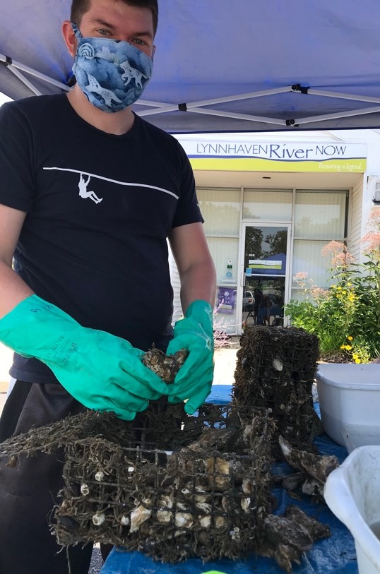
Benefits
Was able to provide skilled and unskilled labor to local nonprofit
Learned a lot about conservation fieldwork
Utilized many past skills including mapping and SCUBA diving
Able to examine viability of conservation as a career possibility

Slide 9
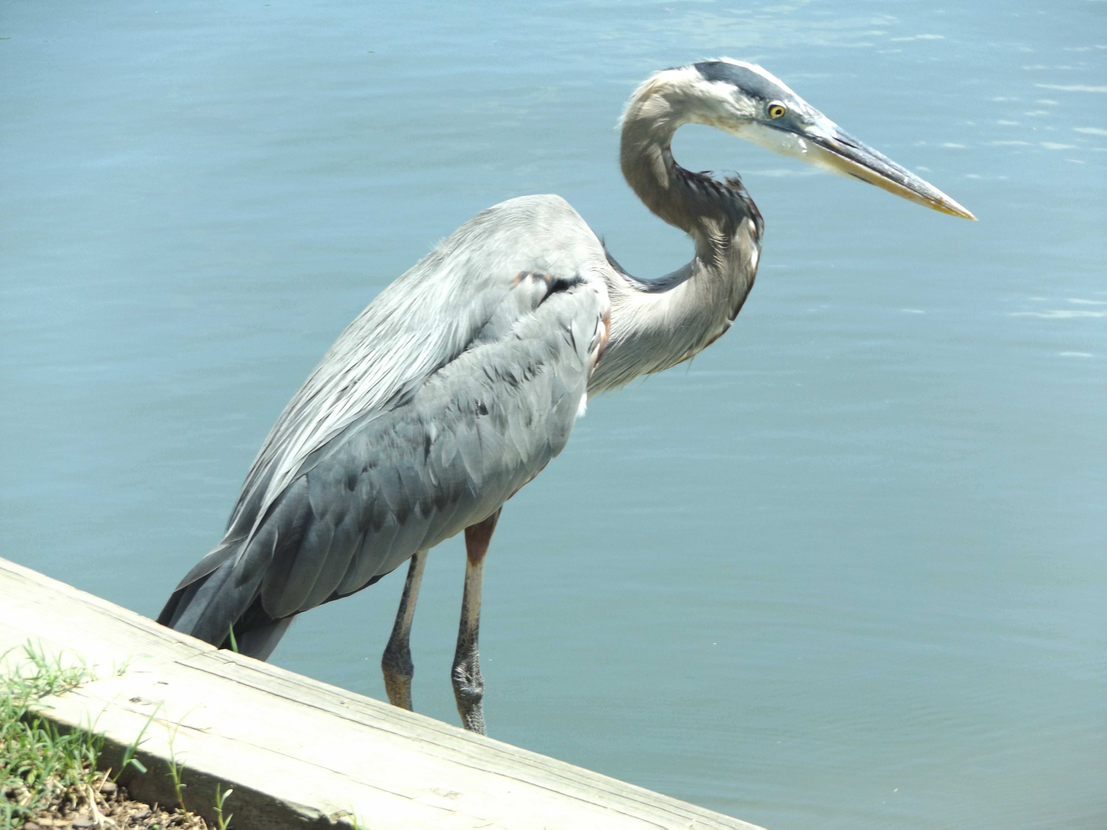
Thanks for your time!
Notes:
Always include a closing slide with “thanks” and contact information.

