Slide 1
The effects of sea level rise and climate change on loggerhead turtle nests at Back Bay Wildlife Refuge
Leslie Gomez

Slide 2
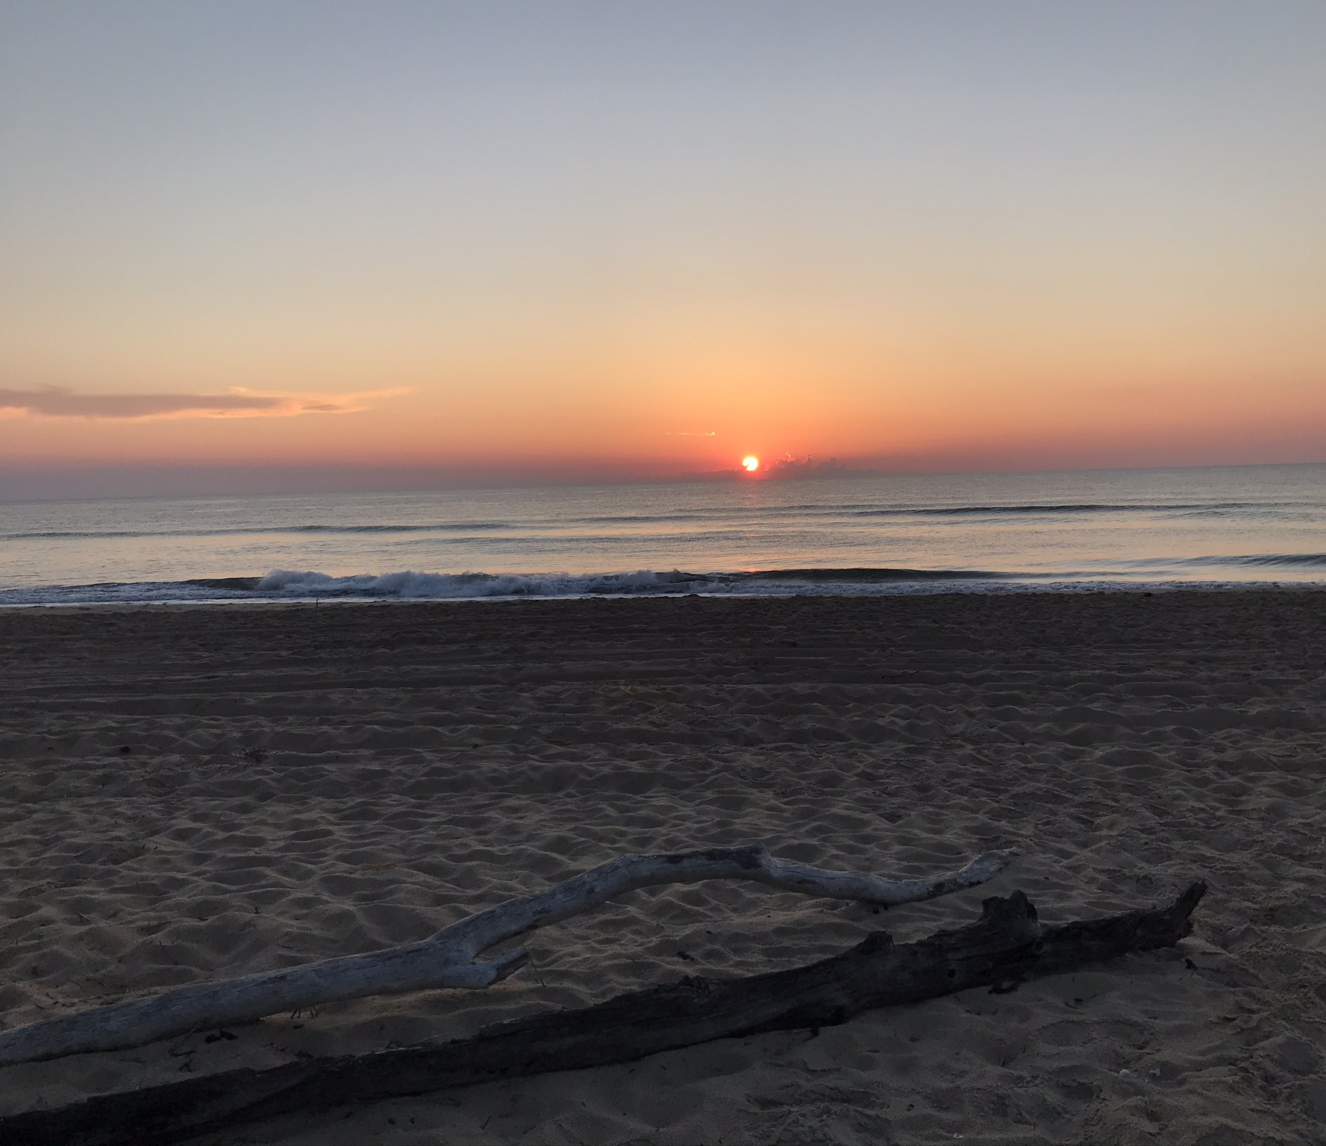
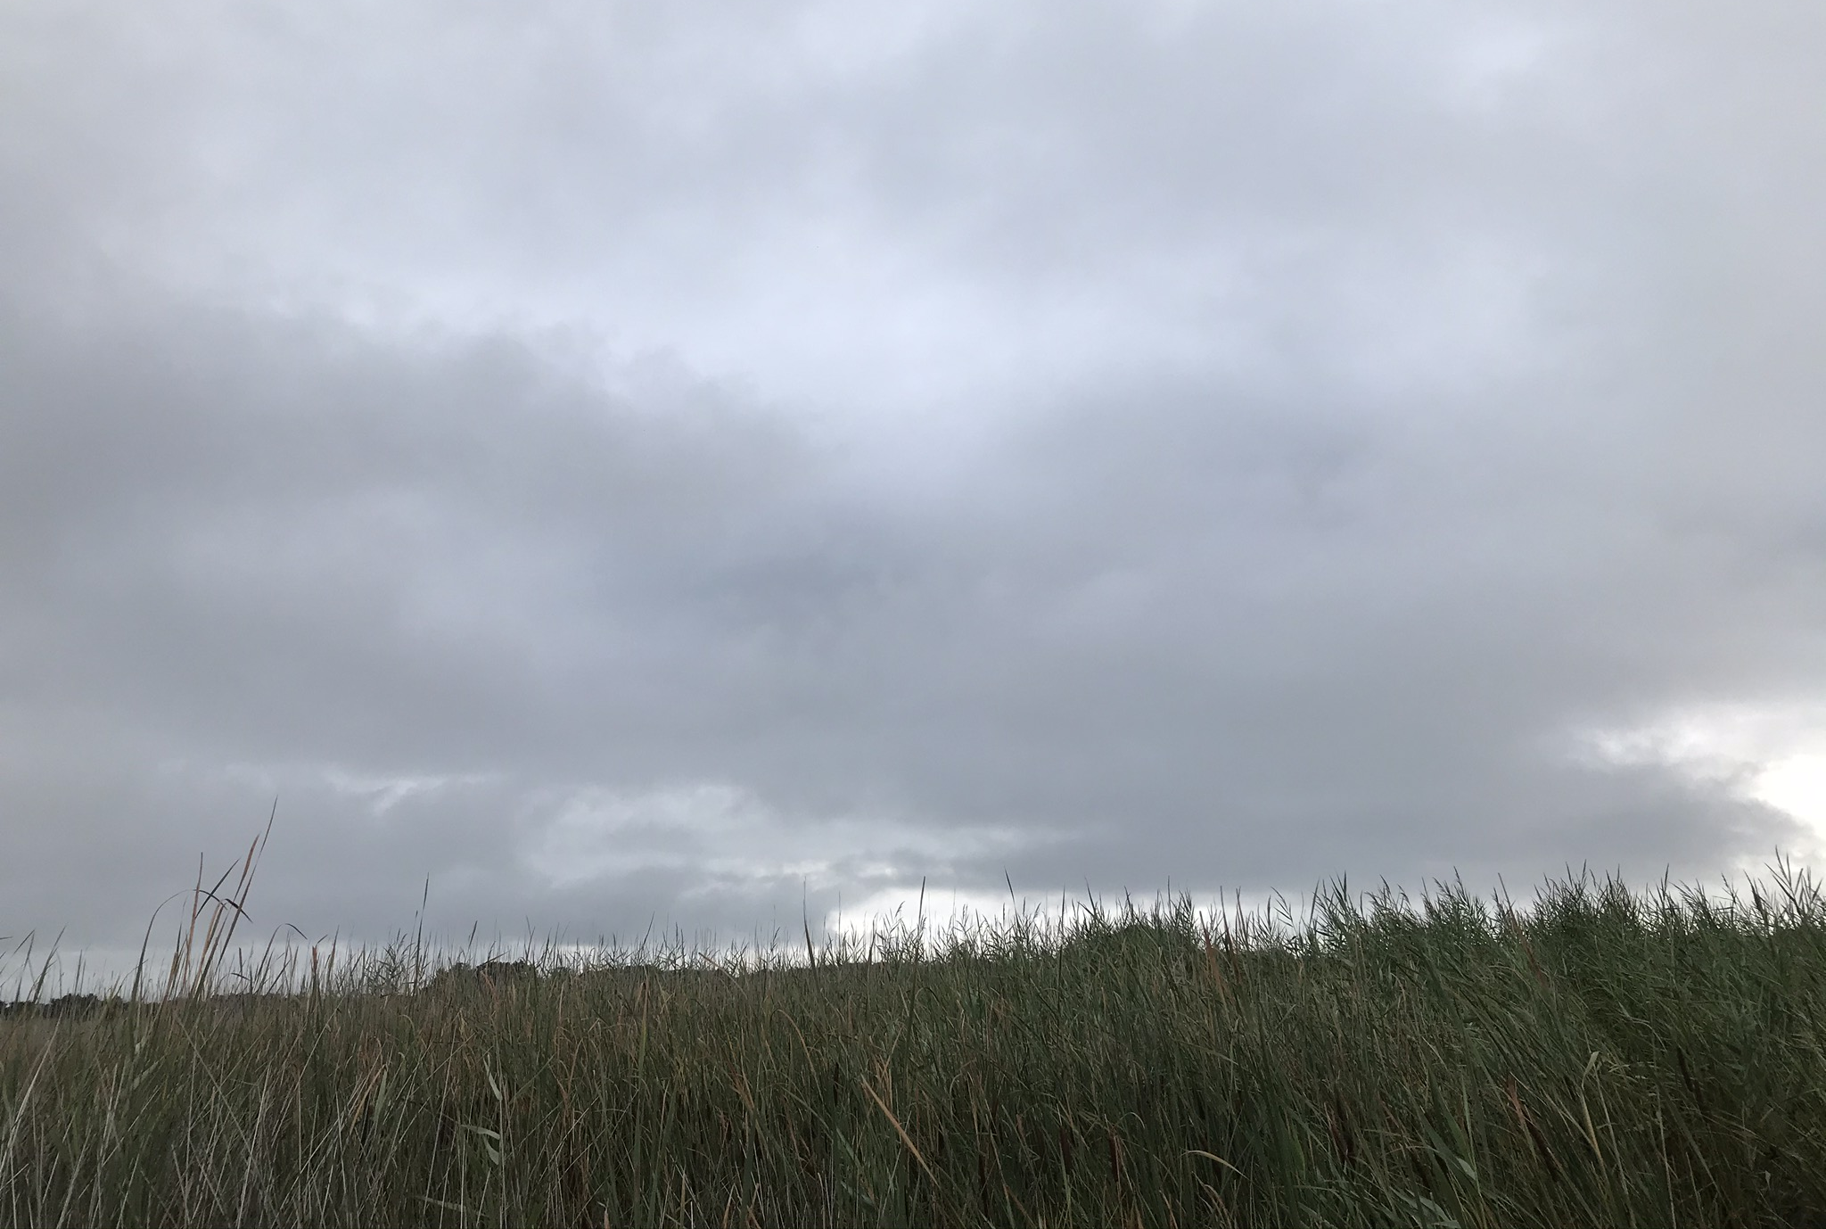
For this Internship I did not only work with my intended research subject, Loggerhead turtles, but all parts of the Refuge which helped my understanding of the entire system at the Back Bay National Wildlife Refuge and not just the system in which Loggerhead turtles reside.

Slide 3
About me…
Leslie Gomez
Bachelors in Marine Biology
Minor in Conservation Leadership
I am passionate about helping animals that don’t have a voice
This presentation is for my research project on Loggerhead turtle nests in the Back Bay National Wildlife Refuge beach

Slide 4
Project
Looking at the future of Loggerhead nests on BBNWR
Limited human disturbances
Near the edge of their current nesting range
Affected by sea level rise and climate change
The narrow strip of land is backed by a bay, so the beach and dunes have no place to migrate to naturally
Notes:
The 5 miles of the back bay beach are connected to the 5? miles of the false cape beach but that beach allows camping and swimming
At back bay only fishing and hiking is allowed. No sunbathing, swimming, or pets
The nesting range reaches Maine but most of the coast is developed or has prominent human disturbances that can harm nests and hatchings

Slide 5
Concepts to remember…
Sex is determined by the temperature of the sand which has changed due to climate change
Increased storms and rising sea levels increase amount of water in nest
Water entering nests can cause microbes and diseases that harm health of eggs
Exposure of eggs due to erosion causes desiccation
Nesting turtles won’t lay if the temperature of the water and sand is not right

Slide 6
Conceptual Model

Slide 7
So, what's the big idea?
There is a chance that nests will produce less and less hatchling when the rate of SLR and climate change increase
The nesting turtles will choose not to nest at BBNWR due various changes in their preferred environment
Understanding all of this I suggest continuing the current work but not interfering when the situation starts to worsen.
The recommendation to do nothing during the threat of climate change and SLR is so the Loggerhead turtles do not become affected by human interference.
Notes:
-Endangered species act 1973: must help the nest produce as many viable eggs due to endangered (T) status
-CCP and Northeast region regulation does not allow for BBNWR to place nest in a lab
-Nearest nesting beach that is similar to BBNWR is to far to move the eggs without damage (SC beach how many miles?)

