Slide 1
How to support the Mission of Back Bay national wildlife refuge under sea level rise
By Alexa Zwicker
Photo by Alexa Zwicker

Slide 2
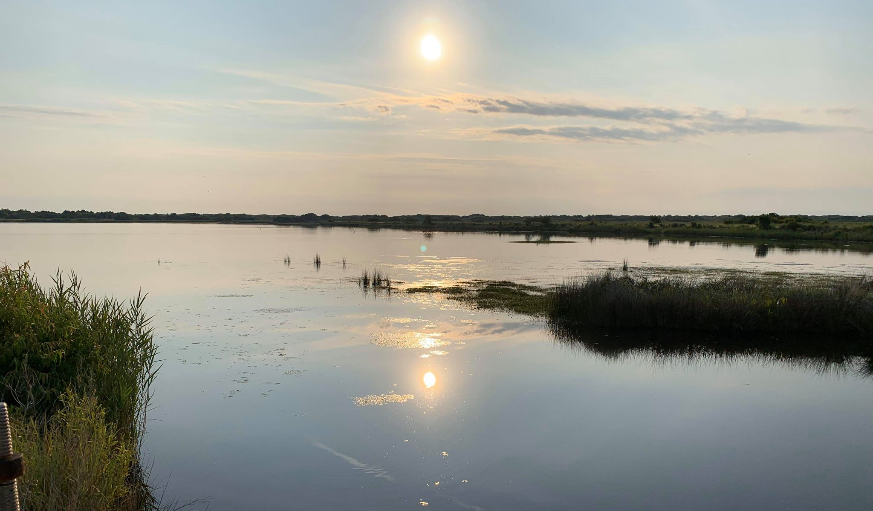
“we don’t own the planet earth, we belong to it. And we must share it with our wildlife.” – Steve Irwin
Back Bay National Wildlife Refuge shot by Alexa Zwicker

Slide 3
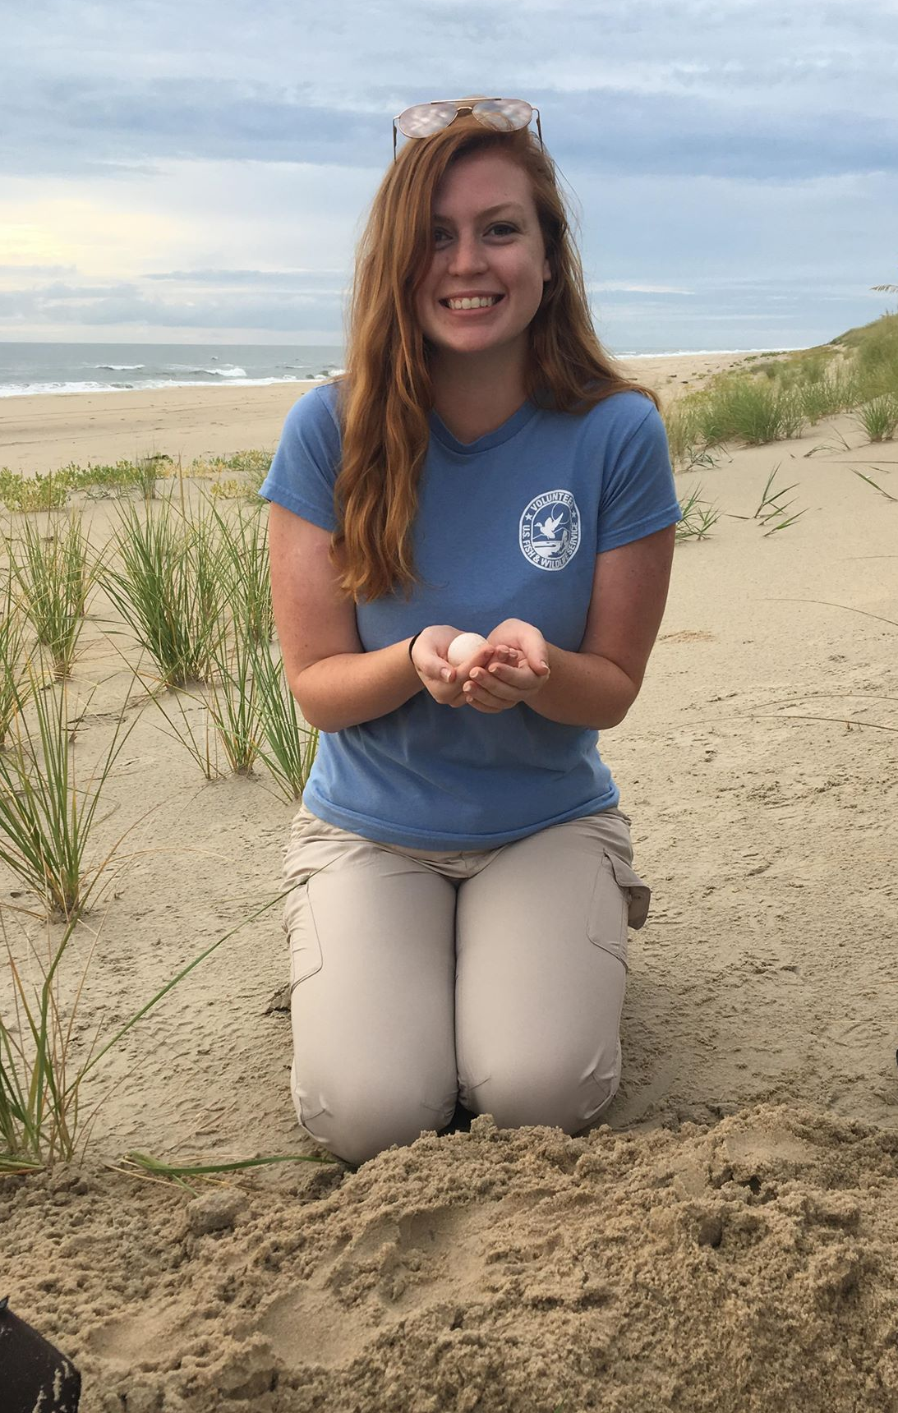
A little bit about me…
Student at Old Dominion University studying Biology with a minor in Conservation Leadership.
Interested in managing threatened ecosystems, learning about invasive species, and protecting endangered wildlife.
Very passionate about leaving a space better than you found it.
Here to present possible ways Back Bay National Wildlife Refuge could combatant sea level rise and uphold the mission of the refuge given increases in salinity.

Slide 4
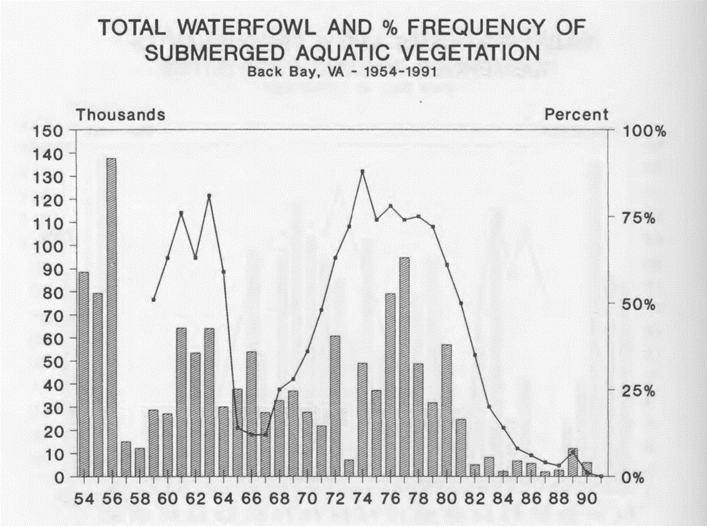
Fresh water vs. Salt Water
Back Bay is currently a freshwater marsh ecosystem threatened by sea level rise and strong storm surges
Inundation, salinification, erosion, over wash and accretion of sediments
Key habitat for migrating birds along the Atlantic Flyway
Submerged aquatic vegetation (SAV) relies on the freshwater ecosystem to thrive and is highly susceptible to saltwater intrusion
Loss of SAV beds reduce the bird population on the refuge
Graph by Settle, Fairfax H. and Schwab, Donald J., 1991. Waterfowl Trends in Back Bay, Virginia from 1954-1990. Proceedings of the Back Bay Ecological Symposium 1990. II. Fauna. 1.

Slide 5
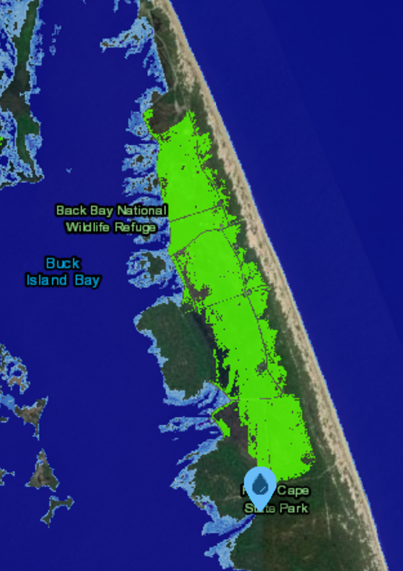
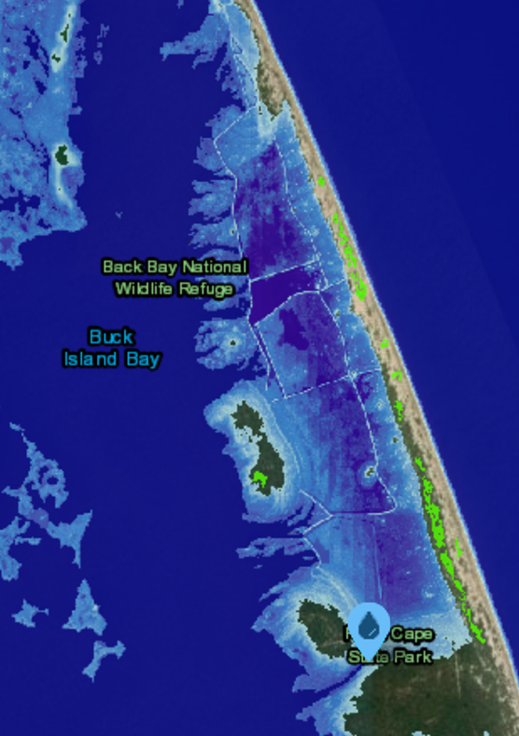
Sea level rise projections
A 0.092-0.283 meter rise by 2030
A 0.152-0.366 meter rise by 2050
A 0.305-1.311 meter rise by 2100
Worst case scenario being a 2.438 meter rise by 2100
It would take between 0.914 meters and 1.219 meters of sea level rise to completely inundate Back Bay
0.3 meters vs. 1.2 meters of sea level rise.
NOAA, 2020. Sea Level Rise Viewer. National Oceaninc and Atmospheric Administration, https://coast.noaa.gov/slr/#/layer/slr/0/-8480130.032241825/4486421.049645084/8/satellite/none/0.8/2050/interHigh/midAccretion. Accessed, April 2, 2020.

Slide 6
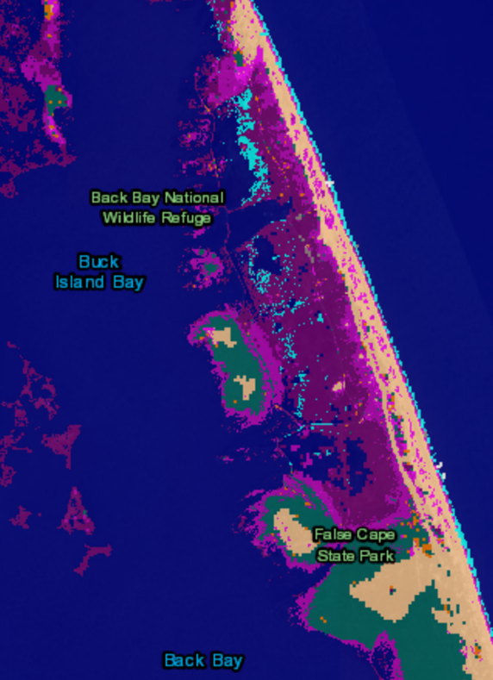
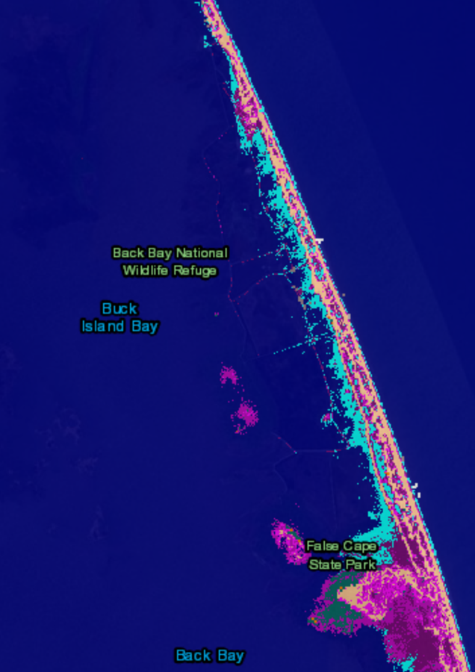
What will Happen to the Freshwater Marshes…
Back Bay sea level rise in double the global rate of sea level rise (Karlov et al., 2017)
0.3 meters vs 1.5 meters
Migrating waterfowl will no longer be able to inhabit the refuge
NOAA, 2020. Sea Level Rise Viewer. National Oceaninc and Atmospheric Administration, https://coast.noaa.gov/slr/#/layer/slr/0/-8480130.032241825/4486421.049645084/8/satellite/none/0.8/2050/interHigh/midAccretion. Accessed, April 2, 2020.
Karlov, N., Hill, E., Plag, H-P., 2017. Sea Level Rise Impacts and Barrier Island Rospong in Back Bay National Wildlife Refuge.

Slide 7
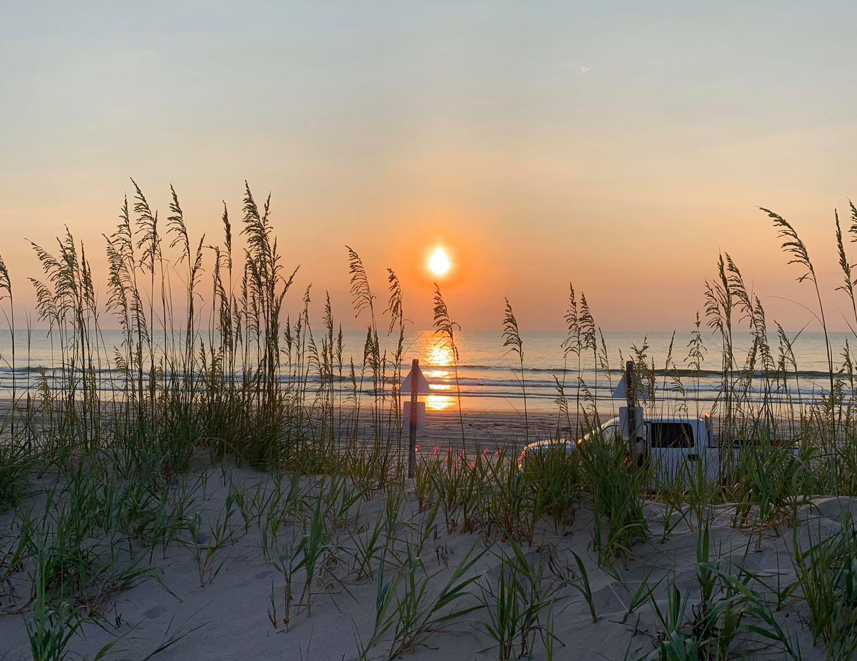
So…
Back Bay National Wildlife Refuge should consider buying farmland in Pungo and converting it into freshwater marshes.
Sea level rise is not going away, we need to adapt quickly.
This makes a difference to the patrons of Back Bay National Wildlife Refuge, as well as the waterfowl that inhabit the refuge.
It is important to know that we can make a difference ,even if it’s small, it matters to someone.
Photo by Alexa Zwicker

Slide 8
Thank you For your time!

