Slide 1
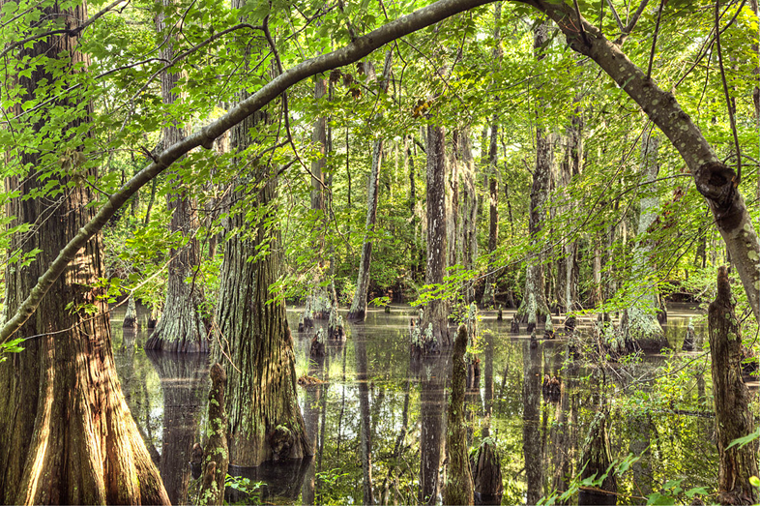
Impacts of Sea Level Rise on First Landing State Park
Internship Overview by: Angela Kennedy

Slide 2
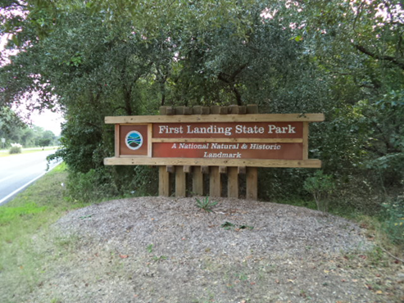
The System
First Landing State Park
The Challenge
Impacts of sea level rise on the park and the unique ecosystem
Stakeholders
Department of Conservation & Recreation
National Natural Landmark Program
Commonwealth of VA
City of VA Beach
Local Community

Slide 3
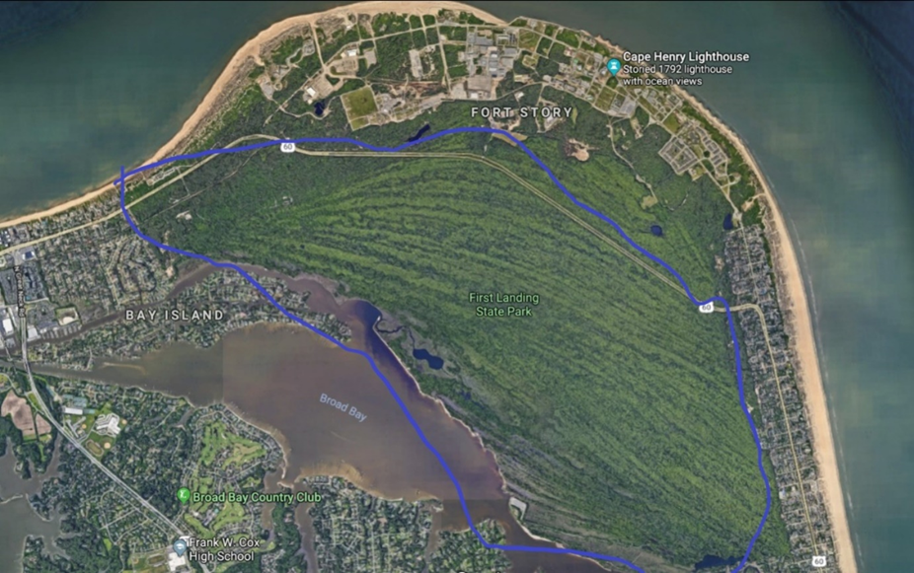
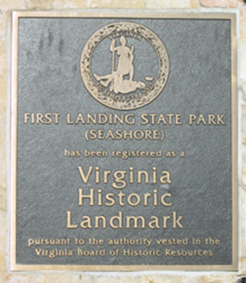
Introduction
FLSP opened as Seashore State Park in 1936
Opened along with 5 other parks in VA state park system
Renamed in 1999 to memorialize landing of first settlers of VA
General assembly authorized land acquisition in 1933; Civilian Conservation Corps developed the park from 1933-1940
2,888 acres of dunes, beaches, swales, maritime forests, SW marshes, FW wetlands
Over 60 rare species; 14 distinct natural communities
National Natural Landmark
19 miles of trails; 1.5 miles of beach
(DCR, 2000)

Slide 4
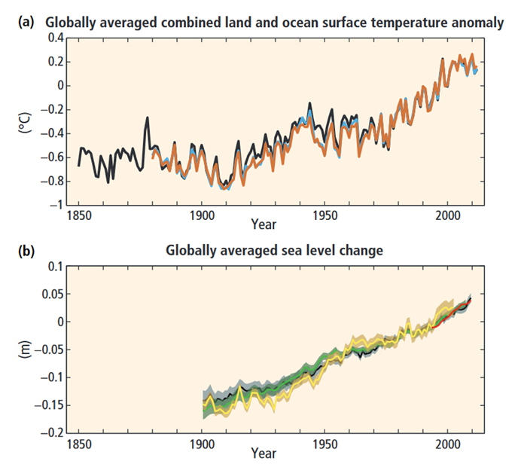
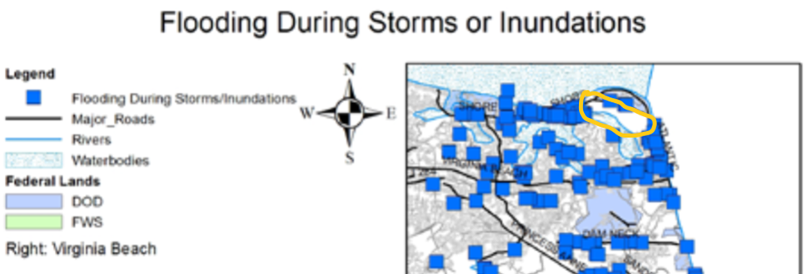
Sea Level Rise Hazards
Global Trends
Anthropogenic influences drive accelerated sea level rise
SLR rate was 10 times faster in 20th century than past 3,000 years
SLR rate significantly higher in last 25 years than last 100 years
Even more of a threat to low-lying coastline areas like FLSP and Chesapeake Bay area
Hazards to FLSP
Flooding and inundation
Rising water table
Increased erosion driven by more frequent & severe storm surges
Saltwater intrusion into the groundwater & surface water
(Institute for Environmental Education, 2011)
(Glick et al., 2008, IPCC, 2015)

Slide 5
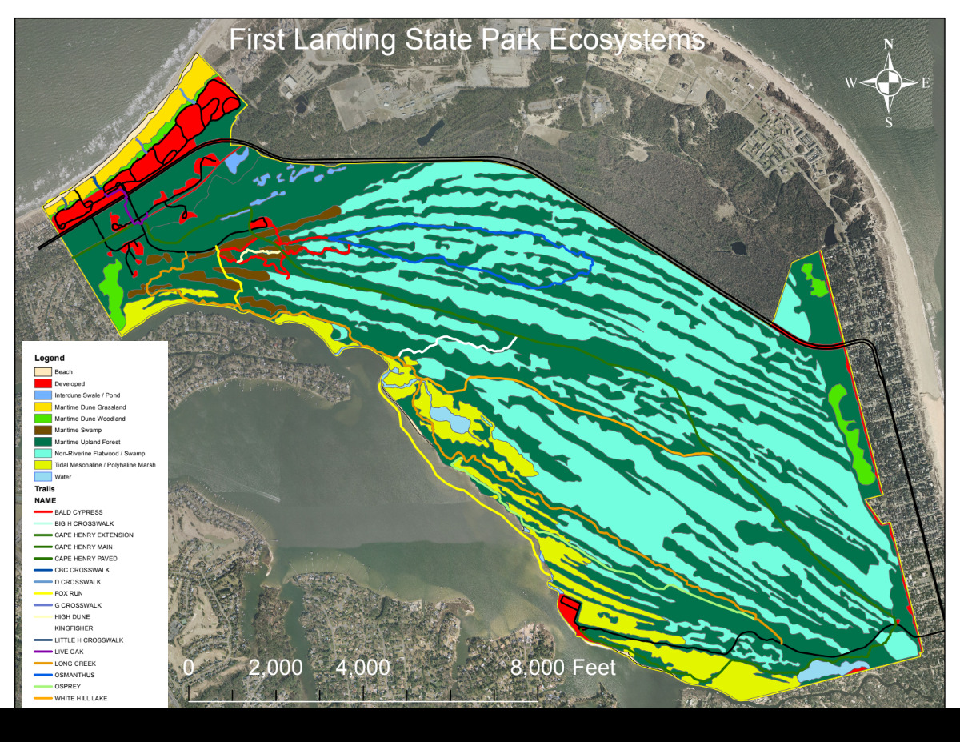
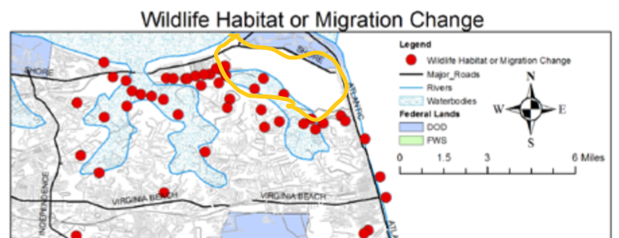
Vulnerabilities of First Landing State Park
Flora and fauna
Over 60 rare species
Includes the chicken turtle & carpenter frog
Adapted to a specific range of salinity fluctuations
Increase in salinity could decrease species composition
Natural communities
14 distinct communities; at least 8 are state rare, and at least 2 are globally rare
Increase in salinity could increase fragmentation of FW & brackish marshes
Recreation and economic activity
FLSP is important to cultural, recreational, & economic state of the Tidewater region
One of the top revenue providers of VA state parks
Contributed $23.5 million in economic impact
Popular for the recreational opportunities, such as hiking, camping & societal benefits, such as stress-reduction, health benefits
(DCR, 2000, Mignini, 2018)
(Institute for Environmental Education, 2011)

Slide 6
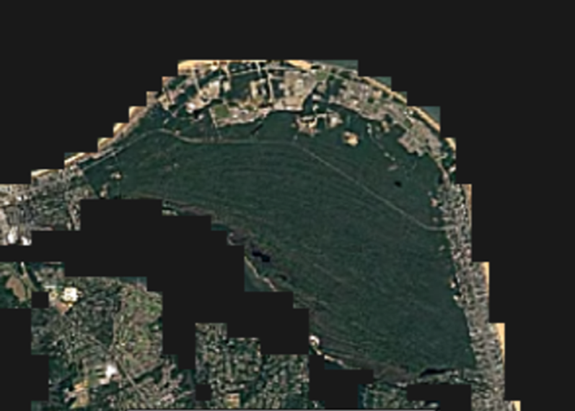
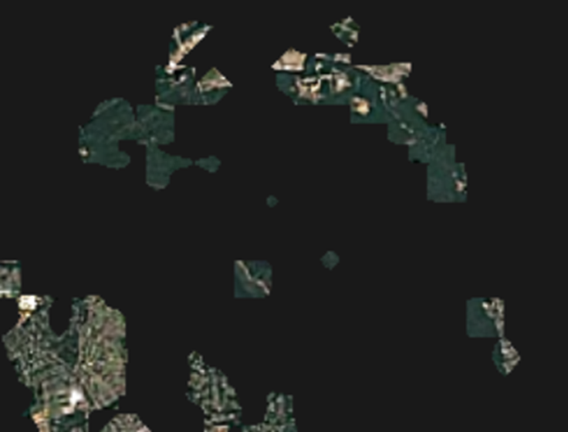
Foresight: Possible Futures of FLSP
Data and models were utilized from:
The 2014 synthesis report of the Intergovernmental Panel on Climate Change (IPCC)
Studies of the Union of Concerned Scientists (UCS)
Studies of the US Geological Survey (USGS)
The findings of scientists Robert Deconto and David Pollard
Carnegie Mellon University’s CREATE Lab’s EarthTime project
Low Risk Scenario
Local SLR of 0.55 m to 1.0 m by year 2100
Allow for more time to support habitat’s resilience & ability to migrate
Areas of FLSP would be frequently flooded, eroded, and/or permanently inundated
High Risk Scenario
Local SLR of more than 2.1 m by year 2100
Rate of sediment accretion & habitat migration would likely not keep pace with SLR
High probability of loss of rare habitats/species and recreational opportunities
(Glick et al., 2008, Caldas et al., 2017, Earthtime,2018)

Slide 7
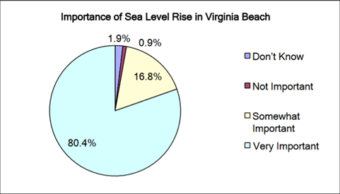
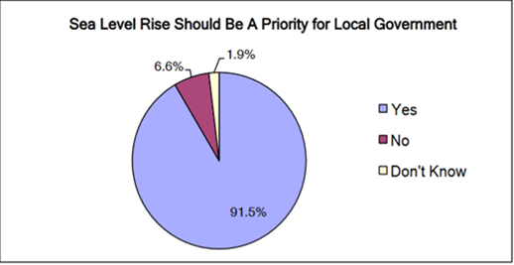
Decision-Making & Stakeholders of FLSP
Virginia’s Department of Conservation & Recreation (DCR)
Lead conservation agency of VA
Oversees FLSP’s management plan that is revised about every 20 years
Plan is reviewed every 5 years to reevaluate progress of projects and plans
Department of Interior’s National Natural Landmark Program
FLSP follows guidelines placed by this federal agency; about 1,500 acres of FLSP are on the national registry
City of Virginia Beach
FLSP operates under agreements of the city, which directs management of certain areas of FLSP
The governor, city, park staff, national agencies, & the local & visiting population need to support the development and execution of plans for mitigating the impacts of sea level rise
Supported by public polls in the Tidewater area showing high concern about impacts of SLR (DCR, 2000)
(Institute for Environmental Education, 2011)

Slide 8
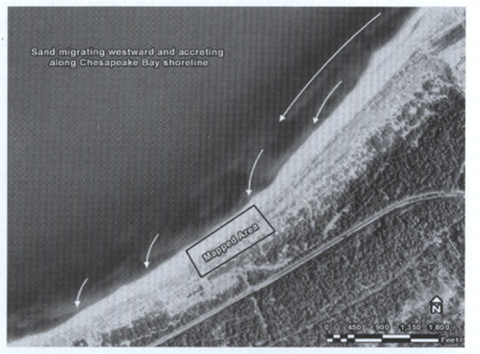
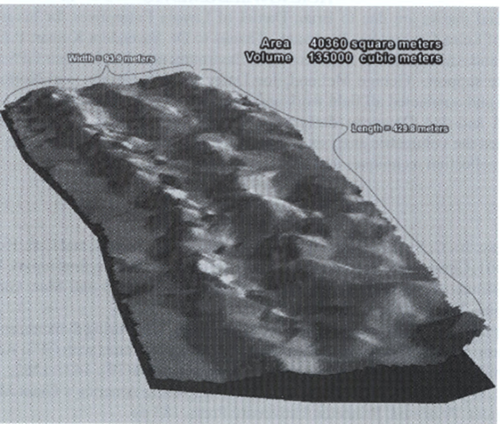
Options & Recommendations for FLSP
Additional studies in topographical changes
Techniques used in a 2007 study at FLSP that produced resultant topographic data of a dune complex on the shoreline bordering the Chesapeake Bay
Used GPS receivers & GIS inspections
By comparing changes over time, could develop possible outcomes
Tidal marsh restoration and preservation
Mesohaline & polyhaline marshes located in western & southern areas of FLSP highly threatened
Further promotion of native species & monitoring of invasive species
More manual methods to promote wetland transition as needed
Land easement and corridor development
Land easement & acquisition in areas west, southwest, & south of the park to allow for further opportunity for habitat migration
Citizen science program development
Facilitate public education about SLR & aid in data collection
Support protection of rare habitats & species
(Mcleod et al, 2007)

Slide 9
References
Caldas, A., Cleetus, R., Dahl, K., Hammer, N.H., Spanger-Siegfried, E., Udvardy, S., Worth, P. 2017. When Rising Seas Hit Home: Hard Choices Ahead for Hundreds of US Coastal Communities. Union of Concerned Scientists. https://www.ucsusa.org/sites/default/files/attach/2017/07/when-rising-seas-hit-home-full-report.pdf.
DCR, 2000. First Landing State Park Resource Management Plan. January 2000. Based on 1993 edition.
Earthtime, 2018. Stories: Sea Level Rise. https://earthtime.org/stories/sea_level_rise.
Glick, P., Clough, J., Nunley, B. 2008. Sea-Level Rise and Coastal Habitats in the Chesapeake Bay Region. National Wildlife Federation. 121 pp. http://www.nwf.org/sealevelrise/pdfs/SeaLevelRiseandCoastalHabitats_ChesapeakeRegion.pdf.
Institute for Environmental Education, 2011. Sea Level Rise in Hampton Roads: Findings from the Virginia Beach listening sessions. https://ien.arch.virginia.edu/sites/ien.virginia.edu/files/SLR%20HamptonRoads%20Final%20July2011.pdf.
IPCC, 2015. Climate Change 2014: Synthesis Report. Intergovernmental Panel on Climate Change.
Magnini, Vincent P. 2018 January. Virginia State Parks Economic Impact Report 2017. Virginia Tech Pamplin College of Business. http://www.dcr.virginia.gov/state-parks/document/2017-economic-impact-study.pdf.
McLeod, George M., Daigneau, J., Collins, J., Swan, N., Allen, TR. 2007. High Resolution Dune Complex Mapping for the Monitoring of Coastal Landform Change, First Landing State Park, Virginia. Virginia Journal of Science, 58(1), 17-25.

