Slide 1
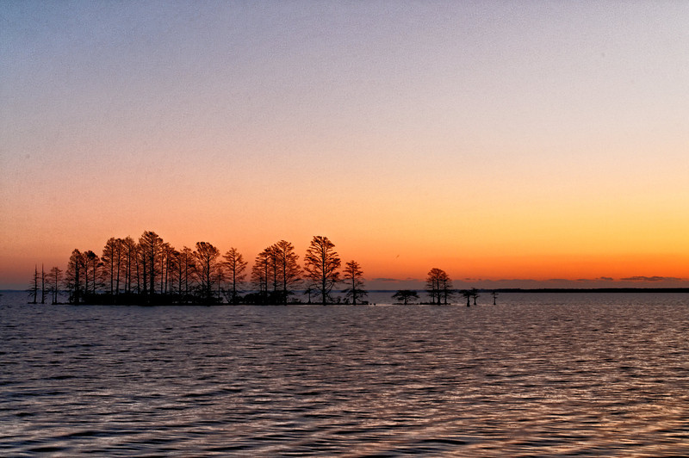
MATTAMUSKEET NATIONAL WILDILIFE REFUGE
Kayla Berger
Conservation Leadership
Old Dominion University

Slide 2
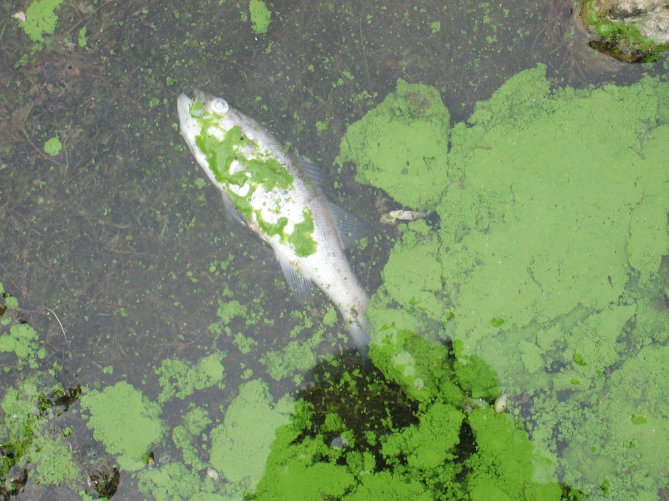
“The environment and the economy are both two sides of the same coin. If we cannot sustain the environment, we cannon sustain ourselves” – Wangari Maathai

Slide 3
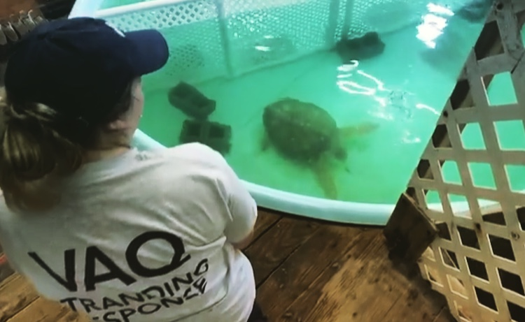
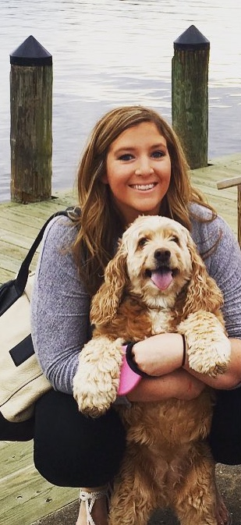
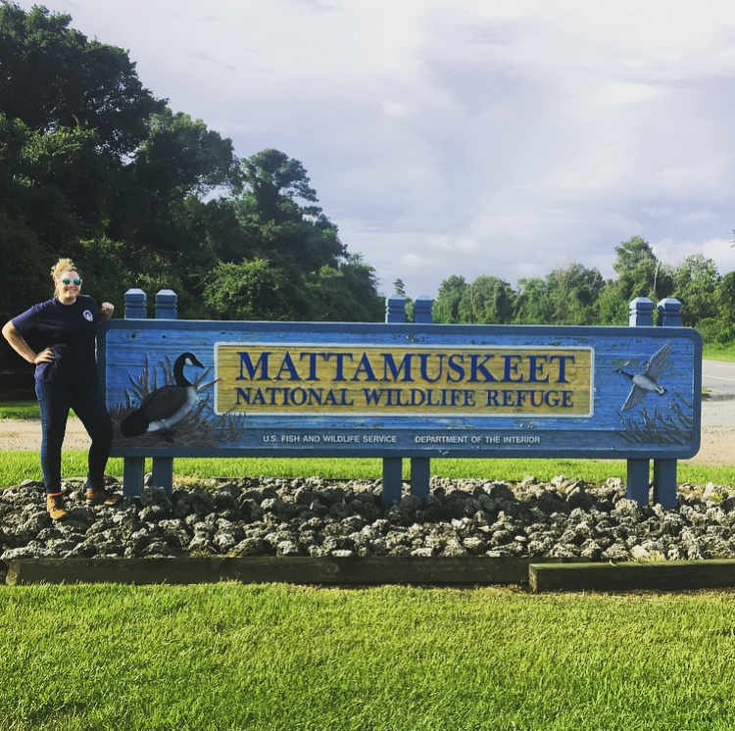
About me…
Biology Major, Interdisciplinary minor in Conservation Leadership
Fun fact: I have a 9 year old cocker spaniel named Layla
Conservation of our environment and wildlife is my ultimate passion and something I hope to pursue as a career
Giving this presentation as a review of my internship with FWS
Notes:
Try to establish a rapport with your audience by balancing personal details with relevance. For example, you might be passionate about coin collecting, but unless you’re giving a talk the local chapter of the American Numismatic Society, that may not be relevant to the presentation (<-----See what we did there? Did you even know the word “numismatic” before today?)

Slide 4
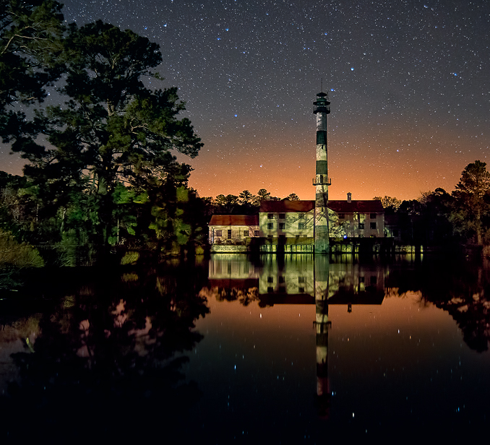
My Internship:
The system:
Mattamuskeet National Wildlife Refuge
The hazards:
Urban Development
Sea Level Rise
The threats:
Water Quality
Local Economy
Notes:
Use the slides as a prompt, not a crutch! You can put additional specifics you might need help remembering here in the notes section. Only you will be able to see it while in slideshow mode.

Slide 5
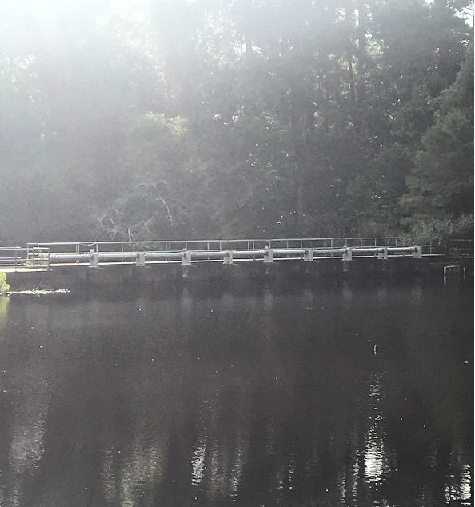
My project:
Designated Hazard: Sea Level Rise
Currently Rising at a rate of 2mm/yr in the Pamlico Sound
Foresight:
Low Scenario: According to UCS (2017), Lake Mattamuskeet and 20 other coastal NC communities will be more than 10% inundated by 2035
Intermediate Scenario: 20% inundated by 2030
High Scenario: 40% inundated by 2060
Tide Gates are built at each canal to avoid salt water intrusion
Notes:
The number of slides varies (we suggest no more than 15-20) but remember -- Use the slides as a prompt, not a crutch! You can put additional specifics you might need help remembering here in the notes section. Only you will be able to see it while in slideshow mode.

Slide 6
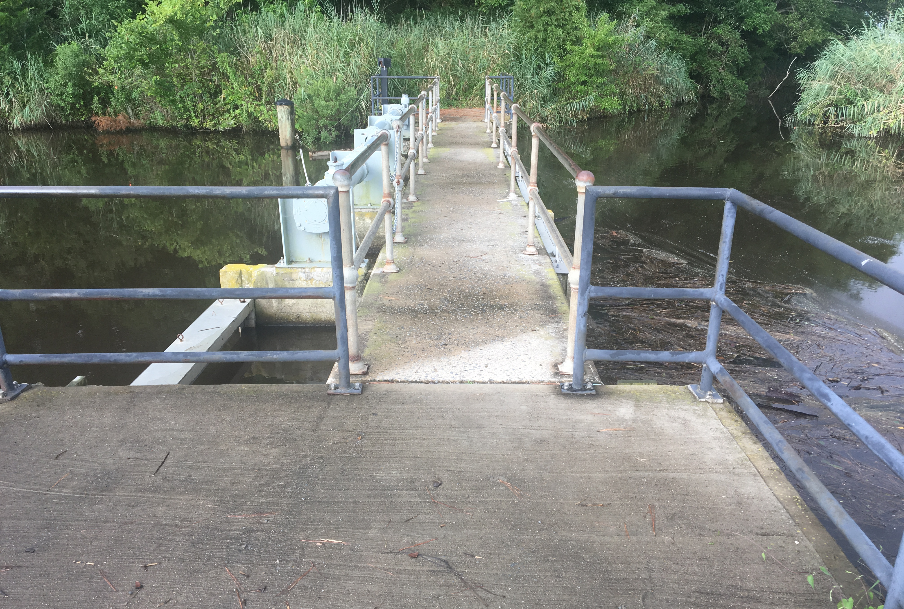
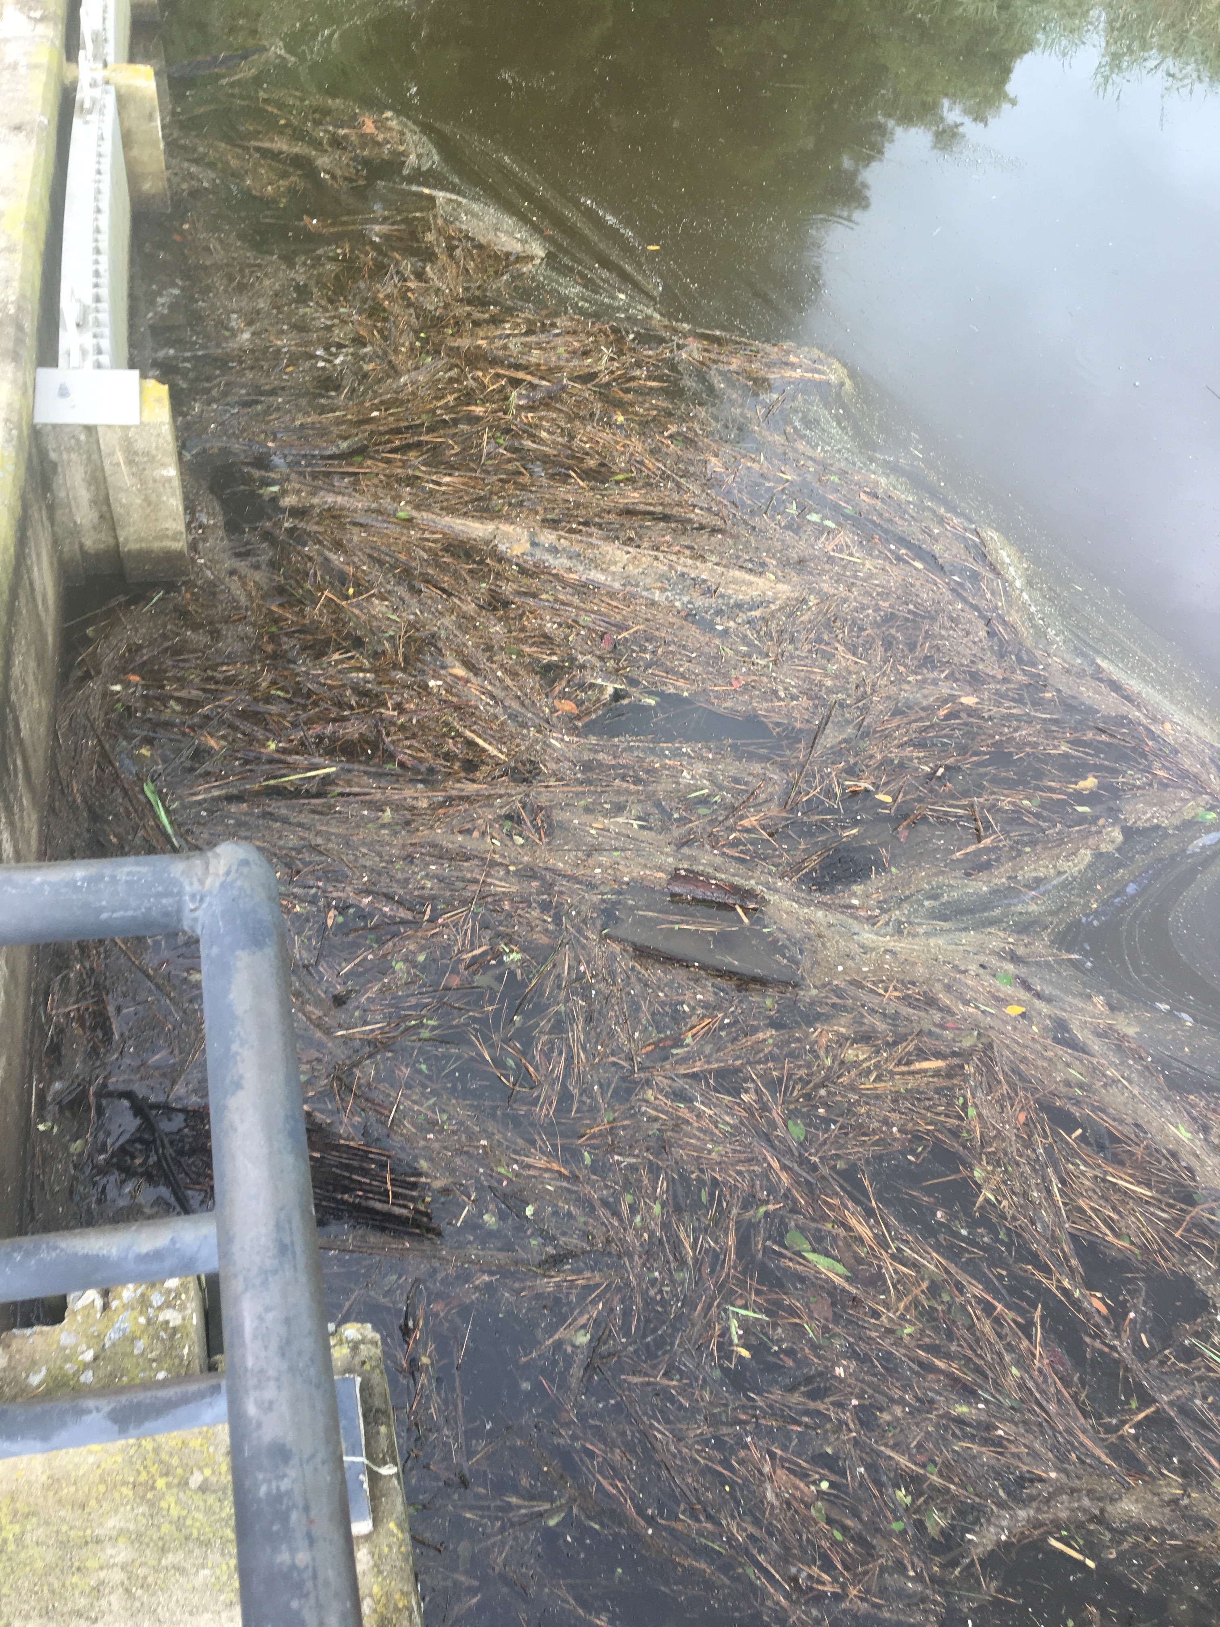
Proposed Mitigation Plans:
Open the Tide Gates
Salt water intrusion is likely to happen inevitably over the next 50-80 years
Opening tide gates could aid in water flow as well as slow introduction to salt water to the freshwater system
Salt water helps remove excess nutrients (could aid in the nutrient pollution from Urban development)

Slide 7
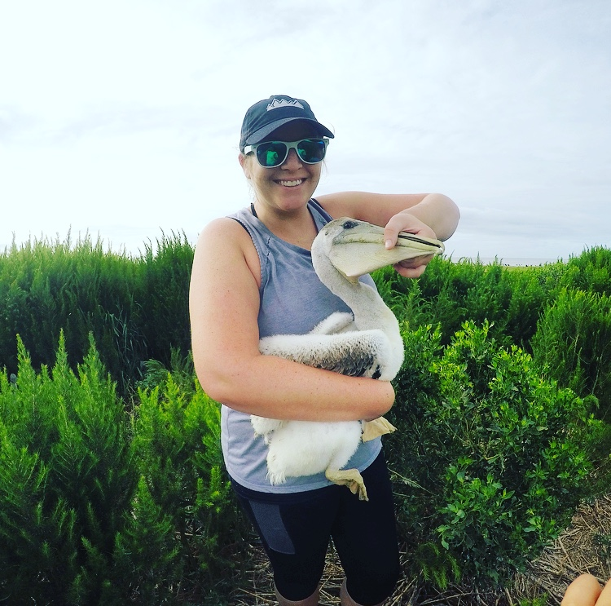
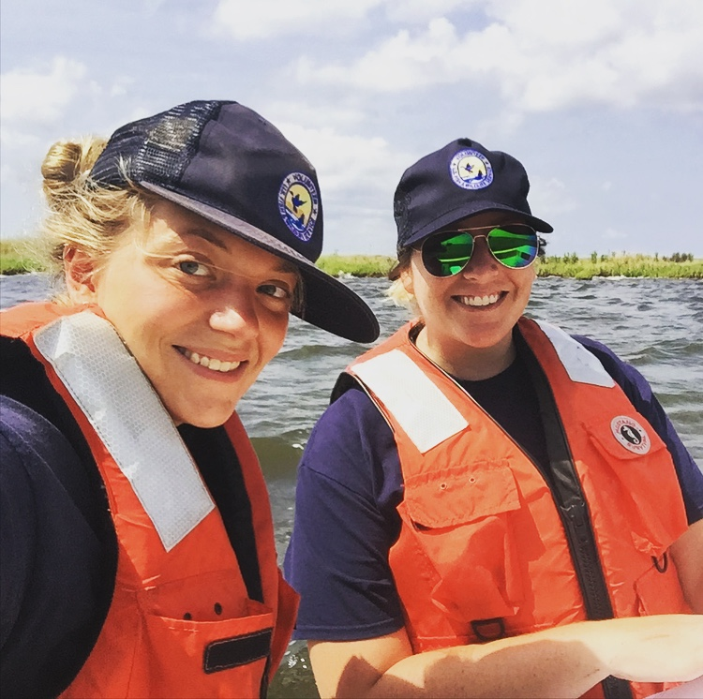
Internship Overview:
What I learned:
Freshwater systems are complicated
Community outreach and cooperation is vital to successful mitigation plans
What I gained:
Valuable experience as a conservationist
An understanding of how refuges are run on a day to day basis
Great relationships with fellow interns, employees, and volunteers
Additional fieldwork experience:
Pelican Banding
Taking water samples
Tern Surveying
Notes:
What’s the “take home” message for your audience? What do you REALLY want them to walk away knowing?

Slide 8
Thank you to Old Dominion University and US Fish and Wildlife Service for this awesome opportunity!!
Notes:
Always include a closing slide with “thanks” and contact information.

