Slide 1
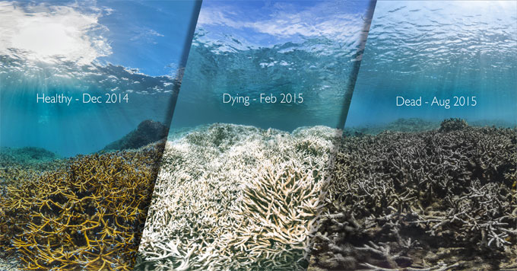
Effects of Ocean Acidification, Ocean Warming, and Humans on Coral Reefs
Importance of Reefs
Biodiversity, socioeconomic importance
Challenges for Coral Reef Futures
Ocean acidification/warming, additional factors
Key Stakeholders in Australia, America, and Caribbean
Scientific organizations
National/local governments
Private companies
Local communities
By Chase Garrison

Slide 2
Defining Coral Reefs and Challenges
Coral reef and zooxanthellae symbiosis
zooxanthellae provides photosynthetic products (amino acids, sugar, etc.); coral provides essential nutrients (ammonia and phosphate) (Hoegh-Guldberg, 1999)
0.6ºC increase in temperature of ocean’s upper layers past 100 years (Hoegh-Guldberg & Bruno, 2010).
expected to increase 1–2ºC each century (Hoegh-Guldberg, 1999)
Zooxanthellae can be stressed by 1-2ºC change, causing disassociation and coral bleaching (Hoegh-Guldberg, 1999)
Oceans are more acidic, average decrease of 0.1 pH (lowest in past 420,000 years) (Hoegh-Guldberg, et al., 2007)
Coral reefs have limited environmental ranges (Guan et al., 2015)
t: 21.7-29.6ºC; salinity: 28.7-40.4 ppt; N and P: 4.51μmol/L and 0.63 μmol/L; aragonite saturation: 2.82
Six major mass bleaching events have occurred since 1979, causing massive coral death, including entire reef ecosystems (Hoegh-Guldberg,1999)
50 to 70% of global coral reefs are directly threatened by human activities (Hoegh-Guldberg, 1999)

Slide 3
Coral Reef Hazards
Ocean Warming
increase in sea temperature (1-2ºC) and coral bleaching (Hoegh-Guldberg, 1999)
Ocean Acidification
pH decreases (carbonate ion (CO₃⁻) decreases); leads to lower production rates. (Pandolfi et al., 2011).
Overexploitation of Fish/Shellfish
Reducing fish populations → increase in sea urchins that feed on zooxanthellae → reduced zooxanthellae → less coral reef (Sebens, 1994).
Reducing fish population → increase in benthic algae → reducing reef’s ability to recover from destruction after bleaching/storm events (Sebens, 1994).
Pollution/Eutrophication from Land Use Changes (Sedimentation, Pollution, Run Off)
Increased nutrient levels may benefit reef growth at first, but also benefits harmful macroalgae (Sebens, 1994).
Likely cause of outbreaks in crown-of-thorns (COTS) starfish Acanthaster planci that feeds on coral; responsible for 0.53% decrease in coral cover per year (De’ath et al., 2012).

Slide 4
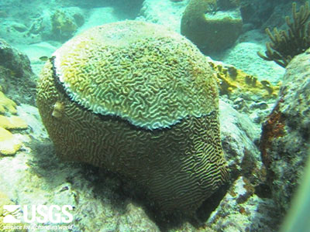
Vulnerabilities of Coral Reefs
Rates of ocean acidification/warming are occurring too quickly for geochemical feedbacks to occur fast enough for reefs to adapt (Pandolfi et al., 2011)
Smaller branching, thin-tissue acroporid and pocilloporid species are more susceptible to increasing temperatures than larger coral species (Walther et al., 2002)
Reefs are limited in ability to move (Walther et al., 2002)
Warmer oceans can lead to increased coral disease (Hoegh-Guldburg, 1999)
Threats of invasive species (Green et al., 2012)
Limited environmental ranges (Guan et al., 2015):
t: 21.7-29.6ºC
Salinity: 28.7-40.4 ppt
N and P: 4.51μmol/L and 0.63 μmol/L
Aragonite Saturation: 2.82

Slide 5
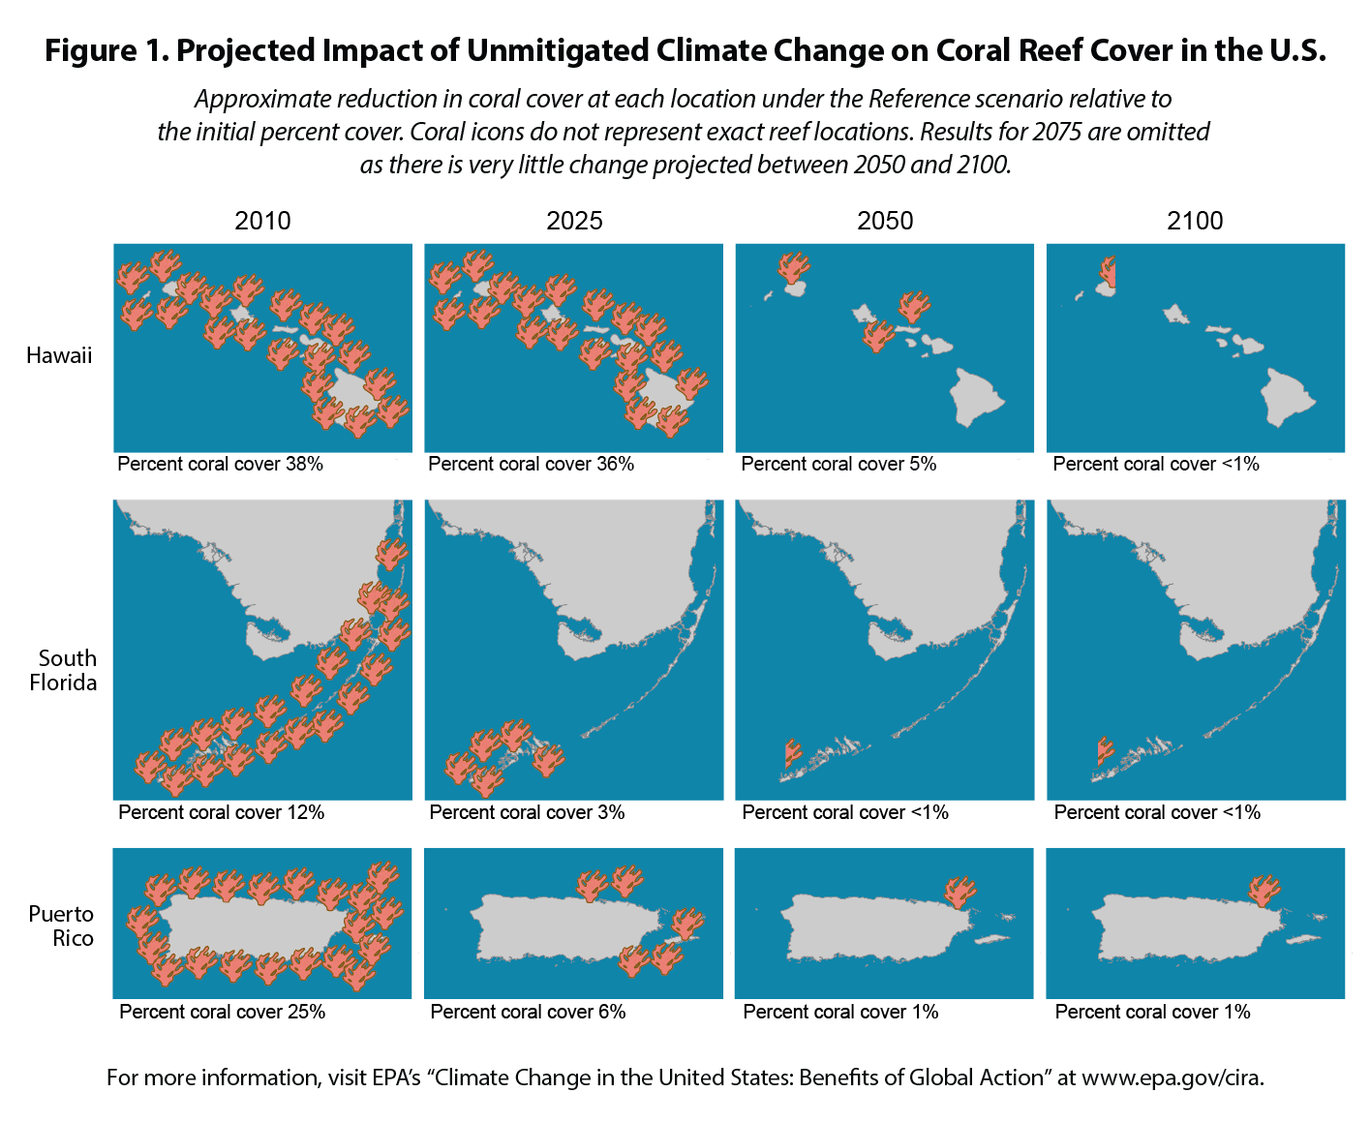
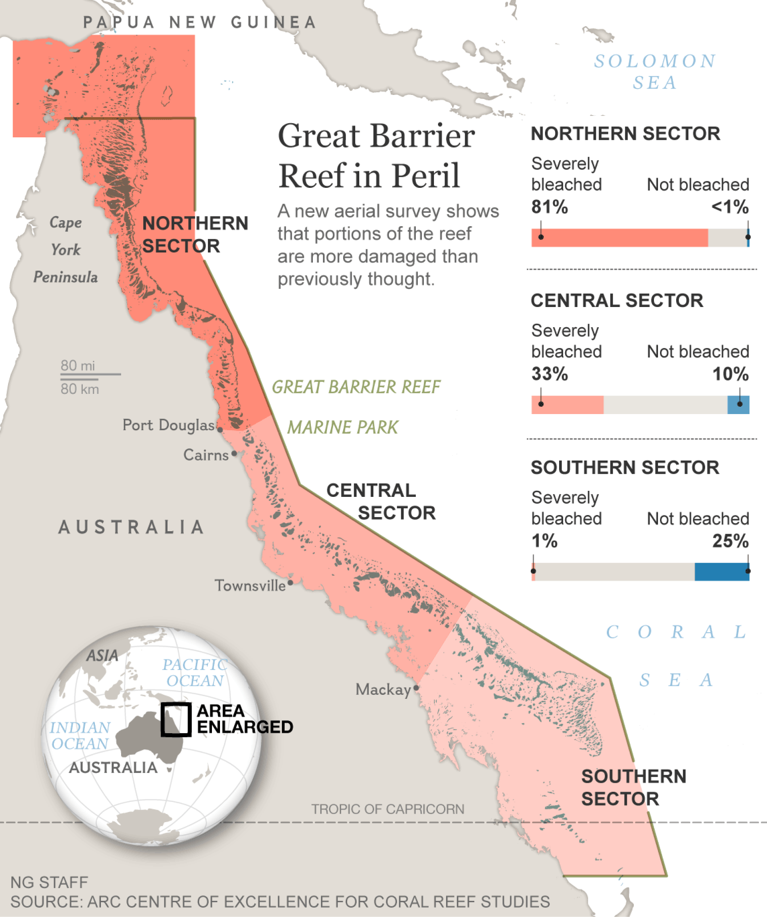
Foresight : Three Scenarios
Three scenarios based on future CO₂ emissions (Donner, 2009):
Business-as-usual: CO₂ concentrations reach 700 ppm, 1.9-2.4ºC increase in SST by 2100; 80% of reefs experience mass bleaching at least once every five years by 2020
Mitigation: CO₂ stabilize at 550 ppm, 1.1-1.5ºC increase in SST by 2100; 80% of reefs experience mass bleaching once every five years by 2030
Commit: CO₂ concentrations at current levels (390 ppm), SST increase 0.4-0.6ºC by 2100; 80% of reefs experience mass bleaching once every five years by 2095
New evidences suggests many climate models do not
accurately consider reef ability to cope/adapt to stress
(Pandolfi et al, 2011)

Slide 6
Foresight : Three Scenarios
Ecological/Socioeconomic effects of ocean warming/acidification:
Mass bleaching causes decrease in coral species, increases in macroalgae (Pandolfi et al., 2011)
Changes in inhabiting species due to bleaching/geographic changes (Pandolfi et al., 2011; Walther et al., 2002)
Loss of 58% of global reef, estimated loss of $140 billion to lost tourism alone (Hoegh-Guldberg, 1999)
Millions of fisherman depend on coral reef fisheries for employment (Hoegh-Guldberg, 1999)
Marine tourism and commercial fishing employs 54,000 people in Australia (Australian Government: Great Barrier Reef, 2018)
In Asia alone, coral reef fishes account for 1/4 of annual caught fish; feed 1 billion people (Hoegh-Guldberg et al, 2007)

Slide 7
Decision Making & Coral Reefs
Global
International Coral Reef Initiative and Coral Reef Alliance
Australia (Great Barrier Reef)
Australian Government
Great Barrier Reef Marine Park Authority
Queensland Government
Private companies, local communities
American Reefs
National Oceanic and Atmospheric Administration
Coral Reef Task Force - Coral Reef Conservation Act of 2000
Coral Reef Conservation Program - works with scientific organizations, local/state governments, private companies, and local communities
Coral Reef Early Warning System (CREWS)
Caribbean Reefs
Caribbean Challenge Initiative - Governments and private companies from 8 island countries: Bahamas, Dominican Republic, Jamaica, Saint Vincent and Grenadines, Saint Lucia, Grenada, Antigua and Barbuda, Saint Kitts and Nevis.
Caribbean Diversity Fund

Slide 8
Options to Protect Coral Reefs
Regarding CO₂ emissions (Donner, 2009):
Business-as-usual (no action) – 700ppm, 1.9-2.4ºC SST increase by 2100; 80% every 5 years by 2020
Mitigation (reduce emissions) – 550ppm, 1.1-1.5ºC SST increase by 2100; 80% mass bleaching every 5 years by 2030
Commit (stop emissions)- 390ppm, 0.4-0.6ºC SST increase by 2100, 80% every 5 years by 2095
United Nations Sustainability Development Goal 14 (United Nations, 2016)
Significantly reduce all marine pollution by 2025
Minimize and address ocean acidification impacts through scientific cooperation
End illegal, unreported, unregulated, and overfishing and implement management plans to provide maximum sustainability of fish populations by 2020
Conserve at least 10% of coastal and marine areas by 2020
Increase knowledge, develop research capacity and transfer of marine technology to improve ocean health and understanding of climate change effects

Slide 9
Recommendations
Mitigation scenario seems best/most likely; however, this scenario projects frequent mass bleaching events to occur by 2030.
Therefore, stricter limits to CO₂ emissions than mitigation scenario calls for so atmospheric CO₂ can remain under projected 550 ppm by 2100.
Reaching UN Sustainability Development Goal 14:
Reduce marine pollution
Implement responsible land use practices, limit agricultural pesticides/herbicides use
Address/minimize ocean acidification impacts
Significantly decrease greenhouse gas emissions
End unsustainable, illegal, and unreported/unregulated fishing practices
Strict commercial fishing regulations to maintain sustainable fisheries and require reporting of all fishing activity
Conservation of at least 10% of marine/coastal areas
Establish more marine protected areas and expand existing areas where coral reefs are found or could potentially grow
Increasing knowledge, research capacity, and transfer of marine technology
Introduce monitoring system such as NOAA’s CREWS in other reef areas
Increased funding of research and improve sharing of knowledge/information access

Slide 10
References
De’ath, G., Fabricius, K. E., Sweatman, H., Puotinen, M., 2012. The 27-year Decline of Coral Cover on the Great Barrier Reef and Its Causes. P Natl Acad Sci USA, 109, 17995- 17999.
Donner, S.D., 2009. Coping with Commitment: Projected Thermal Stress on Coral Reefs under Different Future Scenarios. PLoS One. doi: 10.1371/journal.pone.0005712
Green, S. J., Akins, J. L., Maljković, A., Côté, I. M., 2012. Invasive Lionfish Drive Atlantic Coral Reef Fish Declines. PLoS One. doi: 10.1371/journal.pone.0032596
Guan Y., Hohn S., Merico A., 2015. Suitable Environmental Ranges for Potential Coral Reef Habitats in the Tropical Ocean. PLoS ONE, 10, 1-17. doi:10.1371/journal.pone.0128831
Hoegh-Guldberg, O., 1999. Climate Change, Coral Bleaching and the Future of the World’s Coral Reefs. Mar Freshwater Res, 50, 839-866. doi: 10.1071/MF99078.
Hoegh-Guldberg, O. and Bruno, J.F., 2010. The Impact of Climate Change on the World's Marine Ecosystems. Science, 328, 1523-1528.
Hoegh-Guldberg, O., Mumby, P. J., Hooten, A. J., Steneck, R. S., Greenfield, P., Gomez, E., Harvell, C. D., Sale, P. F., Edwards, A. J., Caldeira, K., Knowlton, N., Eakin, C. M., Iglesias-Prieto, R., Muthiga, N., Bradury, R. H., Dubi, A., Hatziolos, M. E., 2007. Coral Reefs Under Rapid Climate Change and Ocean Acidification. Science, 318, 1737-1742.
Pandolfi, J. M., Connolly, S. R., Marshall, D. J., Cohen, A. L., 2011. Projecting Coral Reef Futures Under Global Warming and Ocean Acidification. Science, 333, 418-422. doi: 10.1126/science.1204794.
Sebens, K. P., 1994. Biodiversity of coral reefs: what are we losing and why? Amer Zoo, 34, 115-133.
United Nations, 2016. Goal 14: Conserve and sustainably use the oceans, seas and marine resources. https://www.un.org/sustainabledevelopment/oceans/. Accessed on April 13, 2018.

