Slide 1
Loss of Ecosystem Services of Wetlands
The System: Virginia Wetlands, Coastal Wetlands
The Challenge: Losing services that wetlands provide
Stakeholders: Department of Environmental Quality, Local and State Government, U.S. Fish & Wildlife Service
Gabby Giacomangeli

Slide 2
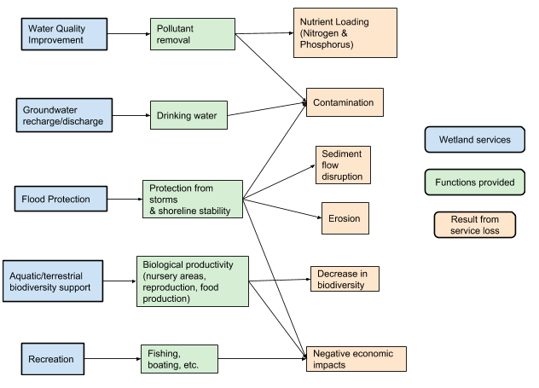
Loss of Ecosystem Services of Wetlands
Wetland degradation
Wetlands were considered a waste of land
Over the past 200 years, the U.S. has lost more than 50% of its wetlands (Stein, 2000).
The U.S. is losing about 60,000 acres of wetlands per year (as of 2004) (U.S. Fish & Wildlife Service, 2005).
Wetland services
Many ecosystem services are being lost (Woodward & Yong-Suhk, 2001)

Slide 3
Hazards
Agriculture Development
Main reason for wetland loss until 2004 (De Steven & Lowrance, 2011).
Nutrient runoff
Urbanization
Prevents system migration (Nicholls et al., 1999).
Flood control structures
Sea Level Rise and Climate Change
SLR of 1 m could threaten half the ecosystems globally (Nicholls et al, 1999)
Storms
Hurricane Sandy
(St. Petersburg Coastal and Marine Science Center, 2016)

Slide 4
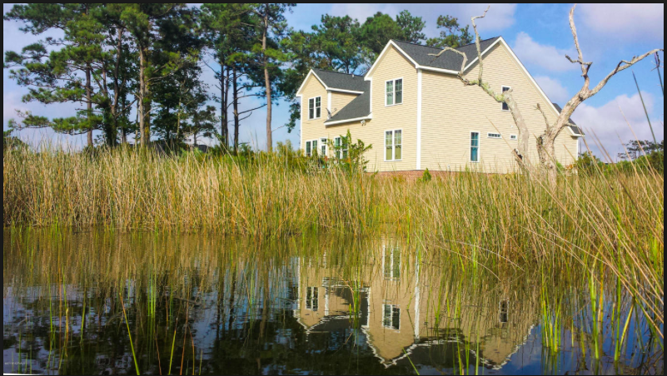
Vulnerabilities
Foundation species
Functionality of a wetland usually depends on a single or small group of species (Osland et al., 2016).
Climate Change
Changes in temperature and precipitation
Changes in plant composition, increase in invasive species
Sea level rise
Coastal wetlands are located in low lying areas where they can experience changes in salinity and water levels
Commercially valuable
People want to live near the water
Coastal wetlands require more artificial draining

Slide 5
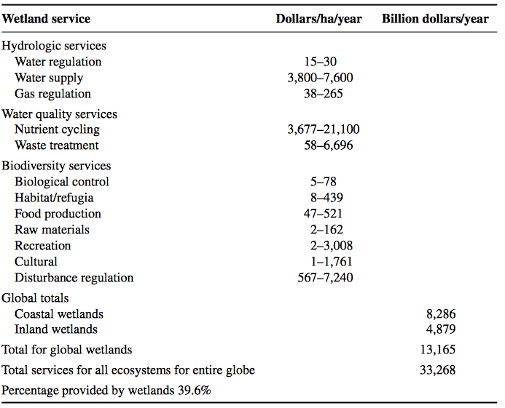
Foresight
Continued wetland loss
Pollution
Decrease in productivity
Loss of a buffer zone
Economic Impacts
unfavorable changes to wetlands can result in more than $20 trillion in ecosystem service losses annually (Ramsar Convention, 2015).
Migration
Table 1. The economic value of each ecosystem service that are provided by wetlands annually and the total percentage provided by wetlands globally (Zedler & Kercher, 2005).

Slide 6
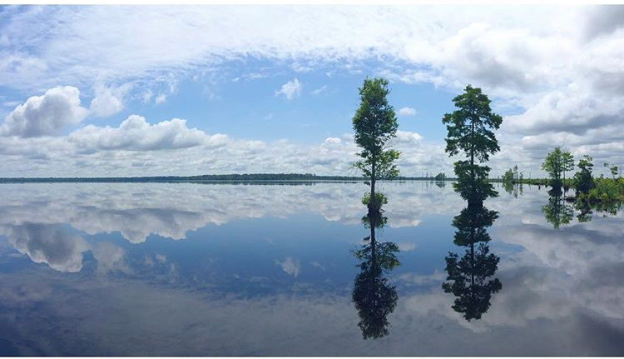
Decision Making
U.S. Fish & Wildlife
Department of Environmental Quality
Local and State Government
General Public
Mandated regulations, policies, permits
Violations
Tax credit

Slide 7
Options
Option 1
Determine which remaining wetlands are the most important and economically valuable, and to protect them from any sort of development
Option 2
Determine which wetlands can be converted back to a functioning ecosystem
Option 3
Protect all remaining wetlands, even if they are degraded, or commercially valuable
Option 4
Increase tax credits or cost of violation fines to provide more incentive

Slide 8
Recommendations
Protect and restore any remaining wetlands, and try to regain any lost services through restoration
Include the general public in the decision making process
Incentives
Voluntary Restoration Programs

