Slide 1





Modeling the Impacts of Water Quality on SAV and other Living Resources in the Tidal Chesapeake Bay
Richard C. Zimmerman, Victoria J. Hill
Bio-Optical Research Group
Department of Ocean, Earth & Atmospheric Sciences
Old Dominion University
Norfolk VA
Charles L. Gallegos
Smithsonian Environmental Research Center
Edgewater, MD

Slide 2
Motivation for this work:
Basic:
Link hydrologic optics with physiology to develop fundamental understanding of climate impacts on aquatic photosynthesis
Applied:
Improve our ability to model & manage the impacts of water quality on shallow water resources in the Chesapeake Bay
  Existing Bay Model works well in the main stem of the Bay but fails to predict WQ and SAV distributions in shallow water, esp tributaries

Slide 3
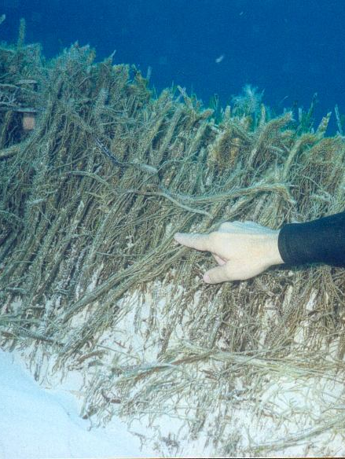
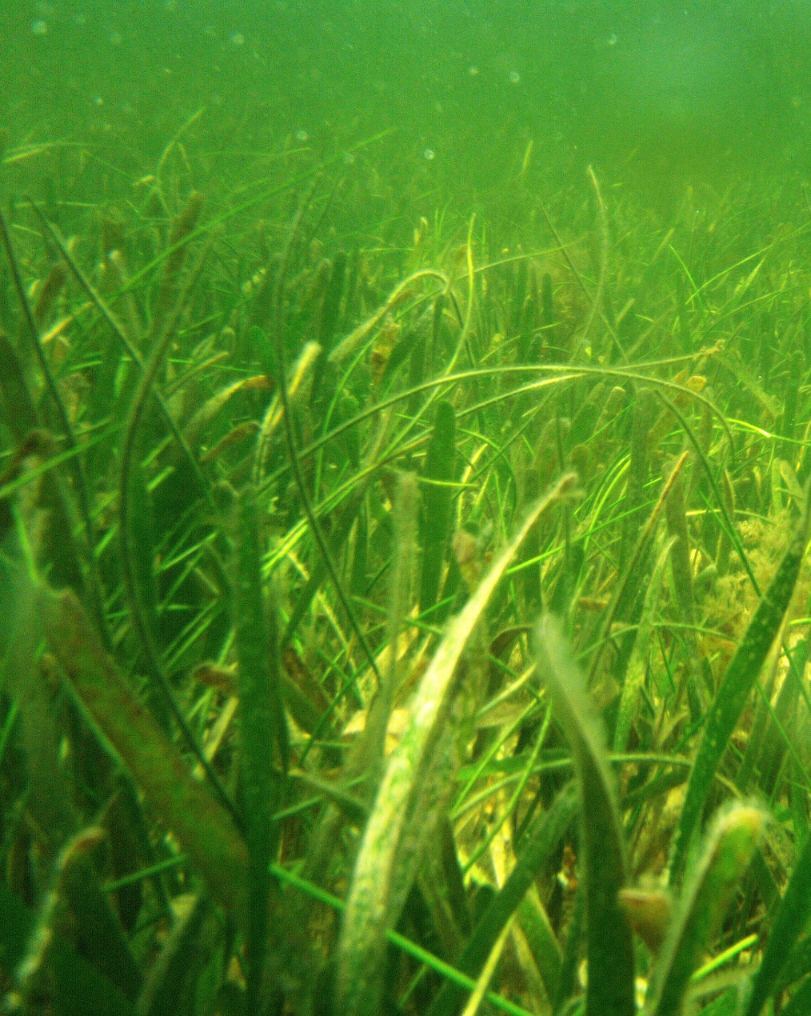
Submerged Aquatic Vegetation
  Leaves, roots & rhizomes
Adapted for submerged growth
More than 100 spp. worldwide
Highly productive
Create habitat and structure for diverse array of marine organisms
Significant biogeochemical agents
  Sediment redox
  Carbonate dissolution & pyrite formation (= alkalinity)
  “Blue Carbon”
    20% of all C buried in <0.1% of the ocean
Occupy <0.1% of the ocean surface

Slide 4
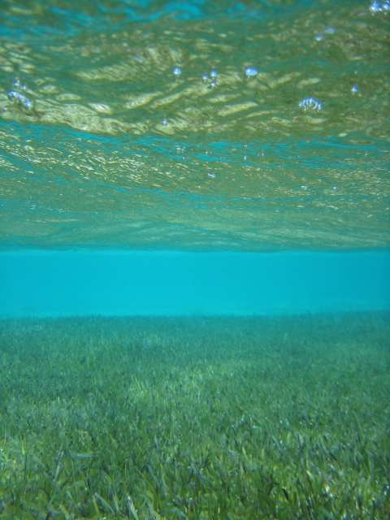
SAV and Climate Change:
High light requirements (10 – 20% surface E)
Vulnerable to poor water quality
Sensitive to high summer temperatures

Slide 5
SAV loss threatens provision of major ecosystem services in shallow coastal environments
  Habitat structure and sediment stability
    Loss of “blue carbon” deposits
  Productivity shift from benthos to plankton
  Shifts in sediment biogeochemistry
    Reduced flux of C_{org} and O₂ to sediments

Slide 6
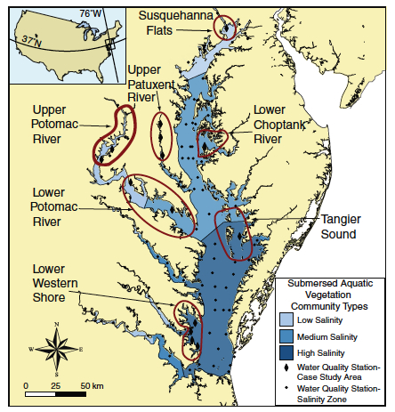
Salinity controls SAV community structure
3 Broad Salinity regimes
Oligohaline
  Salinity <5 (PSS)
  Fresh water habitat
Mesohaline
  5 to 15 (PSS)
  Highly variable
  Most affected by dry/wet rainfall patterns
Polyhaline
  Salinity >15 (PSS)
  Southern Bay
  Mostly marine habitat
Map by R. J. Orth, VIMS

Slide 7
> 22 Spp. SAV in the Chesapeake Bay
Similarities
  Leaves, roots & rhizomes
  Optical properties based on Chl a + b
  Temperature sensitive
  CO₂-limited photosynthesis
Differences:
  Morphology
    Canopy architecture
    Root:shoot allocation
  Physiology
    Salt tolerance
Current management practices set two water transparency thresholds
  13% E (0-) for freshwater and mesohaline SAV
  22% E (0-) for polyhaline SAV (eelgrass and widgeon grass)
  No ability to predict density distribution

Slide 8
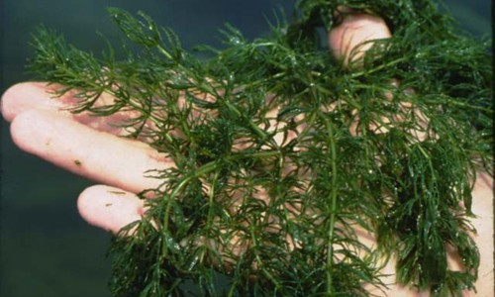
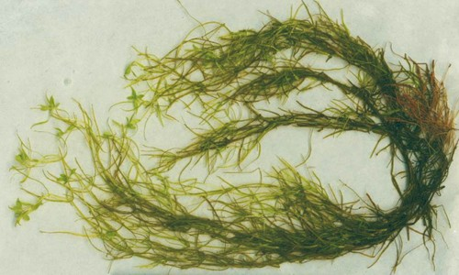
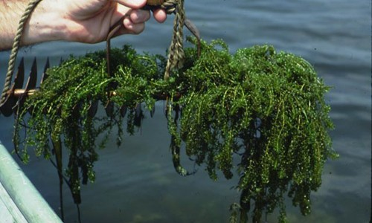
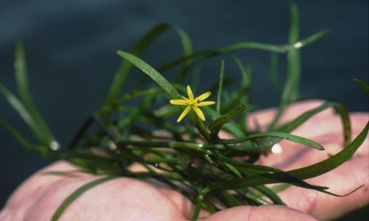
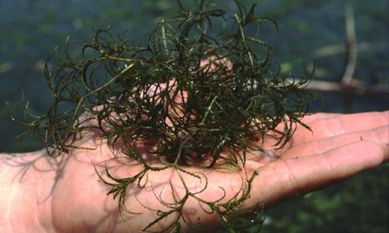
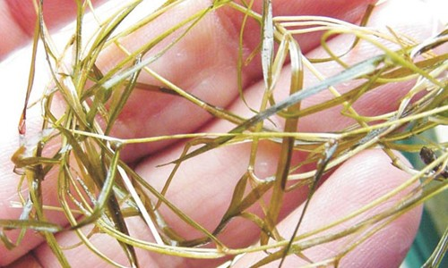
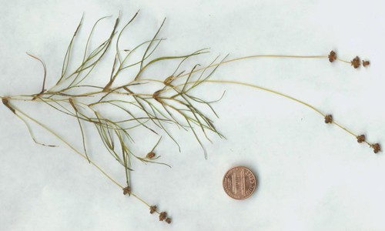
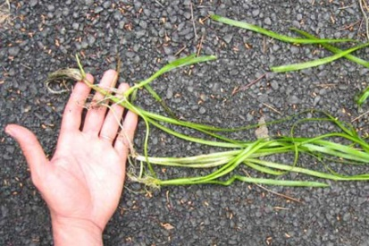
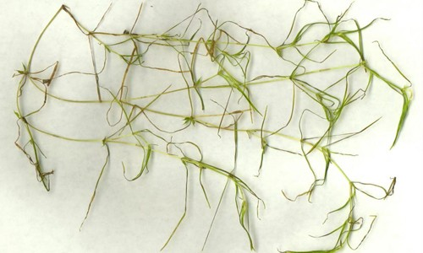
Native Freshwater SAV
9 spp.
Ceratophyllum demersum
Coontail
Callitriche sp.
Water starwort – 4 spp.
Elodea canadensis
Common waterweed
Heteranthera dubia
Water stargrass
Najas spp.
Naiads – 5 spp.
Potamogeton pusilus
Slender pondweed
Potamogeton pectinatus
Sago pondweed
Vallisneria americana
Wild celery
Zanichellia palustrus
Horned pondweed

Slide 9
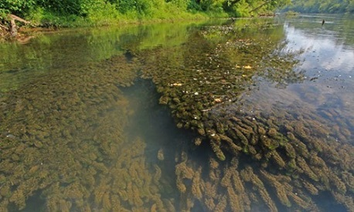
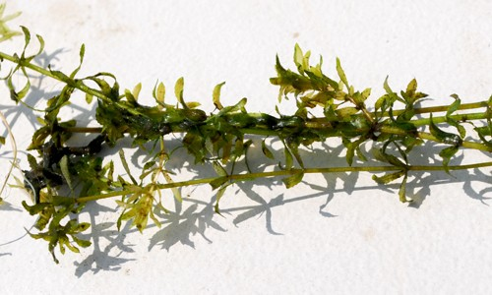
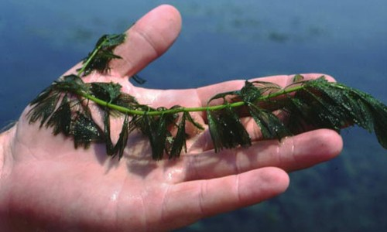
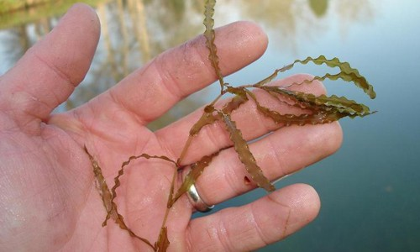
Invasive Freshwater SAV
4 spp.
Egeria densa
Brazilian waterweed
Hydrilla verticillata
Horned pondweed
Myriophyllum spicatum
Eurasian watermillfoil
Potamogeton cruspus
Curly pondweed

Slide 10

Mesohaline SAV
4 spp.
Ceratophyllum demersum
Coontail
Potamogeton pectinatus
Sago pondweed
Ruppia maritima
Widgeon grass
Zanichellia palustrus
Horned pondweed

Slide 11
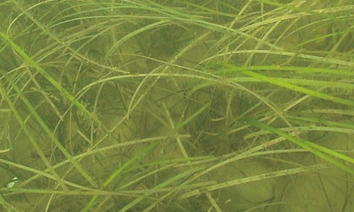
Polyhaline SAV
2 spp.
Ruppia maritima
Widgeon grass
Zostera marina
eelgrass

Slide 12
So, what does climate change have in store for SAV?
Climate warming will increase summer stress
  Chesapeake Bay eelgrass
    Moore & Jarvis. 2008. J. Coast. Res 55:135-247
  Mediterranean Posidonia
    Marbà, N. and C. Duarte. 2010. Global Change Biology 16:2366-2375.
Heat stress events will become more frequent
  European eelgrass
    Franssen, S. and others 2012. Transcriptomic resilience to global warming in the seagrass Zostera marina, a marine foundation species. Proc. Nat. Acad. Sci. 108: 19276-19281.
    Winters, G., P. Nelle, B. Fricke, G. Rauch, and T. Reusch. 2011. Effects of a simulated heat wave on photophysiology and gene expression of high- and low-latitude populations of Zostera marina. Mar. Ecol. Prog. Ser. 435: 83-95.
Water quality continues to deteriorate . . . .

Slide 13
And what about Ocean Acidification?
CO₂ availability modifies eelgrass response to temperature:
  Increased photosynthesis and positive C balance
  Survival & reproduction
  Shoot Size
  Growth
  Below-ground biomass
Long term experiments on whole plants support short-term responses of individual leaves
Can we combine physiology with bio-optical modeling to predict SAV response across the aquatic landscape?

Slide 14
Predictive Modeling with GrassLight Ver 2.13
The SAV Bio-Optical Model
Water Column
Optical Properties
+
Plant/Canopy
Architecture
+
Leaf Optical
Properties
+
Epiphyte Load
Irradiance Distribution
and Light Absorption
Temperature
Photosynthesis and
Carbon Balance
CO2/pH
Depth Distribution

Slide 15
GrassLight Ver. 2.13
The Seagrass Bio-Optical Model
Date, Time
Chl a, TSM
Spectral Solar Irradiance @ Sea Surface
Gregg, W., and K. Carder. 1990. A simple spectral solar irradiance model for cloudless maritime atmospheres. Limnol. Oceanogr. 35: 1657-1675.
E_{d}(λ,0-)
Water Column Constituents & Optical Properties
Lee, Z.-P., K. Du, and R. Arnone. 2005. A model for the diffuse attenuation coeffficient of downwelling irradiance. J. Geophys. Res 110: 1-10.
K_{d}(λ,)
E_{d}(λ,z)
Plant Canopy Architecture & Optical Properties
Zimmerman, R. 2003. A biooptical model of irradiance distribution and photosynthesis in seagrass canopies. Limnol. Oceanogr. 48: 568-585.
E_{a}(λ,z)
Photosynthesis &
Canopy Reflectance

Slide 16


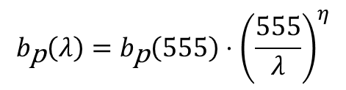




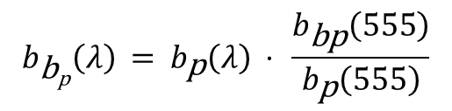
Relating K_{d} to IOPs to optically active constituents:
Absorption
Scattering
$$a_{\text{t}\text{−}\text{w}}\left(λ\right)=a_{\text{g}}\left(λ\right)+a_{\text{ϕ}}\left(λ\right)+a_{\text{p}\text{−}\text{ϕ}}\left(λ\right)$$
$$b_{\text{b}\text{p}}\left(λ\right) = b_{\text{p}}\left(λ\right) ⋅ \frac{b_{\text{bp}}\left(555\right)}{b_{\text{p}}\left(555\right)}$$
$$a_{\text{g}}\left(λ\right)=a_{\text{g}}\left(440\right)⋅exp\left[−s_{\text{g}}\left(λ−440\right)\right]$$
$$b_{\text{p}}\left(λ\right)=b_{\text{p}}\left(555\right)⋅{\left(\frac{555}{λ}\right)}^{η}$$
$$a_{\text{p}\text{−}φ}\left(440\right)=a_{\text{p}\text{−}φ}^{∗}\left(440\right)⋅{\left[\text{TSM}\right]}^{υ_{\text{sa}}}$$
$$a_{\text{p}\text{−}φ}^{∗}\left(λ\right)=c_{1}+c_{2}⋅exp\left[−s_{\text{NAP}}\left(λ−440\right)\right]$$
$$b_{\text{p}}\left(555\right)=b_{\text{p}}^{\text{∗}}\left(555\right)⋅{\left[\text{TSM}\right]}^{υ_{\text{sb}}}$$
$$a_{φ}\left(λ\right)=a_{φ}^{∗}\left(λ\right)⋅{\left[\text{Chl} a\right]}^{υ_{φ}}$$
Lee, Z.-P., K. Du, and R. Arnone. 2005. A model for the diffuse attenuation coefficient of downwelling irradiance. J. Geophys. Res 110: 1-10.
Zimmerman, R., V. Hill, and C. Gallegos. 2015. Predicting effects of ocean warming, acidification and water quality on Chesapeake region eelgrass. Limnol. Oceanogr. 60:1781-1804.

Slide 17
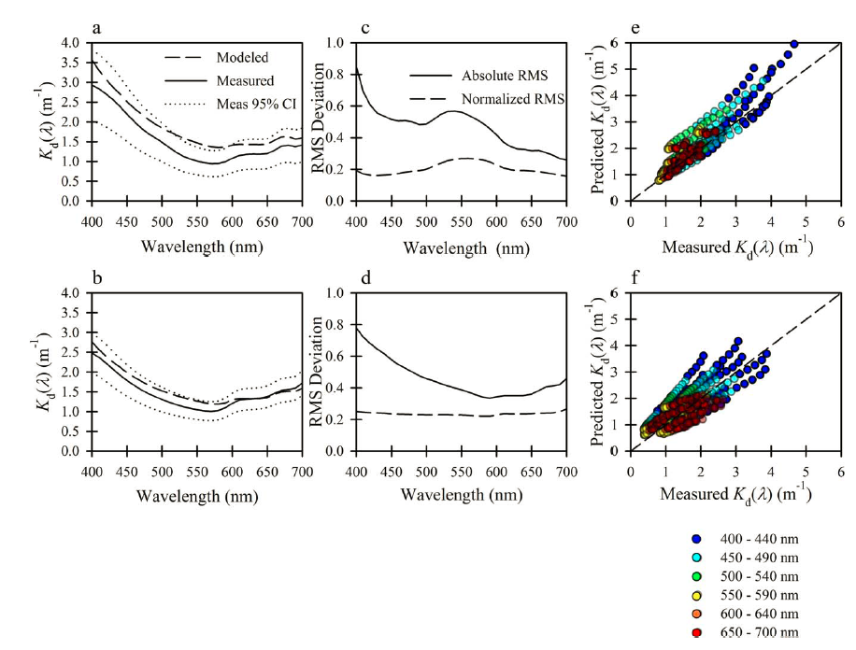
It reasonably predicts AOPs from Chl a and TSM
Zimmerman, R., V. Hill, and C. Gallegos. 2015. Predicting effects of ocean warming, acidification and water quality on Chesapeake region eelgrass. Limnol. Oceanogr. 60:1781-1804.

Slide 18
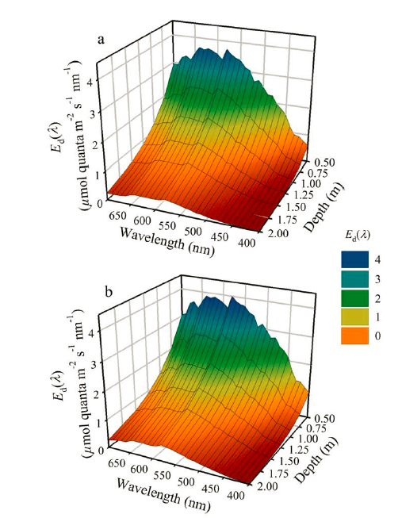
And spectral irradiances
Zimmerman, R., V. Hill, and C. Gallegos. 2015. Predicting effects of ocean warming, acidification and water quality on Chesapeake region eelgrass. Limnol. Oceanogr. 60:1781-1804.

Slide 19
Canopy Architecture:
Vertical Biomass Distribution from Leaf Size-Frequency Distribution
Ψ = biomass at base of canopy
I = Inflection point of the sigmoid curve (ht above seafloor)
s = shape factor, controls steepness of curve
h (z) = height above seafloor
Biomass expressed as Leaf Area Index
  This is what intercepts the light
  LAI = m² leaf m⁻² seafloor
Zimmerman, R. 2003. A biooptical model of irradiance distribution and photosynthesis in seagrass canopies. Limnol. Oceanogr. 48: 568-585.

Slide 20
Projected Leaf Area Depends on Canopy Orientation
L = Density x Shoot Area
l_{p}= L sin β

Slide 21
2- Flow Radiative Transfer

Slide 22
Depth Distribution of Modeled Irradiance
Modeling the irradiance distribution through the water column and vegetation canopy allows us to determine the light
  attenuated by the water column
  absorbed for photosynthesis by SAV and phytoplankton
  reflected to a remote sensing detector

Slide 23
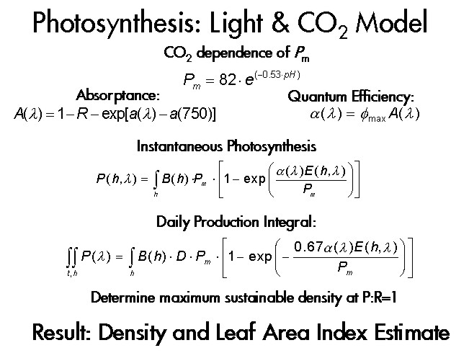
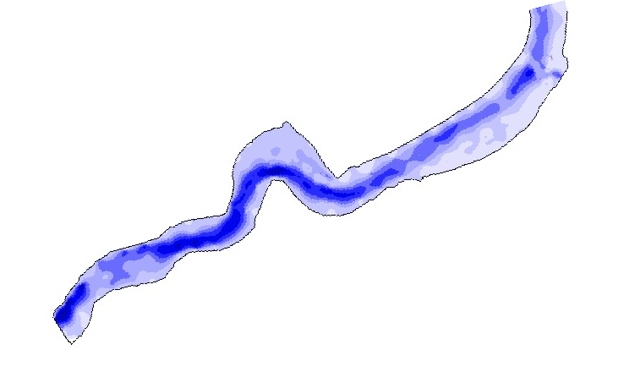
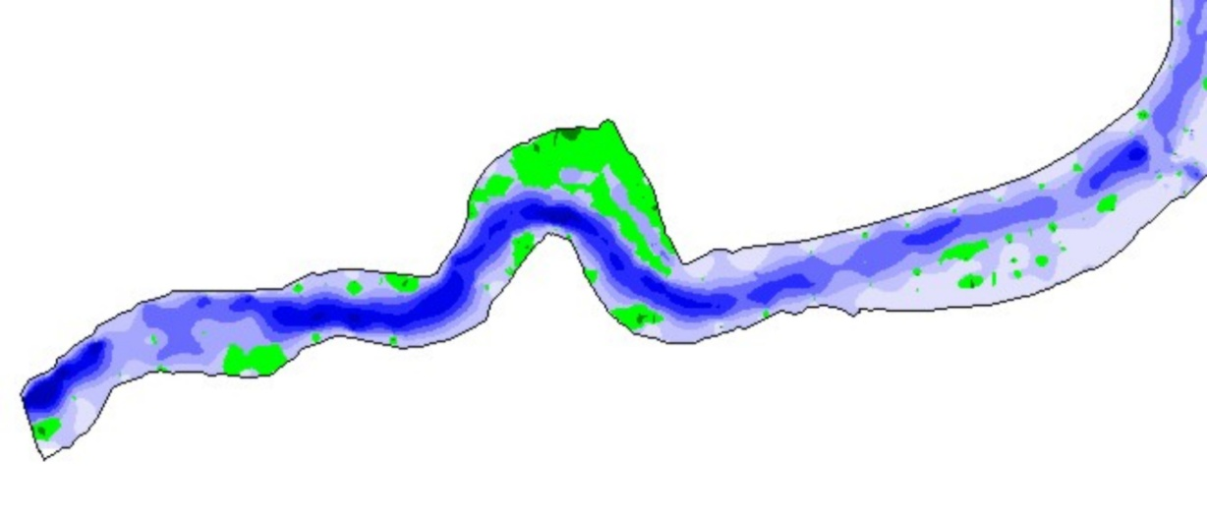
Predicting SAV Distributions:
Leaf Area Index as
[CO₂]
Temperature
Function of Depth
2
-2
lai (m
m
)
0
20
40
0
2
4
E(λ,z)
6
8
Depth (m)
Water Quality:
E_{d}(λ,z) =exp[-K_{d}(λ)z]
K_{d}(λ) = f(a_{CDOM},[Chl a],TSM)
10
12
14
16
LAI = 0.0286(z)
2
18
- 1.8768 (z) + 30.151
R
2
= 0.9999
20
+ Bathymetry
Light Limited Distribution

Slide 24
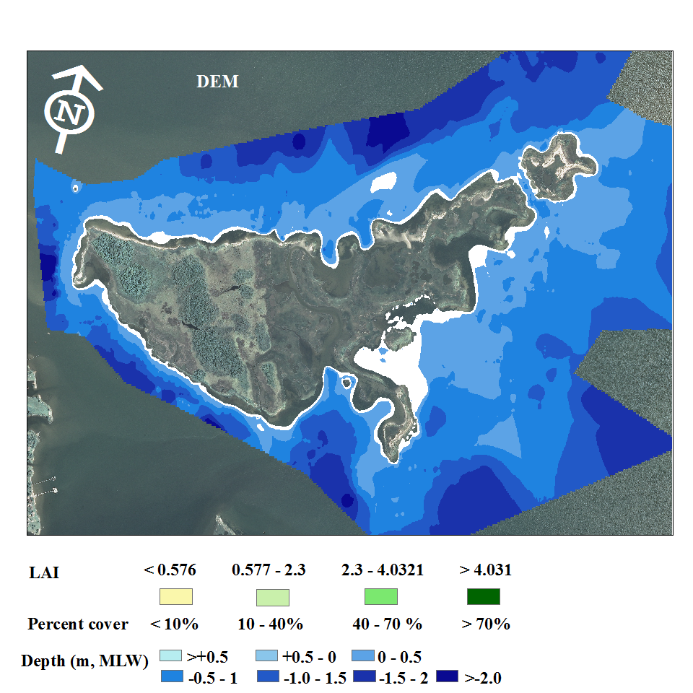
Goodwin Islands NERR
SAV Vulnerable to thermal stress
Time series of
  Water quality measures to drive light availability
  SAV abundances to compare model predictions
Detailed bathymetry
Zimmerman, R., V. Hill, and C. Gallegos. 2015. Predicting effects of ocean warming, acidification and water quality on Chesapeake region eelgrass. Limnol. Oceanogr. 60:1781-1804.

Slide 25
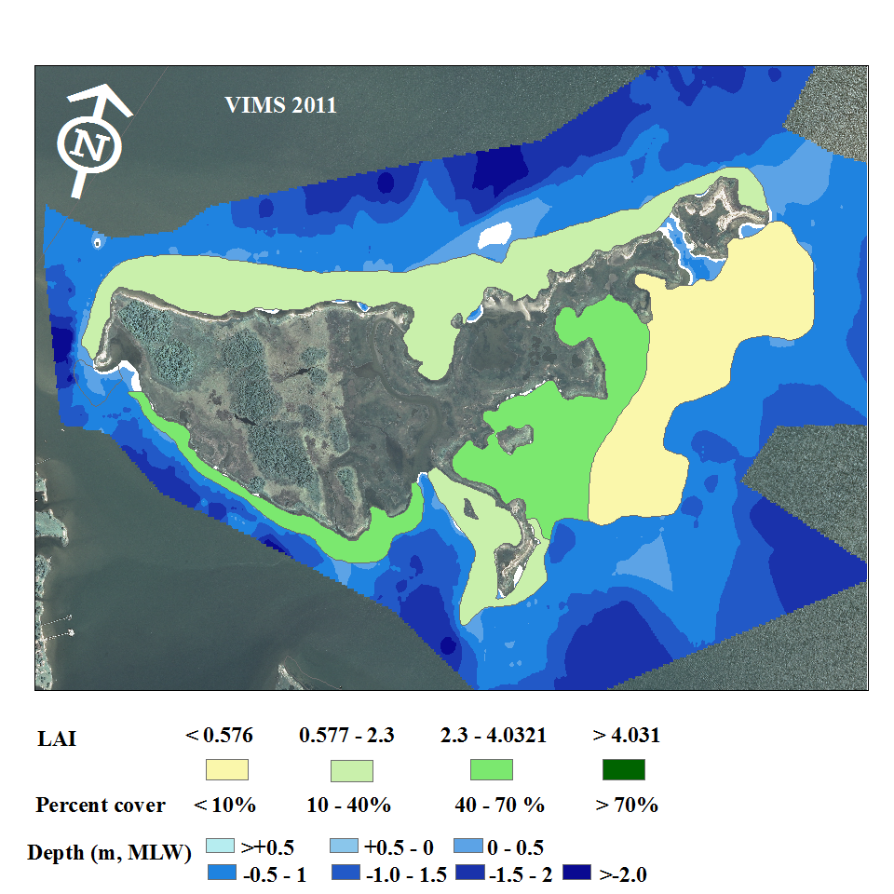
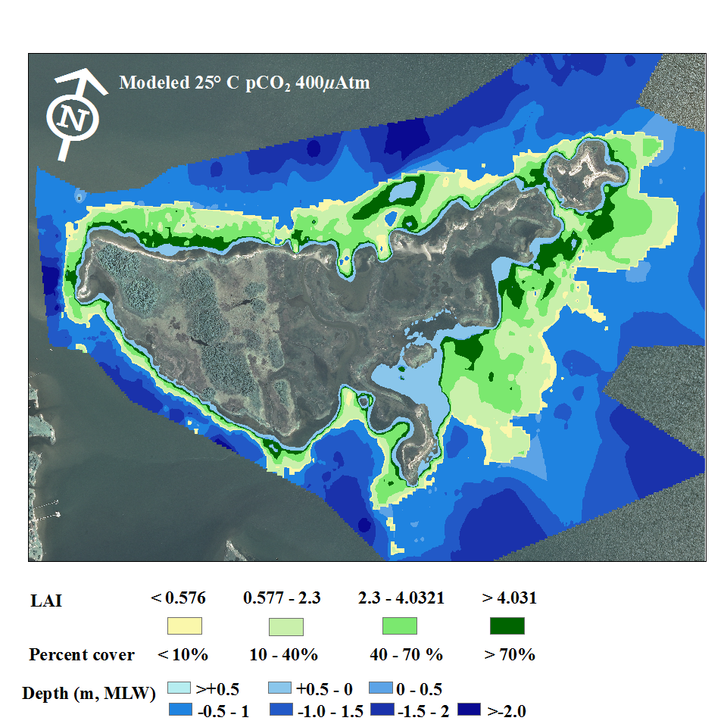
Predicting climate effects on eelgrass distribution
Density decreases with depth
Distribution limited to depths <1.5 m
Consistent with VIMS 2011 SAV map
Zimmerman, R., V. Hill, and C. Gallegos. 2015. Predicting effects of ocean warming, acidification and water quality on Chesapeake region eelgrass. Limnol. Oceanogr. 60:1781-1804.

Slide 26
How will temperature and CO₂ interact to affect eelgrass distribution?
Cool summer temperature
Present-day CO₂ (pH 8)
What happens if we increase temperature?
Zimmerman, R., V. Hill, and C. Gallegos. 2015. Predicting effects of ocean warming, acidification and water quality on Chesapeake region eelgrass. Limnol. Oceanogr. 60:1781-1804.

Slide 27
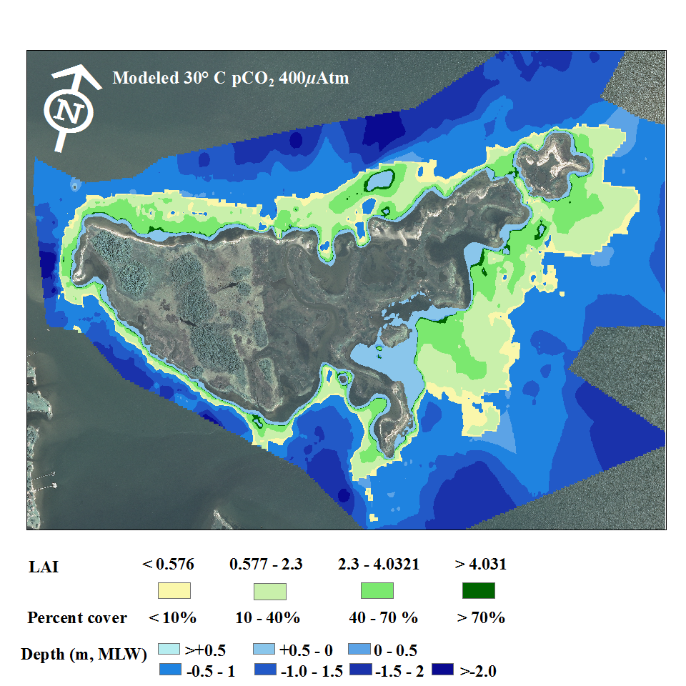
How will temperature and CO₂ interact to affect eelgrass distribution?
Warming alone causes eelgrass die-back
Zimmerman, R., V. Hill, and C. Gallegos. 2015. Predicting effects of ocean warming, acidification and water quality on Chesapeake region eelgrass. Limnol. Oceanogr. 60:1781-1804.

Slide 28
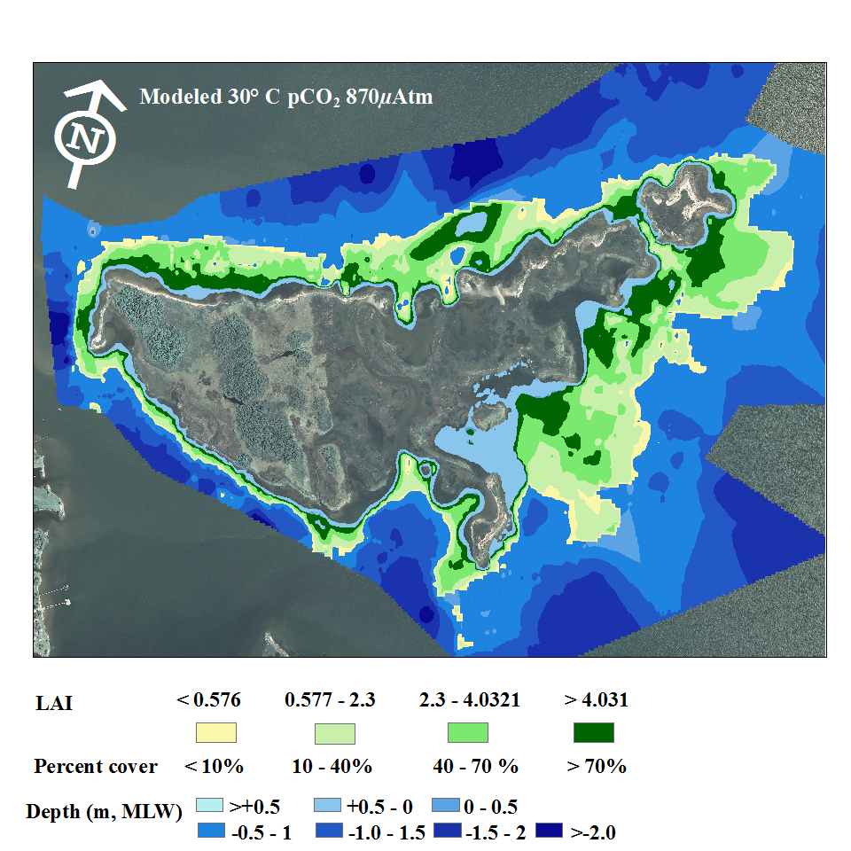
How will temperature and CO₂ interact to affect eelgrass distribution?
Warming combined with CO₂ doubling (pH 7.8) causes re-growth of eelgrass
Zimmerman, R., V. Hill, and C. Gallegos. 2015. Predicting effects of ocean warming, acidification and water quality on Chesapeake region eelgrass. Limnol. Oceanogr. 60:1781-1804.

Slide 29
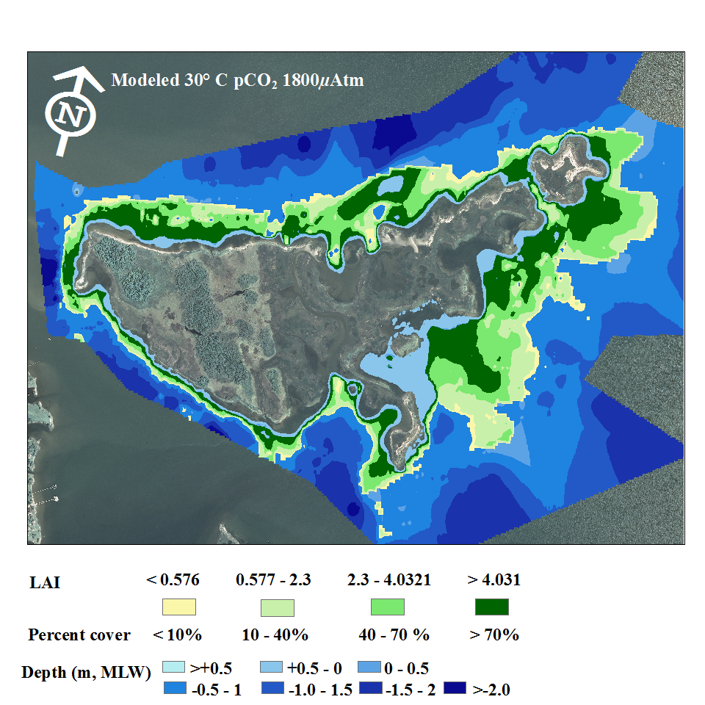
How will temperature and CO₂ interact to affect eelgrass distribution?
Warm summer temperature
CO₂ quadrupling (pH 7.5) further increases shallow water density
Minimal effects on depth distribution
Zimmerman, R., V. Hill, and C. Gallegos. 2015. Predicting effects of ocean warming, acidification and water quality on Chesapeake region eelgrass. Limnol. Oceanogr. 60:1781-1804.

Slide 30
So,
The model predicts eelgrass in the polyhaline region of the Bay…
Will it work for SAV in fresher parts of the Bay?
Chester River
Map by R. J. Orth, VIMS

Slide 31
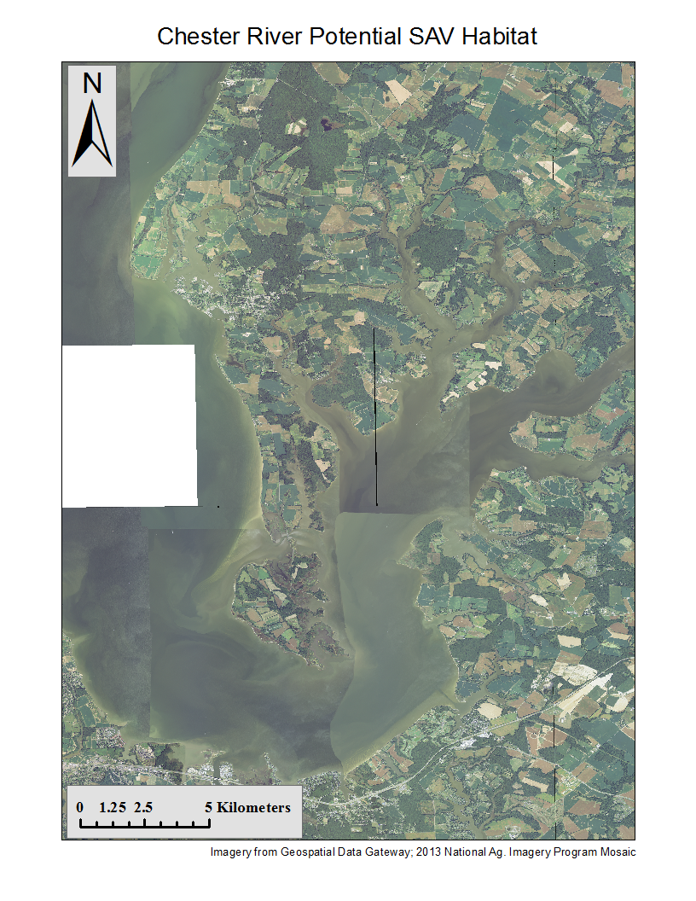
Applying GrassLight to the Chester River
Mesohaline near the mouth
Oligohaline to fresh in the upper reaches
Highly turbid
  TSM » 30 mg L⁻¹
Eutrophic
  Chl a » 20 mg m⁻³

Slide 32
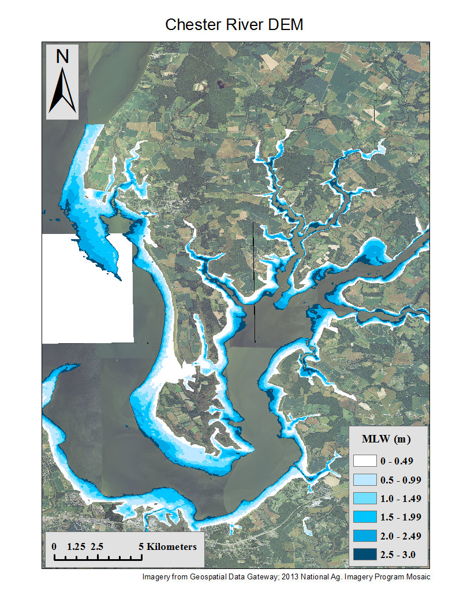
Applying GrassLight to the Chester River
Mesohaline tributary
Highly turbid
  TSM » 30 mg L⁻¹
Eutrophic
  Chl a » 20 mg m⁻³
Gridded 30 m bathymetry
Potential SAV habitat (< 3 m depth) fringing the shore

Slide 33
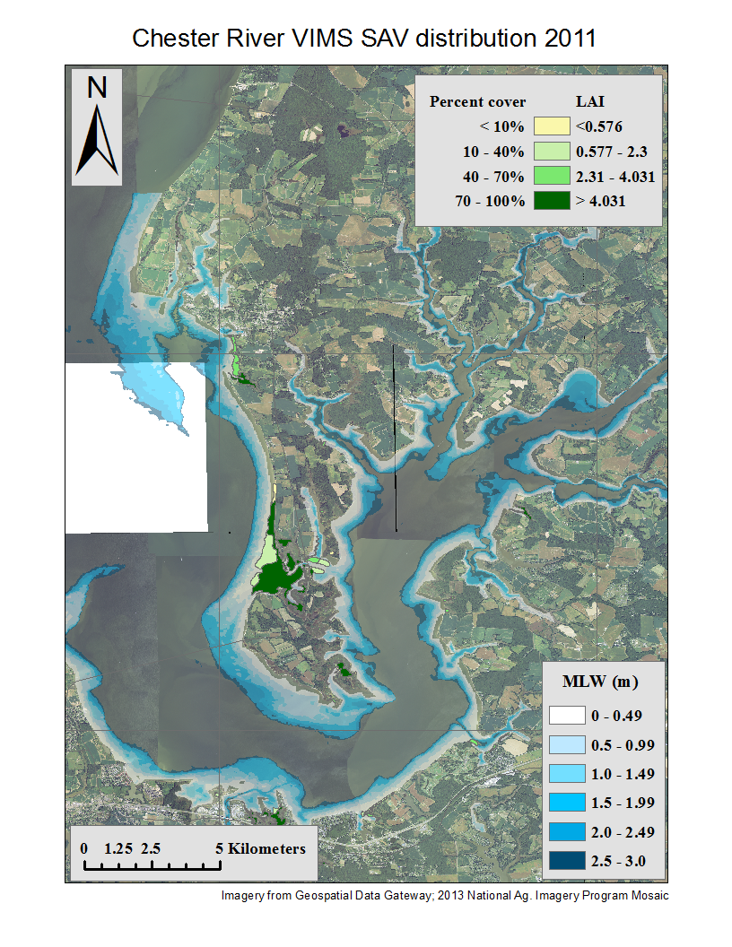
Applying GrassLight to the Chester River
SAV distribution
  Most persistent in shallows around Eastern Neck Island and Chester shoreline
  Species composition depends on salinity
  Abundance depends on water quality
  Temporally variable

Slide 34
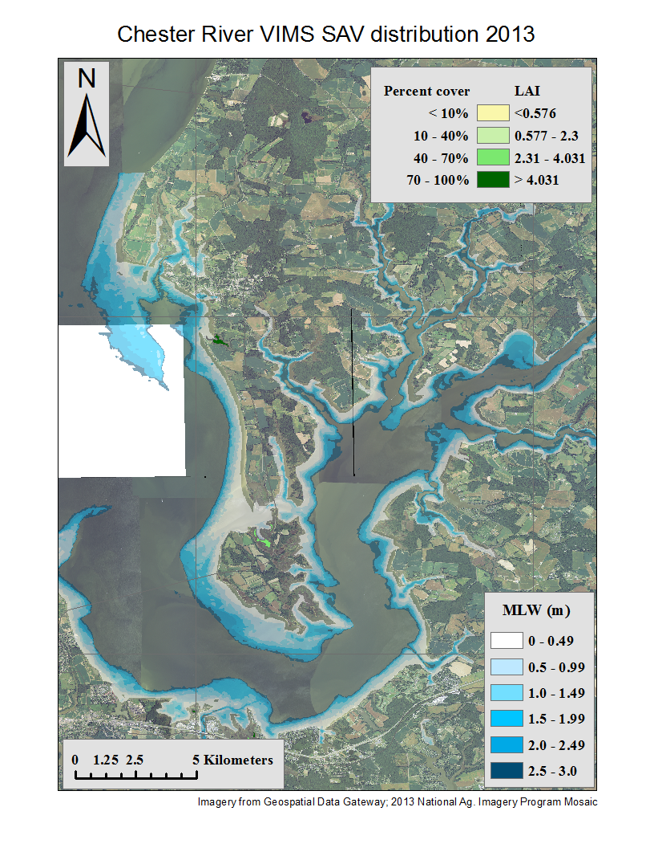
Applying GrassLight to the Chester River
SAV distribution
  Most persistent in shallows around Eastern Neck Island and Chester shoreline
  Species composition depends on salinity
  Abundance depends on water quality
  Temporally variable

Slide 35
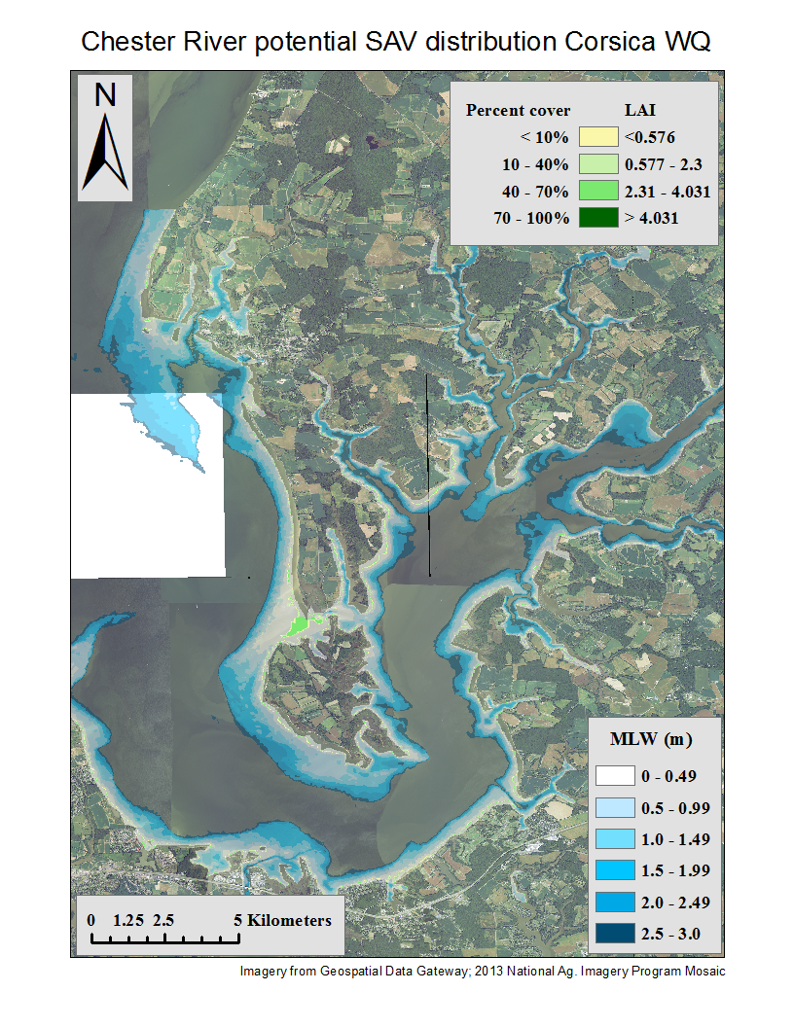
Applying GrassLight to the Chester River
GrassLight prediction of SAV density based on average WQ data is consistent with VIMS field observations
TSM = 30 mg L⁻¹
Chl a = 20 mg m⁻³
z_{E(22%)} = 0.2 m
z_{E(13%)} = 0.3 m
z_{E(1%)} = 0.8 m

Slide 36
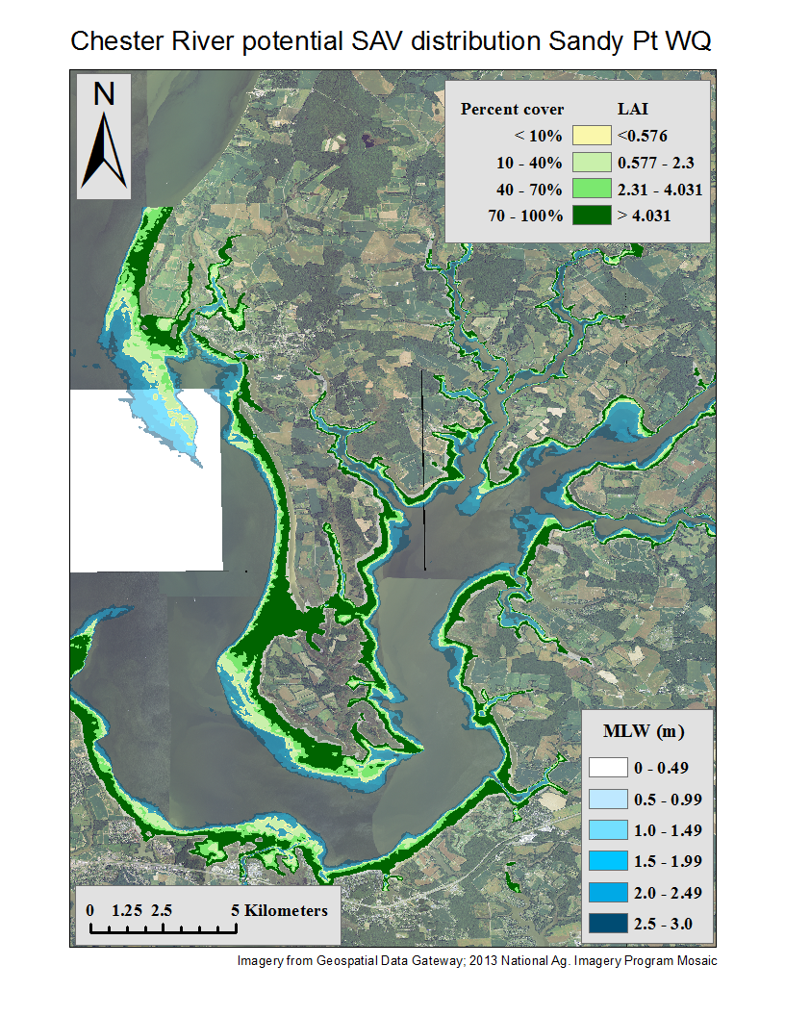
Applying GrassLight to the Chester River
Improving water quality to average for Sandy Point
  TSM = 10 mg L⁻¹
  Chl a = 10 mg m⁻³
  z_{E(22%)} = 0.7 m
  z_{E(13%)} = 0.9 m
SAV distribution expands
Still below ‘historic” distribution limit of 3 m
  Euphotic depth z_{E(1%)} = 2 m
  So, what about the phytoplankton?

Slide 37
Modeling the plankton component
Bio-optical components already built into GrassLight for given levels of Chl a
Metabolic component required to calculate
  Gas exchange
  Nutrient removal & regeneration
  Algae growth, grazing and sinking
  Subsequent impact on water transparency

Slide 38
Modeling the plankton component
The 2-D (depth,time ) model:
  Easily integrated into GrassLight bio-optical structure
  Calculates biologically mediated changes in
    O2, DIC & therefore pH
    Dissolved nutrients
  Ultimately driven by light availability
    Includes a self-shading component from algal biomass
  Responsive to nutrient concentrations
    But does not require explicit definition of Michaelis-Menten coefficients
It does NOT presently consider
  Mixotrophic & motile algae (e.g. Dinoflagellates) that exhibit complex behaviors & trophic relations
  Benthic & pelagic grazing
  Advection

Slide 39
Modeling the photosynthesis
P^{B}_{g}(z) is controlled by light availability:
φ _{P} – quantum yield of photosynthesis (=1/8)
A *_{φ} (λ ) – spectral phytoplankton absorptance
[Chl a] – biomass, to scale absorptance
E(λ,t,z) – wavelength, time and depth-dependent irradiance

Slide 40
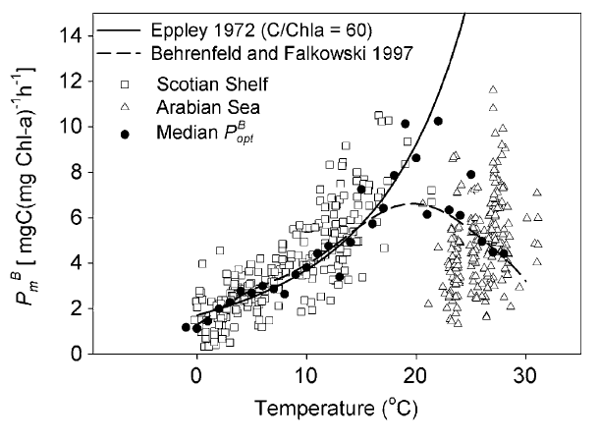
Modeling temperature effects
P ^{B}_{E} and R are temperature dependent
Q₁₀ = 3 to 20° C
P ^{B}_{E} decreases linearly with T to 38° C
Bouman, H., T. Platt, S. Sathyendranath, and V. Stuart. 2005. Dependence of light-saturated photosynthesis on temperature and community structure. Deep Sea Research Part I: Oceanographic Research Papers 52: 1284-1299.

Slide 41
Modeling carbon balance and nutrient requirements
Net productivity is defined by the balance between photosynthesis and respiration
Redfield Ratios define the amounts of dissolved inorganic nitrogen (N) and phosphorus (P) required to convert net photosynthesis into new biomass:

Slide 42
Modeling nutrient limitation
if and , phytoplankton growth is defined by P ^{V}_{net} and the concentrations of dissolved inorganic N and P are reduced accordingly
NH₄⁺ taken up before NO₃⁻
If or , phytoplankton growth is limited by the nutrient in shortest supply, all of which is taken up:

Slide 43
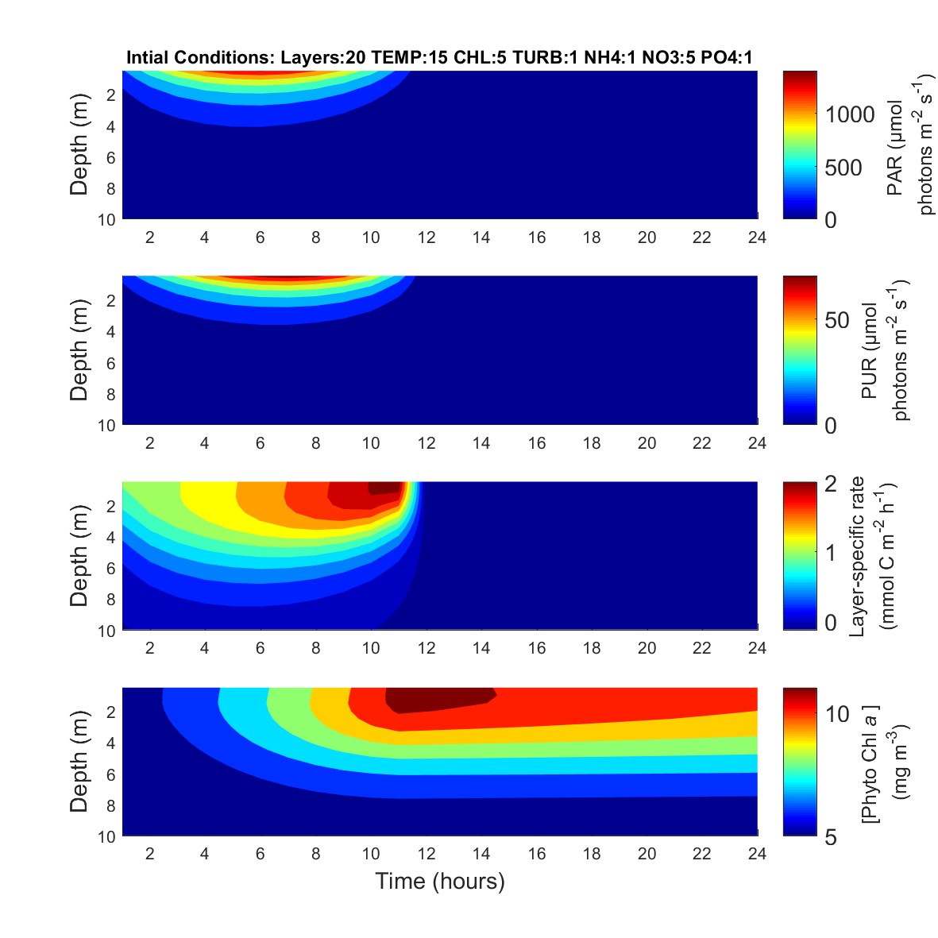
Effect of water transparency on phytoplankton productivity

Slide 44
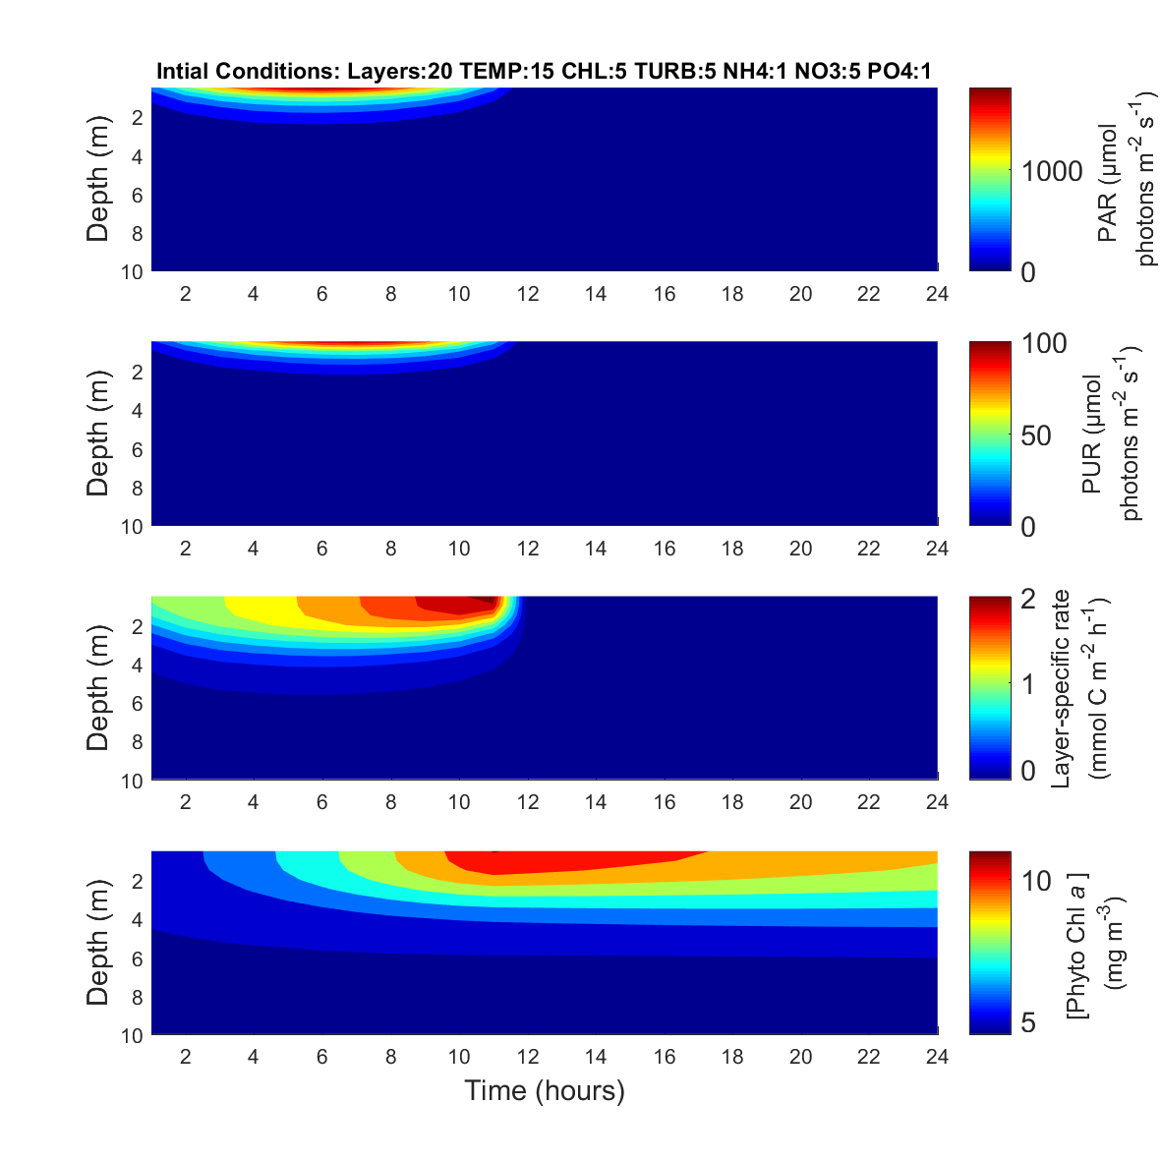
Effect of water transparency on phytoplankton productivity

Slide 45
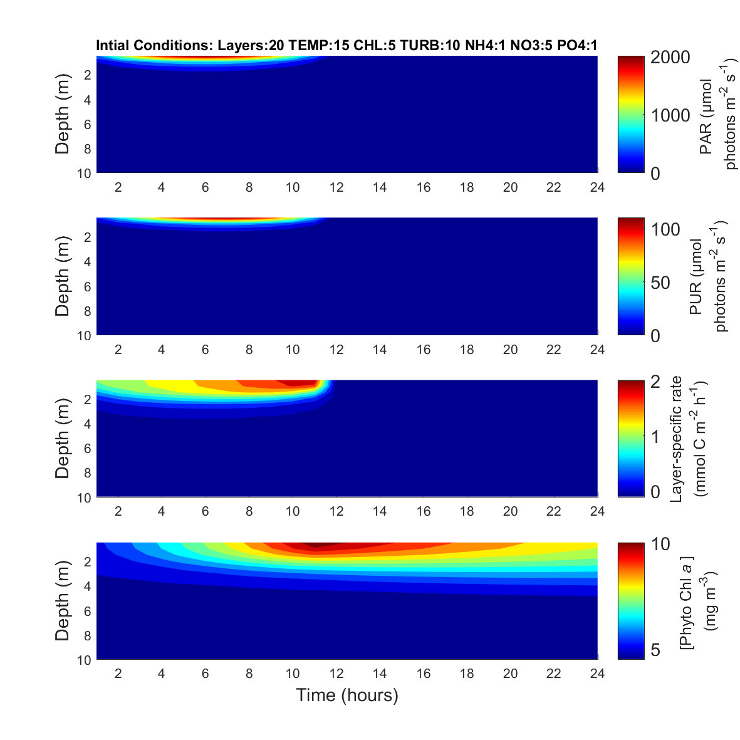
Effect of water transparency on phytoplankton productivity

Slide 46
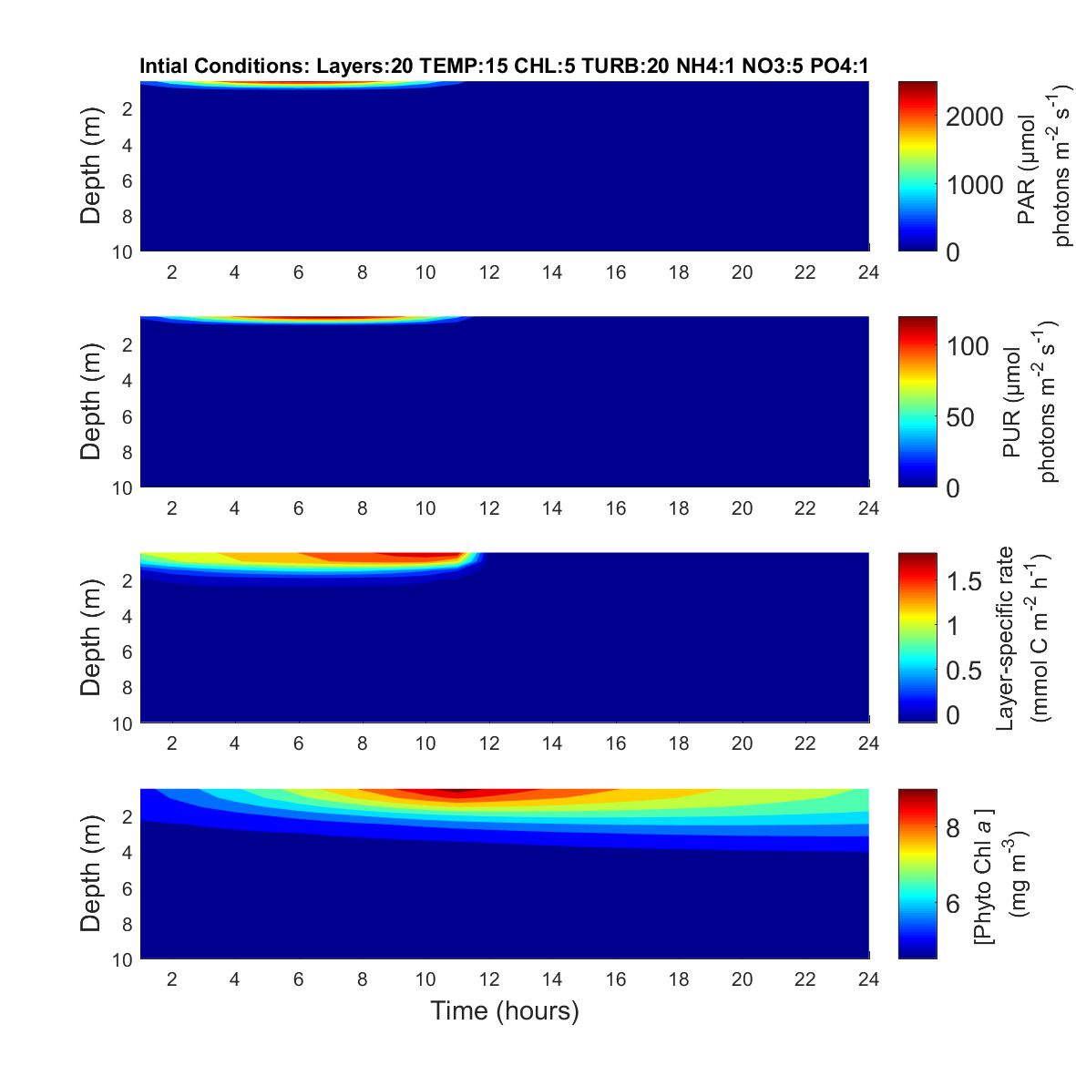
Effect of water transparency on phytoplankton productivity

Slide 47
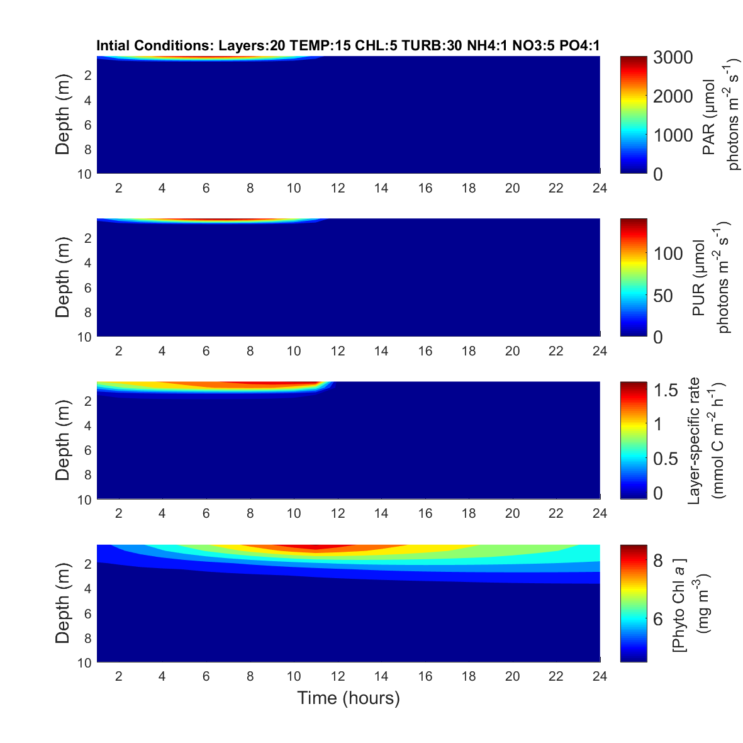
Effect of water transparency on phytoplankton productivity

Slide 48
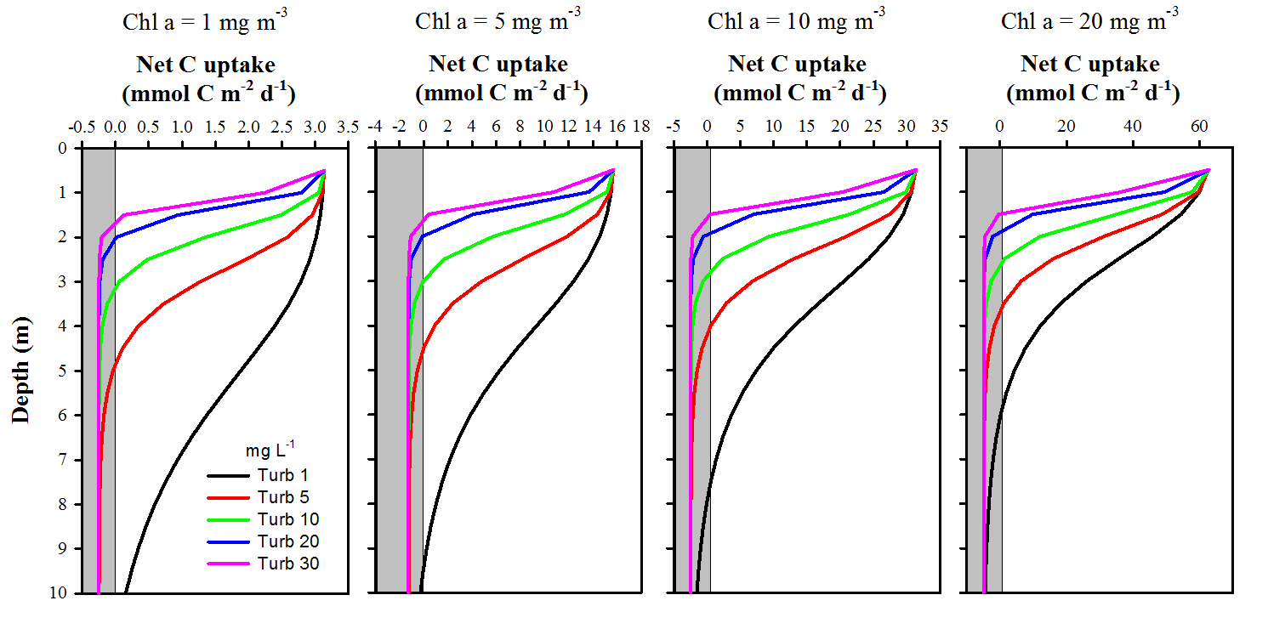
Effect of water transparency on phytoplankton productivity

Slide 49
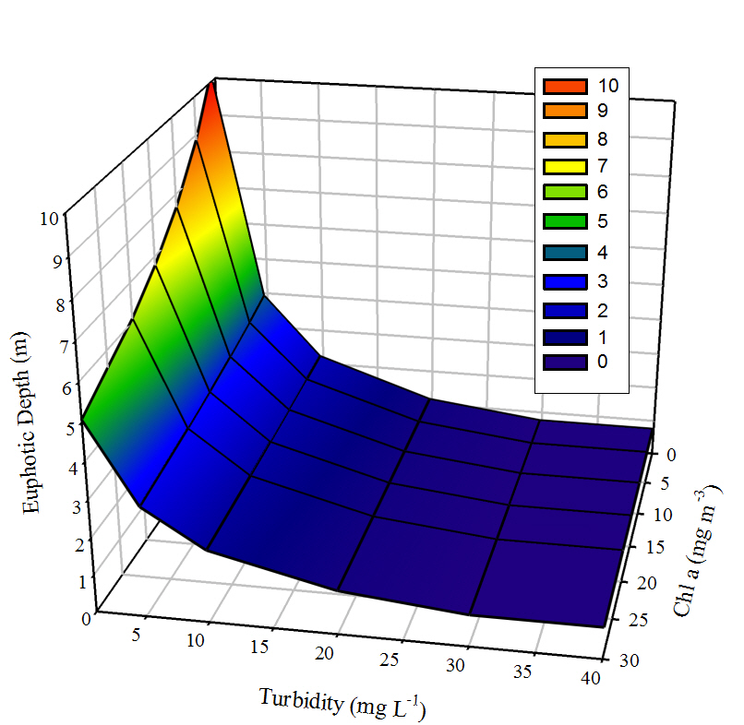
Turbidity has a greater effect on the euphotic depth than Chl a

Slide 50
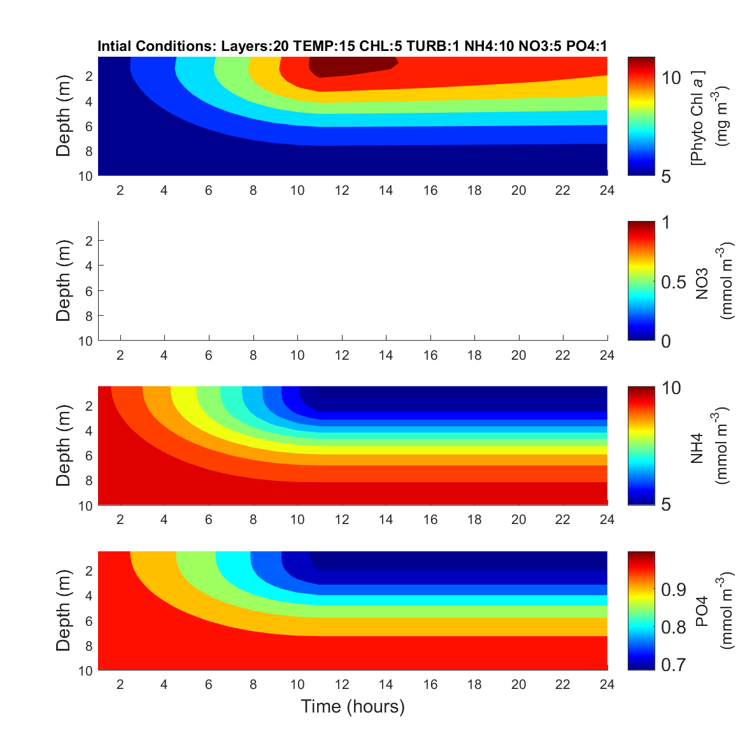
Effect of water transparency on nutrient use

Slide 51
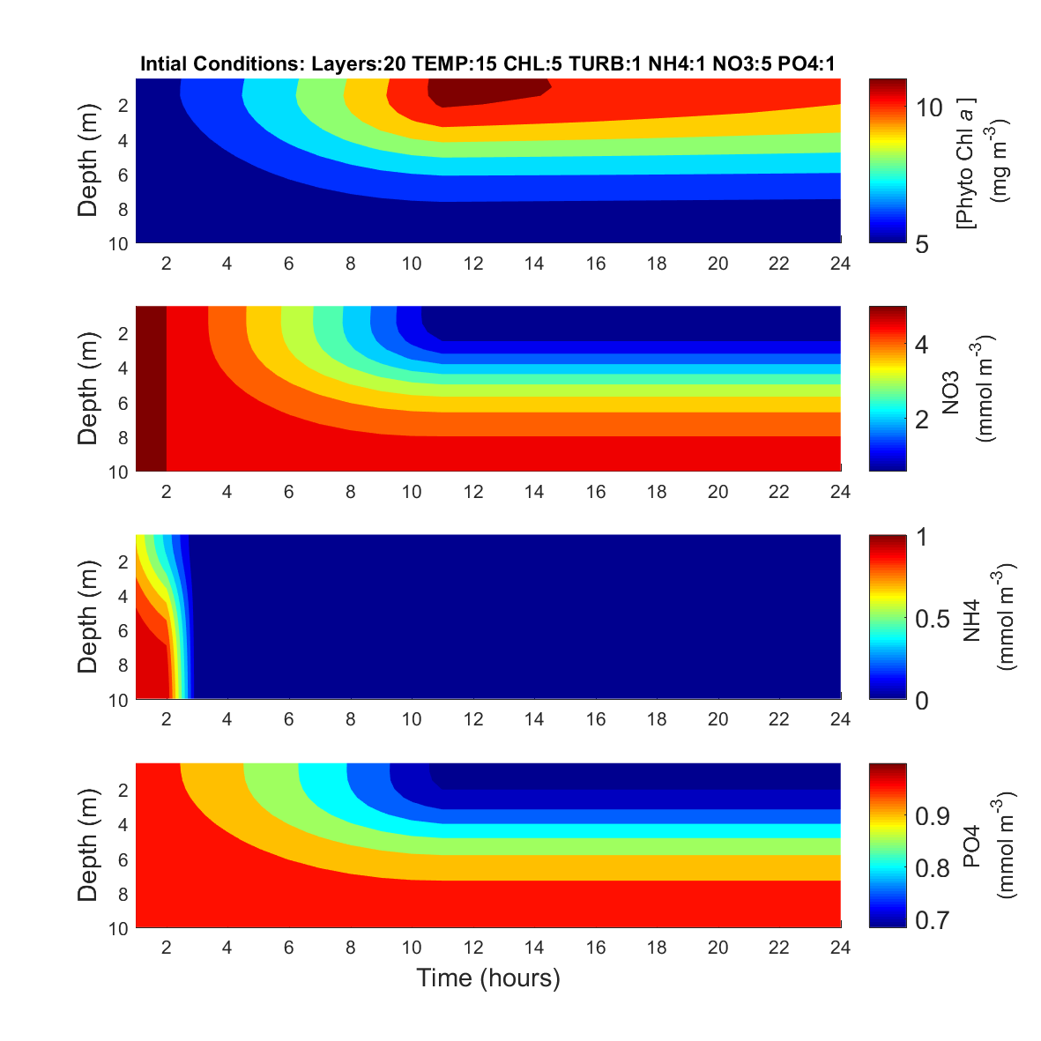
Effect of water transparency on nutrient use

Slide 52
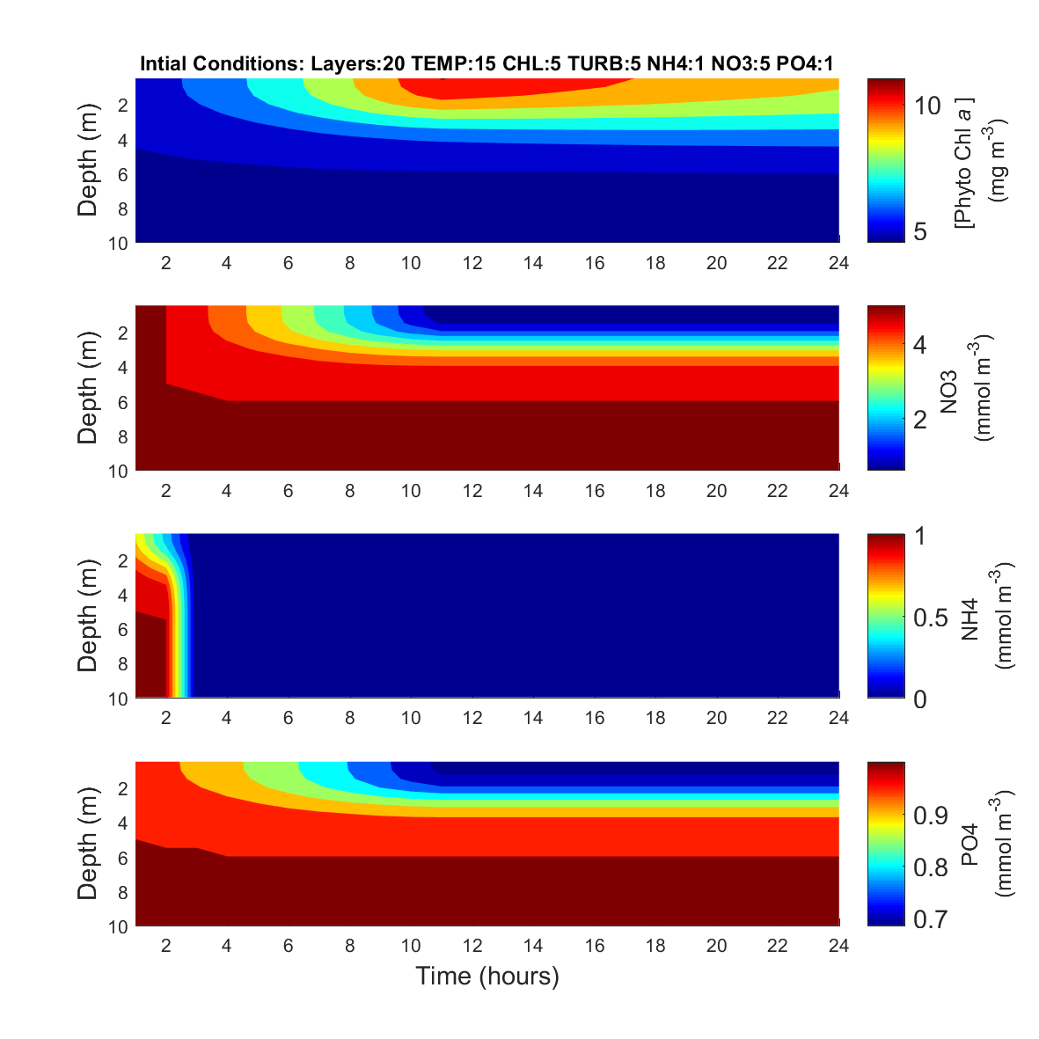
Effect of water transparency on nutrient use

Slide 53
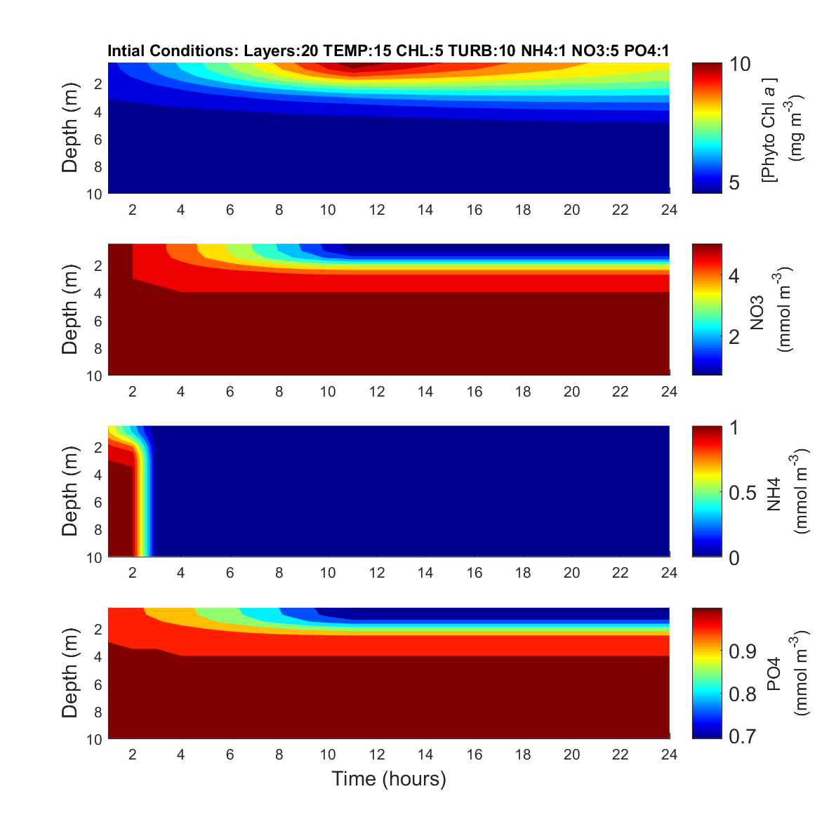
Effect of water transparency on nutrient use

Slide 54
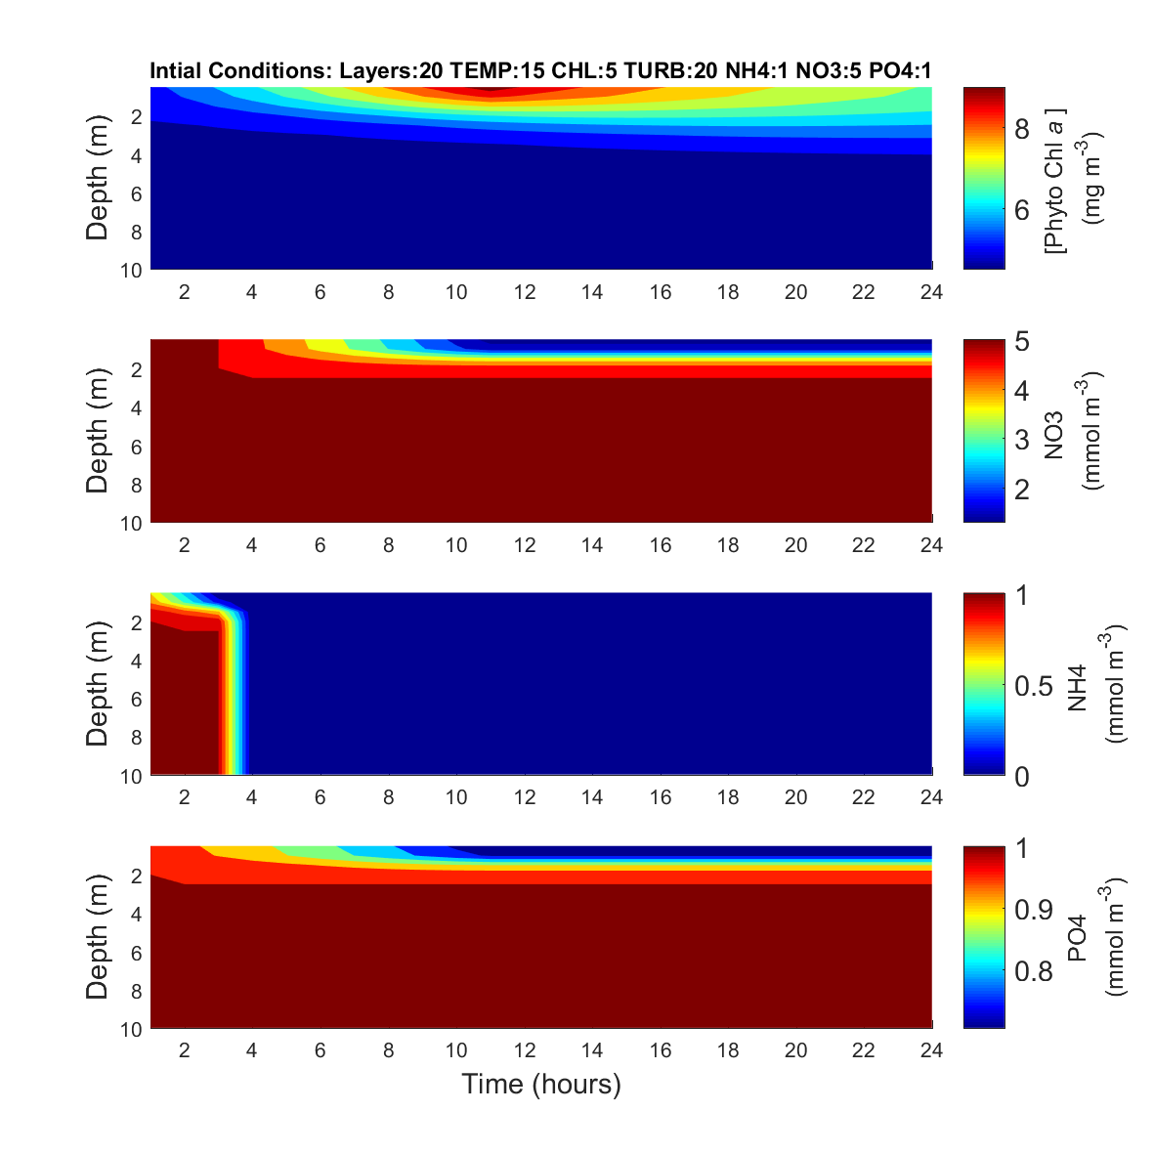
Effect of water transparency on nutrient use

Slide 55

Effect of water transparency on nutrient use

Slide 56
Conclusions
GrassLight accurately predicts
  SAV distribution & density in polyhaline & mesohaline regions
  Predicts some resilience to increasing temperature
  Suggests potential for SAV expansion in response to improved water quality
Phytoplankton module indicates
  Tribs light limited from suspended particulates more than phytoplankton
    Sediment and organic detritus
  Light limitation prevents nutrient drawdown
  Probably net heterotrophic
  Vulnerabe to hypoxia

Slide 57
Next Steps
Link bio-optical models to physical circulation (ROMS)
Evaluate utility for water column biogeochemistry as well as SAV
Can we improve predictability/utility of the Chesapeake Bay model?

Slide 58
Thank you

