Slide 1
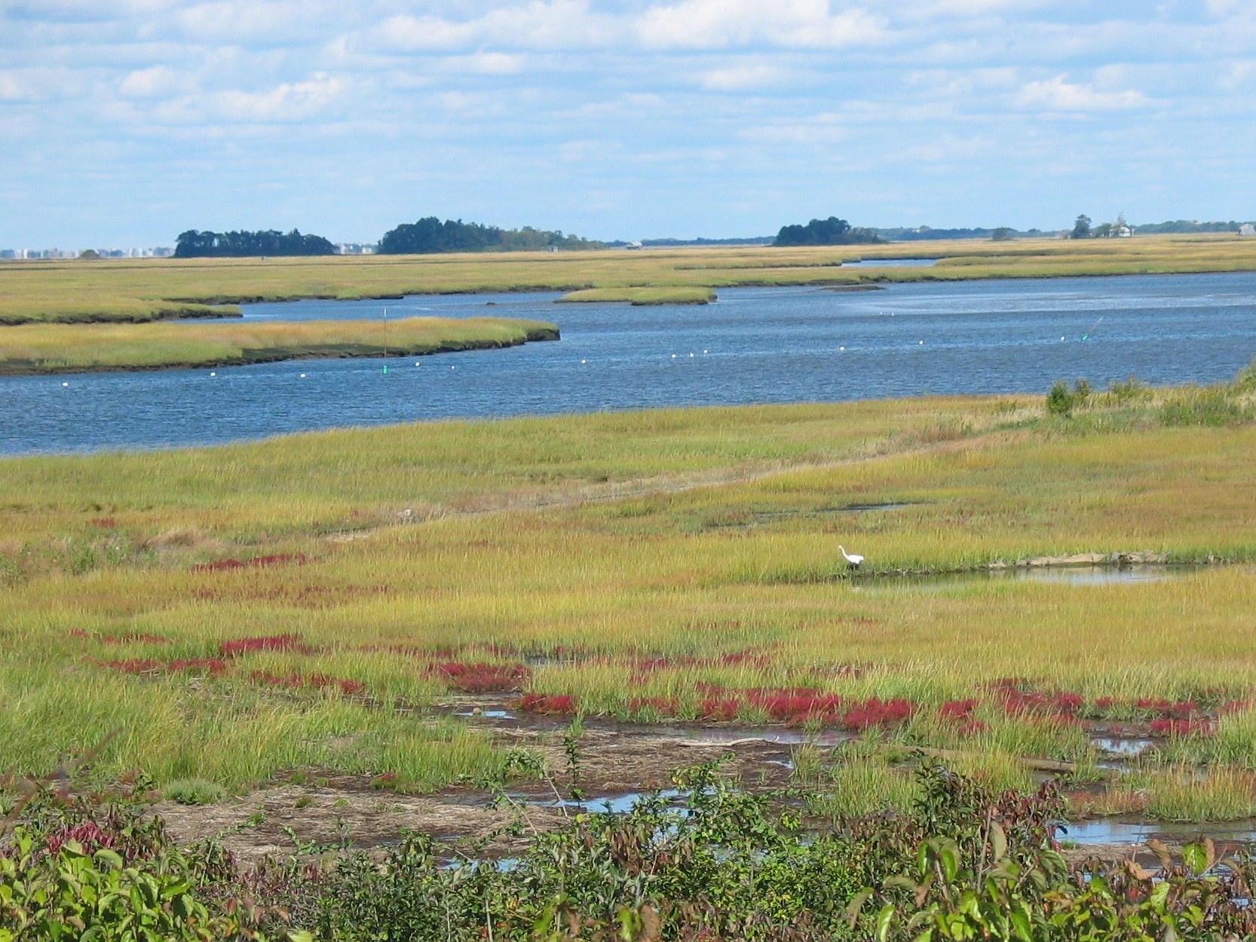
Integrating the Natural Environment into Adaptation
Christopher Hein
Mitigation and Adaptation Research in Virginia Workshop
12 August 2015

Slide 2
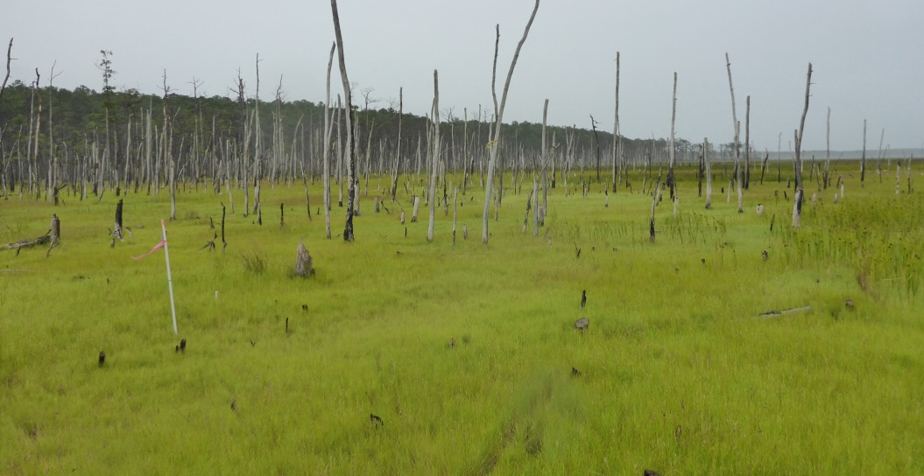
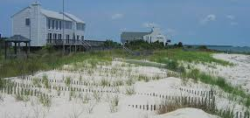
Considering Coastal Variability
Bay & open-ocean coasts of VA composed of wide variety of natural coastal types
Each is responding to sea-level rise, & climate change more broadly, in unique ways
Diversity in environments, along with various anthropogenic modifications, creates a complex problem for mitigation of the worst effects of climate change on "natural" systems and the ecosystems they support
M. Kirwan, VIMS
vims.edu
C. Hobbs, VIMS

Slide 3
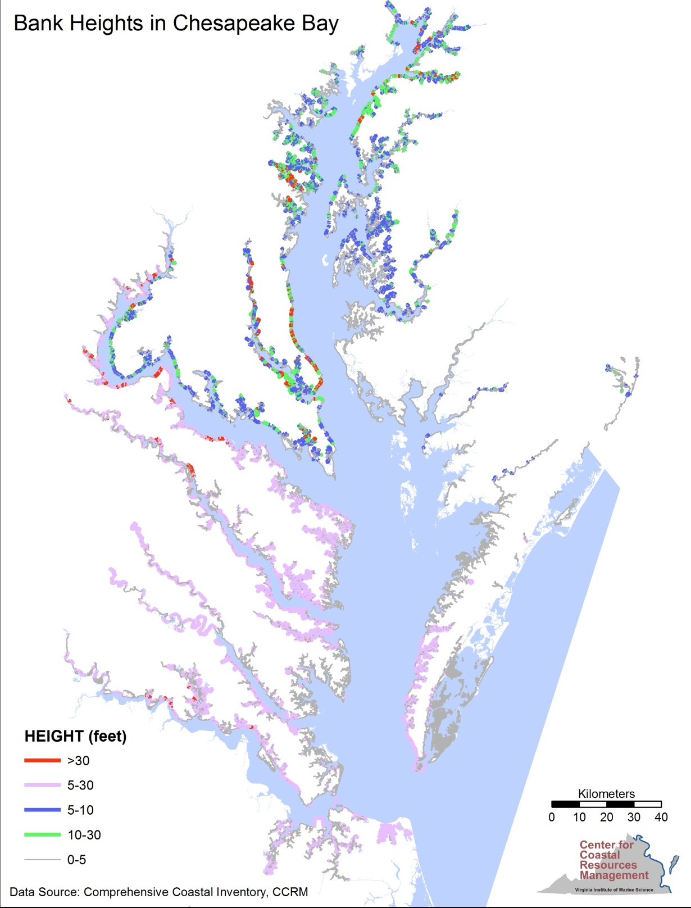
Shoreline Type #1: Erosional Cliffs
Primarily on western side & northern part of Chesapeake Bay
Provide sediment for beaches and marshes
Potential for long-distance transport of eroded sediment to “downdrift” beaches
Courtesy of Julie Herman, CCRM / VIMS

Slide 4
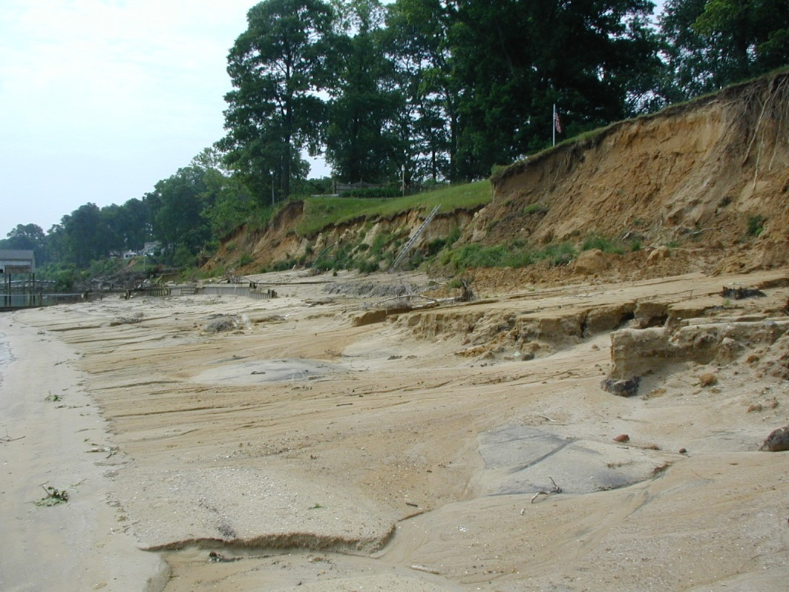
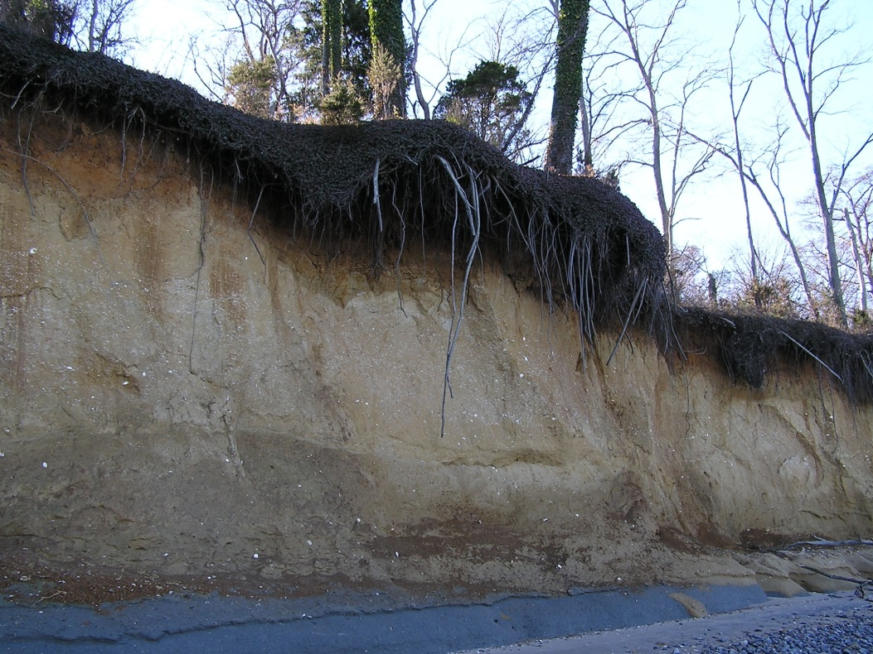
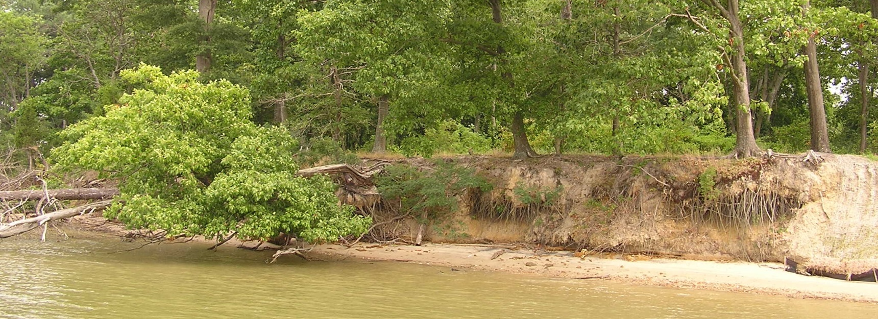
Shoreline Type #1: Erosional Cliffs
Courtesy of Julie Herman, CCRM / VIMS

Slide 5
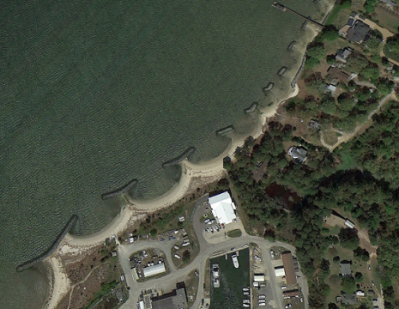
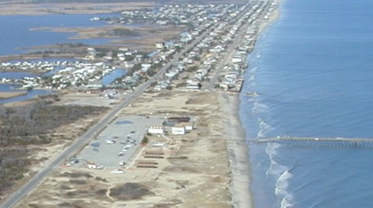
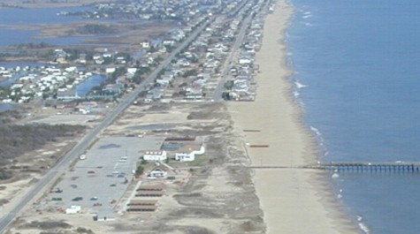
Shoreline Type #2: Mainland & Estuarine Beaches
Sandbridge, VA: before & after nourishment
Fetch-limited: small, fed by bluff erosion, highly variable
Open ocean: storm-dominated; generally highly modified (e.g., nourishment); sediment-starved
Scott Hardaway, VIMS

Slide 6
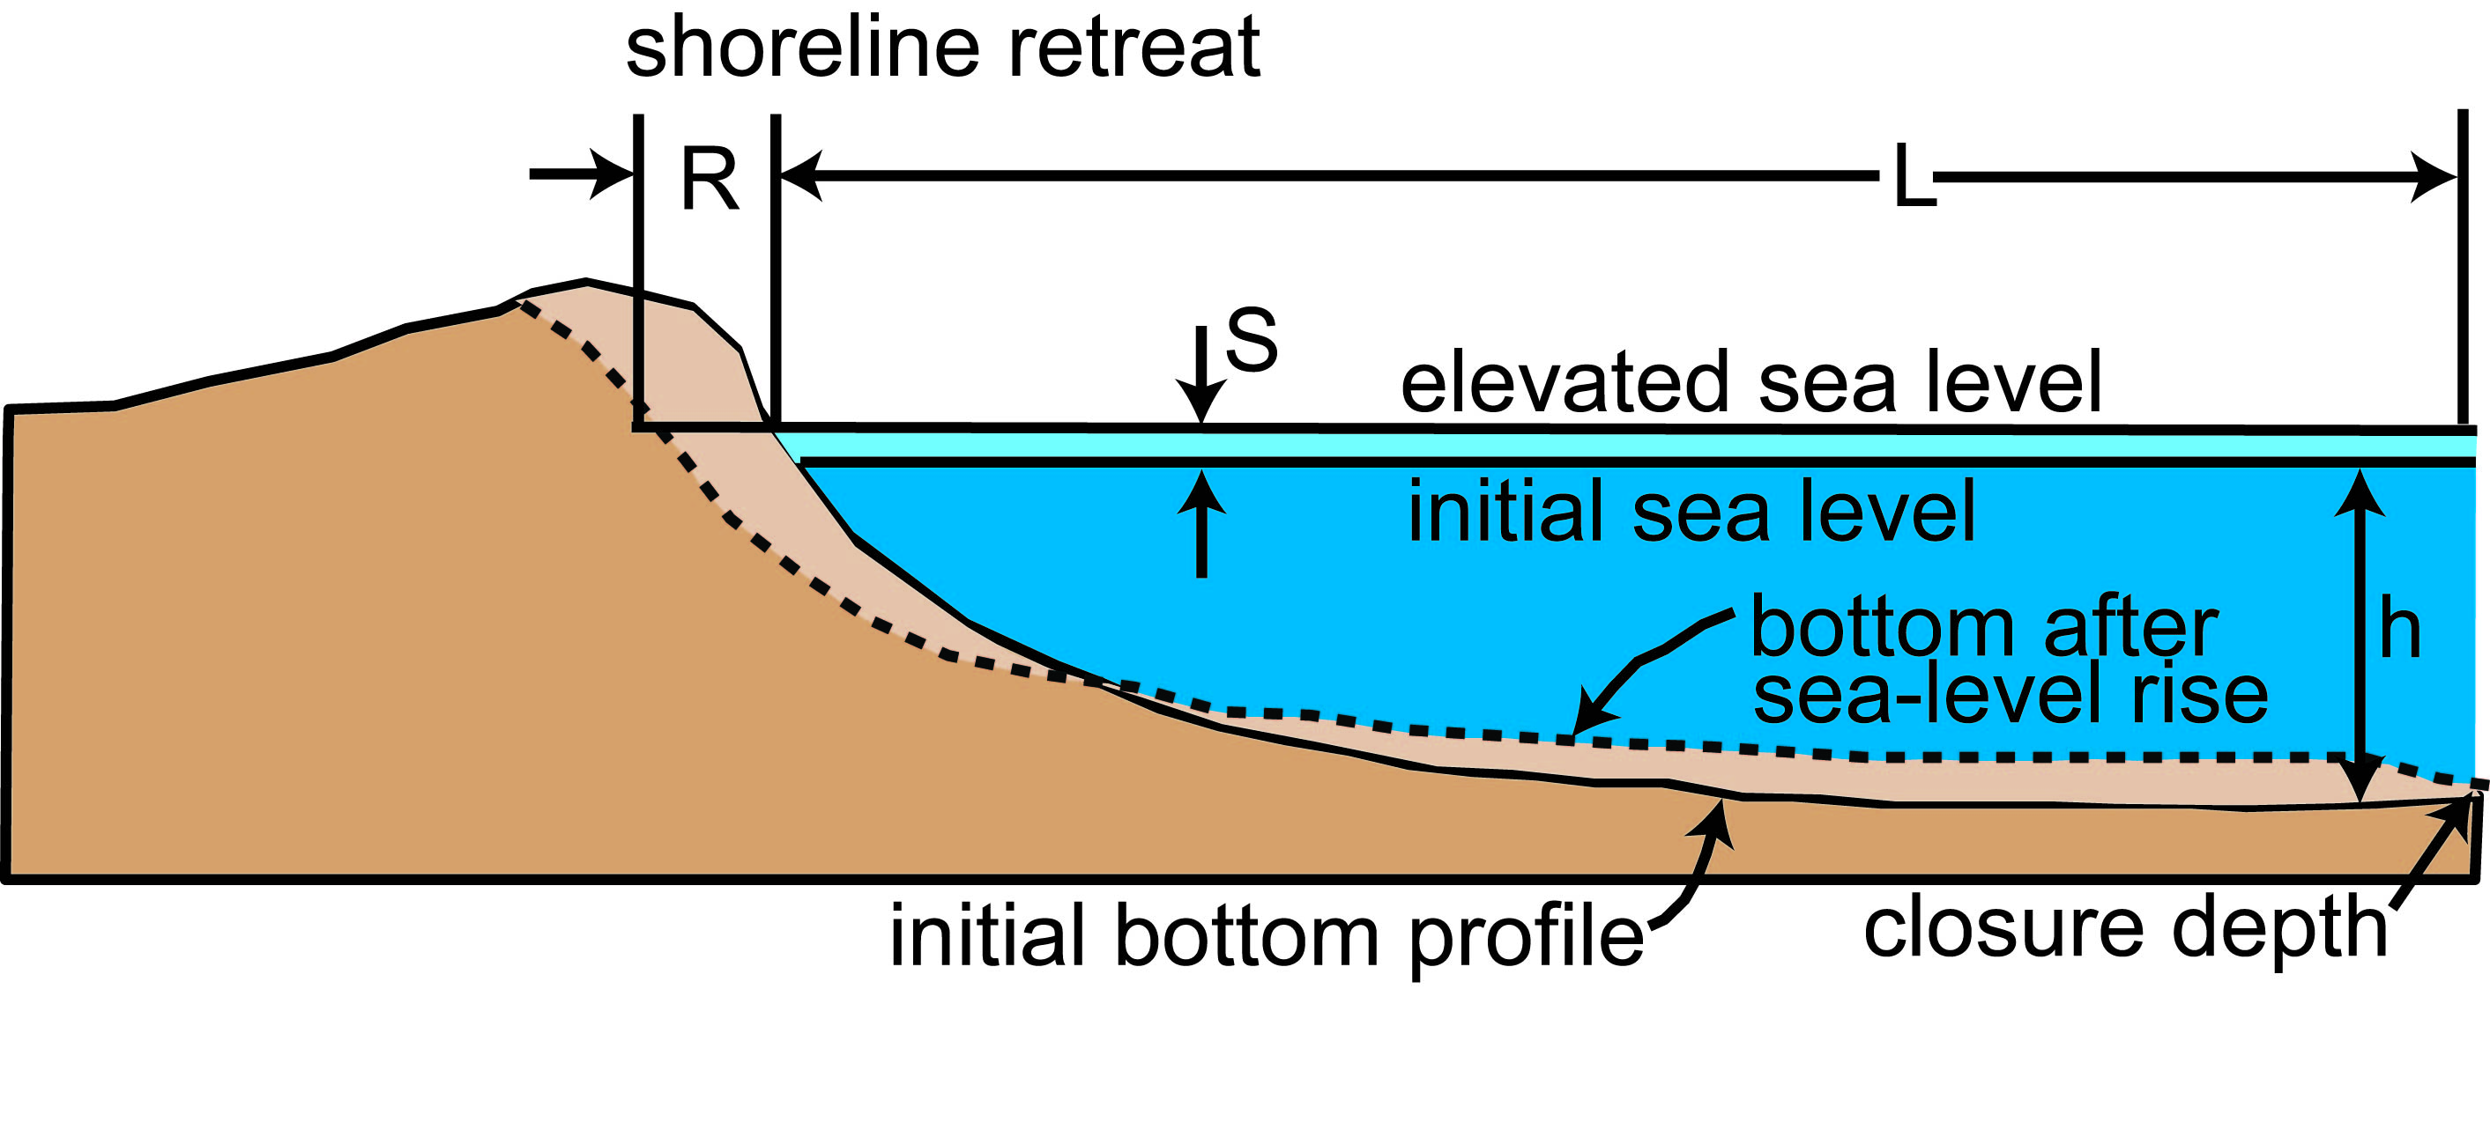
Shoreline Type #2: Mainland & Estuarine Beaches
The Bruun Rule of Shoreline Retreat
Cooper & Pilkey, 2004
Assumptions:
equilibrium profile
net zero sediment input/output

Slide 7
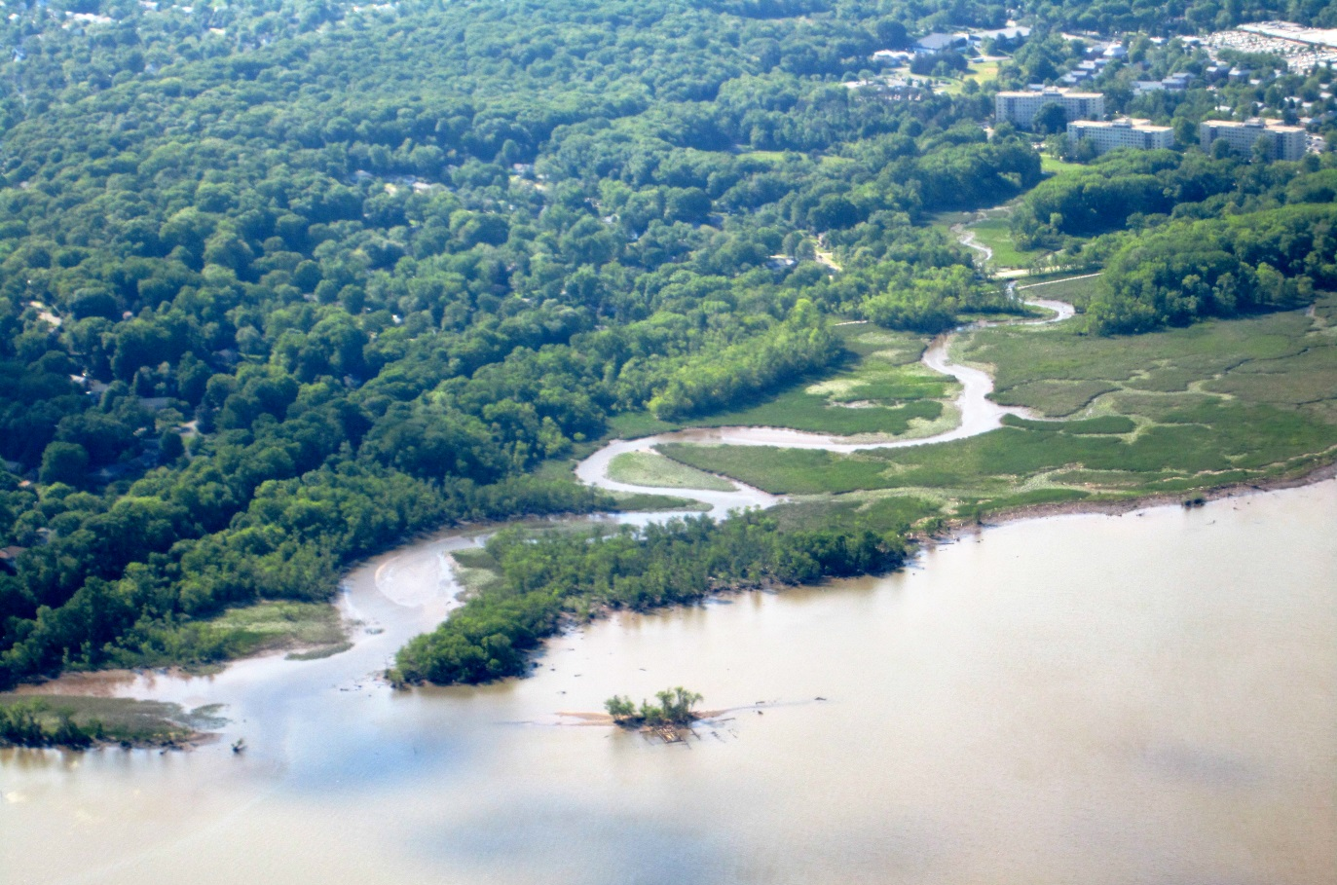
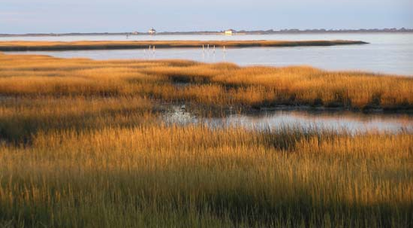
Shoreline Type #3: Marsh
Wikipedia Commons
Dyke Marsh, Alexandria, VA
Chincoteague, VA
Britannica

Slide 8
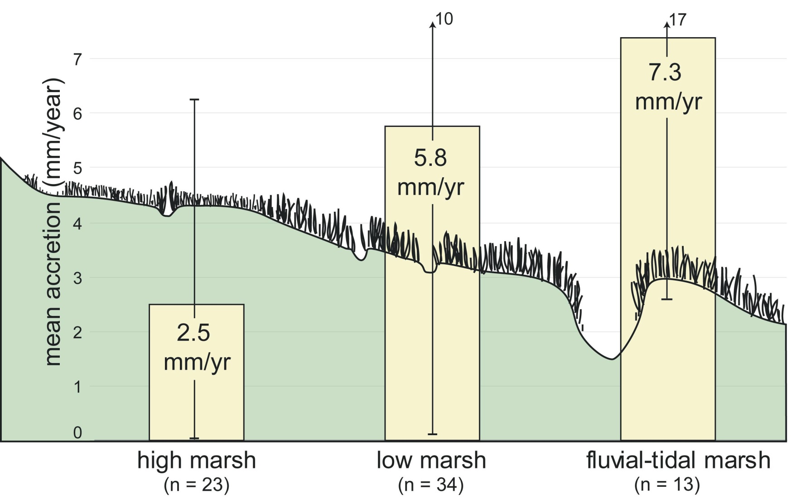
Shoreline Type #3: Marsh
FitzGerald et al., 2008; after Argow, 2008

Slide 9
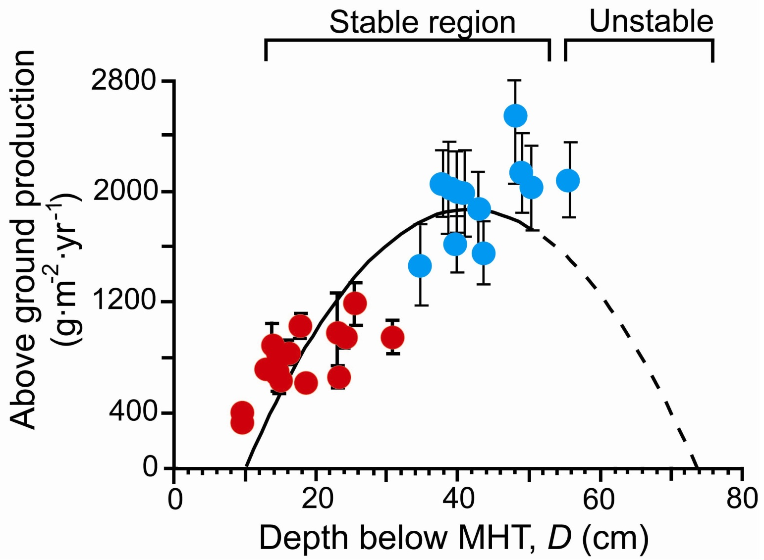
Shoreline Type #3: Marsh
Morris et al., 2002

Slide 10
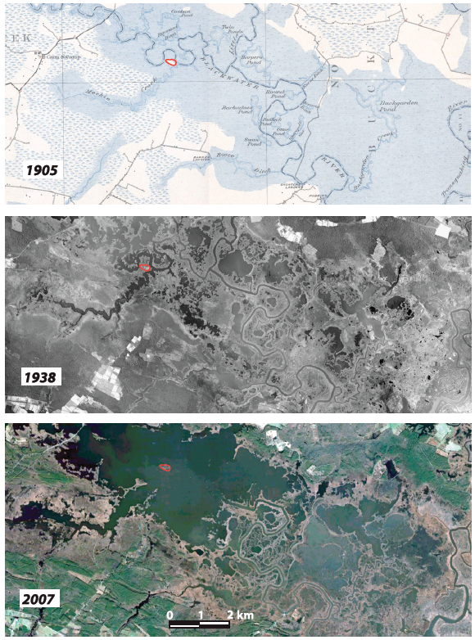
Shoreline Type #3: Marsh
Widespread marsh loss in most sensitive regions of bay
Blackwater River Valley: wetlands converted to open water: 50-150 ha/yr (Cahoon et al., 2010)
Drowning & wave erosion predominant drivers
*Eastern Shore: barrier migration
DeJong et al., 2015

Slide 11
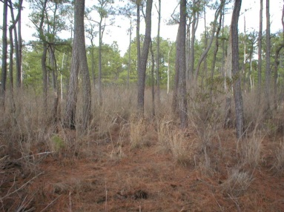
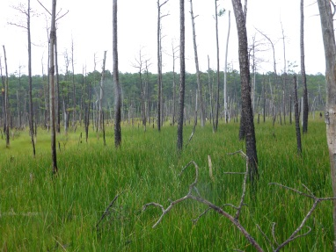
Shoreline Type #3: Marsh
Northern mouth of York River
York River/ Goodwin Island
Western Shore, Chesapeake Bay
Coastal forest
New marsh
Imagery courtesy of M. Kirwan (VIMS)

Slide 12
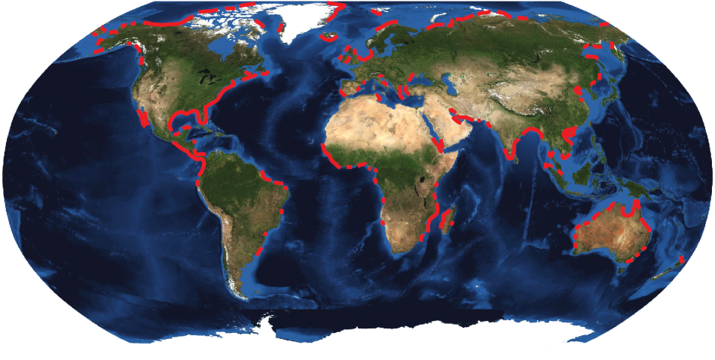
Shoreline Type #4: Barrier Island Systems
2149 globally; 12,914 miles long (~6% of coast)
United States: 405 barrier islands (24% global total)
Stutz & Pilkey, 2011, JCR
Backbarrier
Barrier Island
Continental Shelf

Slide 13
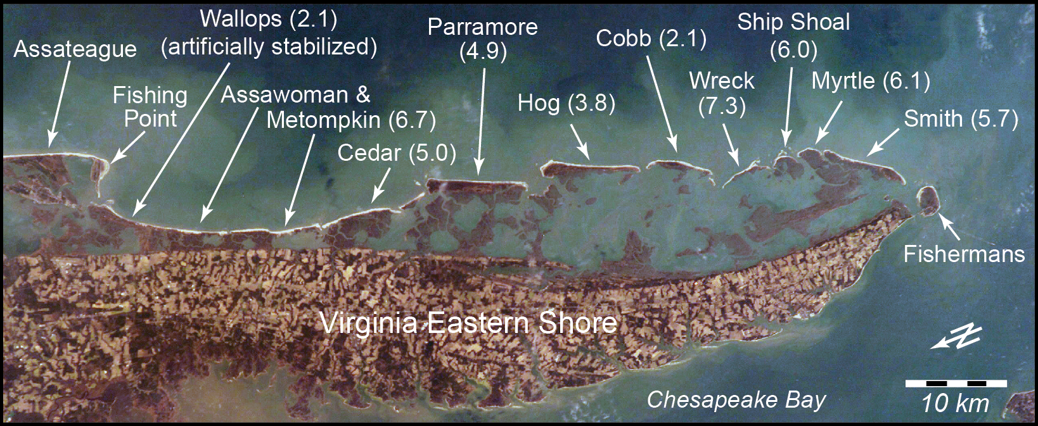
Virginia Eastern Shore: Migrating Barriers

Slide 14
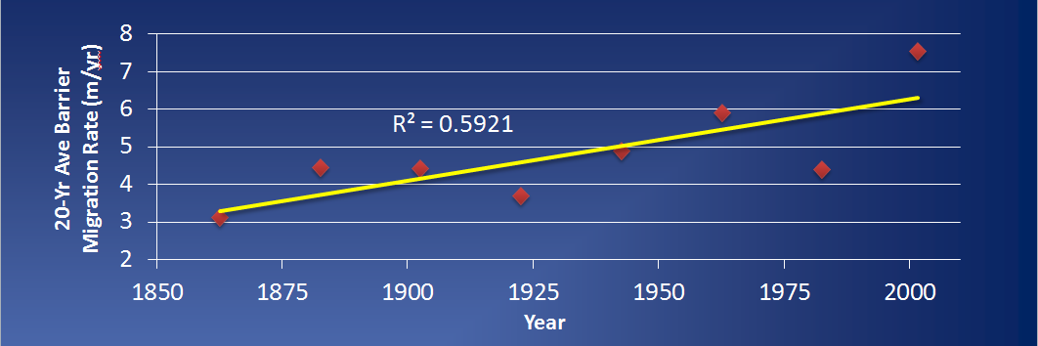
Virginia Eastern Shore: Accelerated Migration
Long-term Barrier Migration Acceleration Rate: ~20 mm/yr²

Slide 15
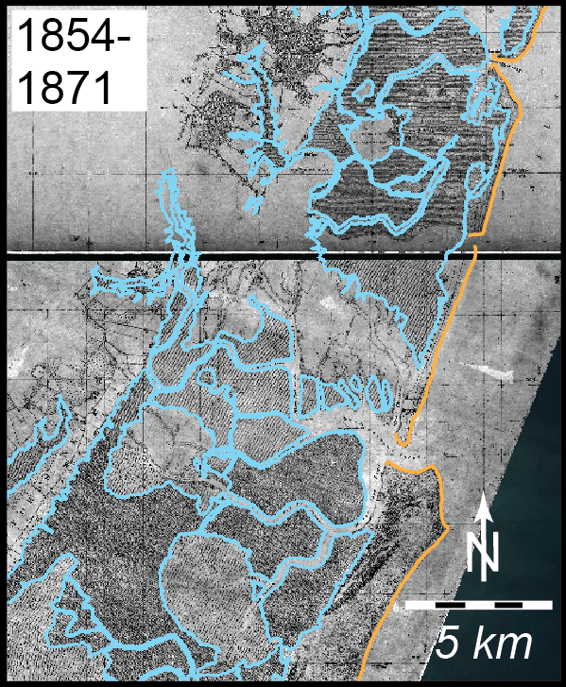
Virginia Eastern Shore: 150 Years of Marsh Loss
FitzGerald et al., in prep

Slide 16
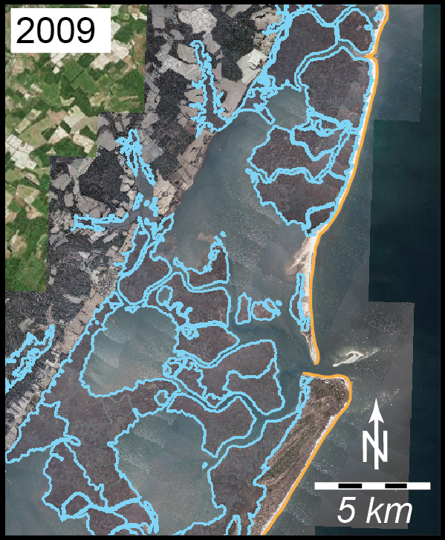
Virginia Eastern Shore: 150 Years of Marsh Loss
FitzGerald et al., in prep

Slide 17
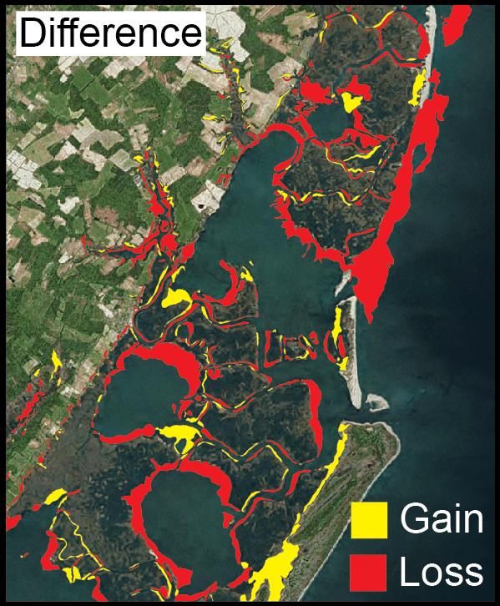
Virginia Eastern Shore: 150 Years of Marsh Loss
FitzGerald et al., in prep

Slide 18
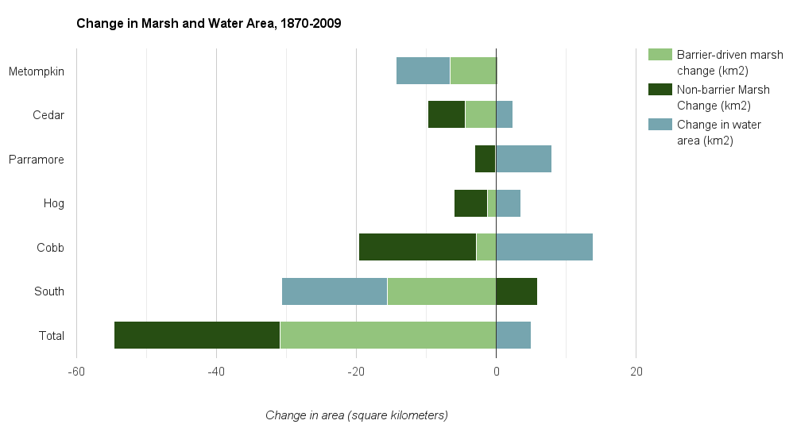
Virginia Eastern Shore: 150 Years of Marsh Loss
Total Marsh Loss:
54.6 km² (18%)
0.39 km²/yr
Barrier-Driven Marsh Loss:
30.9 km² (10%)
0.22 km²/yr
Deaton et al., in prep

Slide 19
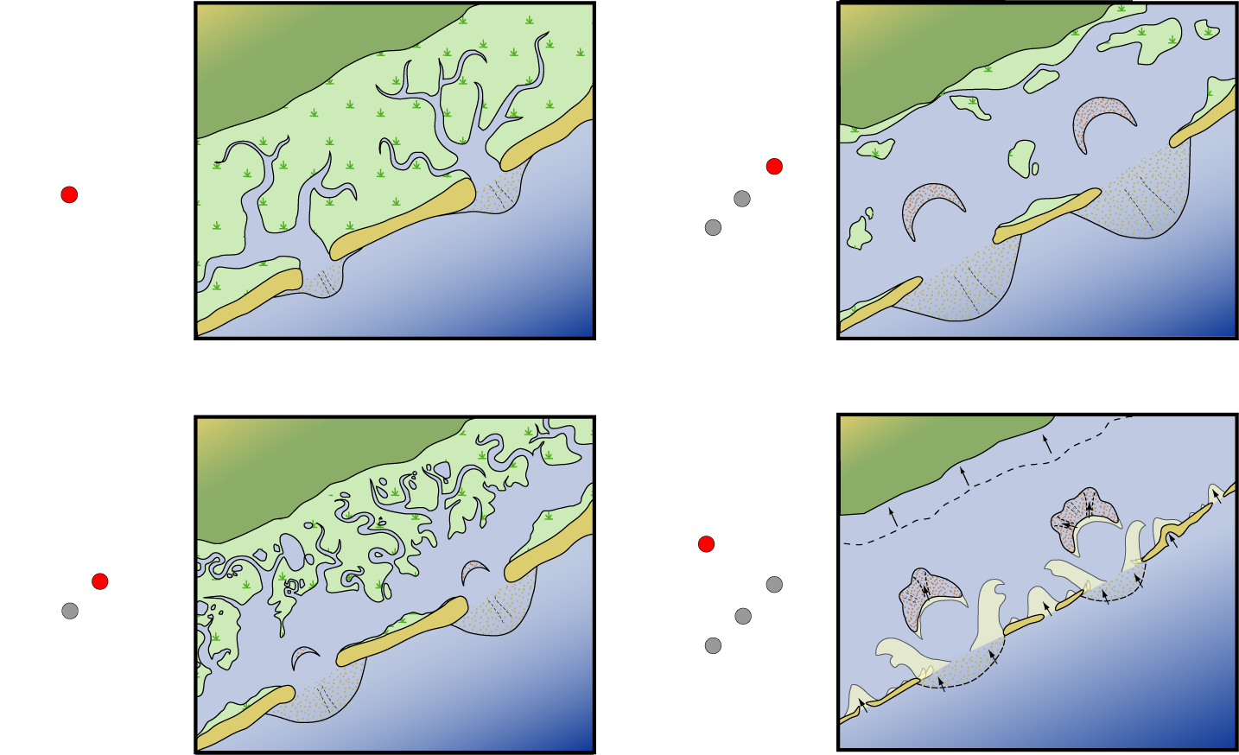
The Role of Barrier-Backbarrier Coupling in Coastal Response to Climate Change Along the Virginia Eastern Shore
FitzGerald et al., 2008, Annual Reviews of Earth Science

Slide 20
The Role of Barrier-Backbarrier Coupling in Coastal Response to Climate Change Along the Virginia Eastern Shore
Inner Shelf Shoals
Mainland-Proximal Barriers
Mainland-Attached Beaches
FitzGerald et al., in prep

Slide 21
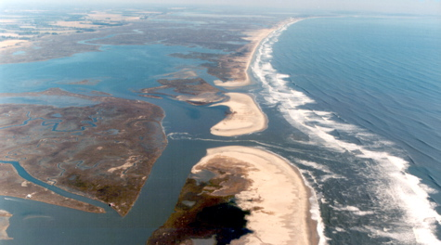
Adaptation Considerations Along “Natural” Shorelines
Diverse coastal environments; some undergone great anthropogenic modifications (is there a “natural” system to consider at all?)
Eroding cliffs: sediment production could outweigh negative impacts of cliff loss
Mainland-attached beaches: commonly sand-starved and modified
Marshes: diverse – drowning, migrating upland, overrun by migrating barriers
Barrier islands: sediment deficit plus complex barrier-backbarrier dynamics drive some of most rapid coastal change in VA
vims.edu

